Slide 1
An introduction to Microservices
Debadatta Mishra

Slide 2
Contents
Various Definitions of Microservices
Confusing notion of Microservices
Monoliths Vs Microservice
SOA VS Microservices
Advantages of Microservices
Principles of Microservices
Types of Microservices
Disadvantages of Microservices
Popularity
Questions and Conclusion

Slide 3
Definition of Microservice
As per “ThoughtWorks” by “Sam Newmann” - Small Autonomous services that work together.
Smart endpoints and dumb pipes – Explain
A way of designing software applications as suites of independently deployable services.
Microservices architecture is an approach to developing a single application as suites of small services, each running in its own process and communicating with lightweight mechanisms.
Each Microservice delivers a single complete business capability.
According to me : Multiple Applications/Services/Components Are Partitioned Along Functional Boundaries.

Slide 4
Confusing Notion/Concept
Spring Boot is used to create Microservices
Docker is used to develop Microservices
Microservice is nothing but a combination of Docker and Spring Boot
Microservice means – Micro – service – small small jar files packaged in an application.
Microservice is better than SOA.
Microservice=REST ( Not Stomp over Websocket)
Only Java provides a way to develop Microservice

Slide 5
Component vs Service
James Lewis and Martin Fowler say that “When talking about components we run into the difficult situation of what makes a component. Our definition is that a component is a unit of software that is independently replaceable and upgradable.
Microservice architectures will use libraries, but their primary way of componentizing their own software is by breaking down into services. We define libraries as components that are linked into a program and called using in-memory function calls, while services are out-of-process components who communicate with a mechanism such as a web service request, or remote procedure call. (This is a different concept to that of a service object in many OO programs [3].)
One main reason for using services as components (rather than libraries) is that services are independently deployable.

Slide 6


Monoliths vs. Microservices
Monoliths Microservices

Slide 7
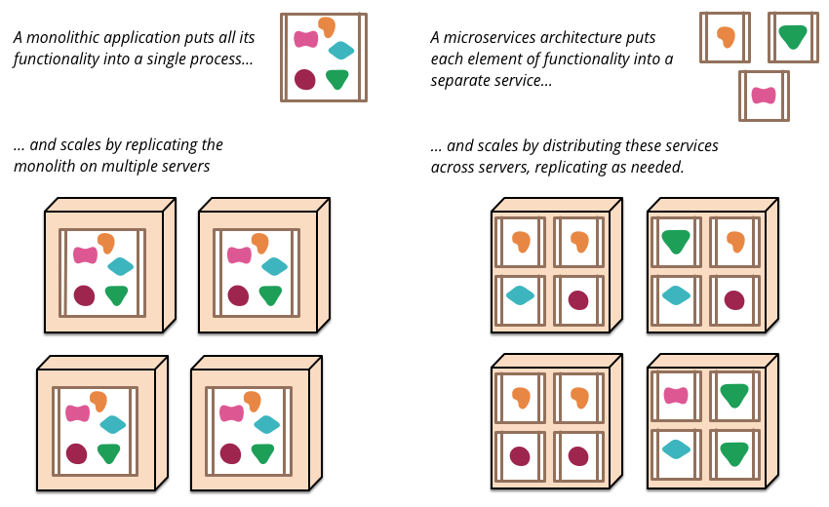
Monoliths vs. Microservices

Slide 8
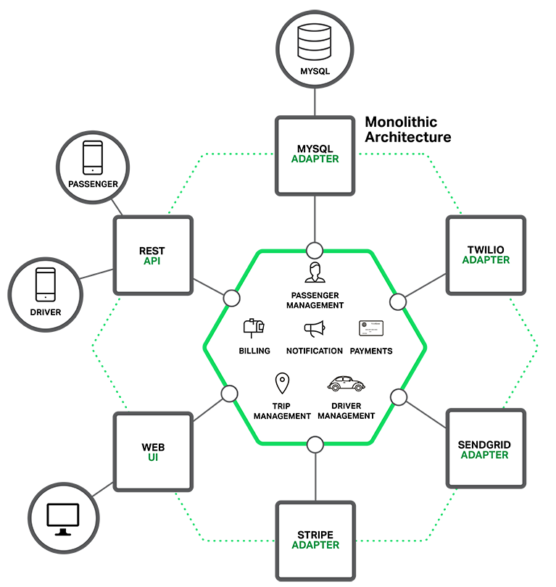
Monolith Architecture

Slide 9
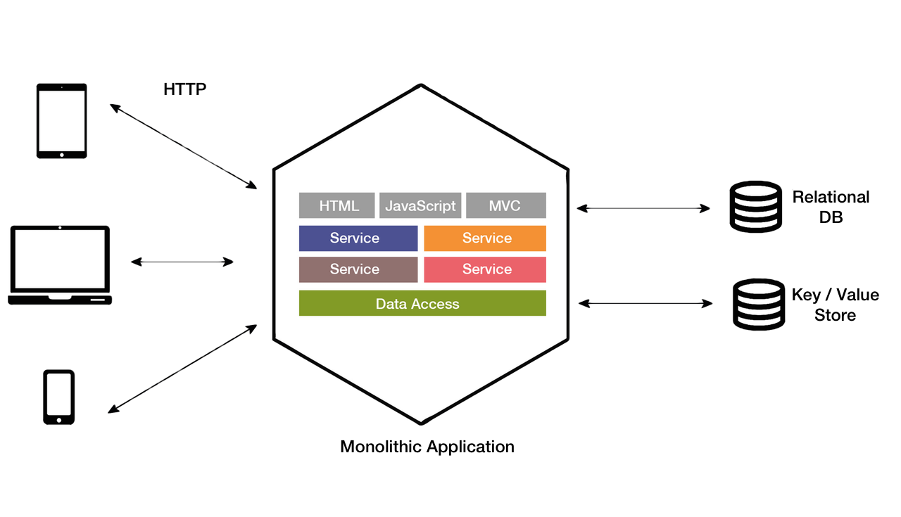
Monolith Architecture

Slide 10
Monolithic architectures: challenges
As your application grows, the code base grows with it, which can overload your IDE every time it loads the application. This definitely reduces developer productivity.
Because you have packaged everything in one EAR/WAR, you will be hesitant to change the technology stack of the application. I mean, suppose you wrote your entire application in Java, and tomorrow you feel that some of the components in the application can be better handled using other languages like Groovy or Scala. With this kind of architecture, I doubt you will even consider refactoring your code base, because you really can’t predict how it will impact your current functionality. Today I see many applications using EJB or Struts, because that’s how they started, and their code base has grown so much that they can’t even imagine refactoring.
If any single application function or component fails, then the entire application goes down. Imagine you have a web application with separate functions handling tasks like payment, login, and history and, for some reason, a particular function starts consuming more memory or CPU. The entire application will feel the pain, even though the issue is really only based on a single component.
Scaling such a monolithic application can only be accomplished by deploying the same EAR/WAR packages in more servers – also known as horizontal scaling. Each copy of the application in various servers will utilize the same amount of underlying resources, which is often not an efficient way to design.
This can have an impact on the development stage as much as application deployments. As applications get bigger, it’s even more important that developers should be able break things down to smaller and more workable units. Because everything in the monolithic approach is tied together, developers cannot work independently to develop/deploy their own modules. And because developers remain totally dependent on others, development time increases.

Slide 11
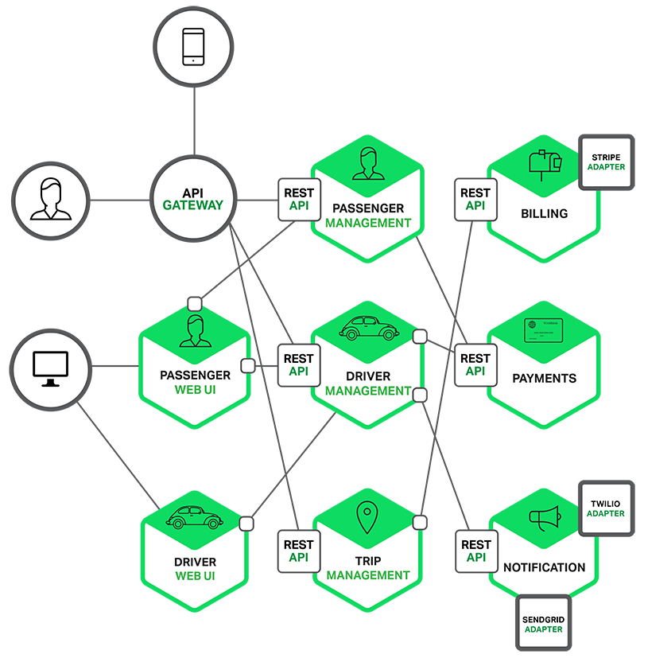
Microservices Architecture

Slide 12
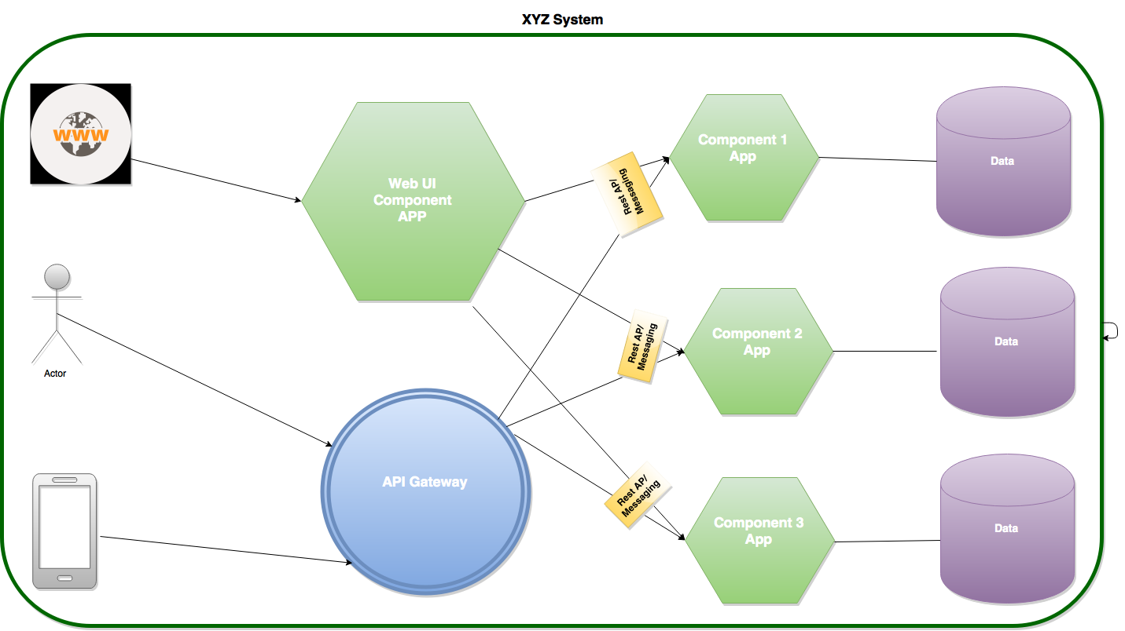
Microservices Architecture

Slide 13
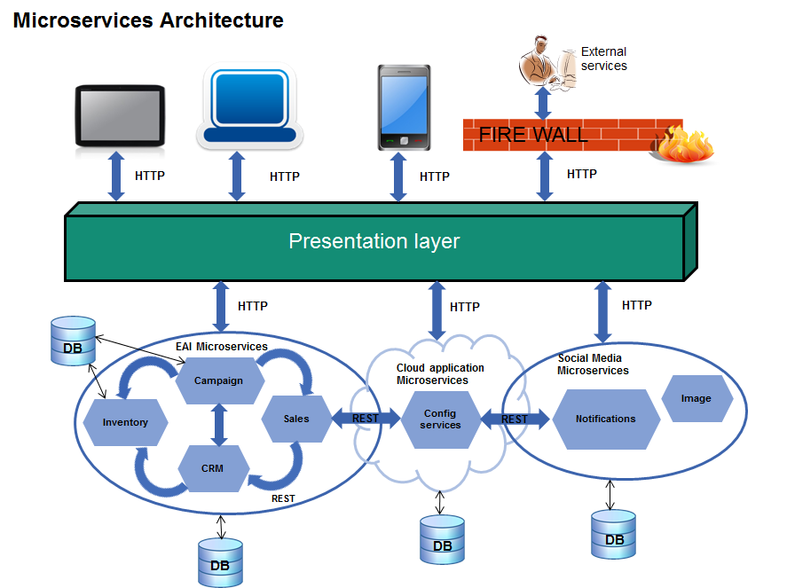
Microservices Architecture

Slide 14
SOA vs Microservices
Service-oriented architecture (SOA): an architectural pattern in computer software design in which application components provide services to other components via a communications protocol, typically over a network.
Microservices: a software architecture style in which complex applications are composed of small, independent processes communicating with each other using language-agnostic APIs
A Service Oriented Architecture is a software architecture pattern, which application components provide services to other components via a communications protocol over a network. The communication can involve either simple data passing or it could involve two or more services coordinating connecting services to each other. Services (such as RESTful Web services) carry out some small functions, such as validating an order, activating account. There are 2 main roles in SOA, a service provider and a service consumer. A software agent may play both roles. The Consumer Layer is the point where consumers (human users, other services or third parties) interact with the SOA and Provider Layer consists of all the services defined within the SOA.
Microservices is a software architecture pattern in which complex applications are composed of small, independent processes communicating with each other using language-agnostic APIs.

Slide 15
Advantage of Microservices Architecture
Each microservice is relatively small
Easier for a developer to understand
The IDE is faster, enhancing developer productivity
The web container starts faster, making developers more productive, and speeding up deployments
High rate of change
Low cost of change
Starts faster than a monolithic – scope is smaller than a monolithic. This leads to a smaller amount of written classes and third party libraries which must be archived. As a result, the deployment and the startup are faster.
Scale Independently – A microservice can scale independently using X-axis cloning and Z-axis partitioning based upon their need. This is different from monolithicic applications that may have distinct requirements and yet must be deployed together.
No long-term commitment to any stack – you can give greater flexibility to the definition of the language and stack that is best suited for a microservice. Even if you want to restrict the choice of technology, you’re not penalized because of past decisions. It enables rewriting the service using better languages and technologies.
Independent and frequent Deployments – each microservice can be independently deployed and redeployed again, without impacting the overall system.

Slide 16
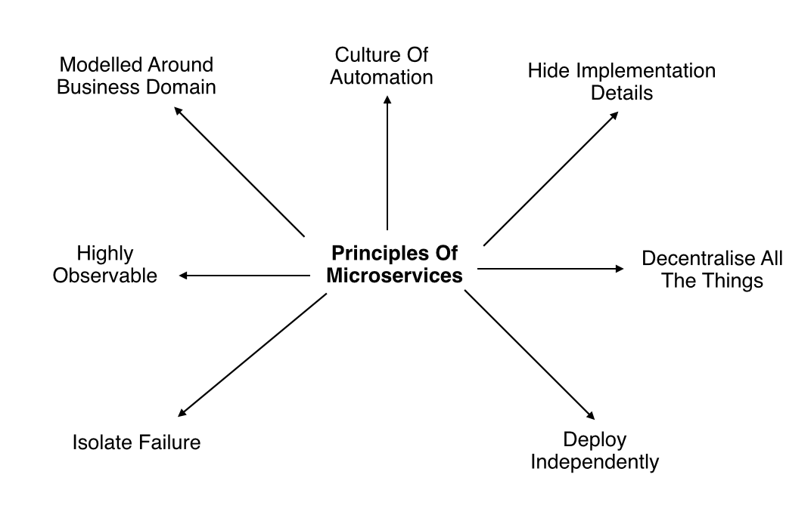
Principles of Microservices

Slide 17
Model Around Business Domain
Services should be created to follow the domain in the organization. Lays emphasis on domain driven concept.
The primary objective of the domain driven design is to focus on the core domain and the associated logic.
This minimizes possibilities of the application getting out of hand.
It also nurtures creative collaboration between the DevOps and development teams as both should understand the domain for scaling up.

Slide 18
Culture of Automation
The whole idea of microservices is to have a fairly large amount of small services and to be able to manage changes to these you need to have automated processes.
This leads to the followings
Infrastructure automation (provisioning of host environments)
Automated testing
Continuous delivery

Slide 19
Hide implementation details
This means for starters that you need to hide your database. Bounded contexts (see Martin Fowlers blogpost for a good example) will give you a good understanding of the information that services share and what information that should be internal to a service.
Microservices are small services with independent lifecycles that work together as a part of the whole application. However, each service can be independent when it has to be a part of the big structure. To enhance the ability of one service to scale independently of the others, it is important to hide each service implementation details. We could use REST protocol over HTTP and ensure services communicate with each other using a light-weight communication

Slide 20
Decentralize all the things
Autonomy is about giving people as much freedom as possible to do the job at hand. Decentralization is all about freedom. Organizations that has embraced microservices have had their operations department to shift from “we are the ones who do stuff” to “we will provide you with tools to do it yourself”
Sam also mentions that with autonomy comes also responsibility which means that teams will be held accountable for their releases. This is the same responsibility that the operations department had before. – Dumb-pipes and smart end-points, don’t move the business logic into a central service bus! Use your service bus as transportation pipes only.
Monolithic implementations usually have a single logical database for persistent data across a range of applications. It becomes complex to changes over a period of time. With microservices, each service can manage its own database, either different instances of the same database technology, or entirely different database systems.

Slide 21
Deploy independently
One service should be possible to deploy without taking any consideration to other services. If you need to co-ordinate release of one service with other services you need to get that resolved before introducing new services. Also Sam strongly recommends to have one service per host in order to not introduce more complexity to your architecture. Consumer Driven Contracts is also a way to manage decoupling of services,

Slide 22
Consumer First (Documentation)

Slide 23
Consumer First (Documentation) contd.

Slide 24
Isolate failure
Each service that consumes other services must have a strategy for handling scenarios when the other services are unresponsive, becomes very slow etc. Make sure to implement timeouts, circuit breakers and Bulkhead into your service application.
A microservice based structure is more resistant compared to the monolithic structure. For example, a malfunctioning microservice, such as with a memory leak or unclosed database connections, will only affect that service while other services continue to handle requests. In case of a monolithic application, one malfunctioning component can bring down the entire system.

Slide 25
Highly Observable
Our services must provide us with information so that we can see what is going on. The services should push information (log events) to us. Use tools like Splunk, fluentd or logstash together with Kibana for managing your log events. You also need to get stats from your services with tools like New Relic. You will need correlation id:s to be able to understand the whole flow through a number of services.

Slide 26
Part-II – Advanced Concepts on Microservices
Deeper Inside Microservices – Jump to 36

Slide 27
Microservices Design Patterns
Aggregator Microservice Design Pattern
Proxy Microservice Design Pattern
Chained Microservice Design Pattern
Branch Microservice Design Pattern
Shared Data Microservice Design Pattern
Asynchronous Messaging Microservice Design Pattern

Slide 28
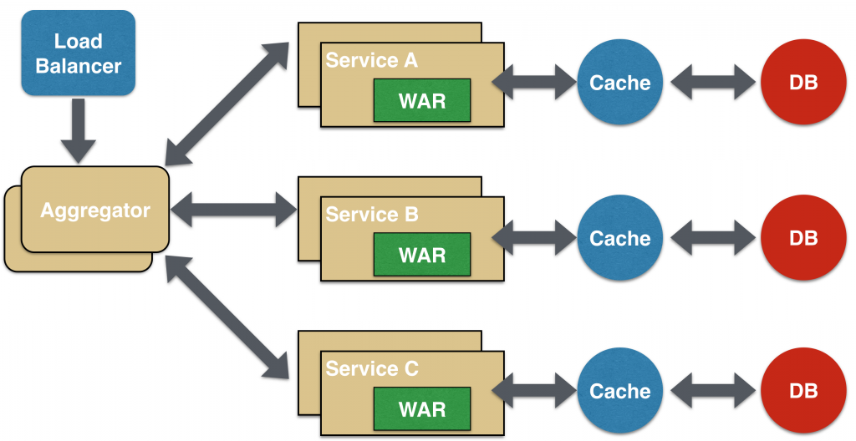
Aggregator Microservice Design Pattern
The first, and probably the most common, is the aggregator microservice design pattern. In its simplest form, Aggregator would be a simple web page that invokes multiple services to achieve the functionality required by the application. Since each service (Service A, Service B, and Service C) is exposed using a lightweight REST mechanism, the web page can retrieve the data and process/display it accordingly.

Slide 29
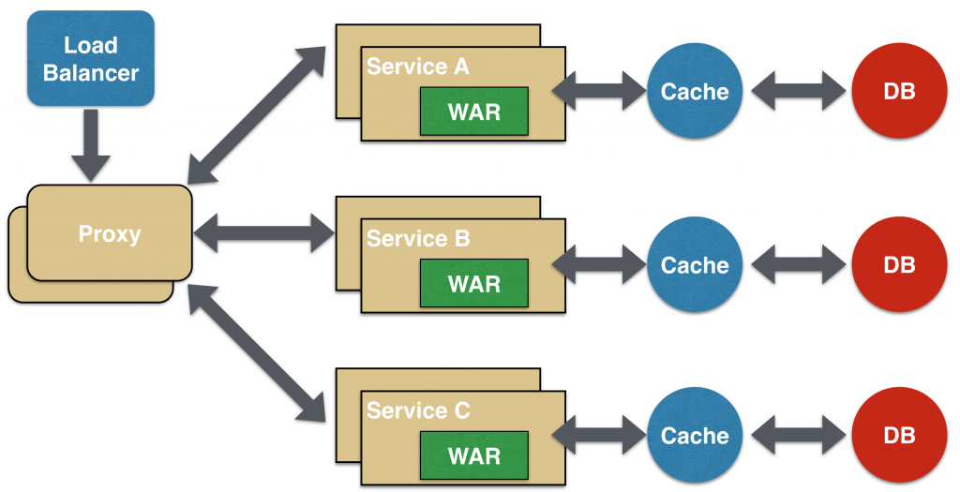
Proxy Microservice Design Pattern
Proxy microservice design pattern is a variation of Aggregator. In this case, no aggregation needs to happen on the client but a different microservice may be invoked based upon the business need.

Slide 30
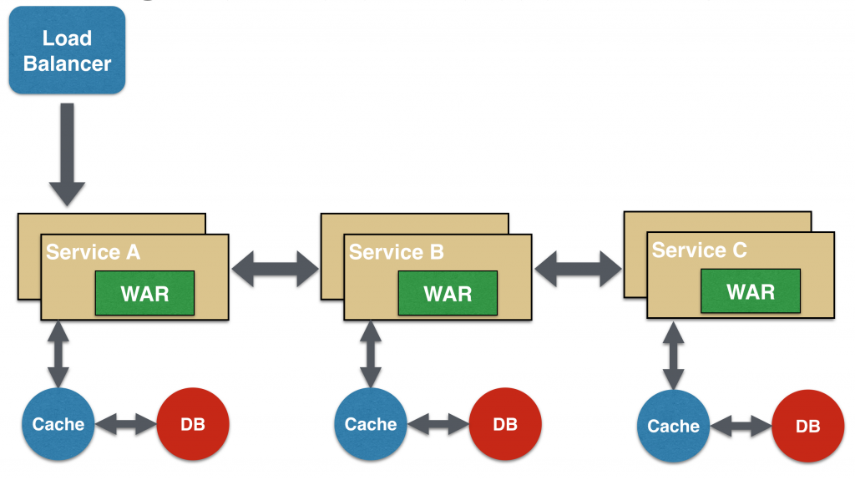
Chained Microservice Design Pattern
Chained microservice design pattern produce a single consolidated response to the request. In this case, the request from the client is received by Service A, which is then communicating with Service B, which in turn may be communicating with Service C. All the services are likely using a synchronous HTTP request/response messaging.

Slide 31
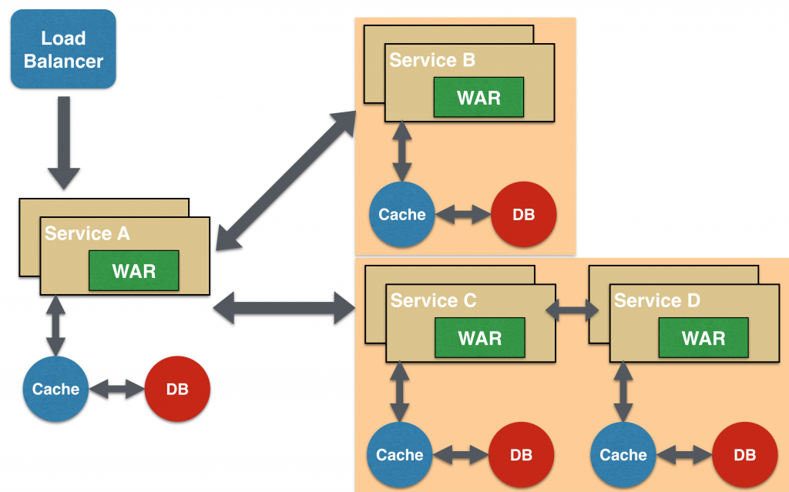
Branch Microservice Design Pattern
Branch microservice design pattern extends Aggregator design pattern and allows simultaneous response processing from two, likely mutually exclusive, chains of microservices. This pattern can also be used to call different chains, or a single chain, based upon the business needs.

Slide 32
Shared Data Microservice Design Pattern
One of the design principles of microservice is autonomy. That means the service is full-stack and has control of all the components – UI, middleware, persistence, transaction. This allows the service to be polyglot, and use the right tool for the right job. For example, if a NoSQL data store can be used if that is more appropriate instead of jamming that data in a SQL database.
However a typical problem, especially when refactoring from an existing monolithic application, is database normalization such that each microservice has the right amount of data – nothing less and nothing more. Even if only a SQL database is used in the monolithic application, denormalizing the database would lead to duplication of data, and possibly inconsistency. In a transition phase, some applications may benefit from a shared data microservice design pattern.
In this design pattern, some microservices, likely in a chain, may share caching and database stores. This would only make sense if there is a strong coupling between the two services. Some might consider this an anti-pattern but business needs might require in some cases to follow this. This would certainly be an anti-pattern for greenfield applications that are design based upon

Slide 33
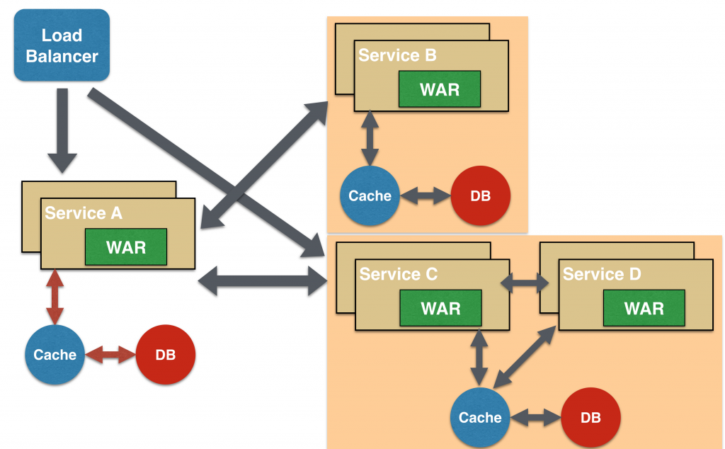
Shared Data Microservice Design Pattern

Slide 34
Asynchronous Messaging Microservice Design Pattern
While REST design pattern is quite prevalent, and well understood, but it has the limitation of being synchronous, and thus blocking. Asynchrony can be achieved but that is done in an application specific way. Some microservice architectures may elect to use message queues instead of REST request/response because of that. In this design pattern, Service A may call Service C synchronously which is then communicating with Service B and D asynchronously using a shared message queue. Service A -> Service C communication may be asynchronous, possibly using WebSockets, to achieve the desired scalability.
A combination of REST request/response and pub/sub messaging may be used to accomplish the business need.

Slide 35
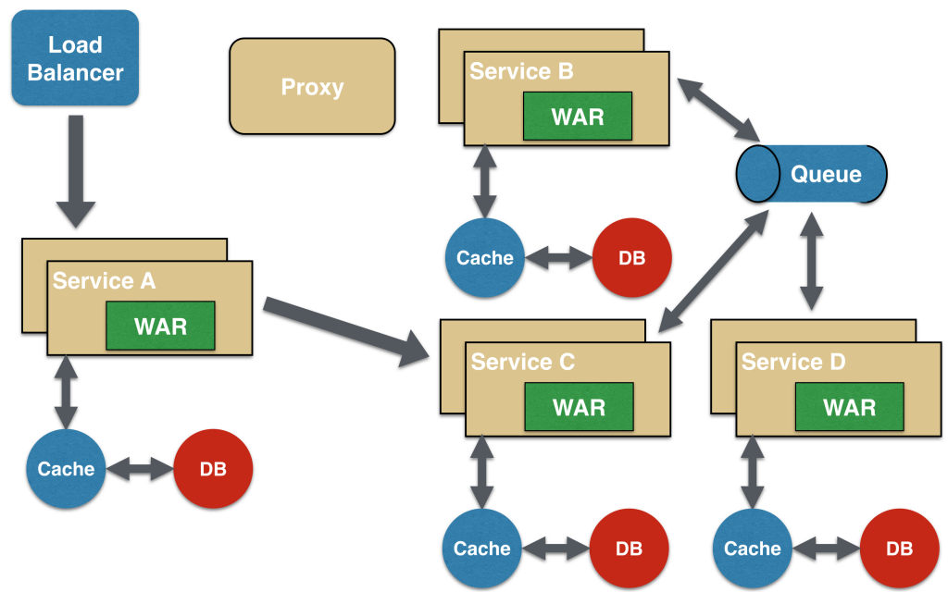
Asynchronous Messaging Microservice Design Pattern

Slide 36
Microservices Disadvantages
A microservices architecture necessitates a distributed system which can be complex and hard to manage. Having the right resources and knowledge can be an inhibitor for organizations considering a transition. Netflix has a great slide deck on the issues they faced.
Microservices creates an increased amount of infrastructure and increased operations management. Each service will require its own resources, monitoring, and testing. Additionally, replicating the automated build, test, and deployment pipeline of each service using continuous delivery practices is a standard for most microservices infrastructures.
Testing within each service is not anything unusual or difficult. However, testing an application utilizing a microservices architecture is not cut and dry. Testing the entire application as a whole, and how services function with one another can be difficult.
Since microservices are isolated from one another, developers have the opportunity to choose which technologies, languages, and libraries should be used for their component. While this is on the list of advantages, a polyglot environment could lead to a more chaotic and hard to manage application.
Common practice in a microservices architecture is to segment services and their corresponding data management systems. Since each database is segmented to support the service, management of the databases and its data becomes much more difficult.
While most argue that team segmentation is generally a positive thing, management complexity increases when teams are separated and working in isolation. Orchestration of microservices brings about a need for increased communication throughout the organization.
A microservices architecture could increase the amount of memory used. In most applications, several classes and libraries are often replicated in each microservice bundle and the overall memory footprint increases.
Depending on how you implement communications between microservices, there could be decreased performance due to increase in communication between various services via HTTP calls.

Slide 37
Microservices Disadvantages
Developing distributed systems can be complex. By which I mean, because everything is now an independent service, you have to carefully handle requests travelling between your modules. There can be a scenario where one of the services may not be responding, forcing you to write extra code specifically to avoid disruption. Things can get more complicated when remote calls experience latency.
Multiple databases and transaction management can be painful.
Testing a microservices-based application can be cumbersome. Using the monolithic approach, we would just need to launch our WAR on an application server and ensure its connectivity with the underlying database. But now, each dependent service needs to be confirmed before you can start testing.
Deploying microservices can be complex. They may need coordination among multiple services, which may not be as straightforward as deploying a WAR in a container.

Slide 38
Popularity of Microservices
Obviously, no one is saying microservices can solve every problem. But microservices architecture may succeed where other service-based approaches have failed, because it's coming from the bottom up.
A key driver in the movement toward microservices is the proliferation of connected devices — smartphones, tablets, wearables, smart home appliances, fitness trackers, drones and beyond. With connected devices flooding the market, there’s an increased emphasis on APIs.
Each Service Can Use It’s Own Language. Resources are affordable in terms of cost.
Success of Netflix and Amazon with microservices led other organizations to follow this architecture.
It is only because of Microservices, Docker, Kubernetes, Microsoft, Amazon were able to sell their product nicely in the market. Develop a product and use Microservice propaganda to place the product in the market.
Notes:
Fat war file deployment in Websphere, Single OS VS Cloud

Slide 39
End
Questions / Answers

