Slide 1
Running Your Services On Docker
An experience report

Slide 2

Who Am I?
Robert Bastian
Director, Platform and Architecture at Drillinginfo
20+ years industry experience in Telcos, Gaming and Energy
I love APIs and services!
Agile and DevOps advocate

Slide 3
Why Docker?
My World Needed To Change
5+ individual teams building “micro services” in Java and Scala
Frictionless deployment of “micro-services” using Chef & AWS
25+ separate “micro-services” deployed in the previous 18 months
Each service is typically deployed to a single AWS virtual machine
Each service is deployed 6x - dev, test, staging (2x) and production (2x)
25+ “micro-services” became nearly 150 AWS virtual machines

Slide 4
Why Docker? COST!
The AWS bill is too damn high!
Decline in the global price of oil causing churn in our business
6 AWS virtual machines per service isn’t sustainable with our budget
AWS monthly bill started to gain visibility from sr. management and the board

Slide 5
Why Docker? WASTE!
We weren’t using the compute and memory resources purchased from AMZN!
Nearly all “micro-services” were at 1% CPU utilization
Nearly all “micro-services’ were only using 40% of memory (JVM)
150+ virtual machines essentially sitting idle

Slide 6
Why Docker? LOCK IN!
How would we leave AMZN if we wanted to?
Could we use Drillinginfo IT’s Openstack platform?
What about alternate IaaS providers like Rackspace or Azure?
What about Container as a Service (CaaS) providers like Joyent, Tutum or Profitbricks?
What about using Amazon’s Container Service?

Slide 7
My World Needs To Change - Problem Statement
“How can we deploy fewer virtual machines while increasing the density and utilization of services per machine without locking us into a specific IaaS provider?”

Slide 8
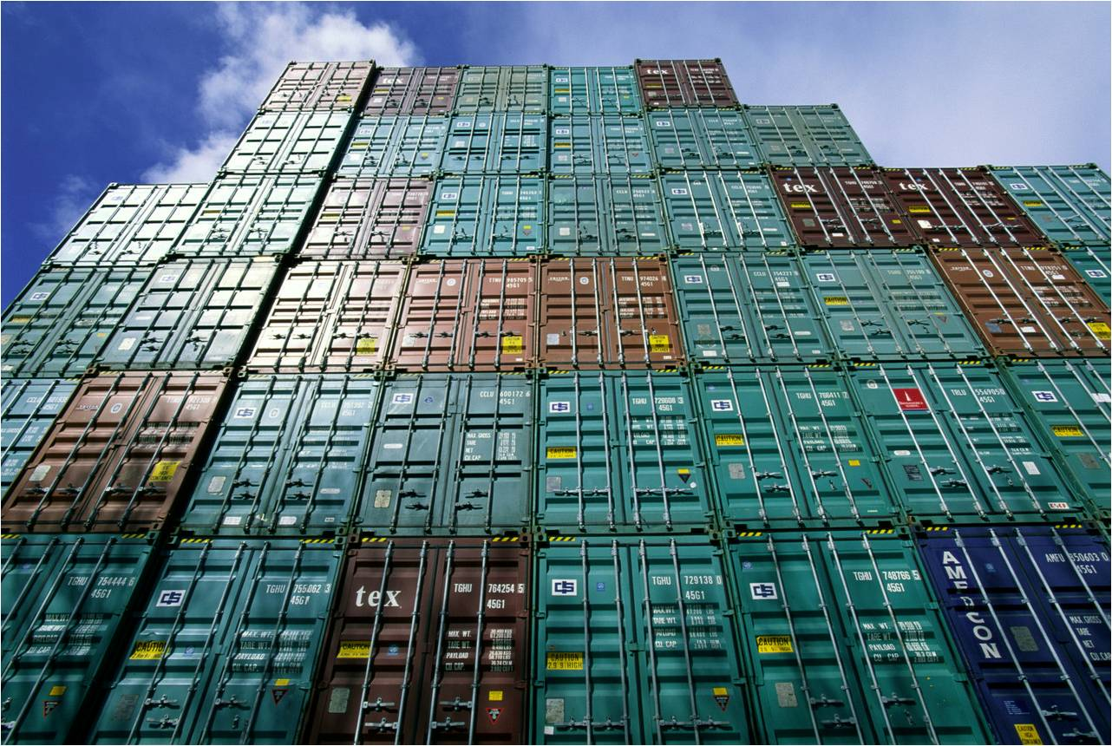

How Docker Solves All The Problems
www.synerzip.com
Webinar Series 2015

Slide 9
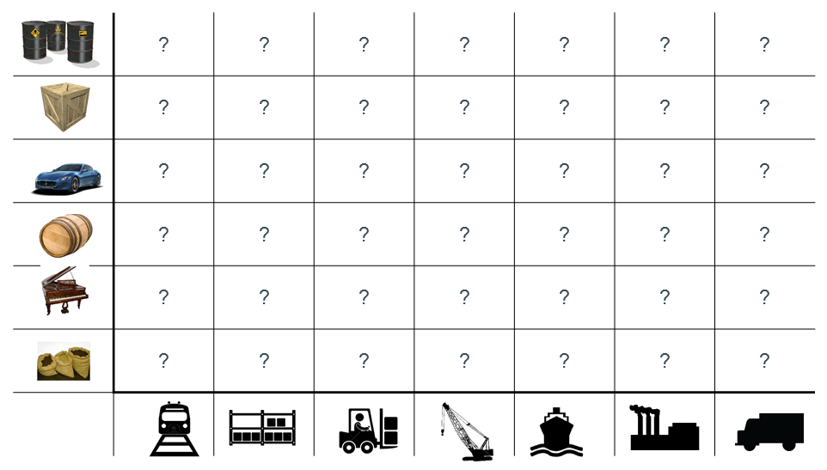
Docker Containers - Shipping Matrix From Hell

Slide 10
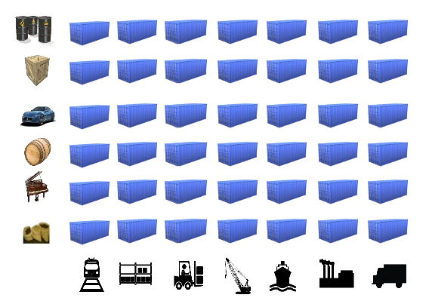
Docker Containers - Standard Shipping Container

Slide 11
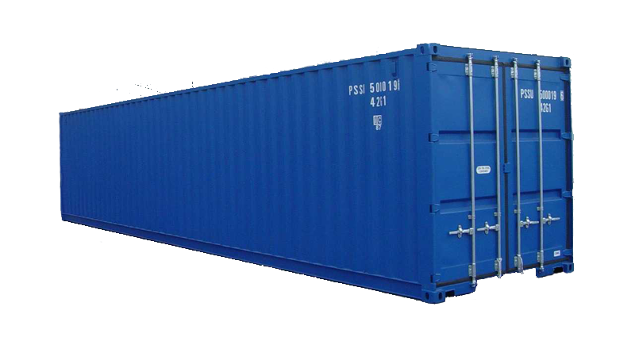
What’s Inside Doesn’t Matter
Notes:
Container metaphor: Monkeys and bananas

Slide 12
Why Docker Is Important - Before Containers
Very inefficient use of memory and CPU resources
12

Slide 13
Why Docker Is Important - After Containers
Isolated services in fewer VMs...
… and use VMs more efficiently.
13

Slide 14
Why Is Docker Important?
Docker container technology provides our “micro-services” platform:
Increased density of isolated “micro-services” per virtual machine (9:1!)
Containerized “micro-services” are portable across machines and providers
Containerized “micro-services” are much faster than virtual machines
14

Slide 15
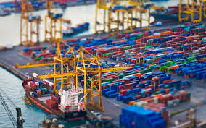
Containers Alone Aren’t Enough
Webinar Series 2015
15
www.synerzip.com

Slide 16
But Containers Aren’t Enough!
Running containerized “micro-services” in production requires much more than just Docker.
It requires a “Platform” that can do the following:
Building and pushing Docker images to an image repository
Pulling images, provisioning and scheduling containers
Discovering and binding to services running as containers
Containers discovering and binding to other containers
Operating and managing services in containers
16

Slide 17


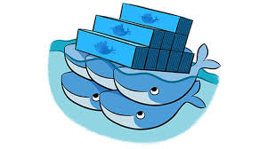
Drillinginfo Docker Platform: Build & Store Images
Problem: Detect changes at Github and build a new Docker image
Problem: Where do we store our Docker images?
17

Slide 18
Drillinginfo Docker Platform: Jenkins & Dockerhub
Problem: How do we build images? Jenkins automates the image builds.
We started building our images with Ubuntu 14.04 (1GB)
We settled on Alpine, a minimal linux distribution (5MB)
Typical “micro-services” now ~ 390MB
Problem: Where do we put them? Dockerhub.
Tried Docker Trusted Registry and Core OS Enterprise Registry
Settled on using Dockerhub
Use latest and sem-ver tags on our images
18

Slide 19

Drillinginfo Docker Platform: Provisioning, Scheduling
Problem: Which host do the containers run on?
Problem: How are containers started and configured?
Dockerhub
19

Slide 20
Drillinginfo Docker Platform - Chef
Problem: How do we determine which host to run a container on and how do we configure and start the container?
We solve scheduling and provisioning with Chef.
Chef schedules containers on specific hosts using Chef roles
Chef provisions and configures containers using Chef recipes and environments
Each “micro-service” has an associated Chef recipe that converts Chef attributes into container environment variables
20

Slide 21
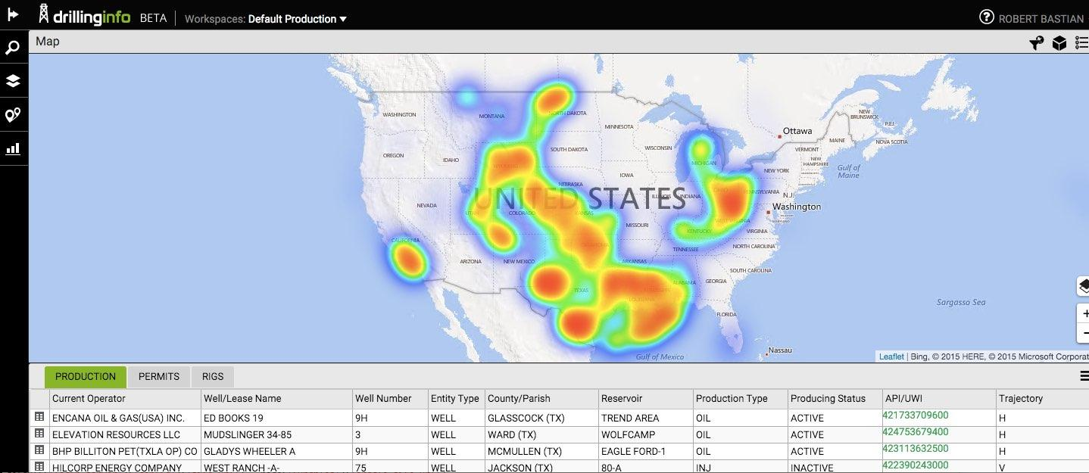

Drillinginfo Docker Platform: Service Directory
Problem: How can web applications discover and bind to containers?
DI Web Applications
DI Docker Containers
21

Slide 22
Drillinginfo Docker Platform - Consul
Problem: How do our browser applications locate service containers?
We use Hashicorp’s Consul as our service directory.
Containers automatically register themselves with Consul when started.
The Docker daemon emits real-time lifecycle events for container start
We use a utility container called Registrator to automate the registration of “micro-service” containers with Consul
Containers are registered with a health check that Consul polls to determine the health of the container
22

Slide 23
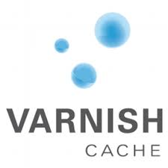

Drillinginfo Docker Platform: Service Discovery
Problem: How can web applications discover and bind to containers?
23

Slide 24
Drillinginfo Docker Platform - Consul Template
Problem: How do our browser applications use services deployed in containers?
We use Hashicorp’s Consul Template for service discovery and Varnish for load balancing.
Consul Template detects containers in Consul and updates Varnish configuration
Consul Template participates in the Consul cluster using Consul Client
Consul Template automatically adds healthy containers and removes sick containers from the Varnish load balancer by updating Varnish configuration
Browser applications use Varnish routes to reach services running in containers
24

Slide 25

Drillinginfo Docker Platform: Container Dependencies
Problem: How can containers discover and bind to other containers?
25

Slide 26
Drillinginfo Docker Platform - Service Proxy
Problem: How can containers find their containerized dependencies on the same host and different hosts?
We use Consul, Nginx and Consul Template to implement a “Service Proxy” for inter and intra-host container communication.
We built a utility container called “Service Proxy” that uses Consul’s service directory to locate a container's ip address and port
“Service Proxy” then uses Consul Template to create an nginx.conf with load balanced routes for each service container
Docker Links work for intra-host dependencies but with a gotcha
26

Slide 27

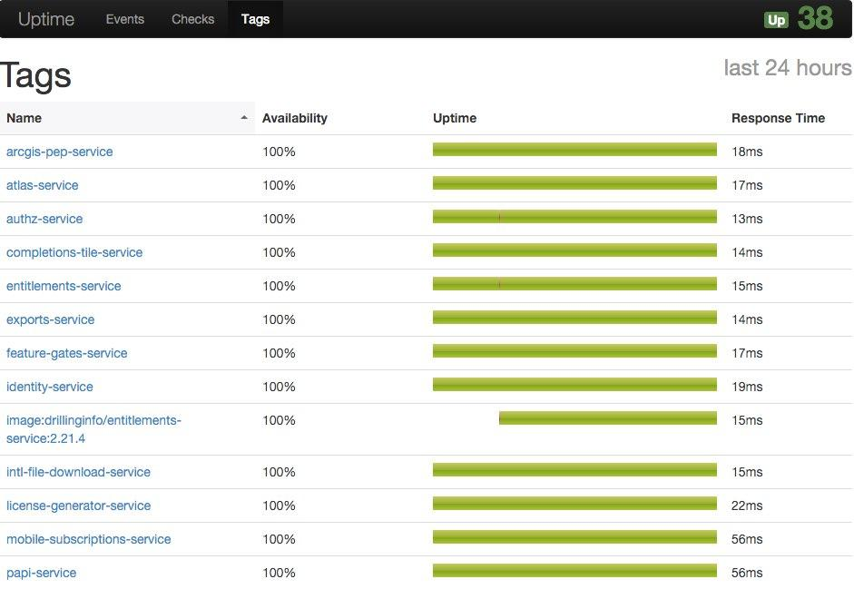
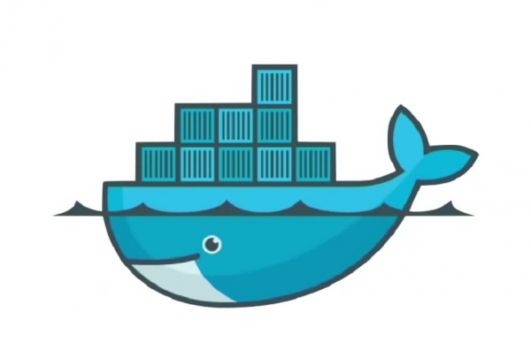
Drillinginfo Docker Platform: Operations & Monitoring
Problem: How do we detect failed or failing containers?
27

Slide 28
Drillinginfo Docker Platform - Operations & Monitoring
Problem: How do we monitor containers and notify and escalate when containerized services aren’t healthy?
We use Uptime and VictorOps monitor our containerized services.
A utility container monitors Docker container lifecycle events and automatically registers a service check with Uptime when a container starts
Uptime service interruptions to VictorOps for on-call scheduling, paging and escalation
28

Slide 29

Drillinginfo Docker Platform: Operations & Monitoring
Problem: How do we monitor the resource usage of hosts and containers?
29

Slide 30
Drillinginfo Docker Platform - Operations & Monitoring
Problem: How do we monitor our Docker host’s resource usage?
We use Datadog to monitor the Docker host utilization and the service’s metrics.
Datadog helps us visualize the resource usage on a host
Datadog helps us understand how our services are performing
Datadog helps us understand how to “pack” containers onto hosts by exposing the current utilization of CPU and memory resources on the host
30

Slide 31





Drillinginfo Docker Platform - Overview
UPTIME
31

Slide 32
Drillinginfo Docker Platform - Wrap Up
The Docker container technology and the Drillinginfo Docker Platform provide our “micro-services” infrastructure the following benefits:
Reduced cost for IaaS hosting
Reduced waste of virtual machine resources
Standardized deployment mechanism for “micro-services”
Standardized service directory, service discovery
Standardized metrics dashboards, monitoring and alerting
32

Slide 33
Drillinginfo Docker Platform - Future
Chef has gotten us where we are today but not where we want to be.
Container orchestration
Host provisioning and pooling
33

Slide 34
Drillinginfo Docker Platform - Orchestration
Docker Compose will replace Chef roles defining the “micro-services” deployed on our platform and which Docker host they run on.
The Docker Compose YAML file:
Defines which containerized “micro-services” run on which host
Define the environment variables for each container
I believe that IaaS providers will standardize on Docker Compose for container orchestration.
34

Slide 35
Drillinginfo Docker Platform - Provisioning & Pooling
Docker Machine will replace Chef for provisioning virtual machines with Docker.
Docker Machine automates the provisioning of Docker hosts
Docker Swarm will replace Chef for scheduling containers on a host.
Swarm combines Docker Machines into a single pool of compute and memory resources
Swarm provides container scheduling and supports plug-in schedulers
Docker Compose will define all the containers that run on the Swarm
35

Slide 36
Running Your Services On Docker: Thank You!
Questions?
36

Slide 37
Contact Info
Please feel free to contact me with any additional questions or comments!
Email: robert.bastian@drillinginfo.com
LinkedIn: rbastian
Twitter: @rbastian
37

Slide 38
Running Your Services On Docker - Links
https://www.docker.com/
https://hub.docker.com/
https://jenkins-ci.org/
https://www.chef.io
https://www.consul.io/
https://github.com/gliderlabs/registrator
https://hashicorp.com/blog/introducing-consul-template.html
https://www.varnish-cache.org/
https://www.nginx.com/
https://github.com/fzaninotto/uptime
https://victorops.com/
https://www.datadoghq.com/

Slide 39

www.synerzip.com
Ashish Shanker
Ashish.Shanker@synerzip.com
469.374.0500
39

Slide 40
Synerzip in a Nutshell
Software product development partner for small/mid-sized technology companies
Exclusive focus on small/mid-sized technology companies, typically venture-backed companies in growth phase
By definition, all Synerzip work is the IP of its respective clients
Deep experience in full SDLC – design, dev, QA/testing, deployment
Dedicated team of high caliber software professionals for each client
Seamlessly extends client’s local team offering full transparency
Stable teams with very low turn-over
NOT just “staff augmentation, but provide full management support
Actually reduces risk of development/delivery
Experienced team – uses appropriate level of engineering discipline
Practices Agile development – responsive yet disciplined
Reduces cost – dual-site team, 50% cost advantage
Offers long-term flexibility – allows (facilitates) taking offshore team captive – aka “BOT” option

Slide 41























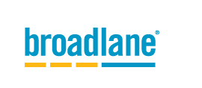













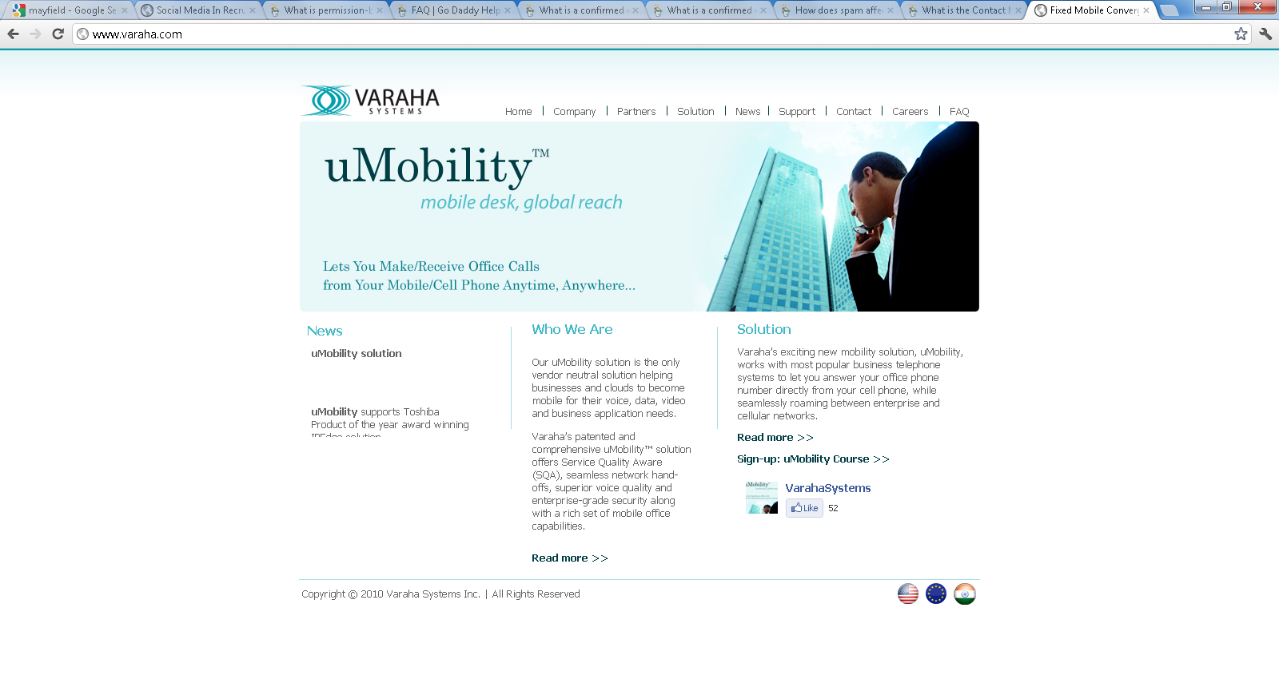






































Synerzip Clients
Notes:
41
41

Slide 42

Next Webinar
Role of the Architect in Agile
Complimentary Webinar: Thursday, November 12, 2015 @ Noon CST
Presented by: Chris Edwards, P.Eng
Software Manager, IHS Inc.

Slide 43



Connect with Synerzip
@Synerzip
linkedin.com/company/synerzip
facebook.com/Synerzip
Ashish Shanker
Ashish.Shanker@synerzip.com
469.374.0500
Notes:
43
43

Slide 44
Running Your Services On Docker: Thank You!
Questions?
44

