Slide 1
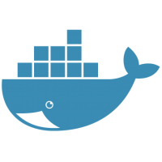
DOCKER
By
Debadatta Mishra(DD)

Slide 2
Contents
What is Docker ?
Why Docker ?
Advantages of Docker
Top companies using Docker
Docker Alternatives
What are containers ?
Docker Installation
Docker Basic Commands
Hands on Docker

Slide 3
What is Docker ?
Docker is a tool designed to make it easier to create, deploy, and run applications by using containers.
Containers allow a developer to package up an application with all of the parts it needs, such as libraries and other dependencies, and ship it all out as one package.
Docker is considered as Container as Service (CaaS).
Docker is a tool that is designed to benefit both developers and system administrators, making it a part of many DevOps (developers + operations) toolchains.

Slide 4
Why Docker ?
Docker allows applications to be isolated into containers.
Many docker containers can run on a single VM.
Docker is open source.
Minimizes the cost
Docker is a huge help in enabling continuous integration, delivery, and deployment pipelines.
Skip the boilerplate and maintenance work.

Slide 5
Advantages of docker
Return on investment & cost savings.
The biggest driver of most management decisions when selecting a new product is the return on investment.
The nature of Docker is that fewer resources are necessary to run the same application. Because of the reduced infrastructure requirements that Docker has, organizations are able to save on everything from server costs to the employees needed to maintain them.
Isolation
Docker makes sure each container has its own resources that are isolated from other containers. You can have various containers for separate applications running completely different stacks.
Multi-Cloud Platforms.
Docker containers can be run inside an Amazon EC2 instance, Google Compute Engine instance, Rackspace server or VirtualBox, provided that the host OS supports Docker. Acontainer running on an Amazon EC2 instance can easily be ported between environments, for example to VirtualBox, achieving similar consistency and functionality. Also, Docker works very well with other providers like Microsoft Azure, and OpenStack, and can be used with various configuration managers like Chef, Puppet, and Ansible,etc
Rapid and Continuous Deployment & Testing.
Docker ensures consistent environments from development to production.
Simplicity & faster configurations.
Users can take their own configuration, put it into code and deploy it without any problems.
Compatibility & maintainability.
Eliminate the concept “it works on my machine” problem once and for all.

Slide 6









Top companies using Docker

Slide 7
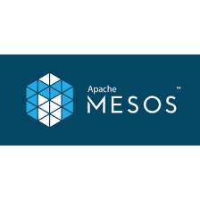
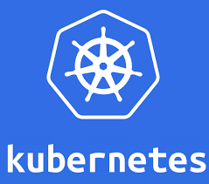
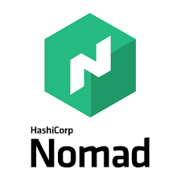

Docker Alternatives

Slide 8
What are containers ?
Containers, or otherwise known as operating-system-level virtualization, are a lightweight approach to virtualization that only provides the bare minimum that an application requires to run and function as intended.
Containers are considered as super minimalist virtual machines that are not running on a hypervisor.
Containerizing an application enables it to run reliably in different environments by abstracting away the operating system and the physical infrastructure.
Containerized applications are sharing the kernel of the host operating system with other containers and the shared part of the OS is read only.
Containers include the followings.
Application
Dependencies
Libraries
Binaries
Configuration files

Slide 9
What are containers ?

Slide 10
What are containers ?

Slide 11
What are containers ?

Slide 12
Title and content layout with chart

Slide 13
Two content layout with table
First bullet point here
Second bullet point here
Third bullet point here
Class | Group 1 | Group 2
Class 1 | 82 | 95
Class 2 | 76 | 88
Class 3 | 84 | 90

Slide 14
Two content layout with SmartArt
First bullet point here
Second bullet point here
Third bullet point here
Step 1
Step 2
Task Description
Task Description
Task Description
Step 3

Slide 15
Add a Slide Title - 1

Slide 16
Add a Slide Title - 2

Slide 17
Add a Slide Title - 3

Slide 18
Add a Slide Title - 4

Slide 19
Add a Slide Title - 5

