Slide 1

Handling spatial data and making maps using QGIS
Dr Debjit Bhowmick
Postdoctoral Research Fellow
Monash University
Notes:
Good morning, everyone! Thank you for joining this workshop on making maps with QGIS. I'm really excited to get started.

Slide 2

Acknowledgement of country
We acknowledge the Traditional Owners of the land we are on today, and pay respect to elders past, present and emerging and acknowledge any Aboriginal and Torres Strait Islander People with us today.
Notes:
I will start by acknowledging the Traditional Owners of the land we are on today, and pay respect to elders past, present and emerging.

Slide 3


Debjit Bhowmick, PhD
Research Fellow, School of Public Health and Preventive Medicine
Bio
Research Fellow leading a number of key projects in the ARC Discovery Project CYCLED (CitY-wide biCycLing Exposure modelling).
Research interests
Education
Sustainable and active mobility
Safety in mobility
PhD in Engineering (Geomatics)
MTech in Transportation Engineering
Technical experience
Interests
(Geo)Spatial data analysis
Mobility data analysis
Cricket, Football
Photography

Slide 4

Let’s talk about you now
https://www.menti.com/alp7b42r8wy8
Go to menti.com and use the code 1301 5004

Slide 5
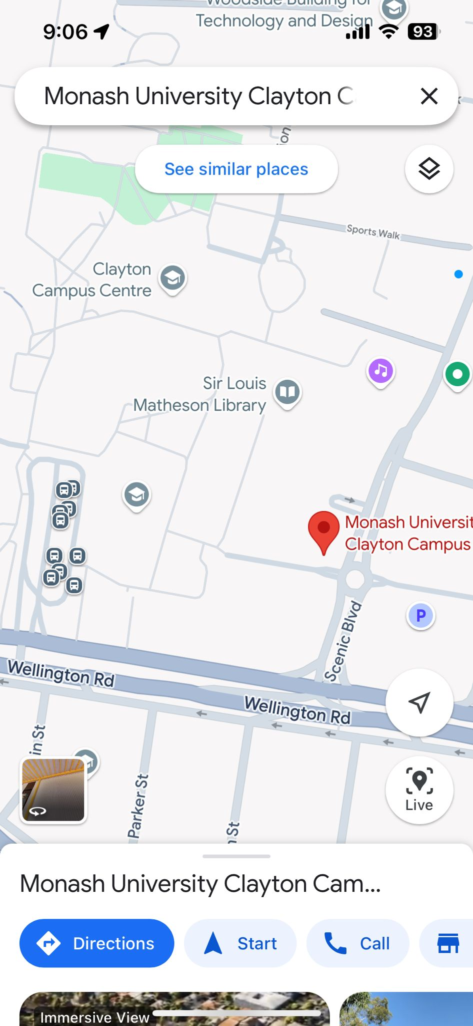
What is Spatial Data?
Spatial data is information about the locations of things on Earth.
It includes data that describes where something is (geography) and sometimes what it is (attributes).

Slide 6
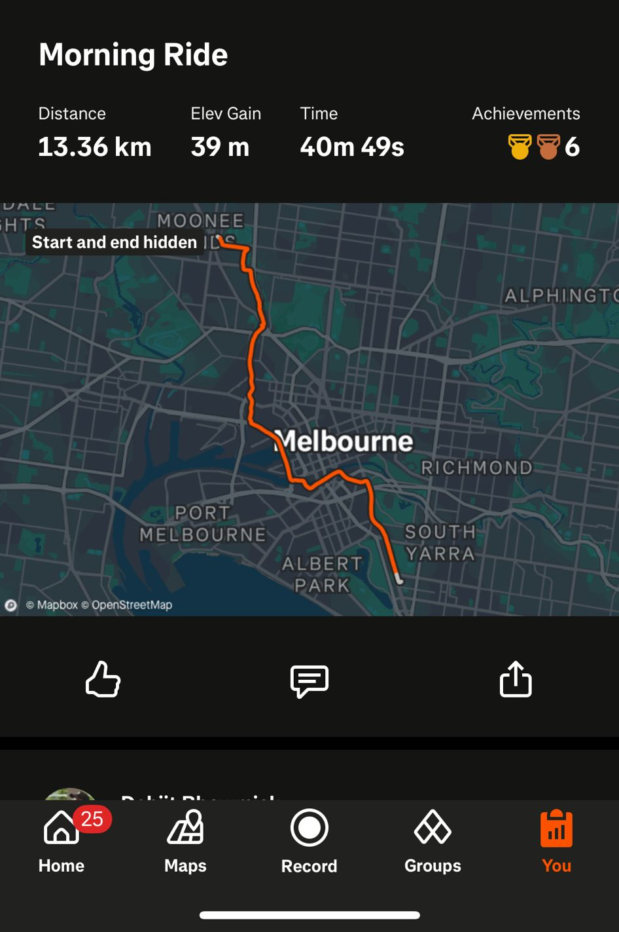
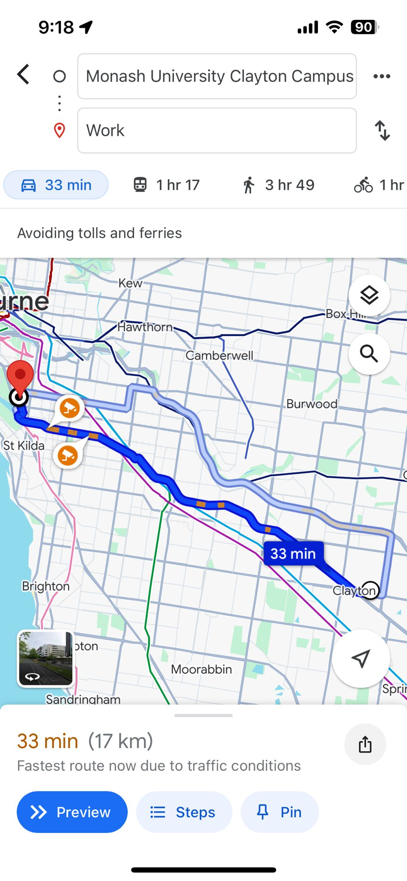
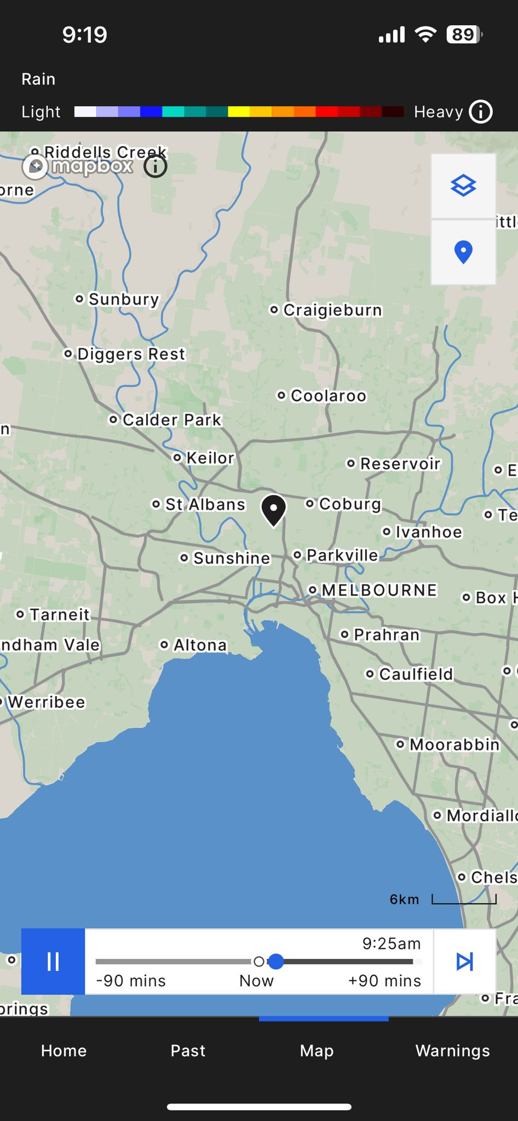



Examples of Spatial Data in Everyday Life

Slide 7
Types of Spatial Data
Vector Data (Precise and Structured):
Points: Represent specific locations (e.g., a city, a tree).
Lines: Represent paths or connections (e.g., roads, rivers).
Polygons: Represent areas (e.g., parks, buildings).
Raster Data (Gridded and Continuous):
Made up of pixels (like a photo) and often used for images (e.g., satellite photos) or gradients (e.g., temperature maps).

Slide 8
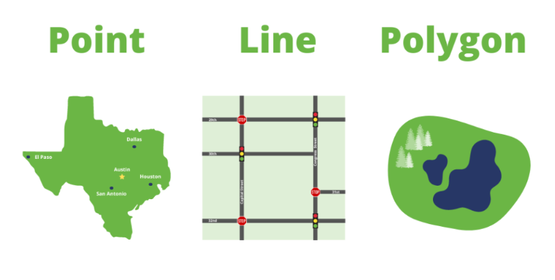
Vector data (more common)
Vector data is composed of XY coordinates

Slide 9
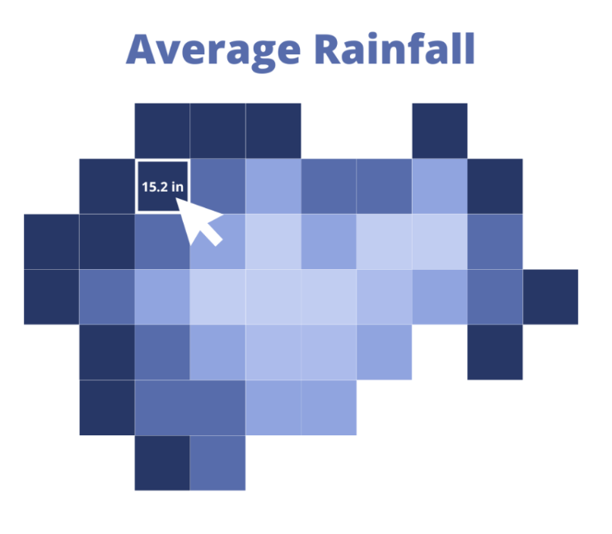
Raster data
Raster data is represented as a matrix of pixels arranged into rows and columns, aka, a grid.

Slide 10
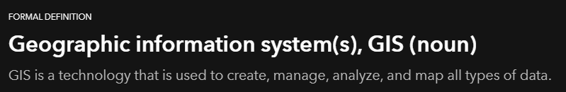
What is GIS?
GIS stands for Geographic Information Systems.
GIS is a tool for working with maps and spatial data.
It helps us understand where things are, how they are related, and how they change over time.
Notes:
Esri is the global market leader in geographic information system (GIS) software, location intelligence, and mapping.

Slide 11
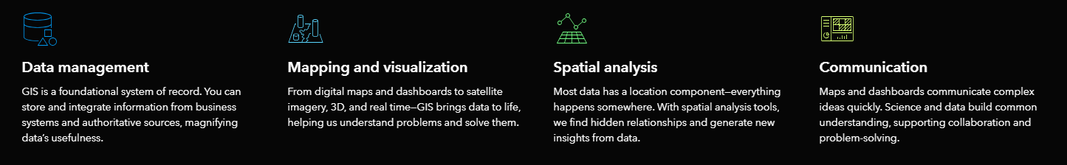
What Can GIS Do?
Create Maps
Show locations of features like cities, roads, or forests.
Analyse Spatial Data
Find patterns and relationships (e.g., areas at risk of flooding).
Solve Problems
Plan routes, design infrastructure, or study environmental impacts.
Notes:
Esri is the global market leader in geographic information system (GIS) software, location intelligence, and mapping.

Slide 12

What is QGIS?
Quantum Geographic Information System
QGIS is a free and open-source GIS software.
It allows you to create, edit, visualise, and analyse spatial data.

Slide 13



Why QGIS?
Free and Open Source
No licence costs; anyone can use and modify it.
Easy to Learn
Beginner-friendly interface with powerful tools.
Community-Driven
Regular updates and a global community for support.

Slide 14



Key Features of QGIS
Map Creation
Design customised maps with layers, styles, and labels.
Data Analysis
Perform spatial analyses like measuring distances.
Supports Many File Formats
Works with shapefiles, GeoJSON, raster data, and more.

Slide 15




Applications of QGIS
Urban planning
environmental monitoring
transportation modelling
disaster management

Slide 16
What to expect from this workshop?
This workshop assumes that you have little or no prior experience with theoretical GIS knowledge or the operation of GIS software.
Limited theoretical background will be provided to explain the purpose of an action you will be performing in the program, but the emphasis is on learning by doing.
At the end of the workshop, you will have a better concept of the possibilities of GIS, and how to harness their power via QGIS.

Slide 17
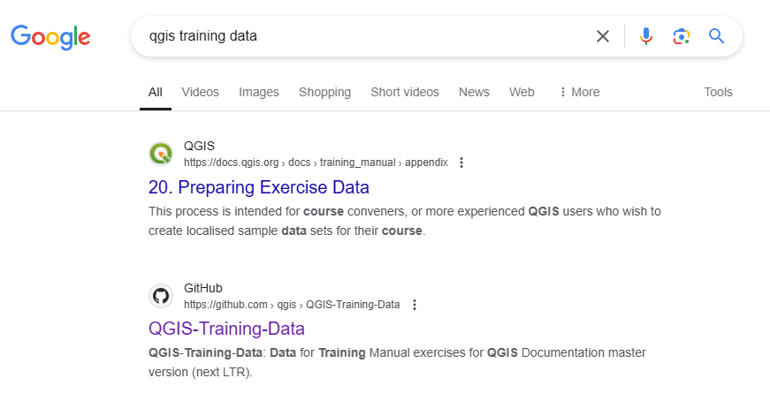
Training Data to download
https://github.com/qgis/QGIS-Training-Data/tree/master/exercise_data

Slide 18
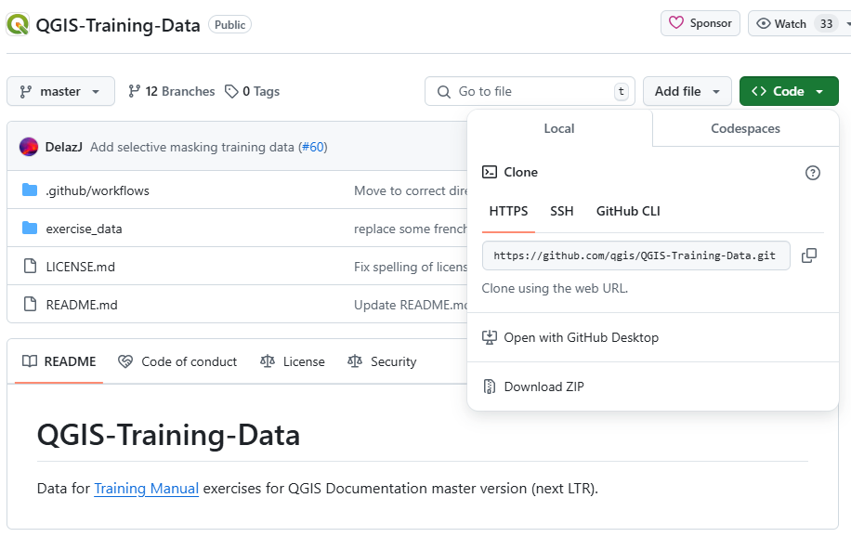

Training Data to download
https://github.com/qgis/QGIS-Training-Data/tree/master/exercise_data
1
2

Slide 19
Spatial data file formats
.SHP (Shapefile)
.GPKG (Geopackage)
.GEOJSON (GeoJSON)
.JSON (JSON)
.CSV (Comma Separated Values)
.TXT (Text)

Slide 20
Let’s GO!!!

