Slide 1

Bangladesh Army University of Science & Technology (BAUST), Saidpur
Department : Computer Science & Engineering
Course Code : CSE 2200
Course Title : Software Development Project II
Submitted By :
Submitted To :
Student Name : Debjyoti Ghosh
ID : 180201099
Batch : 8th
Level : 2 Term : II
Section :B
Date of Submission : 30-11-2020
Teacher Name : MD. Toukir Ahmed
Designation : Lecturer

Slide 2
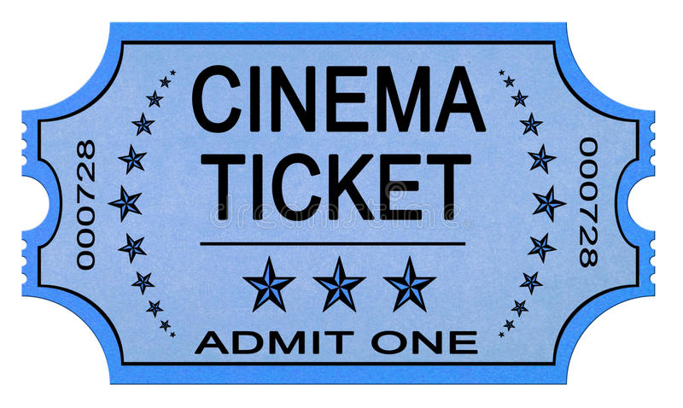
Project Name:
Movie Ticket Management System

Slide 3
Objective :
The purpose of this document is to present an overall description and listing of the functionality of The Testing Assistant for Regression Testing. It will explain the scope of the project as well as describe the system environment. This document will also include an easily traceable means by which the user can trace each functionality’s brief description to its full description. Also included is a user interface specification whereby the user can demonstrate interface standards to be used in designing the system. Furthermore, considerations regarding non-functional requirements and system evolution are addressed.
Purpose of Project :
1.Users---->2.Searching---->3.Select Movie---->4.Booking Ticket---->5.Display Ticket….

Slide 4
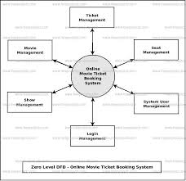
Data Processing :

Slide 5
Platform and Tools :
We use C++ programming language . And we use CodeBlocks ,which is open source IDE for .
Writing this project in c++ .
GNU compiler collection .
Goals :
This project can easily implement under various situation. We can add new features as and when it requires. Reusability of this application is also possible. Tourism group can manage their location, hotel and vehicles details.

Slide 6
Reason behind the selection this topic :
The Movie Ticket Management System has been developed to override the problems prevailing in the practicing manual system. We can easily collect all the information about the tickets through the movie ticket management system. The reason for my selection of this topic is that I love watching movies so how can easily buy movie tickets and get all information about tickets. I hope that everyone will benefit a lot from this project. The movie ticket management system is more versatile, flexible and updating can be done easily .

Slide 7
SYSTEM DESIGN
The Movie Ticket Management System .
EXIT .
-> Case data management :
Cart Report .
Add/Remove/Edit Ticket .
Show Ticket Details .
Exit .
-> Exit :
1. Exits the current application .

Slide 8
Summery :
….Class used in project
class ticket
{ int itemno;
char name[25];
date d;
public:
void add()
{
……..
}
void show()
{
…….
}
Void report()
{
…….
}
class amount: public ticket
{
float price,qty,netamt;
public:
void add();
void show();
void report();
void calculate();
void pay();
float retnetamt()
{
return(netamt);
}
}amt;

Slide 9
Summery :
….Functions used in project
void gotoxy(int x, int y)
void add()
void show()
void report()
void calculate()
void pay(
void amount::calculate()
void amount::add()
void amount::show()
void amount::report()
void amount::pay()

Slide 10
Output Analysis
Sample Code With Output Testing

Slide 11
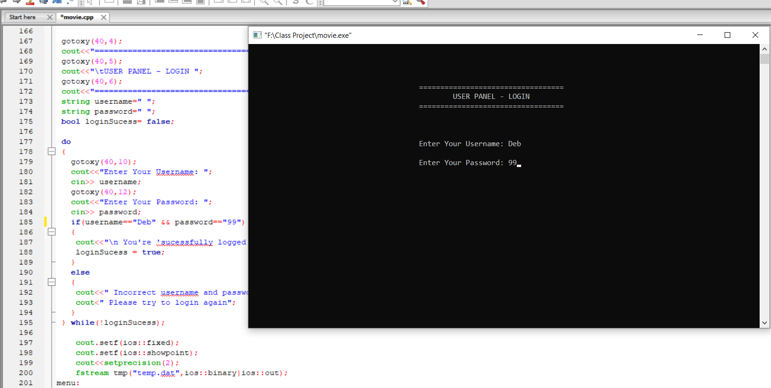
MOVIE TICKET MANAGEMENT SYSTEM

Slide 12
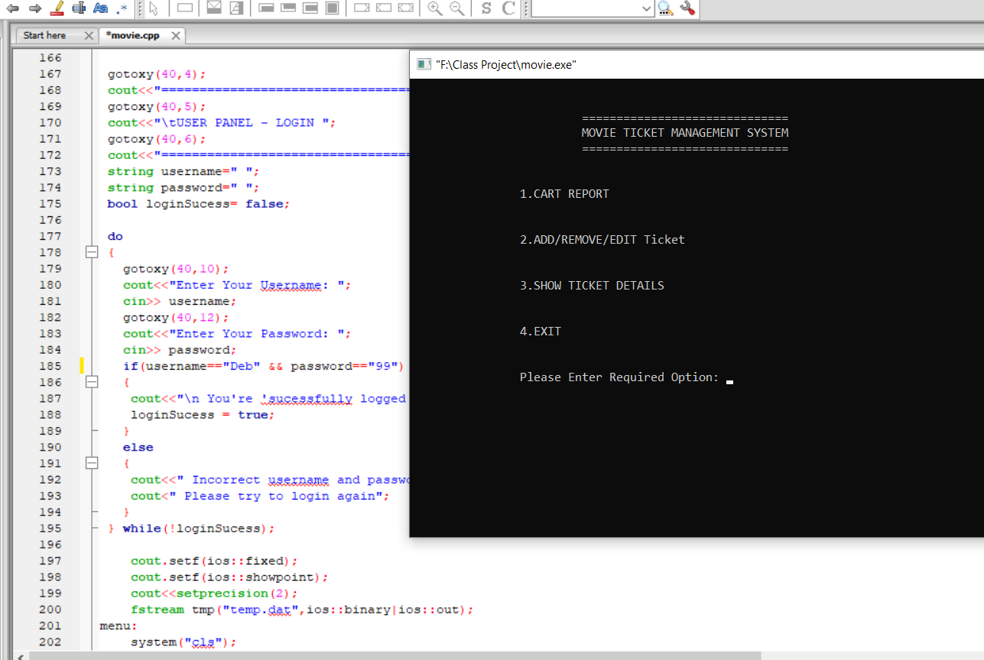
MOVIE TICKET MANAGEMENT SYSTEM

Slide 13
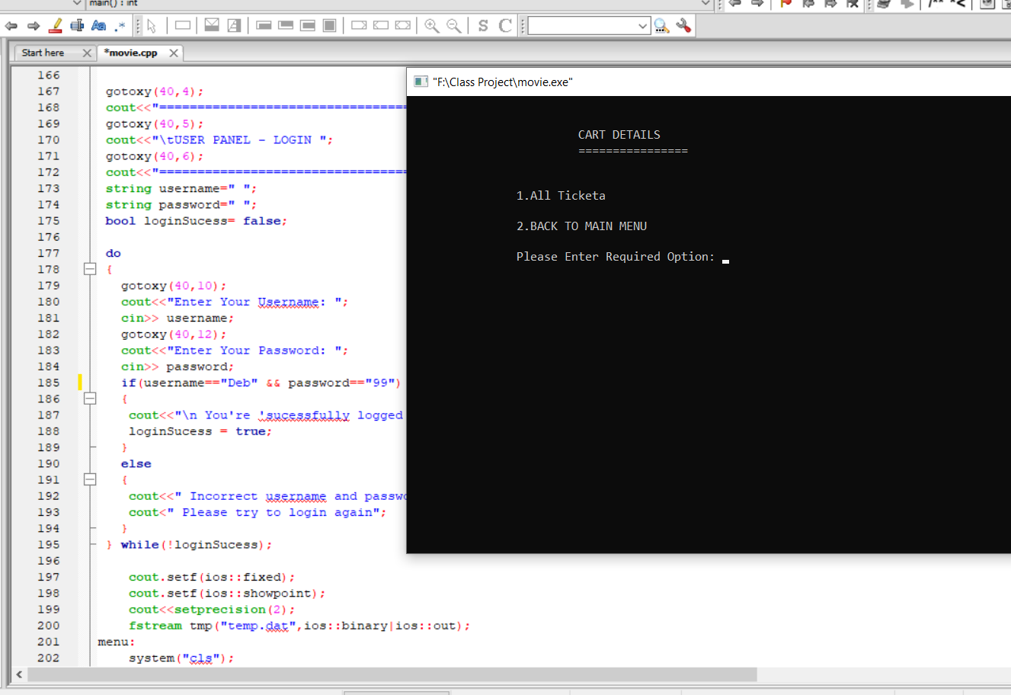
MOVIE TICKET MANAGEMENT SYSTEM

Slide 14
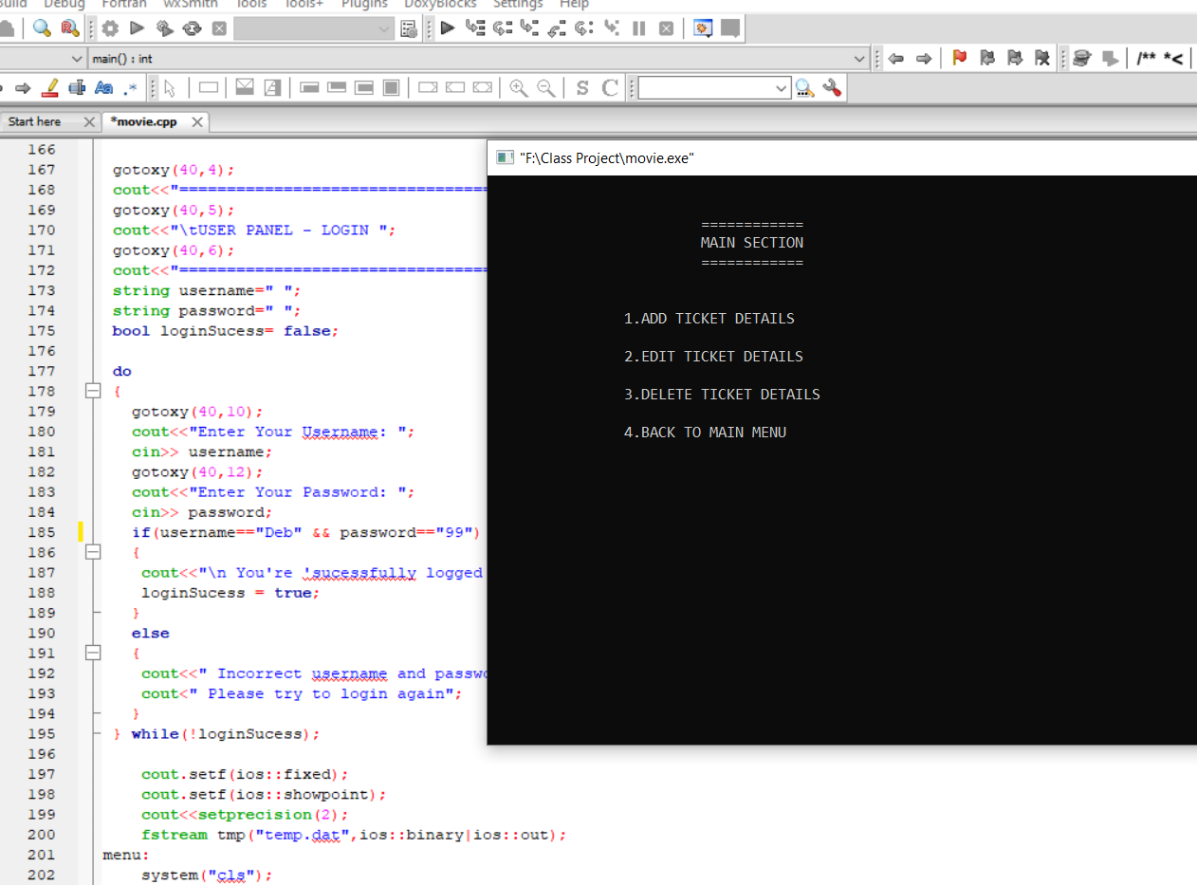
MOVIE TICKET MANAGEMENT SYSTEM

Slide 15
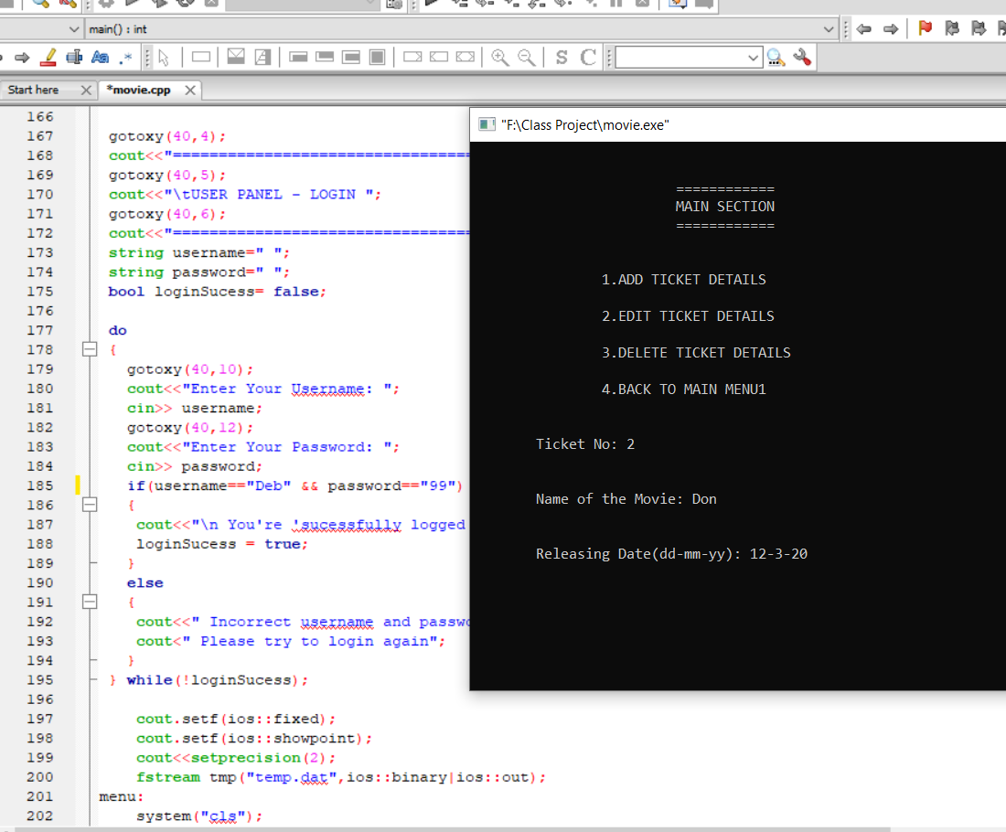
MOVIE TICKET MANAGEMENT SYSTEM

Slide 16
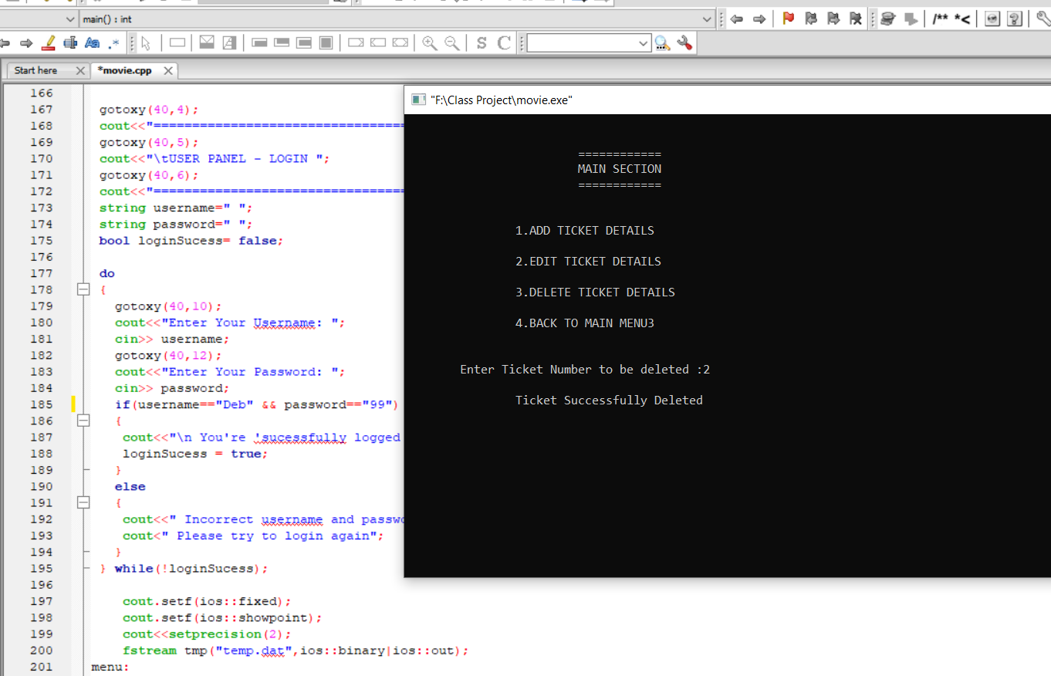
MOVIE TICKET MANAGEMENT SYSTEM

Slide 17
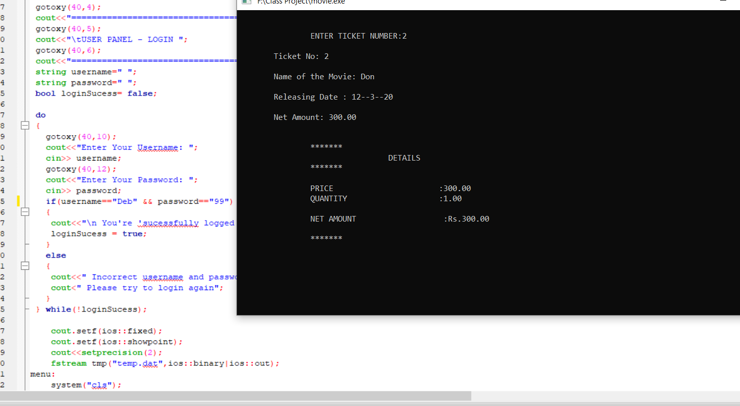
MOVIE TICKET MANAGEMENT SYSTEM

Slide 18
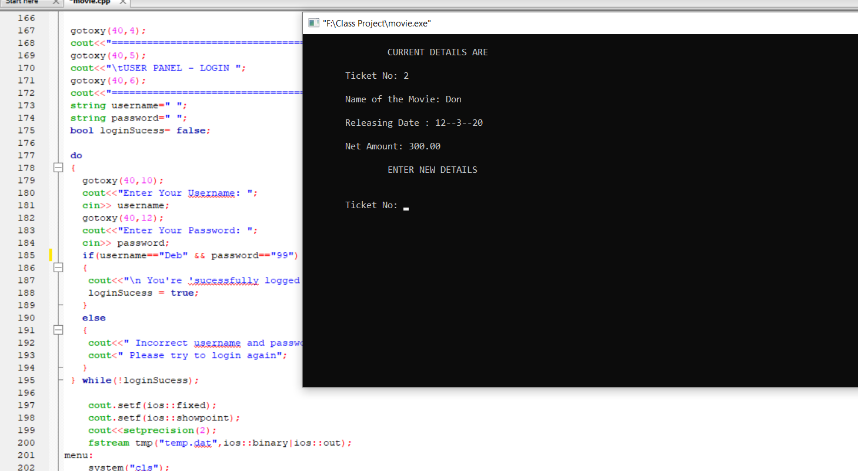
MOVIE TICKET MANAGEMENT SYSTEM

Slide 19
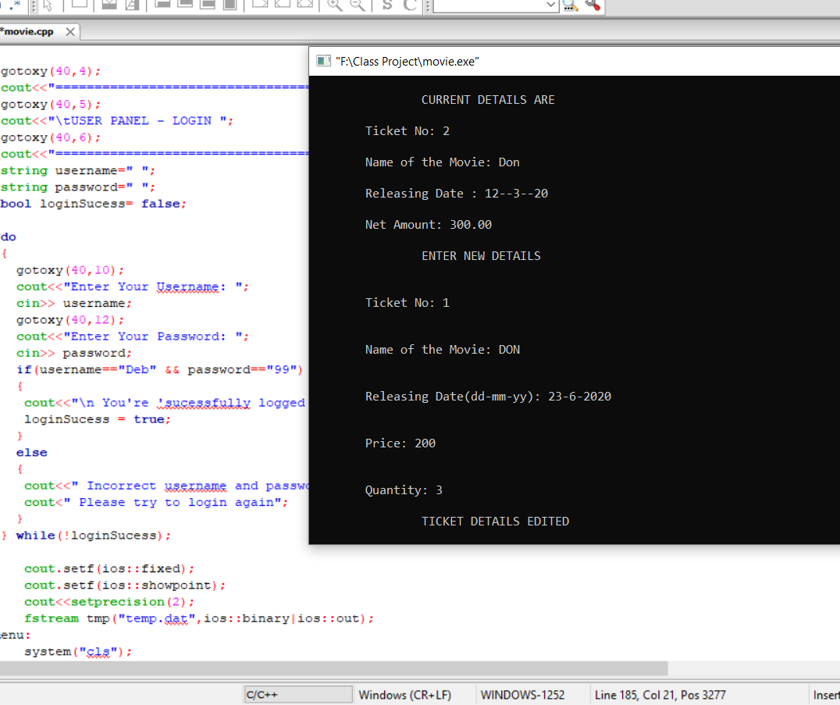
MOVIE TICKET MANAGEMENT SYSTEM

Slide 20
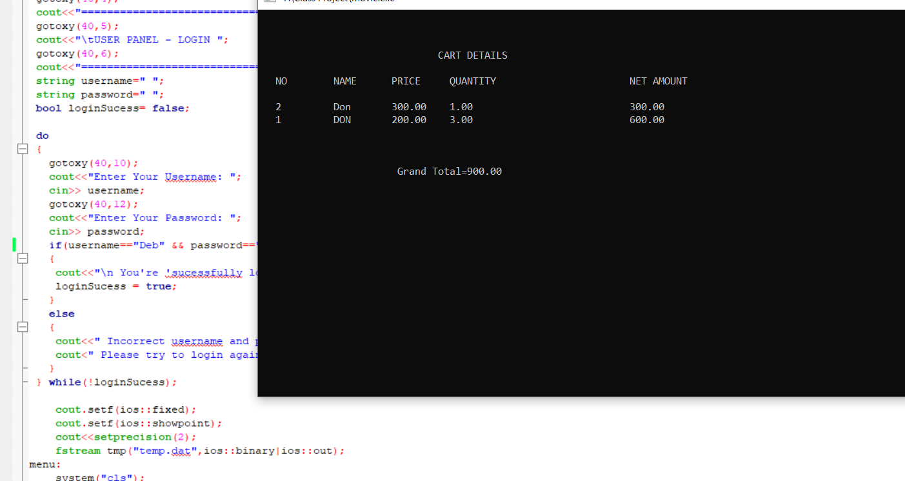
MOVIE TICKET MANAGEMENT SYSTEM

Slide 21
Git-Hub PROJECT LINK
https://github.com/debjyoti099/-Movie-Ticket-Management-system

Slide 22
Future Enhancements :
Online Movie Ticket Booking System is the process in which a customer can purchase his movie tickets directly by using the internet. ONLINE MOVIE TICKET BOOKING SYSTEM Future scope and further enhancement of the Project Future Scope The project E-ticket System for download Online ticket booking system project source I have downloaded online movie ticket booking system. pls send me online ticket reservation system. This is c++ Projects on Online Movie Ticket Booking System. The objective and scope of my Project is to record the details various activities of user.

Slide 23
REFERENCE :
www.google.com
www.youtube.com
www.stackoverflow.com
File Structures –An Object Oriented Approach with C++ By Michael J.Folk, Bill Zoellick, Greg Riccardi
K.R. Venugopal, K.G. Srinivas, P.M. Krishnaraj: File Structures Using C++, Tata McGraw-Hill, 2008.

Slide 24
THANK YOU

