Slide 1
Clock cycle and Analysis regarding
BRISCV

Slide 2
Duration of 1 clock cycle
Always #1 clock = ~clock;
Toggle clock every 1 time units
1 clock cycle = 2 ns

Slide 3
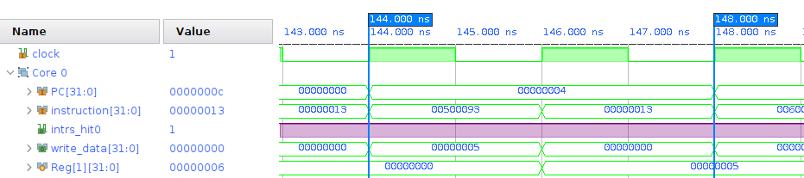
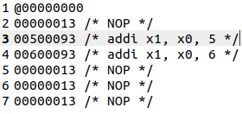
Clock requirements for 1 ALU instruction hit in I-cache: 00500093 ( addi x1, x0, 5)
Alu instruction gets hit in I cache, shown in Instr_hit0 line
No memory accesss
Time taken = (148 – 144) ns = 4 ns = 2 clock cycles
After each instruction, Nop instruction get execute by default
Register write is happening in the second clock cycle

Slide 4
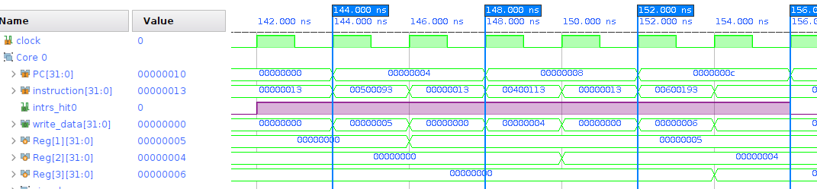
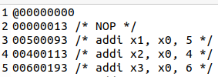
Execution of 3 consecutive Alu instructions

Slide 5
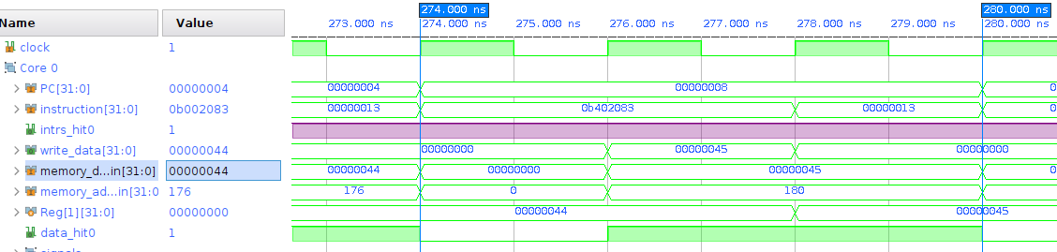
Timing analysis of load hit(I-cache+D-cache) instruction : 0b402083 (lw x1, 180(x0))
No dealy for I-cache or D-cache miss
Clock cycles consumed = (280 - 274) ns = 6ns = 3 clock cycles
Data_hit0 becomes 1 after 1 clcok cycle from the begin of the execution of this instruction

Slide 6
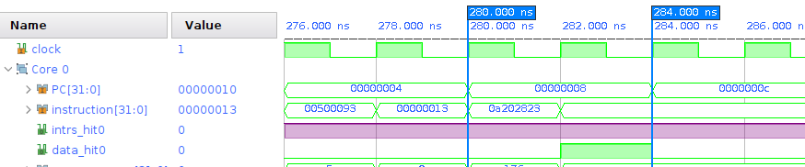

Timing analysis of store hit(I-cache+D-cache) instruction : 0a202823( sw x1, 176(x0))
No dealy for I-cache or D-cache miss
Clock cycles consumed = (284 - 280) ns = 4ns = 2 clock cycles
Data_hit0 becomes 1 after 1 clcok cycle from the begin of the execution of this instruction
As no write back stage in store location, required one clock cycle less than load hit.

Slide 7
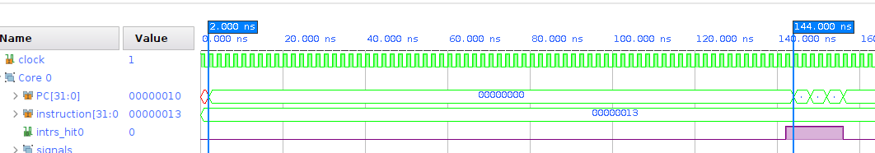

Time required to execute 1 miss Instruction cycle : NOP(00000013)
Instruction miss occurs
Time taken to fetch from memory to cache and then execute = (144-2)ns = 142 ns

Slide 8
State changes during I-cache miss
Reset
Reset
Idle
Cache
Access
Wait
For
access
Cache
Access
Read
state
wait
Update

Slide 9
Clock cycle calculation
From the above diagram we can calculate the following parameters:
Clock cycle in case of instruction miss + fetch + execute = 144ns – 2ns = 142ns
Clock cycle for a hit instruction (no memory access) = 2ns + 2ns = 4 ns, as compulsory NOP instruction is executed after each instruction, provided by the processor.
Instr_hit0 signal line initially was low,
After fetching 4 instructions in I-cache, Instr_hit0 toggles and remain high for consecutive 3 instructions, as shown in the above diagram.

Slide 10
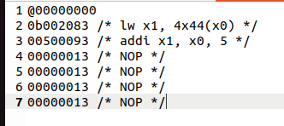
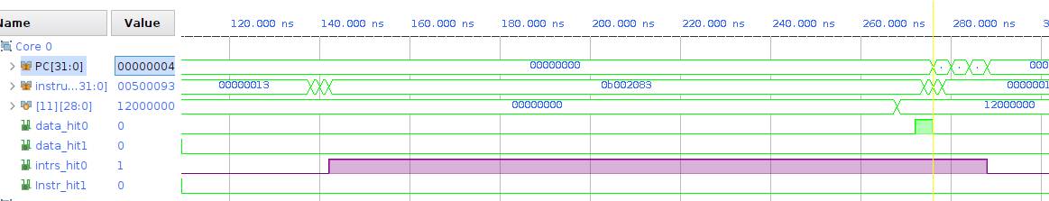
load_test.dat : instructions

Slide 11
Following parameters can be calculated
First instruction is the load instruction, total clock cycle needed = 276 ns
I-cache miss occurs
From 142 ns instr_hit0 line becomes high
D-cache miss occurs
It takes (276-142)ns = 134 ns
From 268 ns tag value got changed to exclusive state

Slide 12
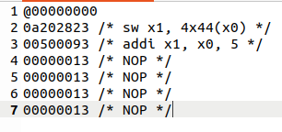
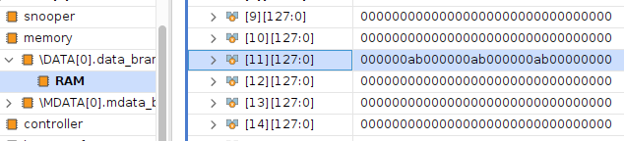
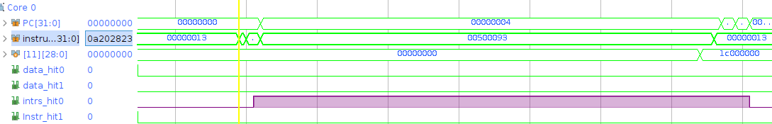
store_test.dat : instructions

Slide 13
Following parameters can be calculated
First instruction is the store instruction, total clock cycle needed = 144 ns
I-cache miss occurs
From 142 ns instr_hit0 line becomes high
From 144ns to 274 ns next instruction executes
Next instruction takes (274-144)ns = 130 ns
It is an Alu opearation(register-register) instruction, only need 4 ns
From 268 ns tag value got changed to modified state

Slide 14
My Findings
Instr_hit0, was initially 0, then switches to 1 for hit instructions
Data are brought to memory in case of store miss also
In case of load miss, PC is incrementing to 4, only after completing the load opeartion including I-miss and D-miss
In case of store miss, PC is incrementing to 4, only after finishing I-cache miss issue, while resolving D-cache miss issue, fetching data from memory, PC points to the next instruction, which elongates the execution of next instruction.

Slide 15
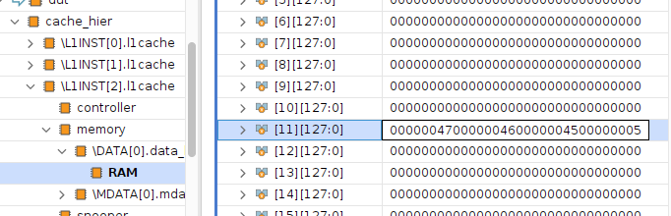
D-cache changed after store operation

Slide 16
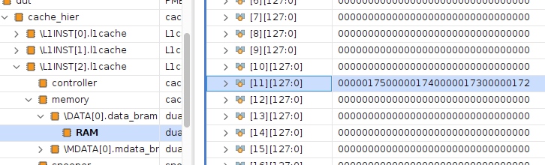
After load operation

Slide 17
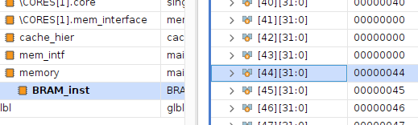
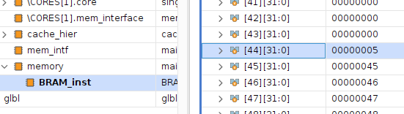
Memory written back

