Slide 1

Project Title -
Car Market Trends Analysis with Car Dekho Data
AICTE STU ID :
STU6a682c43b6ba21785211971
Student Name:
DEBLINA BISWAS

Slide 2

PROBLEM STATEMENT
Market Complexity: The used-car market includes vehicles with varying prices, fuel types, transmission types, and usage levels.
Pricing Uncertainty: It is difficult to determine which specific factors have the greatest impact on a vehicle's resale value.
Lack of Data Insights: Buyers and sellers lack data-driven tools to evaluate fair market value accurately.
Project Goal: Analyze historical Car Dekho data to identify market trends, pricing patterns, and key value drivers to support better pricing decisions.

Slide 3
Project Description
Overview: This project analyzes used-car market data from Car Dekho using Python for data analysis and visualization.
Dataset Variables: Key features examined include Car_Name, Year, Selling_Price, Present_Price, Kms_Driven, Fuel_Type, Seller_Type, Transmission, and Owner.
Objective: Identify relationships between vehicle attributes and selling price to deliver actionable insights for buying and selling decisions.

Slide 4

WHO ARE THE END USERS?
Car Buyers: To evaluate fair market prices and compare vehicle options.
Car Sellers: To set competitive and realistic listing prices.
Car Dealers: To understand customer demand and pricing trends.
Used-Car Businesses: To optimize inventory management and pricing strategies.
Data Analysts & Business Teams: To derive actionable commercial insights from automobile data.

Slide 5

Technology Used
Language: Python
Data Manipulation: Pandas, NumPy
Data Visualization: Matplotlib, Seaborn
Development Environment: VS Code / Jupyter Notebook / Google Colab

Slide 6
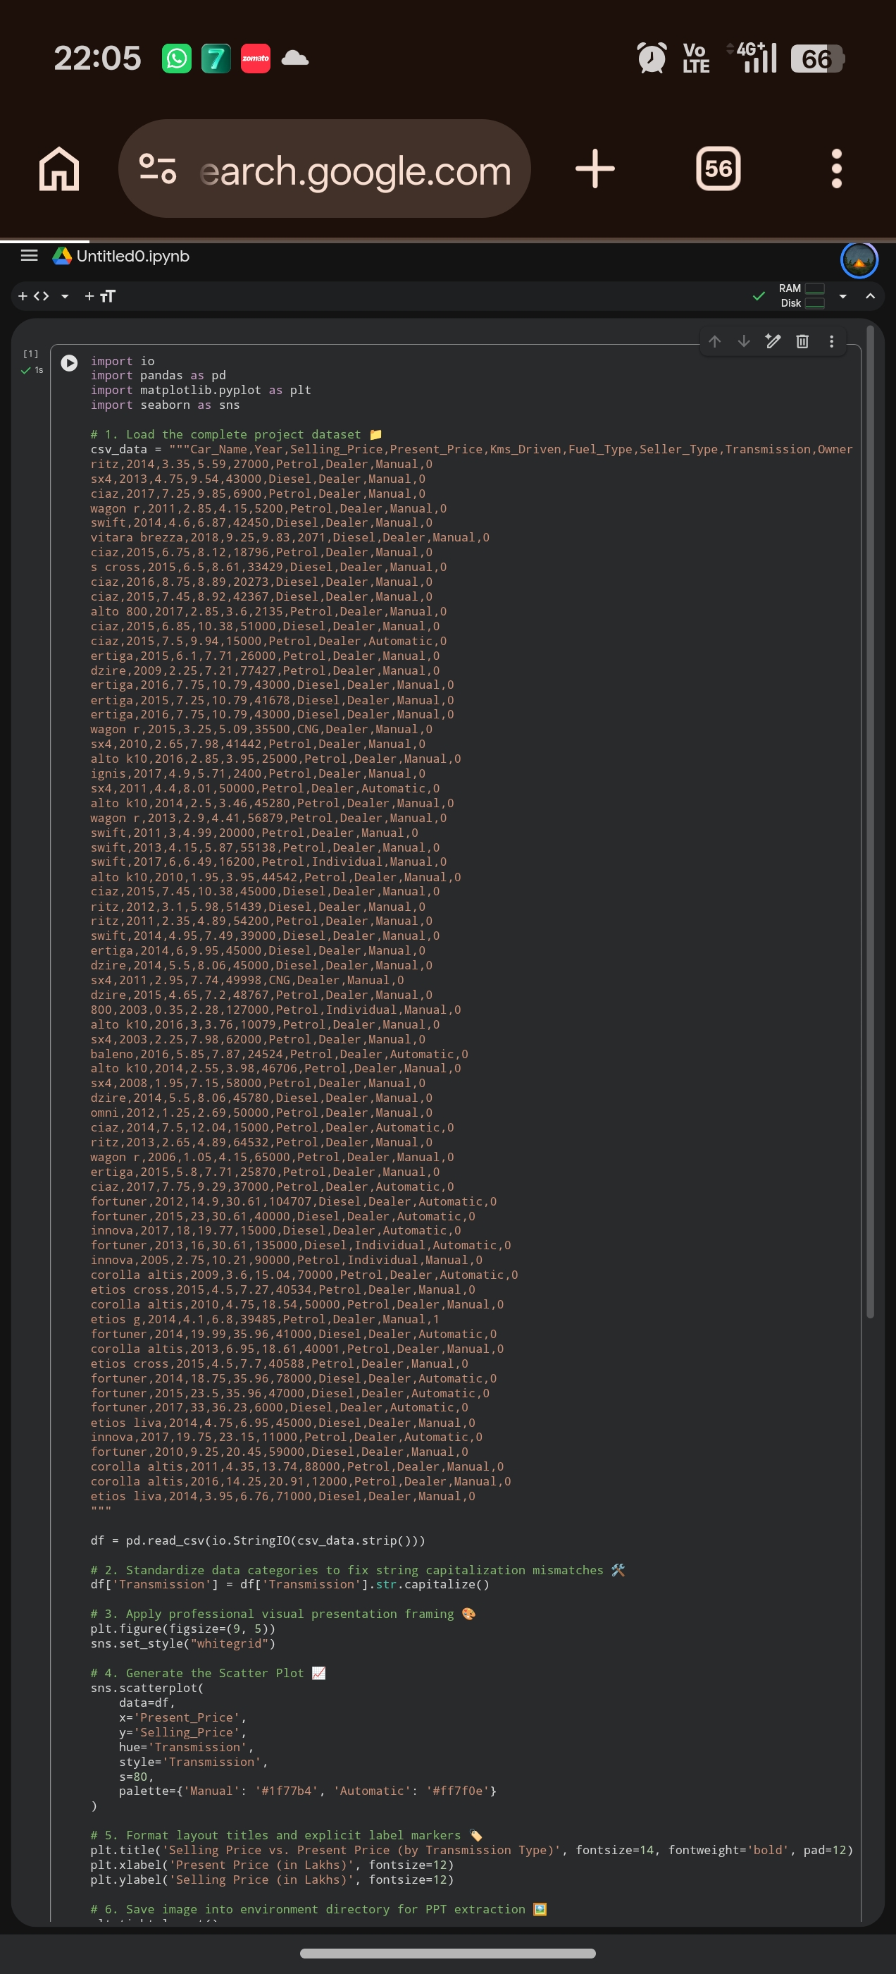
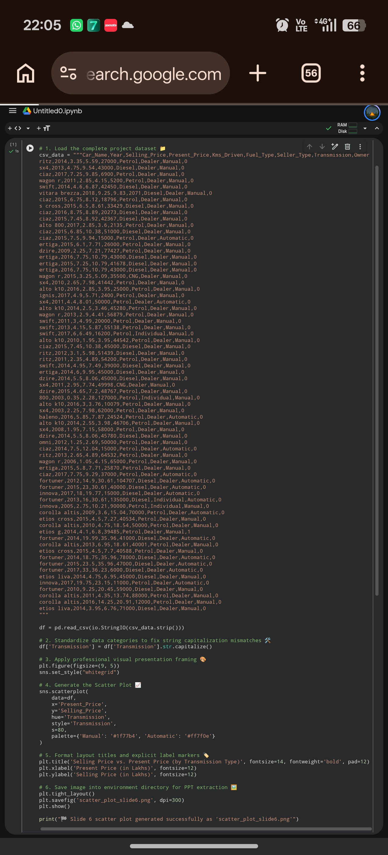
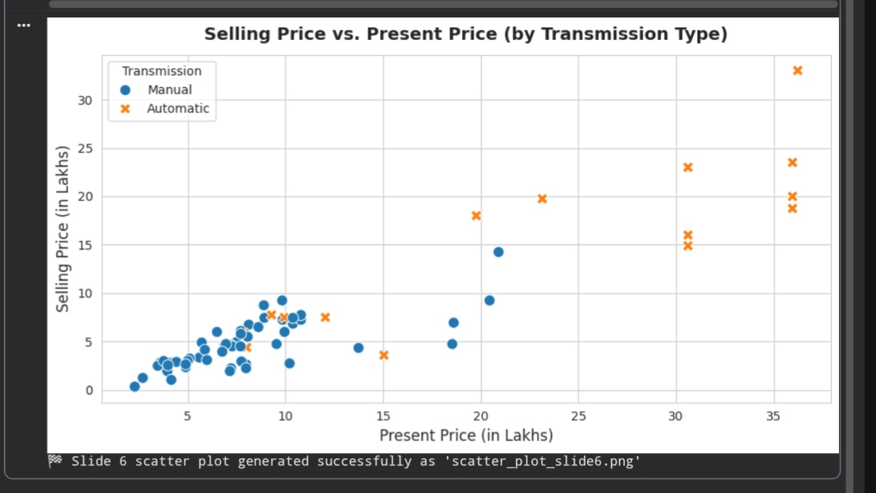
RESULTS
Key Bullet Insight: Cars with higher original prices (Present_Price) retain significantly higher resale value. Automatic transmission vehicles generally command higher selling prices than manual ones.
https://github.com/deblinabiswas2024-lang/Car-Market-Analysis/tree/main

Slide 7
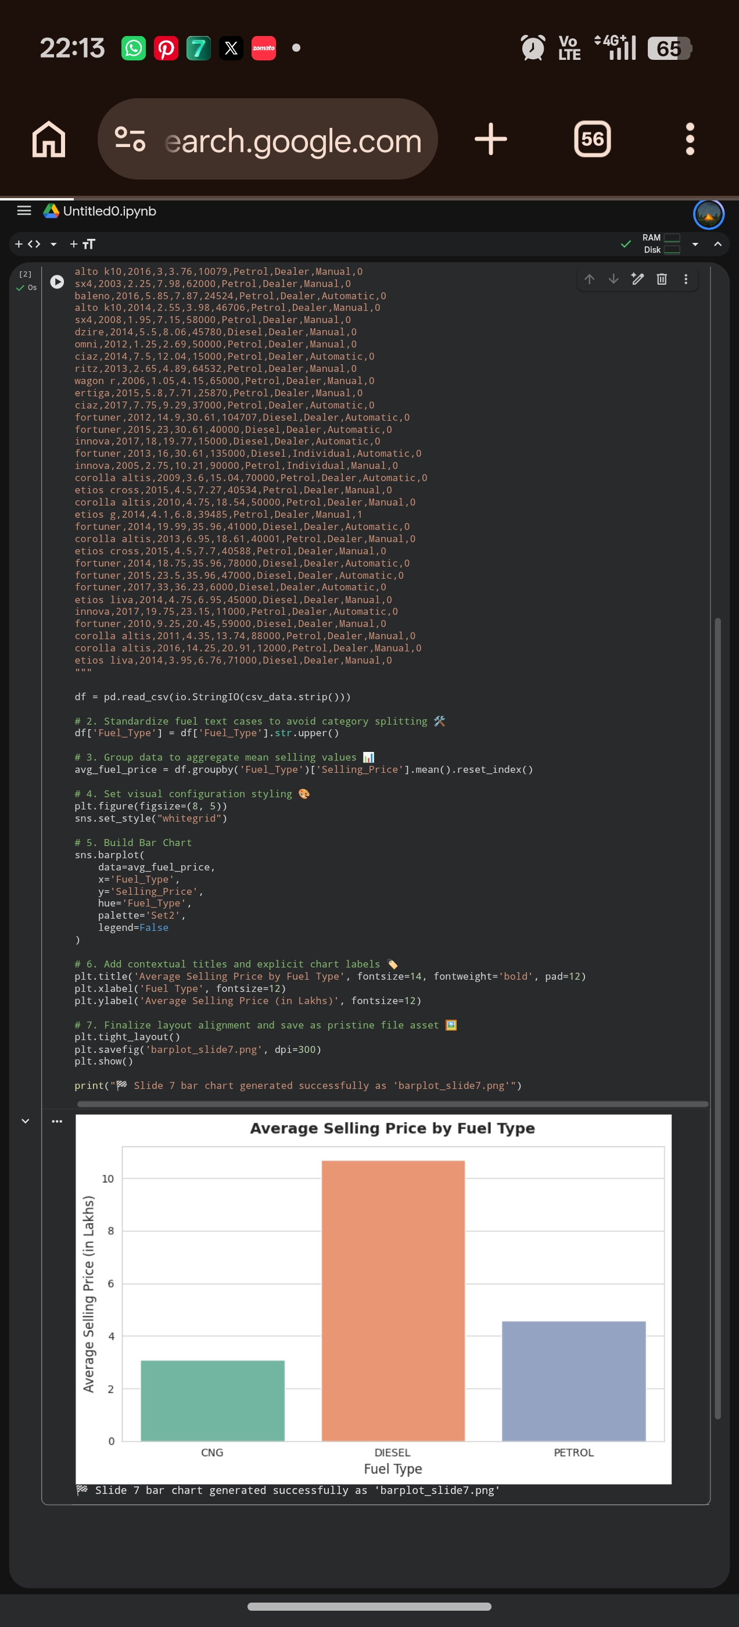
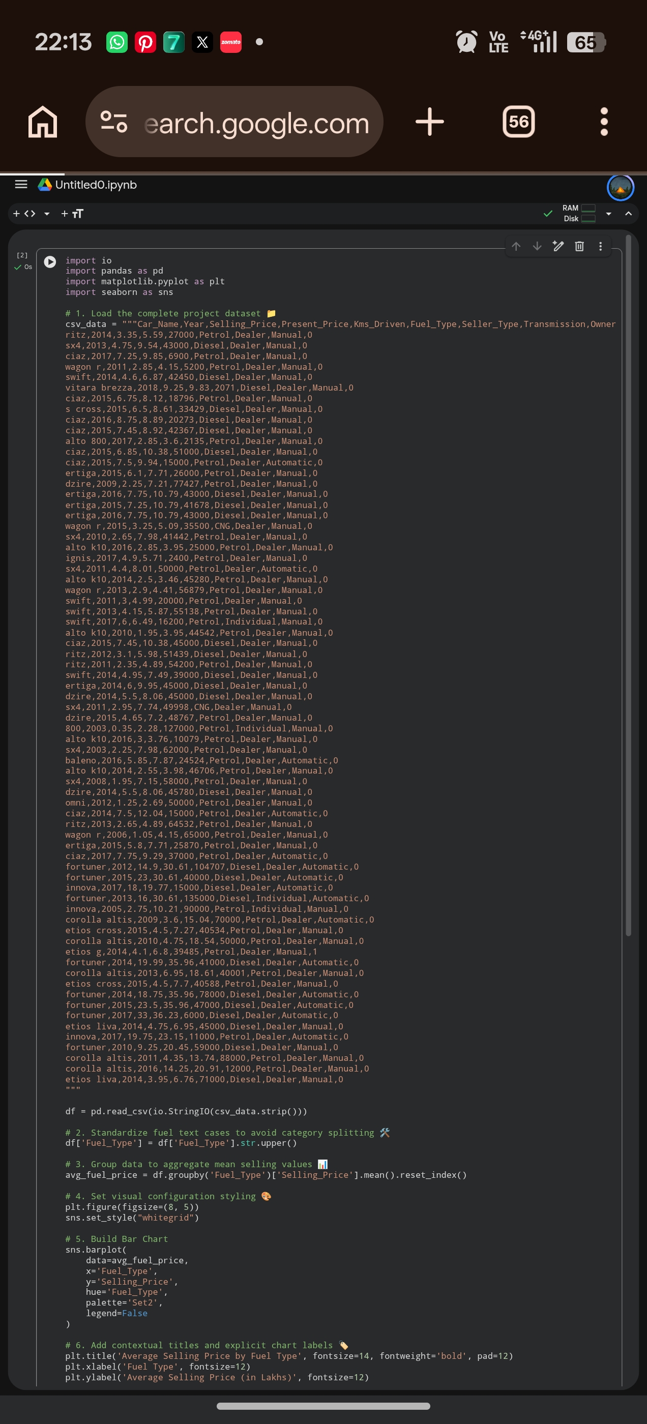
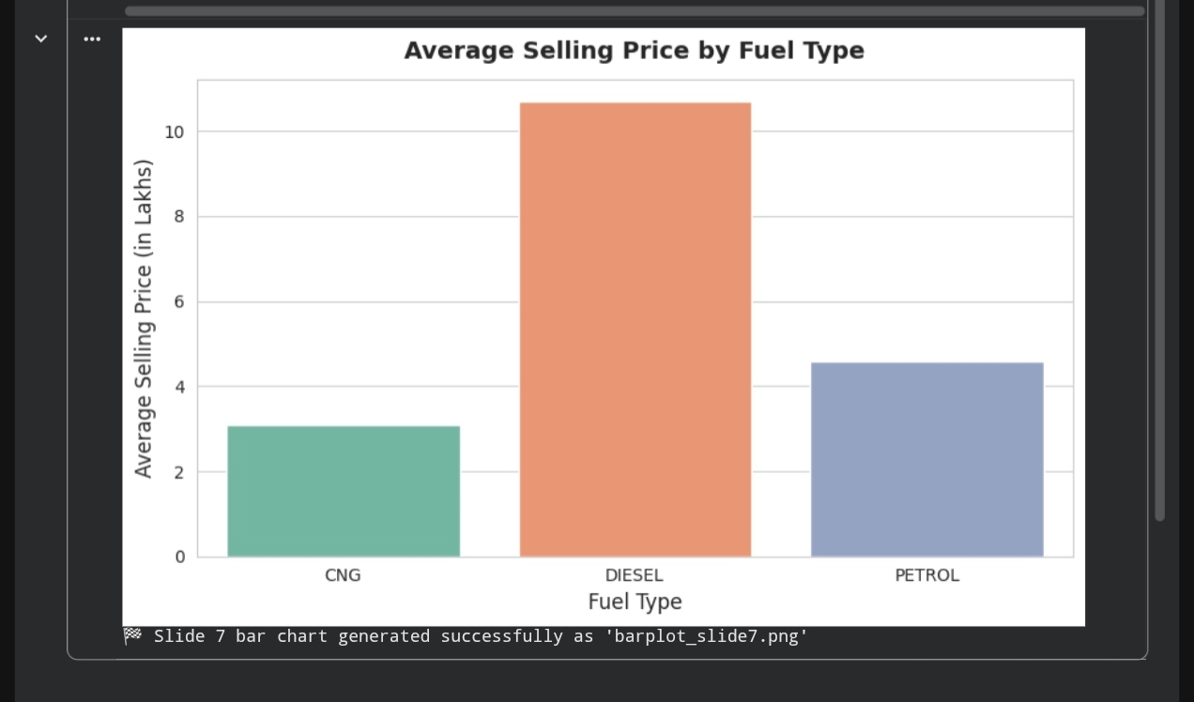
RESULTS
[Add screen shots of your code ]
Key Bullet Insights:
Diesel vehicles have a higher average resale price compared to Petrol and CNG vehicles.
Vehicle age has a strong negative correlation with selling price due to annual depreciation.
https://github.com/deblinabiswas2024-lang/Car-Market-Analysis/tree/main

Slide 8
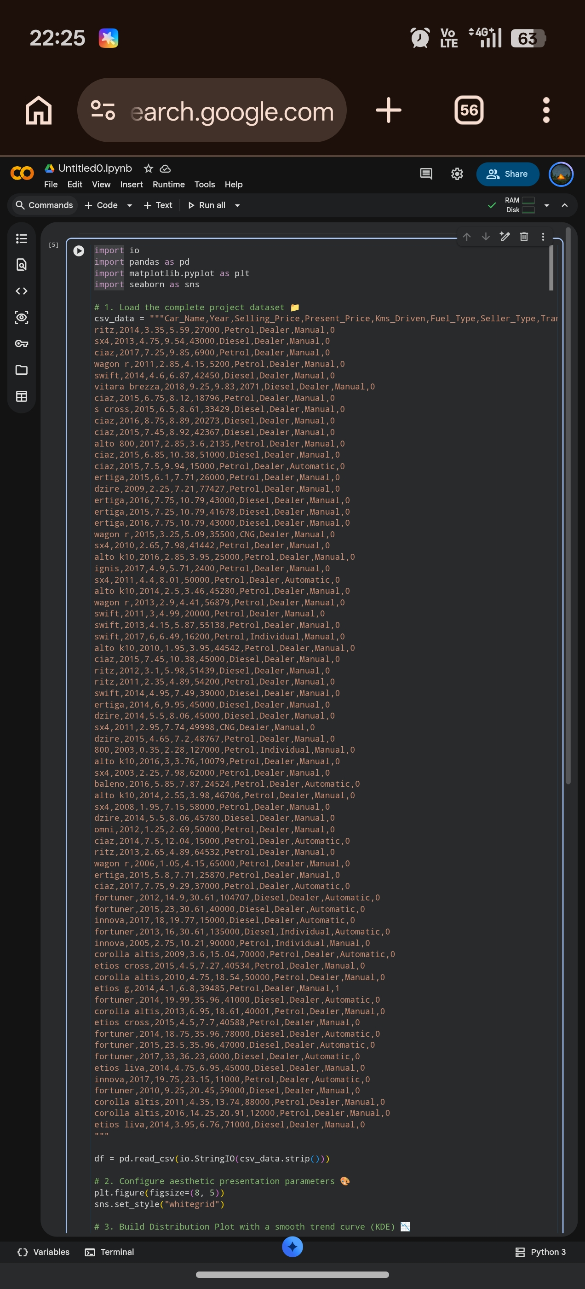
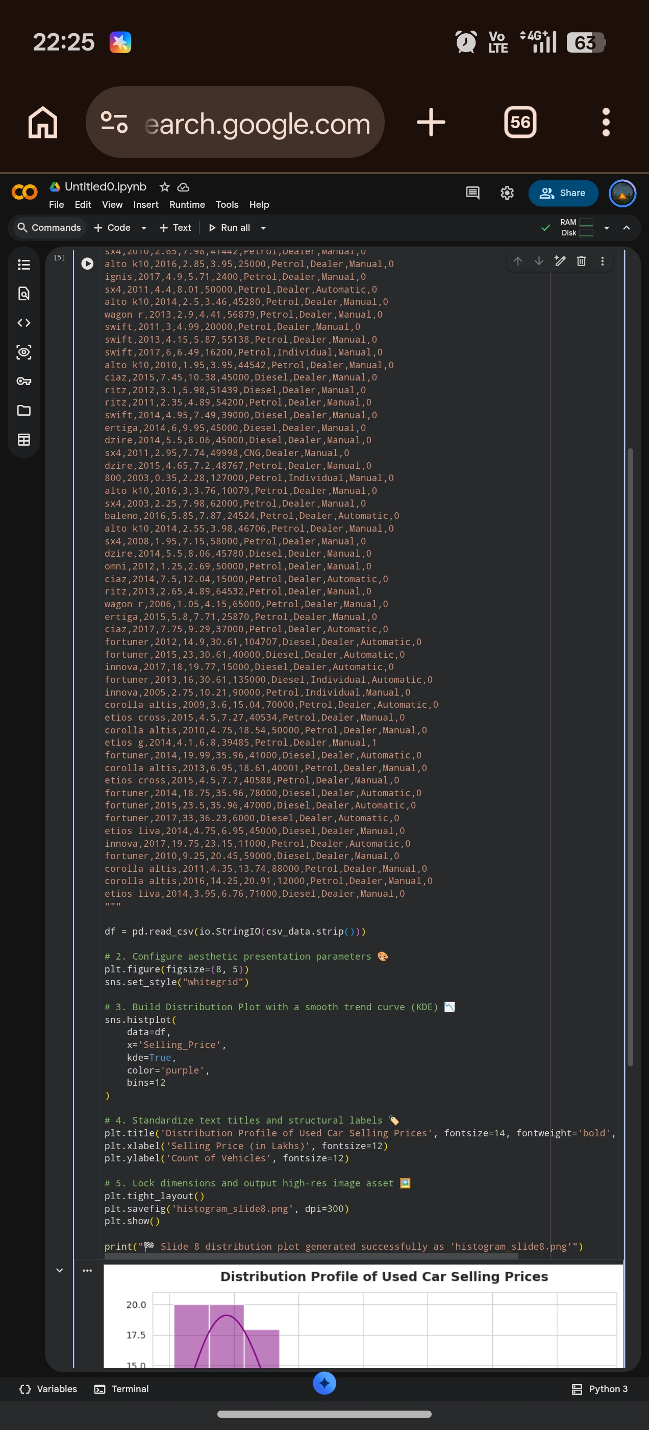
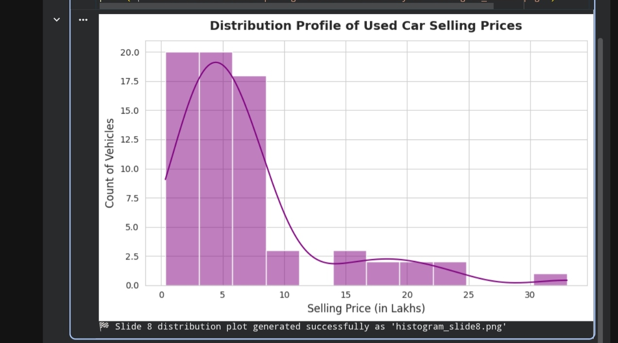
RESULTS
[Add screen shots of your code ]
Price Concentration: Most cars sell below 5 Lakhs.Right-Skewed Data: Distribution peaks at lower price brackets.Premium Outliers: Elite luxury models reach up to 33 Lakhs.Budget Dominance: Affordable options drive total market volume.
https://github.com/deblinabiswas2024-lang/Car-Market-Analysis/tree/main

Slide 9
Thank you
.
.

