Slide 1

Project Title- Seasonal Agriculture Performance Analysis
Student Name: Deblina Biswas
College Name- University of Calcutta (Technology Campus)
AICTE STU ID : STU6a682c43b6ba21785211971

Slide 2

PROBLEM STATEMENT
Agricultural activities are influenced by seasonal variations in environmental conditions, farming practices, resource availability, and market conditions. As a result, agricultural performance may differ from one season to another.
Raw agricultural data does not clearly explain how agricultural performance changes across seasons or what patterns can be observed in different seasonal conditions.
The objective is to analyze the given agricultural dataset and investigate seasonal differences in agricultural performance by identifying meaningful patterns, trends, relationships, and variations within the available data.

Slide 3
Project Description
Core Objective: Conduct an end-to-end data analytics study on 4,000 farm profiles across Kharif, Rabi, and Zaid seasons to evaluate productivity, resource utilization, and financial viability.
Data Preprocessing: Imputed missing values across environmental and output metrics (Rainfall, Soil Moisture, and Yield) using median values grouped by season and crop type to maintain distribution integrity.
Analytical Scope: Evaluated seasonal yield variations, calculated water use efficiency across irrigation methods, and quantified revenue, input costs, and net profit margins.
Evidence-Based Findings: Translated statistical patterns into actionable operational recommendations for sustainable seasonal farming planning.

Slide 4

WHO ARE THE END USERS?
Individual Farmers & Farmer Producer Organizations (FPOs): For data-driven crop selection, input budgeting, and scheduling seasonal sowing based on climate patterns.
Agricultural Extension Officers & KVKs: For formulating localized advisory on irrigation methods, fertilizer thresholds, and pest control timings.
Agritech Firms & Rural Financial Institutions: For assessing farm-level productivity, evaluating seasonal credit risks, and structuring agricultural insurance.
Policymakers & Water Resource Authorities: For regional canal water allocation, input subsidy targeting, and drought mitigation planning.

Slide 5

Technology Used
  Programming Language: Python 3.x
  Core Libraries:
  Pandas: Data manipulation, seasonal grouping, imputation, and metric aggregation.
  NumPy: Mathematical calculations and numerical array processing.
  Matplotlib & Seaborn: Statistical chart generation, distribution plots, and correlation heatmaps.
  Platform & Tools: Google Colab, Jupyter Notebook, GitHub.

Slide 6
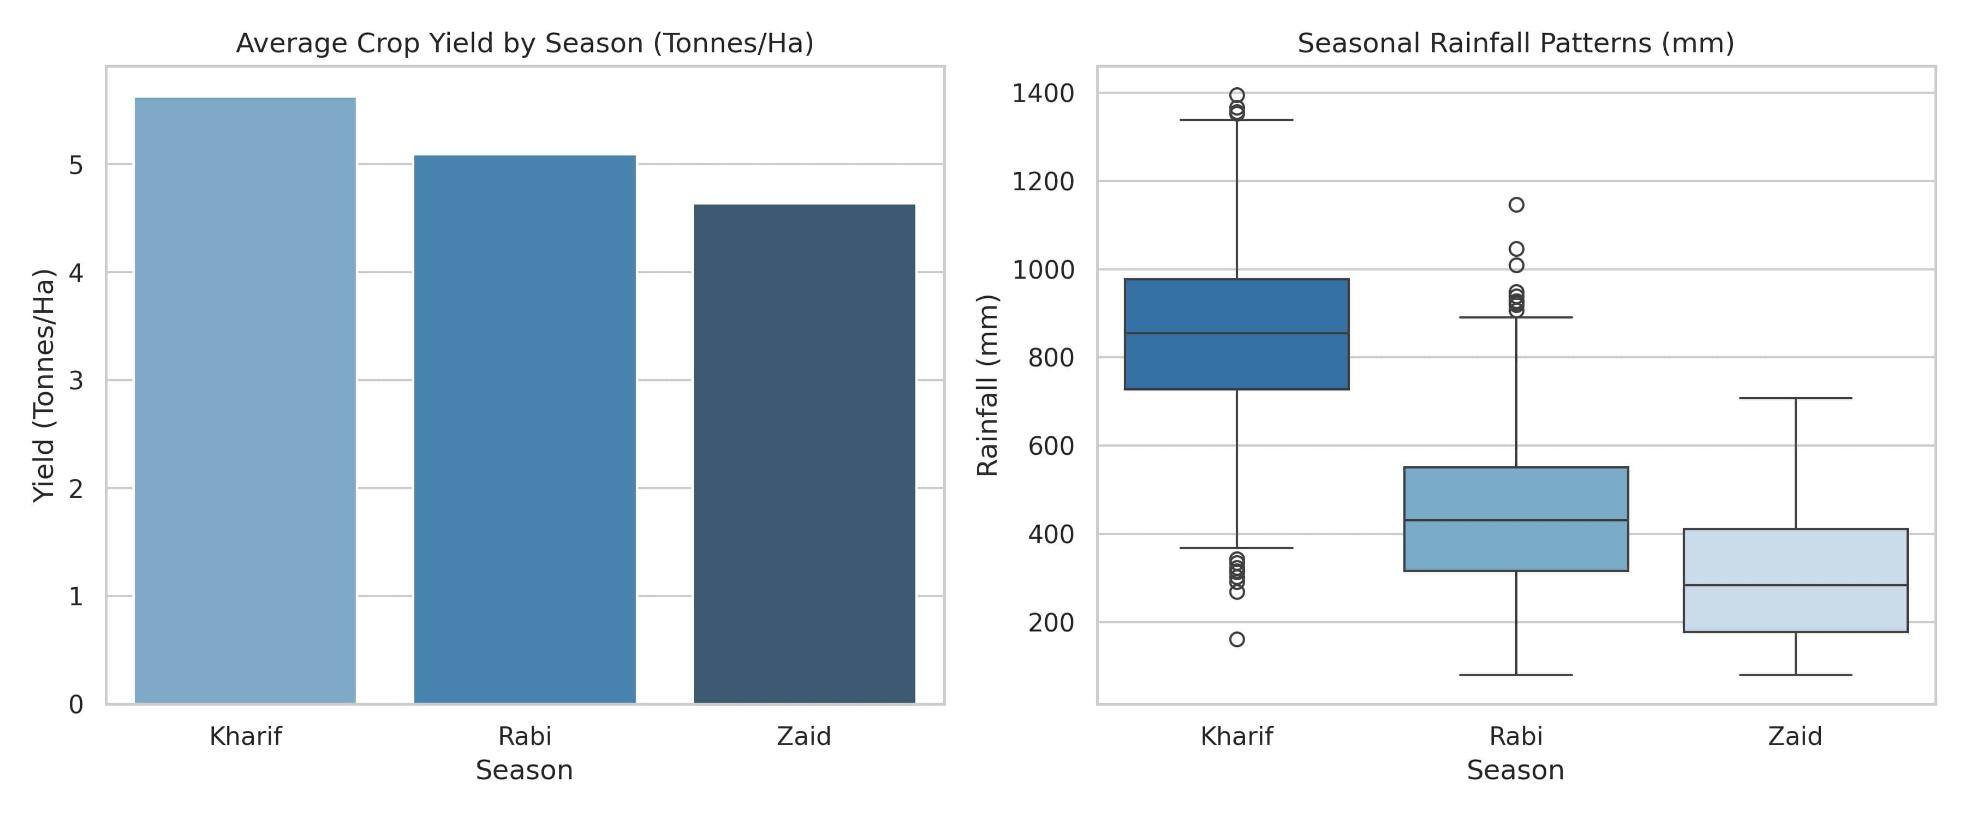
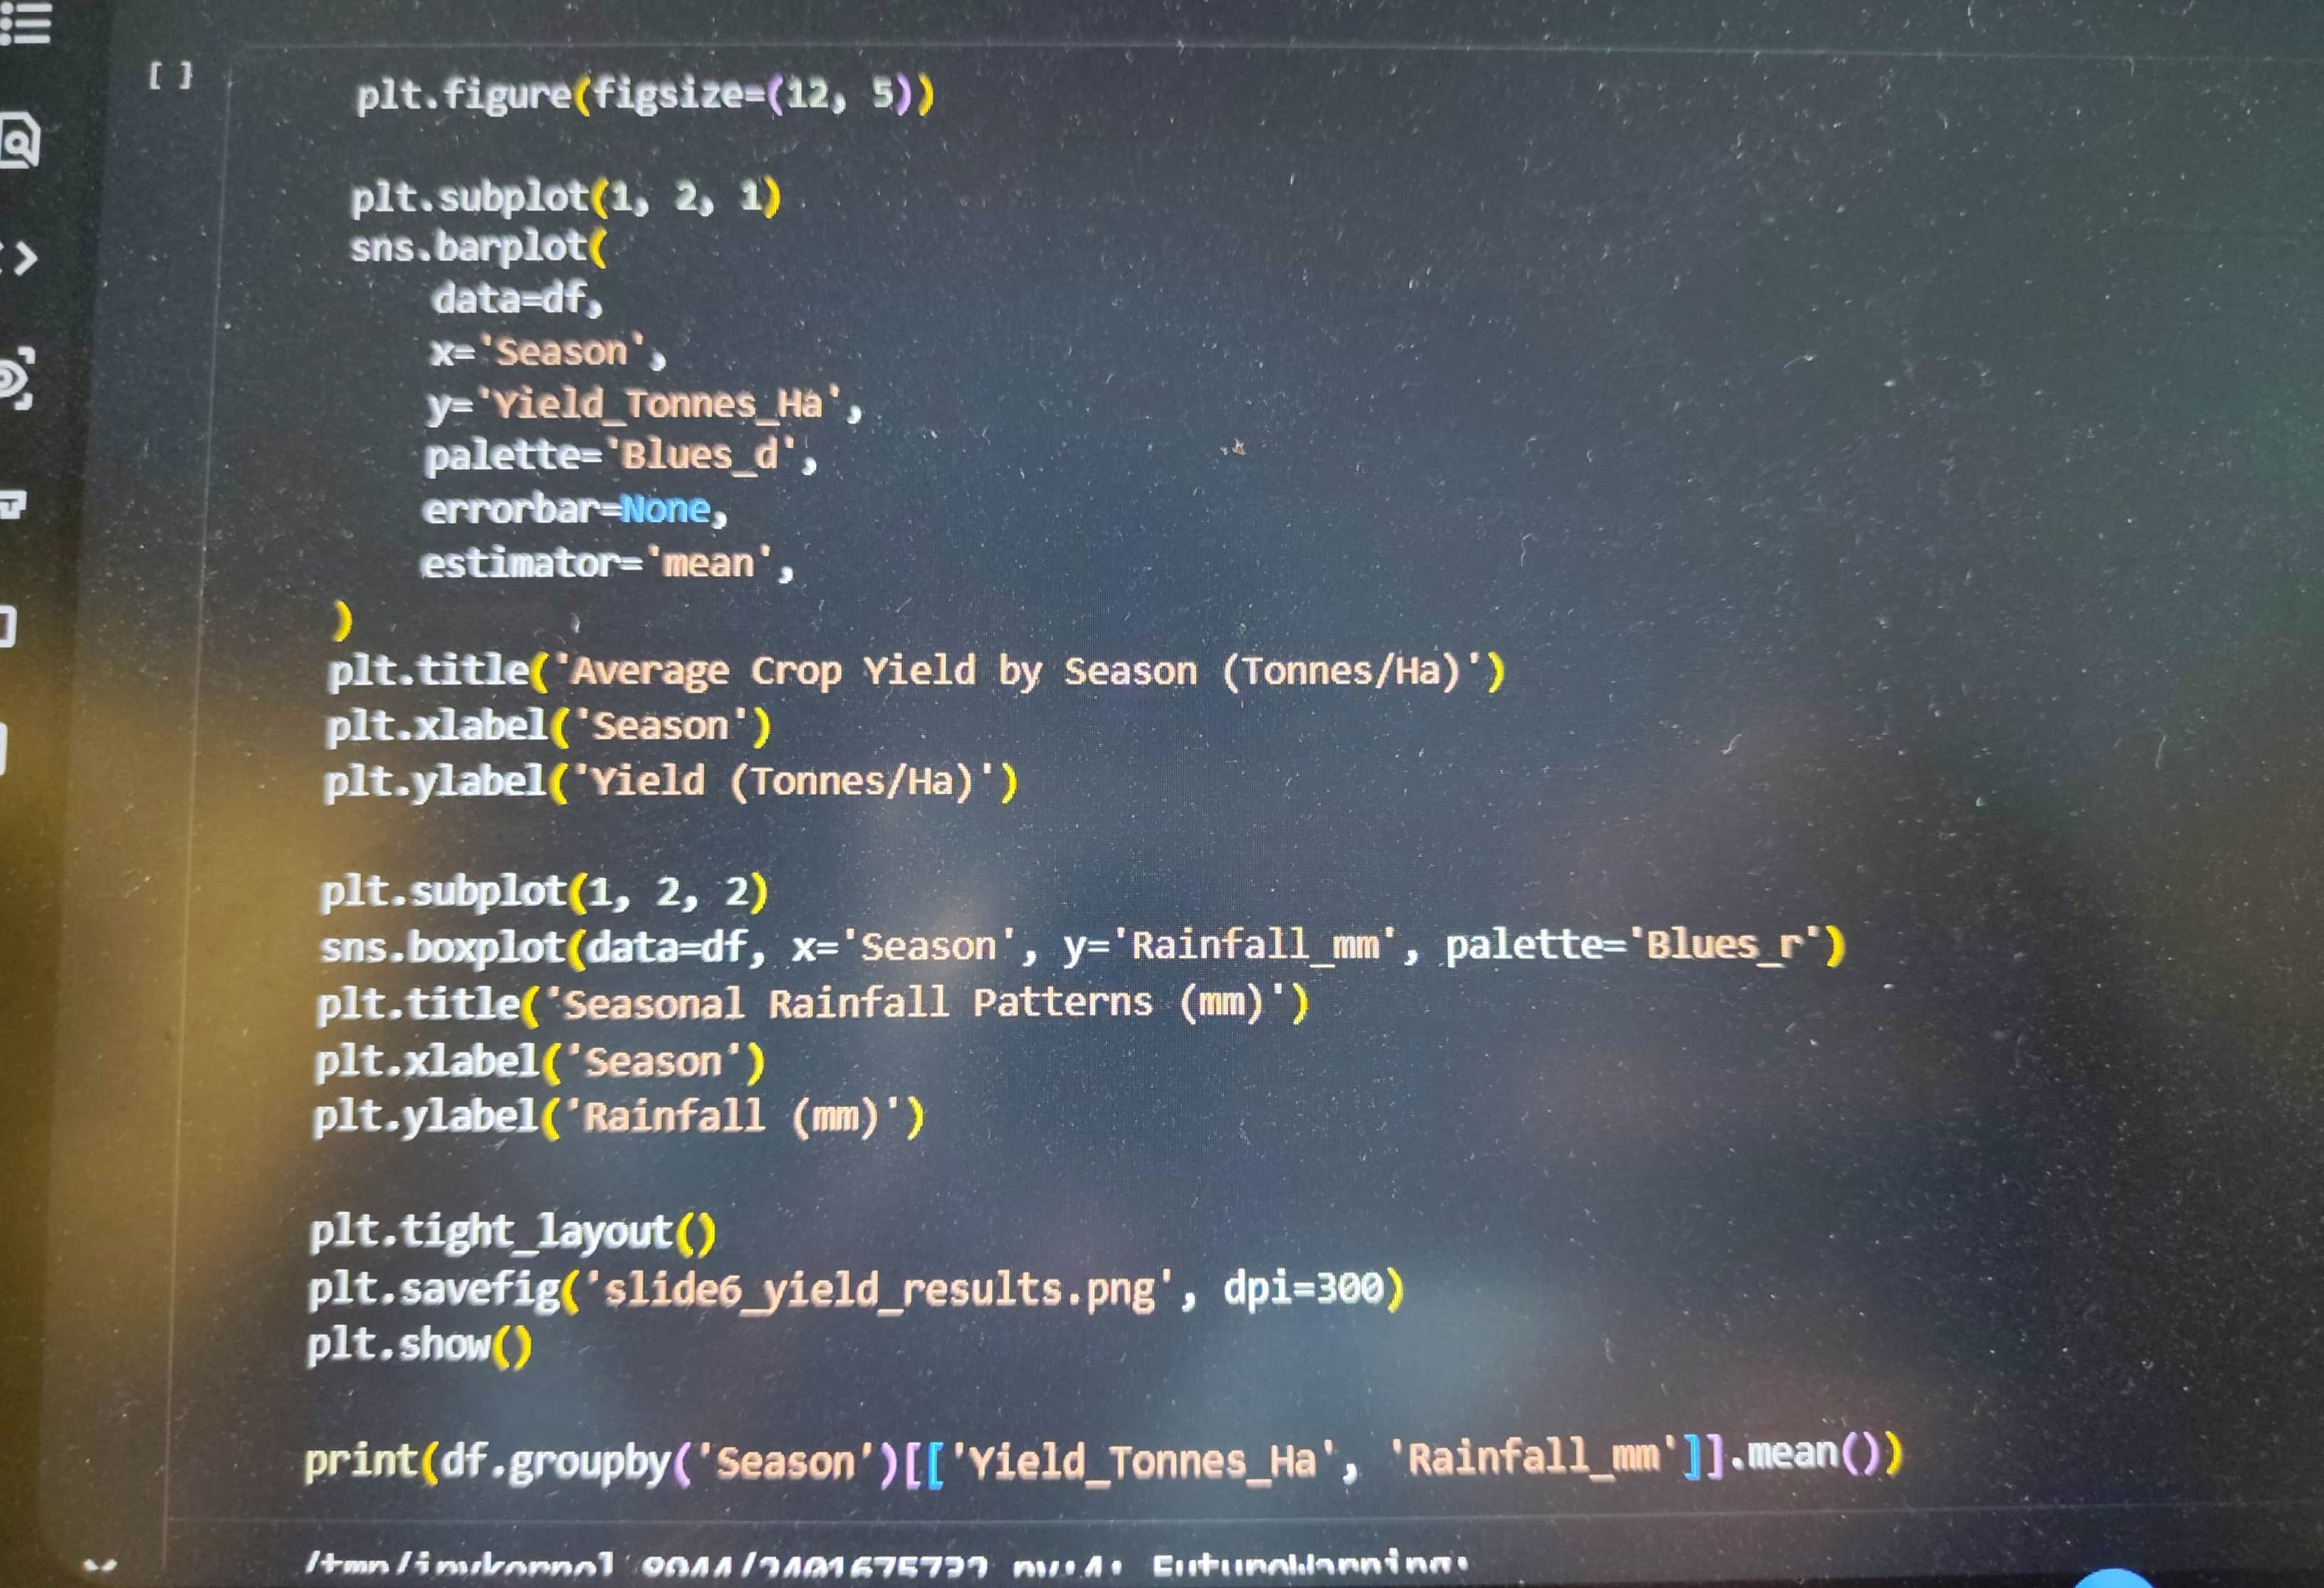
RESULTS – Seasonal Crop Yield & Productivity
Kharif Season Peak: Records the highest average yield at 5.63 tonnes/ha, heavily supported by peak monsoon rainfall averaging 852.11 mm.
Rabi Season Stability: Delivers consistent productivity averaging 5.09 tonnes/ha with moderate rainfall (435.94 mm), effectively utilizing residual soil moisture.
Zaid Season Deficit: Displays the lowest mean yield at 4.64 tonnes/ha due to dry conditions, limited rainfall (299.12 mm), and elevated thermal stress.

Slide 7
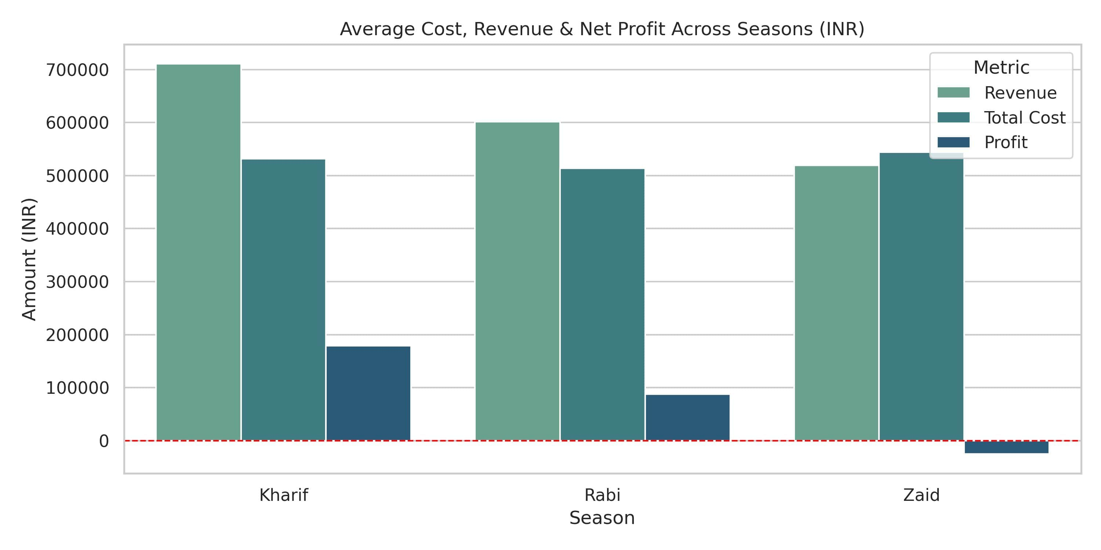
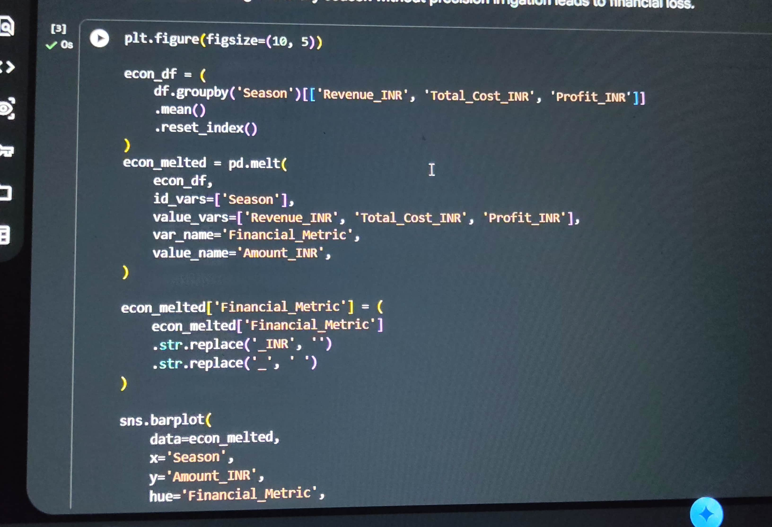
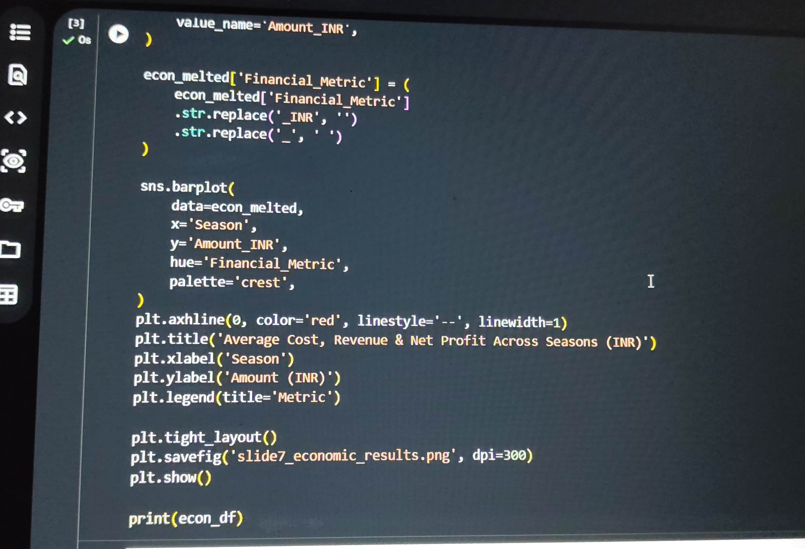
RESULTS – Economic Performance & Farm Profitability
Kharif Surplus: Delivers the highest net return, generating an average profit of ₹1,78,915 per farm on ₹7.11 Lakh average revenue.
Rabi Operating Margin: Maintains stable profitability with an average net profit of ₹87,689 per farm on ₹6.02 Lakh revenue.
Zaid Economic Losses: Operates at an average net deficit of -₹24,805 per farm, as total cultivation costs remain high (₹5.44 Lakh) while seasonal revenue drops to ₹5.19 Lakh.

Slide 8
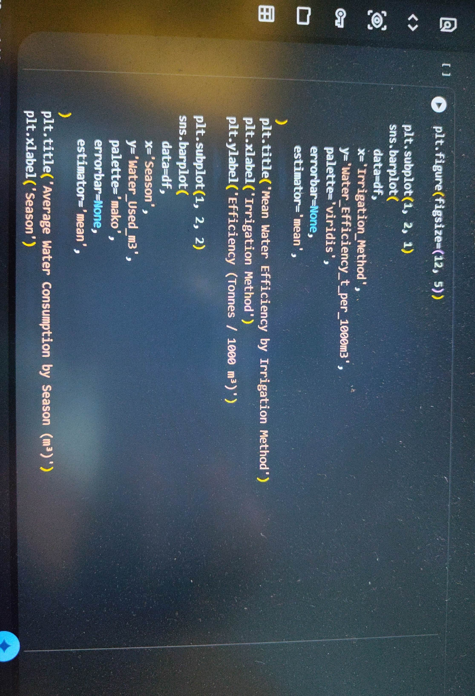
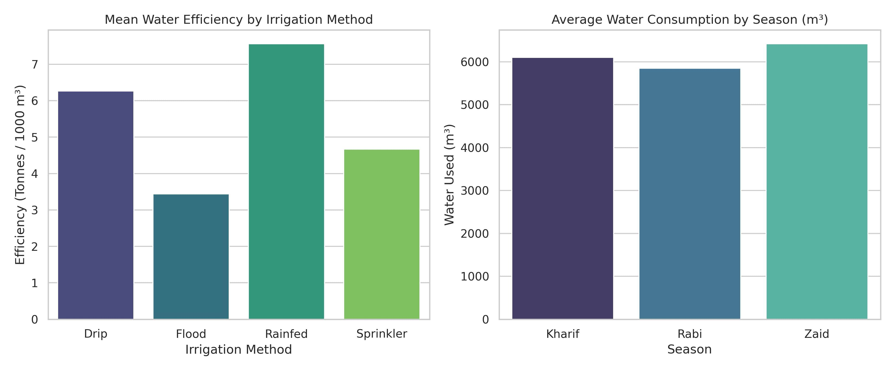
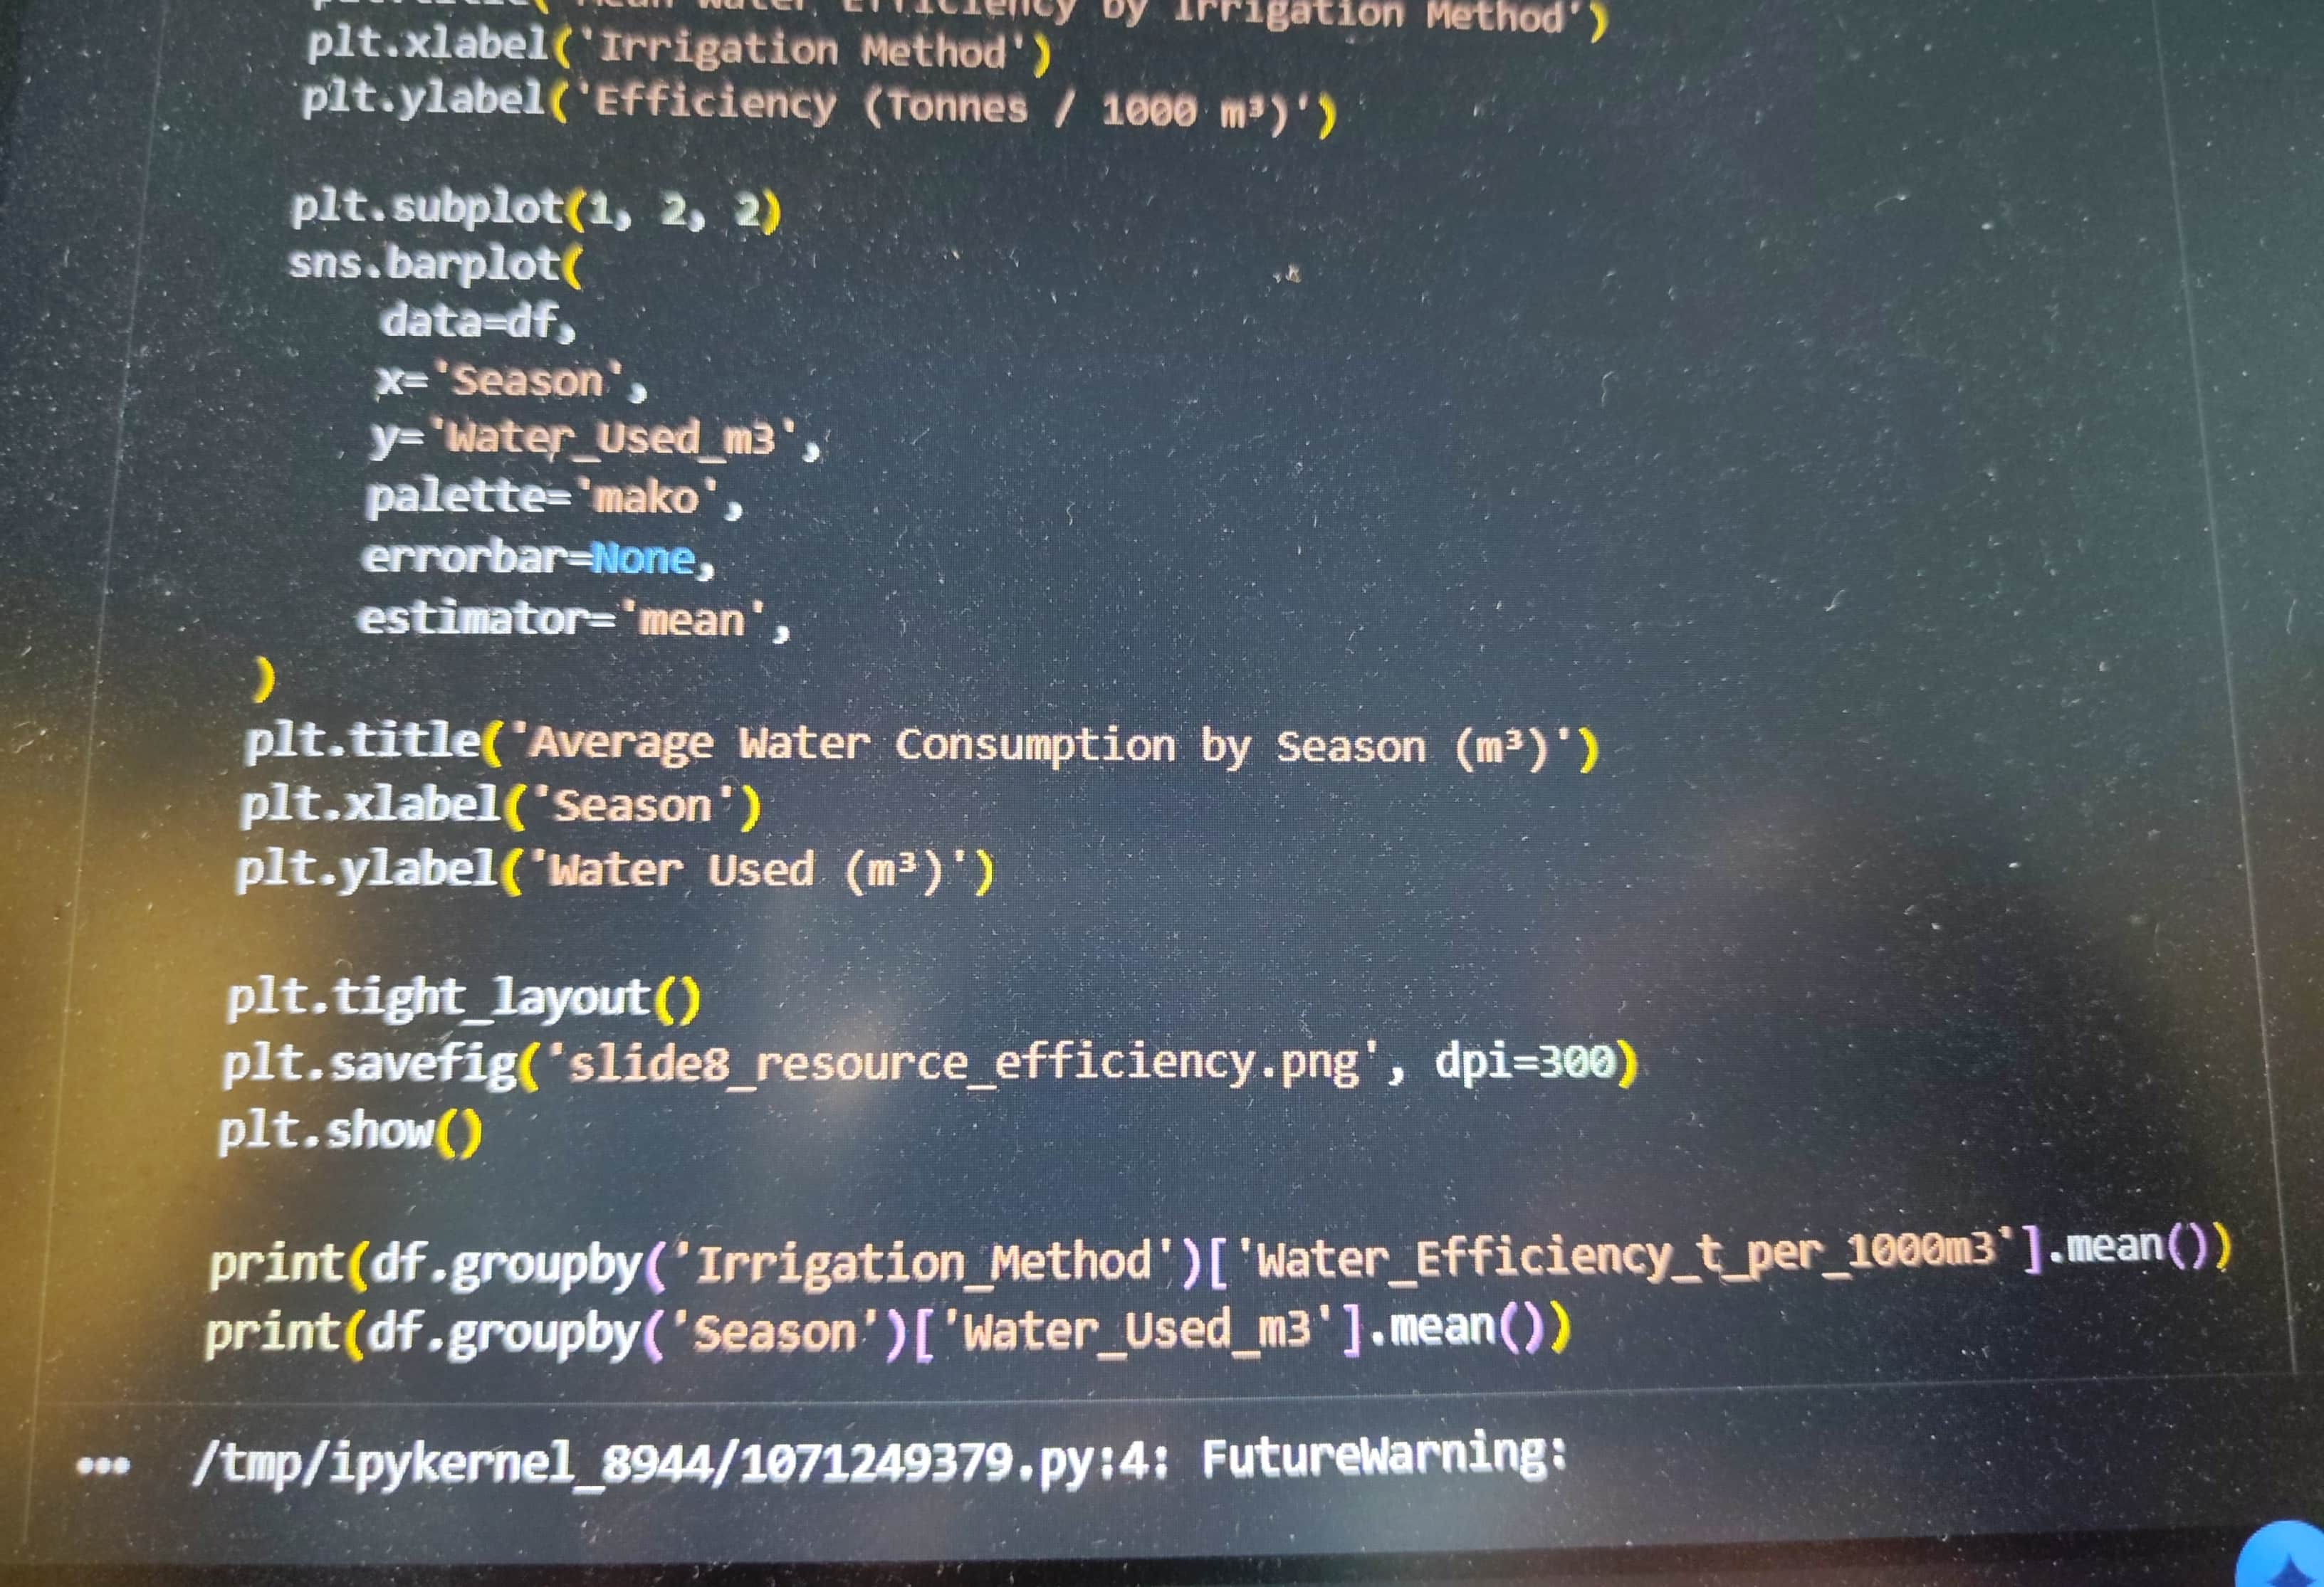
RESULTS – Resource Usage & Irrigation Efficiency
Micro-Irrigation Advantage: Drip systems achieve high water efficiency (6.27 tonnes / 1000 m³), outperforming conventional Flood irrigation (3.44 tonnes / 1000 m³).
Rainfed Crop Efficiency: Rainfed setups show strong baseline water efficiency (7.56 tonnes / 1000 m³) by relying directly on monsoon precipitation.
Seasonal Water Demand: Total water usage peaks during Zaid (6,419.89 m³) due to intense evaporation and dry soil conditions.

Slide 9
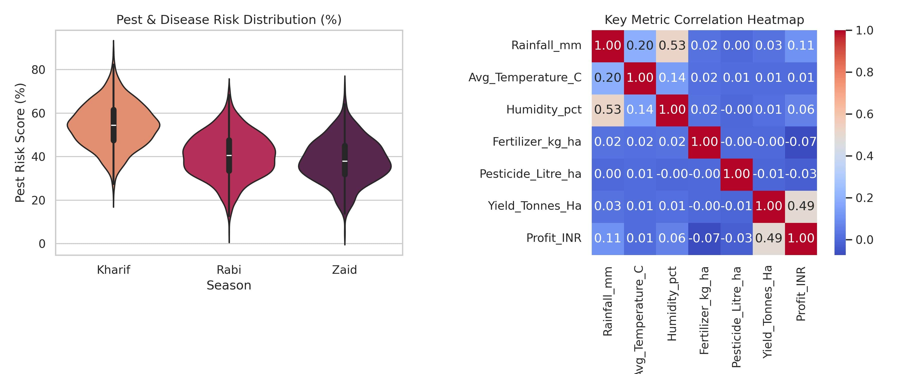
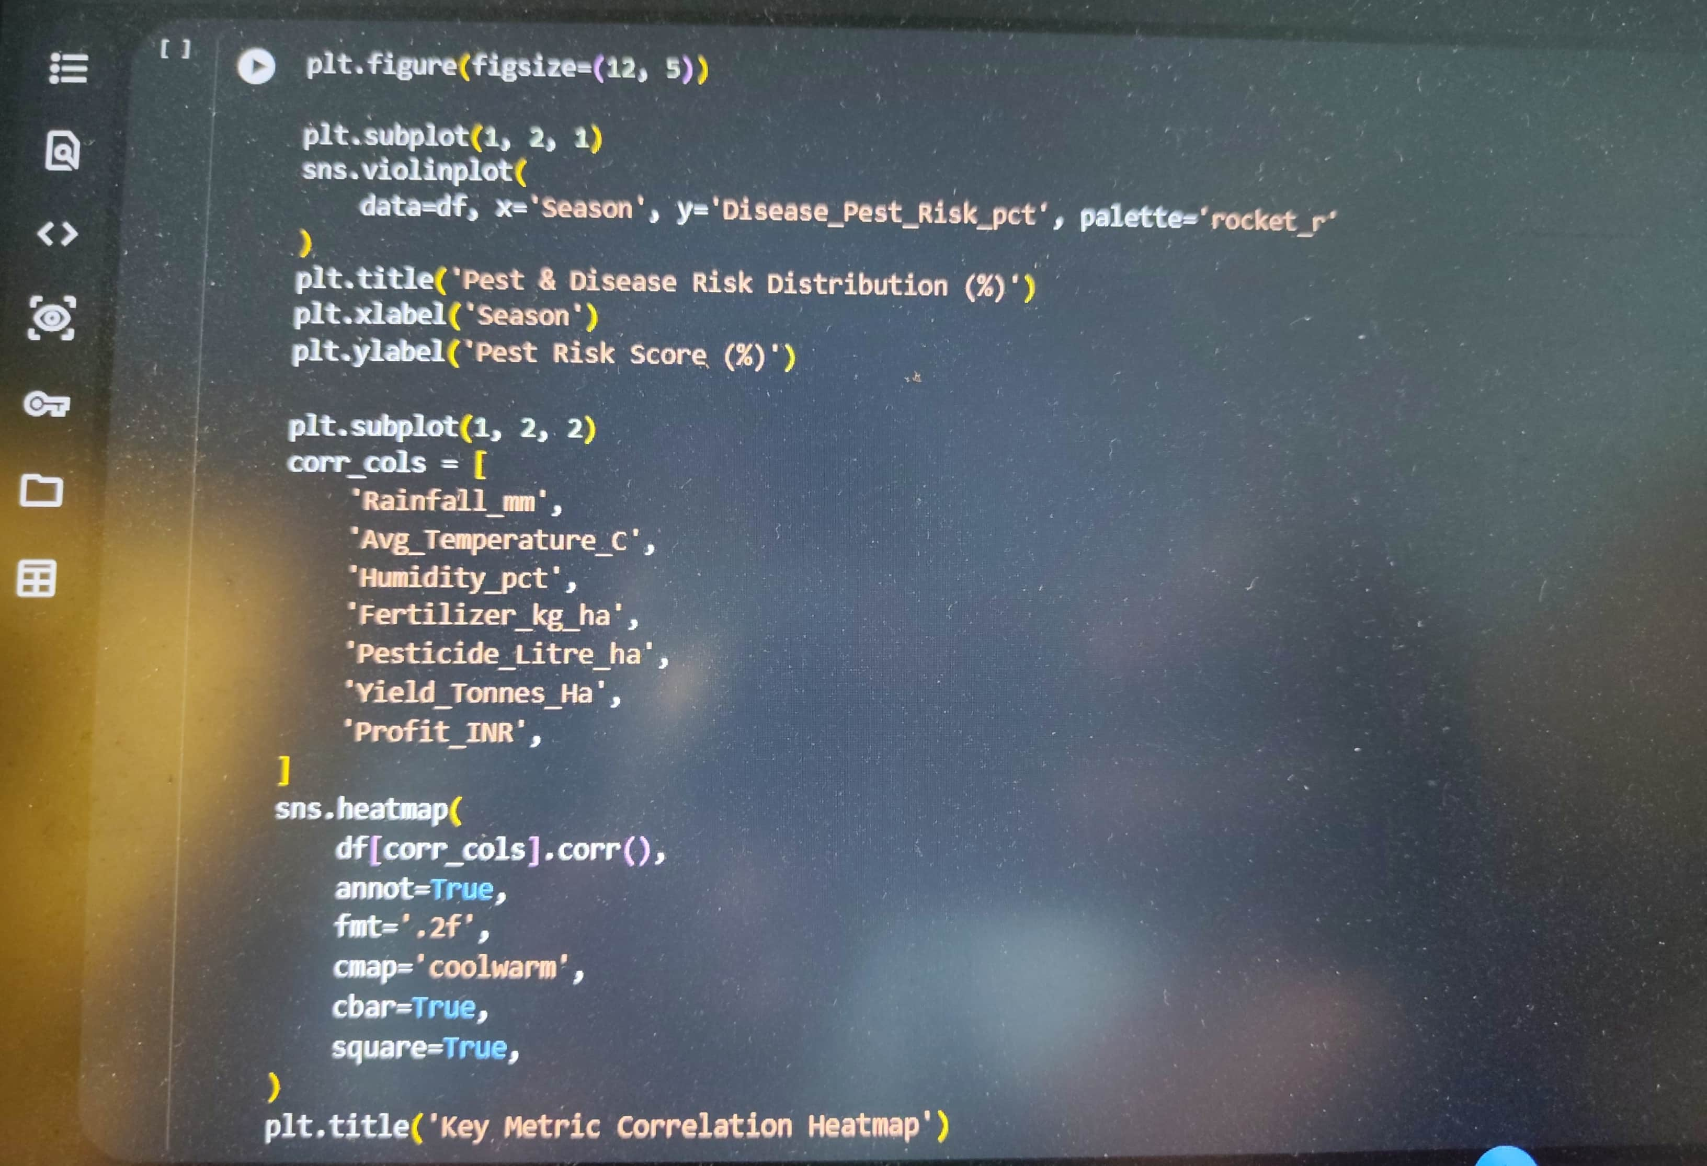
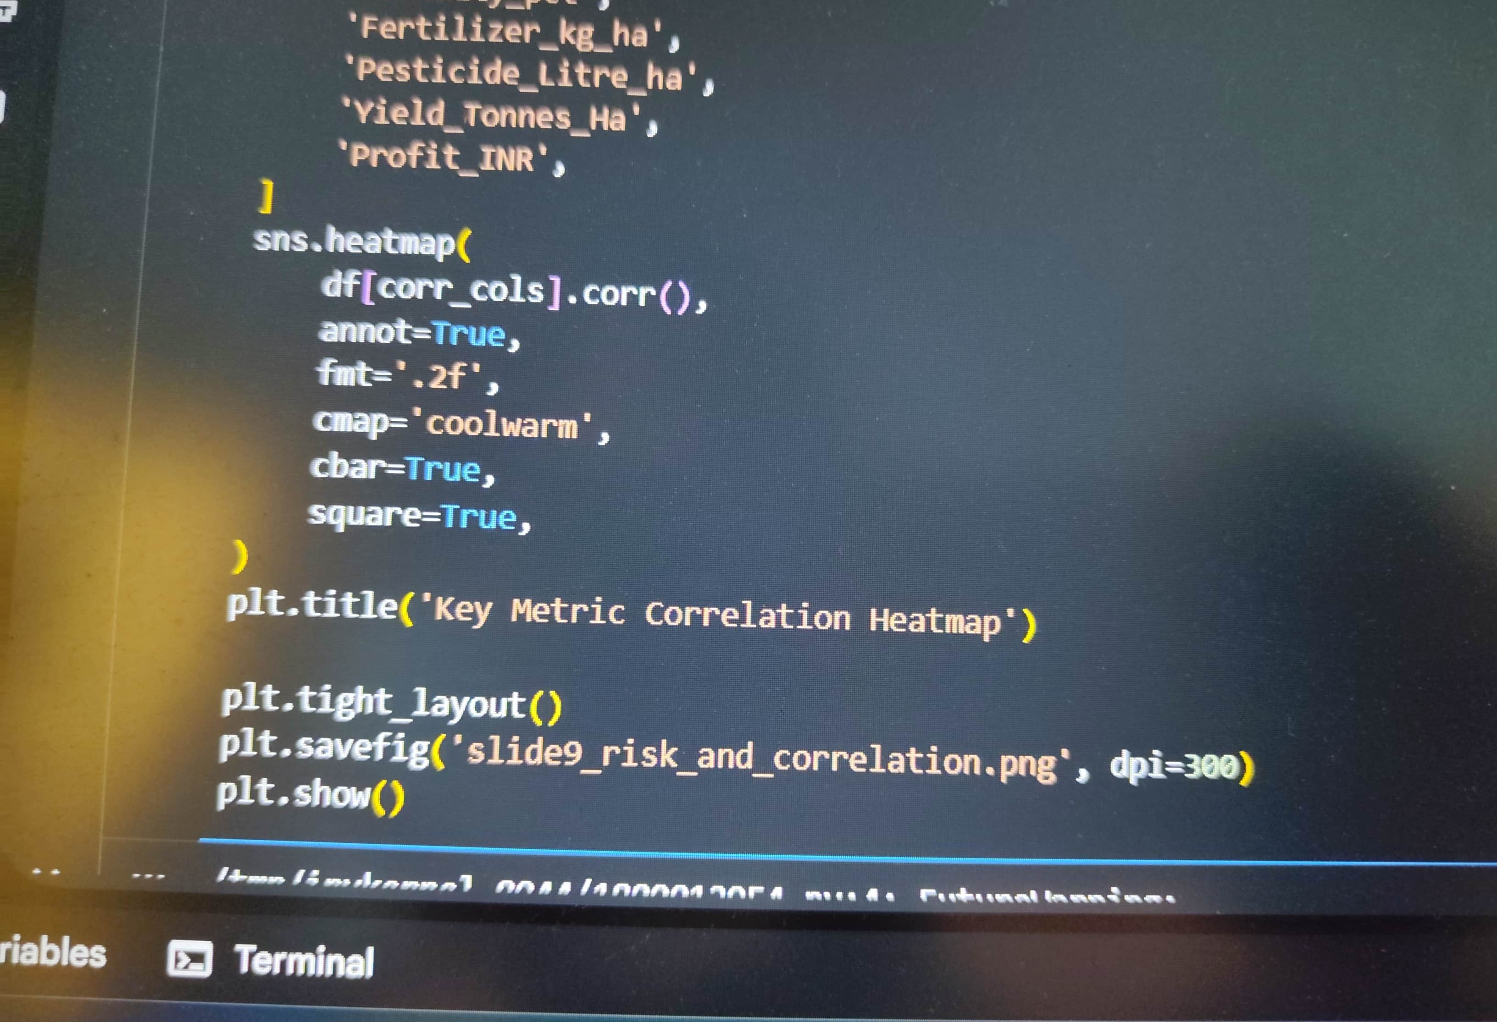
RESULTS – Environmental Risk & Feature Correlation
Pest & Disease Pressure: High ambient humidity and elevated temperatures across summer and monsoon months drive up disease and pest risk scores.
Rainfall & Humidity Coupling: Correlation analysis reveals a strong positive association (r = 0.53) between rainfall levels and humidity.
Input Overutilization: Excessive chemical fertilizer and pesticide application above soil-calibrated thresholds does not yield proportional productivity gains, inflating costs without boosting profit margins.

Slide 10
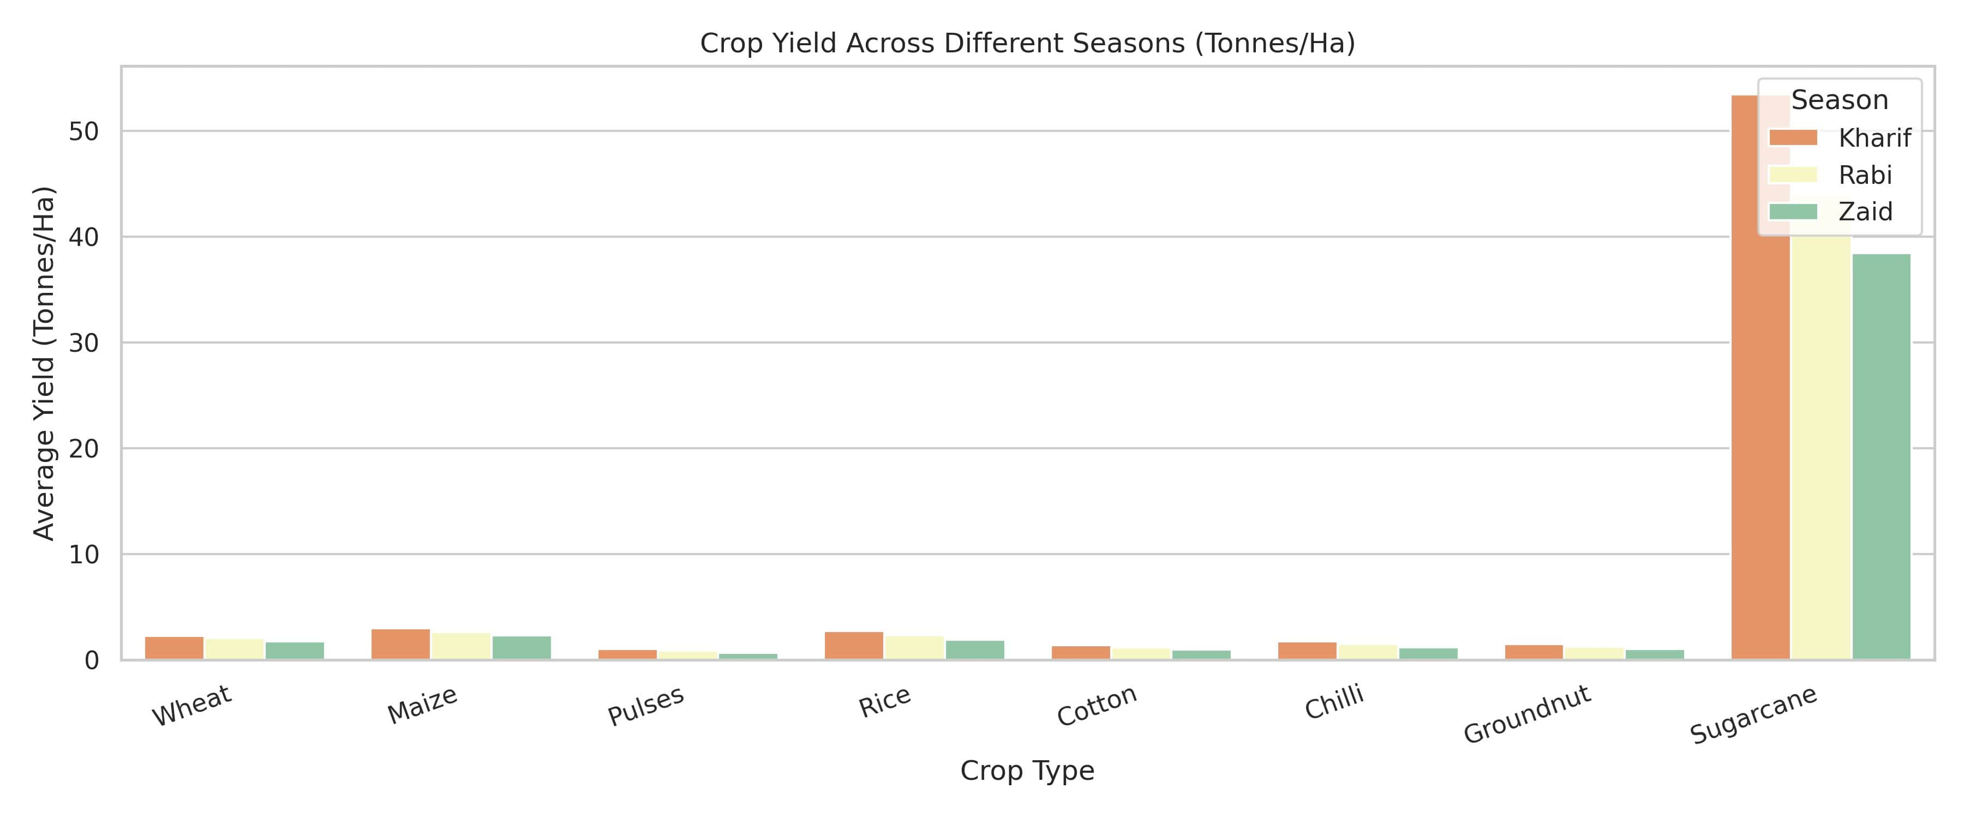
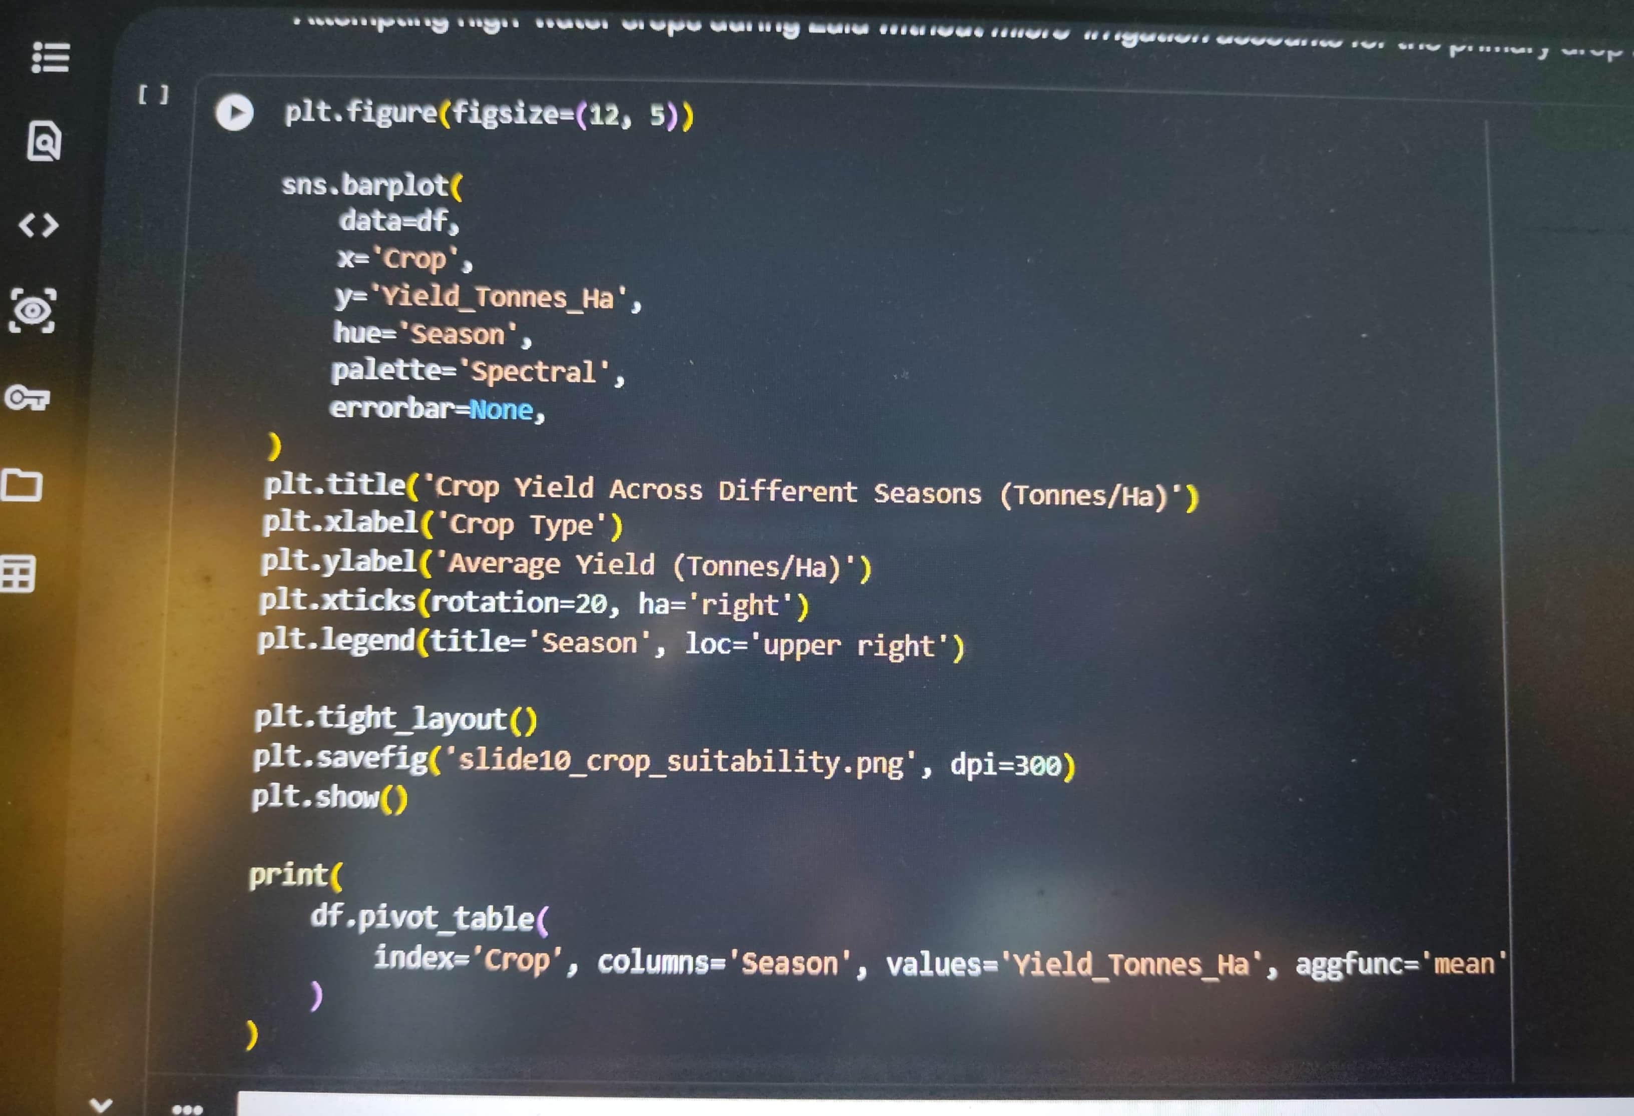
RESULTS – Crop-Specific Seasonal Performance
Heavy Biomass Crops: Sugarcane attains peak yields during Kharif (53.46 t/ha), tapering to 43.96 t/ha in Rabi and 38.42 t/ha in Zaid.
Grain & Commercial Crops: Maize (2.97 t/ha), Rice (2.71 t/ha), and Wheat (2.26 t/ha) exhibit their strongest performance in Kharif and Rabi.
Seasonal Vulnerability: Cash crops like Chilli, Cotton, and Pulses show steep productivity declines during Zaid unless supported by micro-irrigation.

Slide 11
Future scope
Predictive Machine Learning: Build regression models (such as Random Forest and XGBoost) to forecast crop yield and market revenue prior to seasonal sowing.
IoT & Dynamic Advisory: Integrate real-time soil moisture telemetry and weather forecasts to automate micro-irrigation scheduling.
Geospatial GIS Analytics: Map district-level performance across states to detect regional drought vulnerability and optimize resource allocation.
Carbon & Sustainability Tracking: Quantify energy and carbon footprints per tonne of agricultural output across various farming practices.

Slide 12
GitHub Link
https://github.com/deblinabiswas2024-lang/Seasonal-Agriculture-Performance-Analysis

Slide 13

VOIS Course completion certificate -
Course name- Data Visualization

Slide 14
Thank you
Presenter Details:
Name: Deblina Biswas
College: University of Calcutta (Technology Campus)
AICTE Student ID: STU6a682c43b6ba21785211971
Key Discussion Topics:
Seasonal Yield Dynamics: Productivity variations across Kharif, Rabi, and Zaid regimes.
Resource Optimization: Water efficiency gains from drip and sprinkler micro-irrigation over flood irrigation.
Economic Viability: Addressing cost vs. revenue imbalances to prevent deficits in dry-season farming.
.
.

