Slide 1
The Relation Between Expenditure And Revenue Earned By West Bengal Govt.Through Taxation
UG SECOND SEMESTER PROJECT
INSTRUCTOR - Dr. SHARMISHTHA MITRA
DEBLINA MONDAL

Slide 2
ACKNOWLEDGEMENT
I would like to put on our appreciation and profound gratitude to all who have rendered their support for making this project. Without them it would not have been possible for me to shape this study. I would therefore like to convey our gratitude towards Dr. Sharmishtha Mitra, Associate Prof. in the dept of Mathematics and Statistics, IITK for her exemplary guidance.

Slide 3
ABSTRACT
The project focuses on the relationship between the revenue earned through taxation and the expenses incurred in different purposes of development for the state such as rural, educational, unemployment, administrative and social by the Govt. of West Bengal.
Here we have taken various types of indirect taxes viz, sales tax(VAT+CST+WBST), property tax, coal cess, petrol cess and luxury tax for the financial year 1989-90 to 2012-13.
The data taken from the office of “Directorate of Commercial Taxes Government of West Bengal”.
www.wbcomtax.nic.in

Slide 4
OBJECTIVE
Impact of various kind of taxes on expenditure using Multiple Linear Regression.
Analysis software used- SAS(Statistical Analysis Software).
Here We work with the following data .

Slide 5
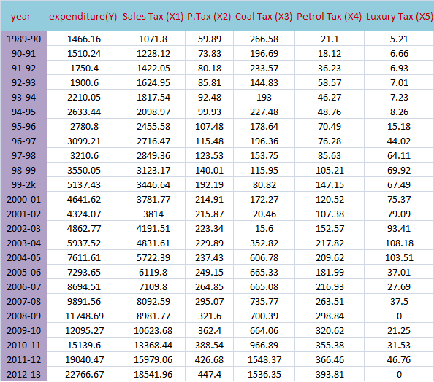

Slide 6
Analysis
Tentative assumption of the straight line model Y= β₀+ β₁X₁+ β₂X₂+ β₃X₃+ β₄X₄+ β₅X₅+ ε.
PROC REG DATA=exp;
MODEL y=x1 x2 x3 x4 x5 / P R;
OUTPUT OUT=NEW P=PRED R=RES;
run;
PROC GPLOT DATA=NEW;
PLOT RES*PRED='+'/ VREF=0;
run;
proc autoreg data=exp;
model y = x1 x2 x3 x4 x5 / dw=4 dwprob;
run;

Slide 7
The SAS System
The REG Procedure
Model: MODEL1
Dependent Variable: y
Number of Observations Read 24
Number of Observations Used 24
Sum of Mean
Source DF Squares Square F Value Pr > F
Model 5 752884124 150576825 729.75 <.0001
Error 18 3714140 206341
Corrected Total 23 756598263
Root MSE 454.24782 R-Square 0.9951
Dependent Mean 6804.04125 Adj R-Sq 0.9937
Coeff Var 6.67615

Slide 8
Parameter Estimates
Parameter Standard
Variable DF Estimate Error t Value Pr > |t|
Intercept 1 -56.46902 334.03660 -0.17 0.8676
x1 1 1.01436 0.12791 7.93 <.0001
x2 1 0.99385 5.62749 0.18 0.8618
x3 1 1.02445 0.76757 1.33 0.1986
x4 1 3.05908 4.61017 0.66 0.5154
x5 1 -0.21117 3.58888 -0.06 0.9537
Here we see that, only x1 is significant regressor at level of significance α =0.01 and also 0.05.

Slide 9
The SAS System
The AUTOREG Procedure
Dependent Variable y
Ordinary Least Squares Estimates
Durbin-Watson Statistics
Order DW Pr < DW Pr > DW
1 1.9006 0.1201 0.8799
Here we want to test H₀: ρ=0 vs H₁: ρ ≠0 at the level of significance α =0.01 and also 0.05.
We see that, for AR(1) α =0.05 <(Pr < DW) and
α =0.05 <(Pr > DW).So we accept the H₀: ρ=0 . Hence we say that there is no auto correlation.
NOTE: Pr<DW is the p-value for testing positive autocorrelation, and Pr>DW is the p-value for testing negative autocorrelation.

Slide 10
Outlier Checking:
The SAS System
The REG Procedure
Dependent Variable: y
Output Statistics
Hat Diag Cov
Obs Residual RStudent (r_{i}) H Ratio DFFITS
1 39.3736 0.0934 0.1869 1.7277 0.0448
2 -7.9437 -0.0186 0.1615 1.6803 -0.0081
3 -63.9337 -0.1476 0.1401 1.6262 -0.0596
4 -102.5551 -0.2390 0.1546 1.6337 -0.1022
5 -6.7640 -0.0154 0.1187 1.5988 -0.0057
6 81.0284 0.1848 0.1185 1.5794 0.0678
7 -155.8232 -0.3554 0.1138 1.5210 -0.1274
8 -139.7749 -0.3188 0.1148 1.5360 -0.1148
9 -151.8913 -0.3597 0.1777 1.6374 -0.1672
10 -126.5067 -0.3028 0.1967 1.6985 -0.1498
11 988.0781 2.7178 0.1321 0.1863 1.0605
12 119.1872 0.3036 0.2910 1.9239 0.1945
13 -35.5053 -0.1020 0.4452 2.5307 -0.0914

Slide 11
14 -17.3964 -0.0434 0.2636 1.9122 -0.0259
15 -140.3987 -0.3849 0.3857 2.1774 -0.3050
16 386.5562 1.0953 0.3896 1.5335 0.8751
17 -335.6699 -0.8721 0.2916 1.5297 -0.5595
18 -63.2234 -0.1458 0.1378 1.6222 -0.0583
19 -105.9468 -0.2494 0.1707 1.6623 -0.1131
20 743.1190 2.3543 0.3953 0.4286 1.9035
21 -641.2545 -1.7945 0.3048 0.7158 -1.1882
22 -821.4696 -2.3083 0.2386 0.3605 -1.2922
23 -232.9849 -0.7067 0.4879 2.3127 -0.6898
791.6997 3.3964 0.5825 0.1509 4.0122
Here, we see |r_{i}|>3 for the 24th observation. Hence it is an outlier

Slide 12
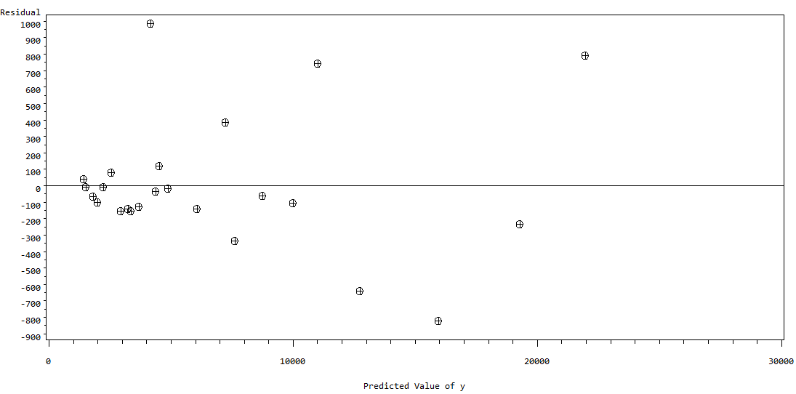
Residual Plot:
The following residual plot indicates an outward opening funnel, which implies that the variance is an increasing function of y.

Slide 13
Since, the error is heteroscadastic we use the square root transformation to make it homoscadastic.
PROC REG DATA=exp;
MODEL sqrty=x1 x2 x3 x4 x5 / P R;
OUTPUT OUT=NEW P=PRED R=RES;
PROC GPLOT DATA=NEW;
PLOT RES*PRED='+'/ VREF=0;
run;
The SAS System
The REG Procedure
Model: MODEL1
Dependent Variable: sqrty
Number of Observations Read 24
Number of Observations Used 24

Slide 14
Sum of Mean
Source DF Squares Square F Value Pr > F
Model 5 23061 4612.27194 530.7 <.0001
Error 8 156.41184 8.68955
Corrected Total 23 23218
Root MSE 2.94780 R-Square 0.9933
Dependent Mean 76.39787 Adj R-Sq 0.9914
Coeff Var 3.85849

Slide 15
Parameter Standard
Variable DF Estimate Error t Value Pr > |t|
Intercept 1 29.25514 2.16770 13.50 <.0001
x1 1 0.00161 0.00083003 1.93 0.0690
x2 1 0.10012 0.03652 2.74 0.0134
x3 1 0.00855 0.00498 1.72 0.1031
x4 1 0.07888 0.02992 2.64 0.0168
x5 1 0.00951 0.02329 0.41 0.6877
Here, for α=0.05 X₂ and X₄ are significant regressors.
we have done square root transformation and we see in the following residual plot that the error become more or less homoscadastic.

Slide 16
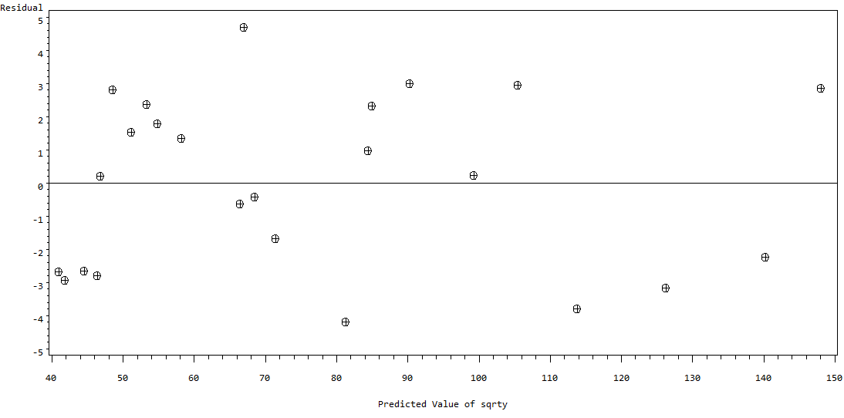
Residual plot (sqrt y)

Slide 17
Q-Q Plot:
PROC REG DATA=exp;
MODEL y=x1 x2 x3 x4 x5 / P R;
OUTPUT OUT=NEW P=PRED R=RES;
PROC UNIVARIATE noprint ;
QQPLOT RES / normal;
RUN;

Slide 18
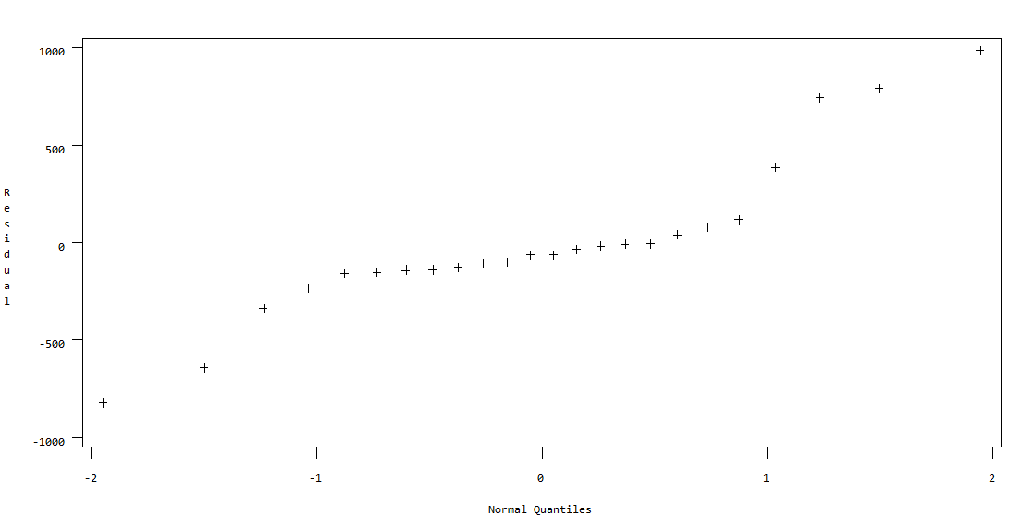
(Q-Q Plot)
So, the data comes from Leptokurtic (Heavy tailed) distribution

Slide 19
Check for Multicollinearity:
(Used standardized values)
proc reg data=exp ;
model y = x1 x2 x3 x4 x5 ;
run;
proc reg;
model y = x1 x2 x3 x4 x5
/ vif influence;
run;
The SAS System
The REG Procedure
Model: MODEL1
Dependent Variable: y
Number of Observations Read 24
Number of Observations Used 24
Sum of Mean
Source DF Squares Square F Value Pr > F
Model 5 0.00042132 0.00008426 4.10 0.0116
Error 18 0.00036974 0.00002054
Corrected Total 23 0.00079106

Slide 20
Root MSE 0.00453 R-Square 0.5326
Dependent Mean 0.01526 Adj R-Sq 0.4028
Coeff Var 29.70098
Parameter Standard
Variable DF Estimate Error t Value Pr > |t|
Intercept 1 0.01342 0.00120 11.16 <.0001
x1 1 0.75241 0.54375 1.38 0.1834
x2 1 -0.01936 0.01566 -1.24 0.2323
x3 1 -1.18862 0.30050 -3.96 0.0009
x4 1 -0.02704 0.04035 -0.67 0.5113
x5 1 -0.00952 0.00902 -1.06 0.3049
Here from the column of parameter estimate β̂=0.75241. Hence X1 plays an important role in predicting y.

Slide 21
The SAS System
Least Squares Analysis
The REG Procedure
Model: MODEL1
Dependent Variable: y
Number of Observations Read 24
Number of Observations Used 24
Sum of Mean
Source DF Squares Square F Value Pr > F
Model 5 0.00042132 0.00008426 4.10 0.0116
Error 18 0.00036974 0.0000205
Corrected Total 23 0.00079106
Root MSE 0.00453 R-Square 0.5326
Dependent Mean 0.01526 Adj R-Sq 0.4028
Coeff Var 29.70098

Slide 22
Variable DF Parameter Standard t Value Pr>|t| Variance
Estimate Error Inflation
Intercept 1 0.01342 0.00120 11.16 <.0001 0
x1 1 0.75241 0.54375 1.38 0.1834 1.62218
x2 1 -0.01936 0.01566 -1.24 0.2323 1.01502
x3 1 -1.18862 0.30050 -3.96 0.0009 1.81795
x4 1 -0.02704 0.04035 -0.67 0.5113 1.41637
x5 1 -0.00952 0.00902 -1.06 0.3049 1.41608
Here the VIF_{j} , j=1(1)5 all are < 5. So there is no multicollinearity between the regressors. All are independent. Hence there is no need of Ridge Regression.

Slide 23
Variable Selection Using Forward Selection Method:
proc reg data = exp;
model y = x1-x5/
selection = forward slentry = 0.99;
run;
quit;
The SAS System
The REG Procedure
Dependent Variable: y
Number of Observations Read 24
Number of Observations Used 24

Slide 24
Forward Selection: Step 1
Variable x1 Entered: R-Square = 0.9943 and C(p) = 0.9335
Sum of Mean
Source DF Squares Square F Value Pr > F
Model 1 752278828 752278828 3831.55 <.0001
Error 22 4319435 196338
Corrected Total 23 756598263
Parameter Standard
Variable Estimate Error Type II SS F Value Pr > F
Intercept 76.76007 141.39390 57865 0.29 0.5927
x1 1.19585 0.01932 752278828 3831.55 <.0001
Bounds on condition number: 1, 1

Slide 25
Forward Selection: Step 2
Variable x3 Entered: R-Square = 0.9946 and C(p) = 1.7720
Analysis of Variance
Sum of Mean
Source DF Squares Square F Value Pr > F
Model 2 752518481 376259240 1936.73 <.0001
Error 21 4079782 194275
Corrected Total 23 756598263
Parameter Standard
Variable Estimate Error Type II SS F Value Pr > F
Intercept 98.14817 141.96142 92863 0.48 0.4969
x1 1.13786 0.05564 81260223 418.27 <.0001
x3 0.68774 0.61921 239652 1.23 0.2793
Bounds on condition number: 8.3816, 33.526

Slide 26
Forward Selection: Step 3
Variable x4 Entered: R-Square = 0.9951 and C(p) = 2.0312
Sum of Mean
Source DF Squares Square F Value Pr > F
Model 3 752877686 250959229 1349.03 <.0001
Error 20 3720577 186029
Corrected Total 23 756598263
Parameter Standard
Variable Estimate Error Type II SS F Value Pr > F
Intercept -8.14894 158.58522 491.19833 0.00 0.9595
x1 1.02788 0.09606 21300165 114.50 <.0001
x3 0.97231 0.63960 429903 2.31 0.1441
x4 3.66697 2.63892 359206 1.93 0.1799
Bounds on condition number: 26.093, 142.12

Slide 27
Forward Selection: Step 4
Variable x2 Entered: R-Square = 0.9951 and C(p) = 4.0035
Sum of Mean
Source DF Squares Square F Value Pr > F
Model 4 752883409 188220852 962.67 <.0001
Error 19 3714854 195519
Corrected Total 23 756598263
Parameter Standard
Variable Estimate Error Type II SS F Value Pr > F
Intercept -56.32400 325.14977 5866.89437 0.03 0.8643
x1 1.01676 0.11802 14512516 74.23 <.0001
x2 0.87876 5.13636 5722.86351 0.03 0.8660
x3 1.03085 0.73963 379797 1.94 0.1795
x4 3.05454 4.48702 90608 0.46 0.5042
Bounds on condition number: 42.564, 499.06

Slide 28
Forward Selection: Step 5
Variable x5 Entered: R-Square = 0.9951 and C(p) = 6.0000
Sum of Mean
Source DF Squares Square F Value Pr > F
Model 5 752884124 150576825 729.75 <.0001
Error 18 3714140 206341
Corrected Total 23 756598263
Parameter Standard
Variable Estimate Error Type II SS F Value Pr > F
Intercept -56.46902 334.03660 5896.82319 0.03 0.8676
x1 1.01436 0.12791 12977481 62.89 <.0001
x2 0.99385 5.62749 6435.74286 0.03 0.8618
x3 1.02445 0.76757 367562 1.78 0.1986
x4 3.05908 4.61017 90852 0.44 0.5154
x5 -0.21117 3.58888 714.40043 0.00 0.9537
Bounds on condition number: 48.413, 684.12

Slide 29
All variables have been entered into the model.
Summary of Forward Selection
Variable Number Partial Model
Step Entered Vars In R-Square R-Square C(p) FValue Pr > F
1 x1 1 0.9943 0.9943 0.9335 3831.55 <.0001
2 x3 2 0.0003 0.9946 1.7720 1.23 0.2793
3 x4 3 0.0005 0.9951 2.0312 1.93 0.1799
4 x2 4 0.0000 0.9951 4.0035 0.03 0.8660
5 x5 5 0.0000 0.9951 6.0000 0.00 0.9537
Here X1 is important regressor among all.

Slide 30
proc reg data = exp;
model y = x1;
run;
The SAS System
Least Squares Analysis
The REG Procedure
Model: MODEL1
Dependent Variable: y
Number of Observations Read 24
Number of Observations Used 24
Sum of Mean
Source DF Squares Square F Value Pr > F
Model 1 752278828 752278828 3831.55 <.0001
Error 22 4319435 196338
Corrected Total 23 756598263
Root MSE 443.10038 R-Square 0.9943
Dependent Mean 6804.04125 Adj R-Sq 0.9940
Coeff Var 6.51231

Slide 31
Parameter Standard
Variable DF Estimate Error t Value Pr > |t|
Intercept 1 76.76007 141.39390 0.54 0.5927
x1 1 1.19585 0.01932 61.90 <.0001
proc reg data = exp;
model y = x1 x11 ;
run;
The SAS System
Least Squares Analysis
The REG Procedure
Dependent Variable: y
Number of Observations Read 24
Number of Observations Used 24

Slide 32
Sum of Mean
Source DF Squares Square F Value Pr > F
Model 2 752280124 376140062 1829.25 <.0001
Error 21 4318139 205626
Corrected Total 23 756598263
Root MSE 453.45965 R-Square 0.9943
Dependent Mean 6804.04125 Adj R-Sq 0.9937
Coeff Var 6.66456
Parameter Standard
Variable DF Estimate Error t Value Pr > |t|
Intercept 1 91.44883 234.87970 0.39 0.7009
x1 1 1.19018 0.07404 16.08 <.0001
x11 1 3.206789E-7 0.00000404 0.08 0.9375
Hence the final model is y^ = 76.76007 + 1.19585X₁

Slide 33
_{4.Conclusion:}
Hence the lionshare of the expenditure comes from sales tax.
5.Problems:
• We faced problems at the time of data collection. Only some data were available in the site of the “Directorate of Commercial Taxes, Government of West Bengal”( www.wbcomtax.nic.in) . And rest had been collected from the office.
6.References:
www.wbcomtax.nic.in
“Intoductioin to linear regression analysis” by Douglas C.Montgomery, Elizabeth A. Peck, G. Geoffery Vining ,willey.
“The little sas book” by Lora D. Delwiche and Susan J. Slaughter , fifth edition.

Slide 34
Thank You…

