Slide 1
Mood Analysis In Social Media

Slide 2
1. Problem Domain 2. Related Study 3. Problem Definition 4. Requirement Matrix 5. Project Plan 6. Hierarchy of Modules 7. Use Case Diagram 8. Class Diagram 9. Activity Diagram 10. Conclusion 11. References
Topics

Slide 3

Problem Domain
What is Data Mining?
Upcoming concept : Data Mining in social media
What is Sentiment Analysis?
What is Mood Analysis?
What is Cluster Analysis?

Slide 4
Related Study
01
Twitter Sentiment Analysis.^{[1]}
02
Facebook Status Sentiment Analysis.^{[2]}
03
Recognizing contextual polarity in Phrase-Level sentiment analysis.^{[3]}
04
Automatically predicting mood from expressed emotions.^{[4]}

Slide 5




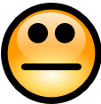
Problem Definition
To analyse a series of comments from a social media site- Twitter
Why Twitter?
Exploit public sentiment in social media
Output will be in the form of a pie chart
Our Assumptions

Slide 6
Requirement Matrix
Click Here

Slide 7
Project Plan
Click Here

Slide 8
Hierarchy of Modules

Slide 9
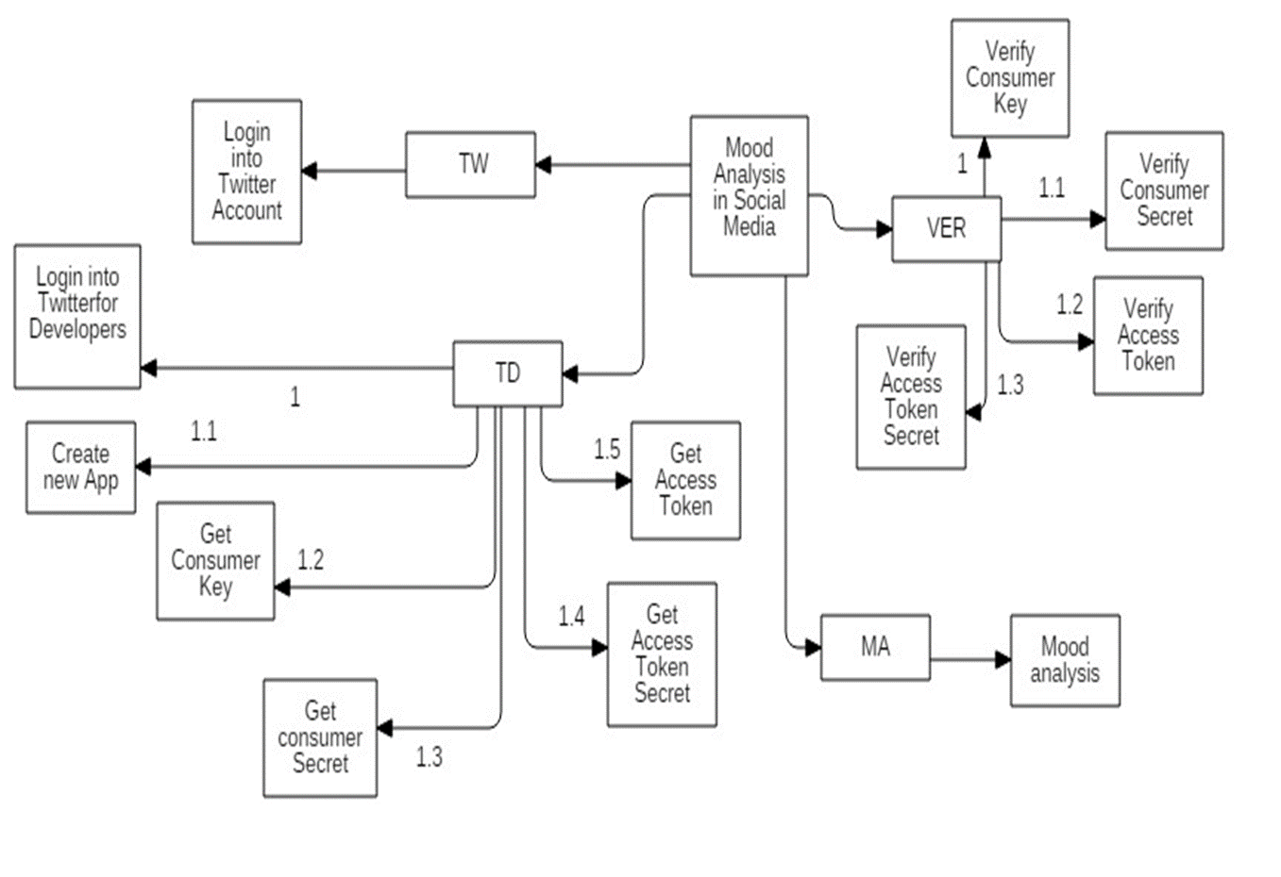
You can copy&paste graphs from Google Sheets

Slide 10
Use Case Diagram

Slide 11
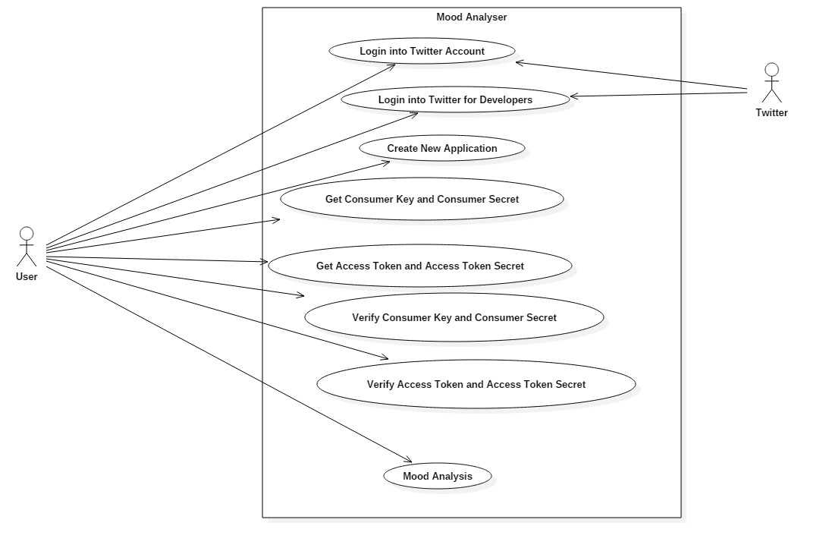

Slide 12
Class Diagram

Slide 13
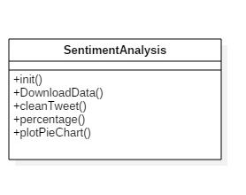

Slide 14
Activity Diagram

Slide 15
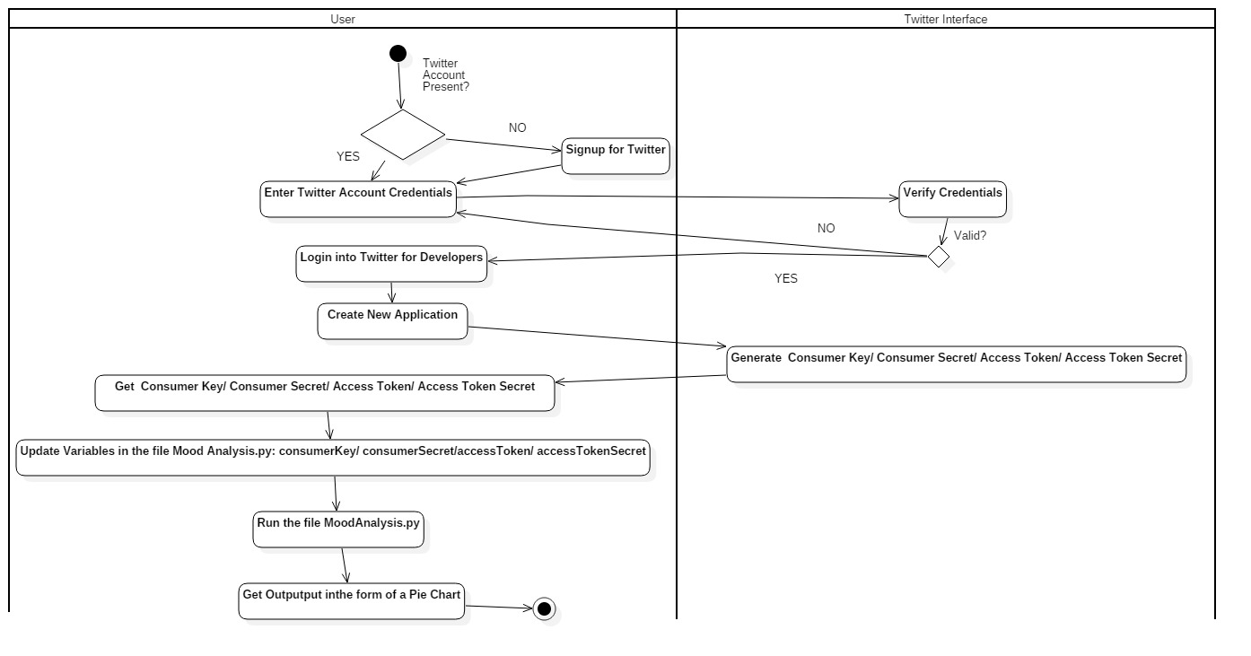

Slide 16
Sample Output

Slide 17
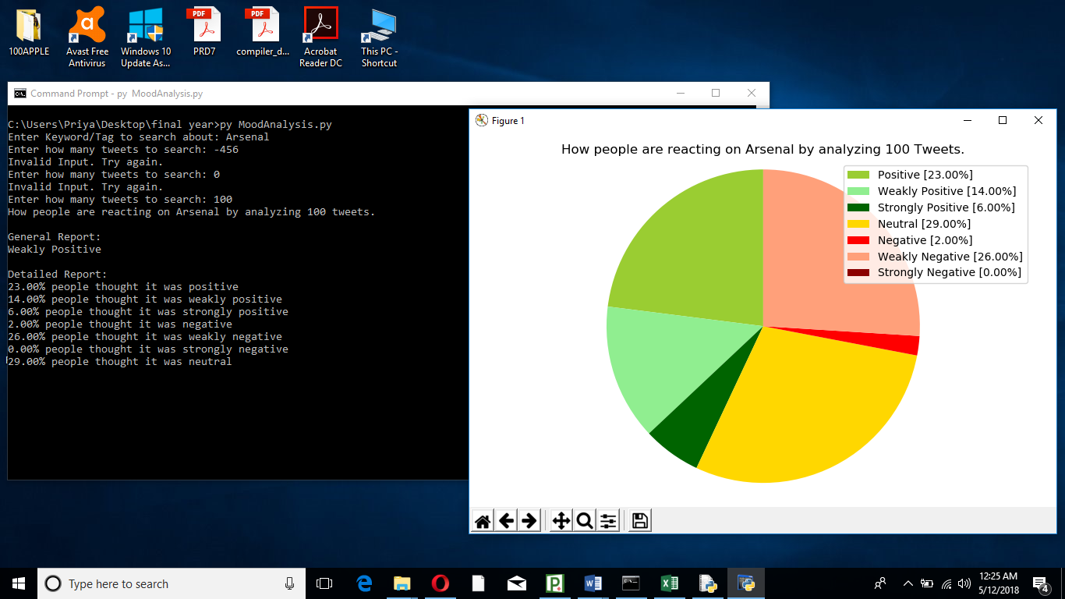

Slide 18
Conclusion
Valuable source of data
Implications of status updates and hashtags
Future Scope?

Slide 19
References
^{[1]} https://dl.acm.org/citation.cfm?id=1944571
^{[2]} https://repository.tudelft.nl/islandora/object/uuid%3A12355ac5-e752-43e6-a26c-cb0528c48977
^{[3]} https://dl.acm.org/citation.cfm?id=1220619
^{[4]} https://repository.tudelft.nl/islandora/object/uuid%3A12355ac5-e752-43e6-a26ccb0528c48977
https://twitter.com
https://apps.twitter.com
https://pythonspot.com

Slide 20
Thank you

