Slide 1
Class 3.2 – Control flow & Collections
Class 3.2 – 12/6/2018
Instructor: Hank dedona

Slide 2
Class 3.1 Recap
Hello world example – public static void main (String[] args)
Static vs dynamic typing (type safety, yay!)
Strings and primitives (int, double, char, boolean)
Variable declaration: String message = “Hello, world”;
I/O and Scanner – Scanner in = new Scanner(System.in);
Arrays – int[] myNumbers = {1,2,3,4,5};
Static vs. non-static (regular) methods

Slide 3
Conditionals (if’s)
Conditional statements in Python and Java are very similar. In Python we have three patterns.
If statement – if (condition == true)
If elseif statement – if (condition == true) else if (otherCondition == true)
If else statement – if (condition == true) else

Slide 4
Simple if in java
if (condition) {
statement1
statement2
...
}
Once again, you can see that in Java the curly braces, rather than indentation, define a block. In Java, the parentheses around the condition are required.

Slide 5
IF / Else IF in java
if (grade < 60) {
System.out.println('F’);
} else if (grade < 70) {
System.out.println('D’);
}
Instead of elif in python you spell out else if Java

Slide 6
If / else in java
if (condition) {
statement1
statement2
...
} else {
statement1
Statement2
...
}
As you can see an else has no parenthesis like an else if in Java, but still requires curly brackets.

Slide 7
Switch statements
A switch statement is similar to an if/else if if you had a number of else if’s.
switch (dayNum) {
case 0:
day = "Sunday";
break;
case 1:
day = "Monday";
break;
default: // in this example, this block runs if none of the above blocks match
day = "Int does not correspond to a day of the week";
}

Slide 8
Switch statements continued
In this example the switch statement takes in a dayNum as an integer. The cases are the possible values.
E.g. If dayNum = 1, then day = “Monday”
E.g. if dayNum = 9, then day = “int does not correspond to a day of the week”
Breaks in the case statement prevent the subsequent case statement from executing.
The default block executes when none of the case statements is valid.

Slide 9
for loops & Iteration
for (int i = 0; i < 10; i++ ) {
System.out.println(i);
}
Start: 0, Stop: 10, Step 1
Output: 0,1,2,3,4,5,6,7,8,9
Java doesn’t have ranges like Python e.g. i in range(10) for the example above
i++ = This is Java short hand for i += 1 or i = i +1

Slide 10
For loops continued
for (start clause; stop clause; step clause) {
statement1
statement2
...
}
This is for loop in Java is equivalent to a for loop with range(start,stop,step) in Python.

Slide 11
For loops continued - part 2
Loops don’t have to increment, they can decrement as well.
Python for loop that starts at 100 and decrements by 5 to 0:
for i in range(100,-1,-5):
print I
Java equivalent:
for (int i = 100; i >= 0; i -= 5) {
System.out.println(i);
}

Slide 12
For each loops
Instead of using an iterator (e.g. i) to work through a collection (list, etc), you can use a for-each loop.
Python:
nums = [1, 1, 2, 3, 5, 8, 13, 21]
for i in nums:
print i
Java equivalent:
for(int i : nums) {
System.out.println(i);
}
Note: You’re required to provide the type (in this example int) in the for-each loop

Slide 13
While loops
Python and Java while loops are very similar.
Python:
while condition:
statement1
statement2
Java:
while (condition) {
statement1
statement2
}
Only differences are the required parenthesis and curly braces, everything else is the same!

Slide 14
Do/while loops
Do/while loops in Java are very similar to Python.
Java:
do {
statement1
statement2
...
} while (condition);
Only difference is that the loop is guaranteed to run at least once.

Slide 15
Break and continue
There are instances where you may want to terminate a loop if a given condition is met.
In these instances, the break statement comes in handy.
If you want to loop through an array of integers searching for a given integer and you want to quit the loop once that number is found, use a break.

Slide 16
Break example
int[] someInts = {1, 10, 2, 3, 5, 8, 10};
for(int oneInt : someInts) {
if (oneInt == 10) {
System.out.println("Found it!");
break;
}
}
This example will only print 10 once as it will break out of the loop once it finds it. Without the break, we would print 10 twice.
If you have nested loops the break will only escape the inner loop, not the outer.

Slide 17
Continue example
Continue is like break, however, instead of terminating the entire loop, it only terminates the current iteration.
for(int oneInt : someInts) {
if (oneInt == 10) {
System.out.println("Found it!");
continue;
}
System.out.println("Not here");
}
Without the continue keyword, the loop would print “Found it!” and “Not here” when 10 was present in the array of someInts.

Slide 18
Collections
Just like in Python, Java has collections to store multiple of the same type of object.
Linear data structures: lists, queues, stacks, etc.
Non-linear data structures: maps, trees, etc.

Slide 19
Arrays & ArrayLists
In Java, Arrays and ArrayLists are both linear data structures used to store data.
Differences in declaration:
Array of ints: int[] nums = new int[5];
ArrayList of ints: ArrayList<int> nums = new ArrayList<>();
Things to note:
Arrays need a pre-determined size known ahead of time, array lists don’t.
ArrayLists can keep growing as you add items to it.

Slide 20
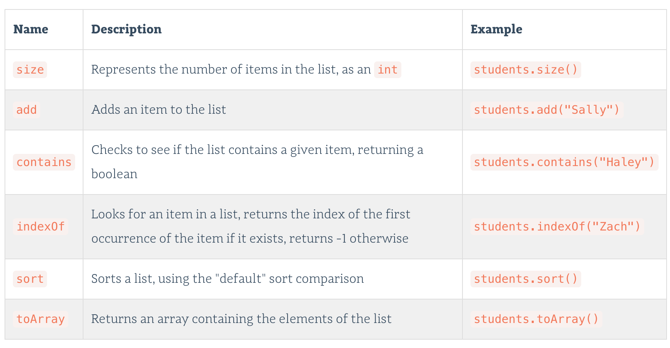
Arraylist methods

Slide 21
Hashmaps: Key/value data structure
HashMaps are a type of Map in Java used to store key/value data.
Similar to Dictionaries in Python
Example:
HashMap<String, Double> students = new HashMap<>();
This creates a new HashMap with a key of String and a value of Double.
To add a value to the map for ”Billy” as the key and 3.5 as the value:
students.put(“Billy”, 3.5);

Slide 22
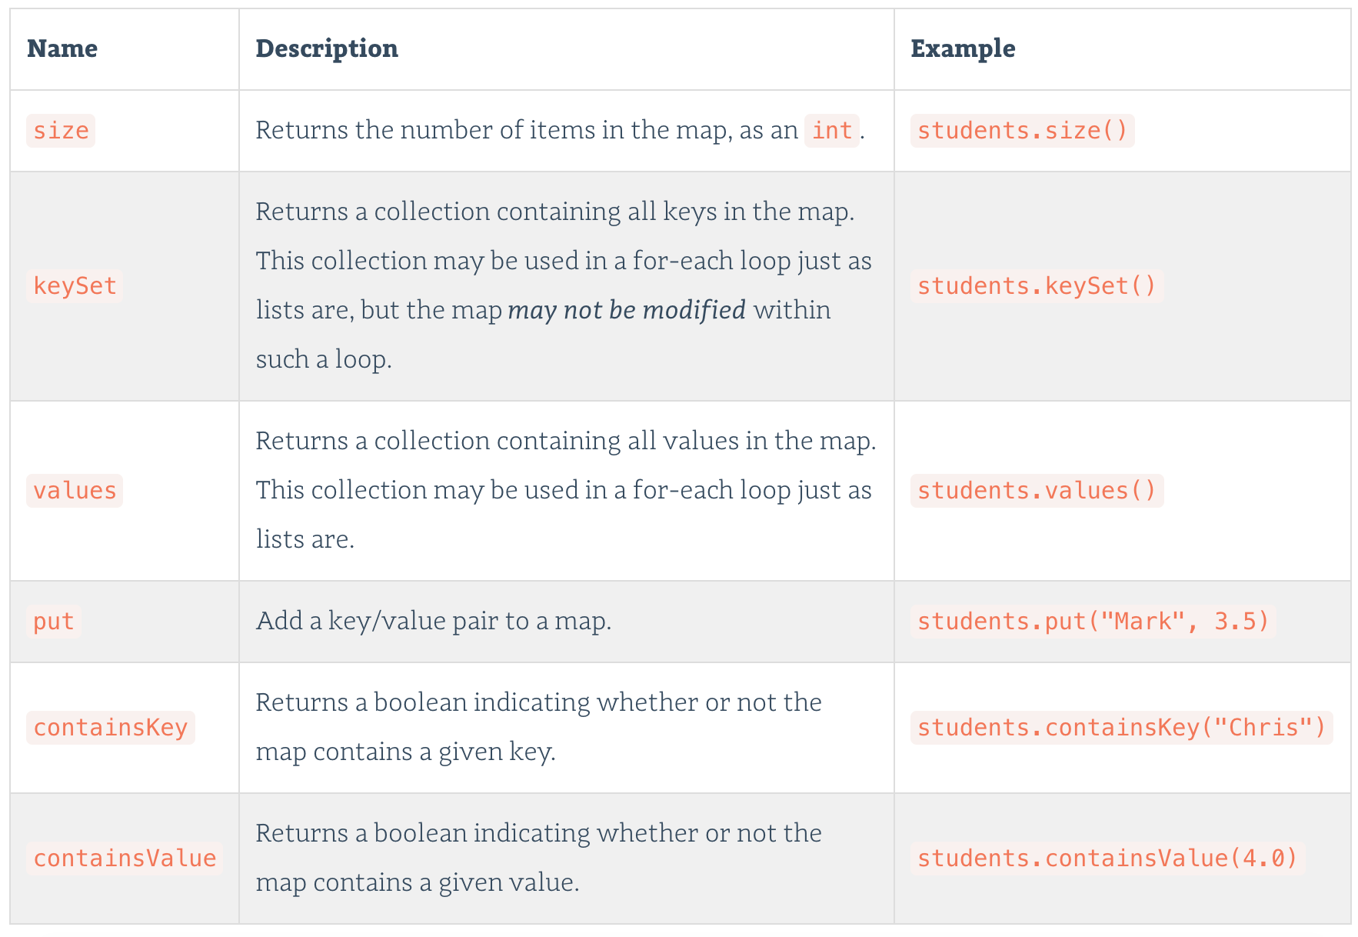
Hashmap methods

Slide 23
Next…
Class studio counting characters:
https://education.launchcode.org/skills-back-end-java/studios/counting-characters/
Begin assignment tech jobs console app:
https://education.launchcode.org/skills-back-end-java/assignments/techjobs-console/

