Slide 1
unit 3 – Introduction to Back-end dev with java
Class 3.1 – 12/3/2018
Instructor: Hank dedona

Slide 2
Welcome!
Welcome to Unit 3, you’ve made it this far! Congratulations!
This is the final unit in your LaunchCode learning adventure!
The class is 7 weeks long (14 classes total)
This class covers the basics of java → MVC web application/services development with the Spring Boot Framework
Are you ready?!

Slide 3
Why Java?
As of November 2018 Tiobe Index – Java is the #1 most popular language with 16.76% of ratings, Python is #4 with 7.68%
There are numerous companies developing web applications and web services using Java today and Java developers are always in demand!
Think of Java as Python with structure
https://www.tiobe.com/tiobe-index/ *In case you’re interested

Slide 4
Lets jump right in!
If you haven’t already:
Install JDK (Java Development Kit) – For this class we’ll stick with Java 8 SE 8u191/192
Install IntelliJ IDEA – Integrated Development Environment
Fork and checkout the java-exercises github repo https://github.com/LaunchCodeEducation/java-exercises

Slide 5
Hello, world… Again
public class Hello { public static void main(String[] args) { System.out.println("Hello, World"); } }

Slide 6
Lets look into this deeper…
Line 1: public class Hello
This line defines the class itself.
Classes can be public or private.
All code in Java must be in a class (unlike Python where you can just start coding)

Slide 7
And deeper
Line 2: public static void main(String args[])
This is the entry point for all standard Java applications
Again this method is public
Static keyword – This defines that the method is the same per class rather than per instance (more about this later)
Void – This is the return type, in this case void means we aren’t returning anything
Main – This is the name of the main function
(String args[]) – This is the function parameters, in this case a String array called args (short for program arguments)

Slide 8
And last
Line 3: System.out.println(“Hello, World”);
System.out – This defines that the output will go to the console or standard output.
Println – Prints a line with a carriage return (new line)
All String literals must be in double quotes (“ “)
And last, but not least, all lines must end with a semicolon ;

Slide 9
Formality and structure
As you can see from this simple example, Java has a lot of structure
All code must be in a class
All code must be in a method or function that has the following
A name
Public/Private/Protected/Package Private declaration
Return type declaration (void, String, int, etc)
Curly braces opening/closing the method/function

Slide 10
Static vs dynamic typing
Type safety for the win! If you haven’t heard me complain about type-safe languages or lackthereof, you will now ☺
Python
Name = “Hank”
This is an example of a dynamically typed (or type unsafe) language defining a variable, called name, to “Hank” (a string)
Java
String name = “Hank”;
This is an example of a statically typed (or type safe) language defining a variable, called name, to again, ”Hank” (a string)

Slide 11
Differences python vs. java
The difference between python and Java is that I can take that name variable from the previous slide and change it.
Python
name = 5 // Totally cool and allowed
Java
name = 5 // Fail, this will give you a compile error, can’t go from String to int
You cannot change the type of a variable once declared, I can only store other Strings in the variable name if I declare it as a String

Slide 12
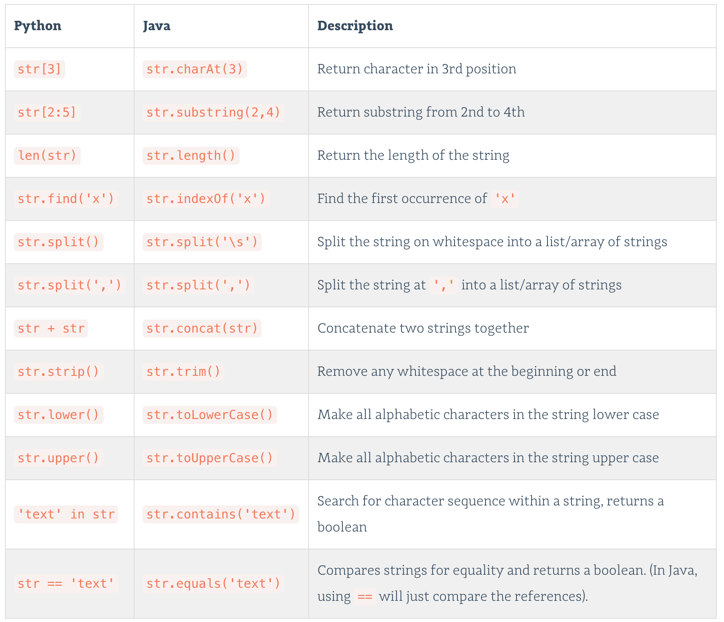
Strings (Java & Python)

Slide 13
Primitives (and their object counterparts)
Primitives (int, float, double, char and boolean) have their own Object counterparts (Integer, Float, Double, Char and Boolean)
Primitives cannot be null, objects can be null.
Java will do something called Autoboxing where it will convert from the primitive to the Object form for you automatically.
E.g.
int x = 5;
Integer y = Integer.valueOf(x);

Slide 14
Importing
As you have imported libraries in your Python projects, so can you import libraries (or standard JDK classes) into your Java projects!
For example: Import java.util.Scanner;
This will allow you to use the Scanner class in your class, without it, your project will throw a ClassNotFound exception
In order to import a class into your project, it must be on the classpath

Slide 15
Declaring variables
In Python, we can declare variables without specifying what kind of variable it is.
E.g. x = 5.8
This is not possible in Java, you must declare a type
E.g. double x = 5.8;
If you attempt to put a String into x like such:
double x = “hello”;
You will get a compile error

Slide 16
I/O and Scanner
The java scanner class (found in java.util.Scanner) allows for input and output
E.g. Scanner in = new Scanner(System.in);
This declares a new scanner instance that takes input from the system.in or the console for user input. It could also take input from a file, stream, etc
Once declared, we can use the scanner to accept input from the user, please note though that you must know what kind of input to expect (String, double, int, etc)
E.g. Fahrenheit = in.nextDouble(); // This accepts a double input from the user and stores it in Fahrenheit

Slide 17
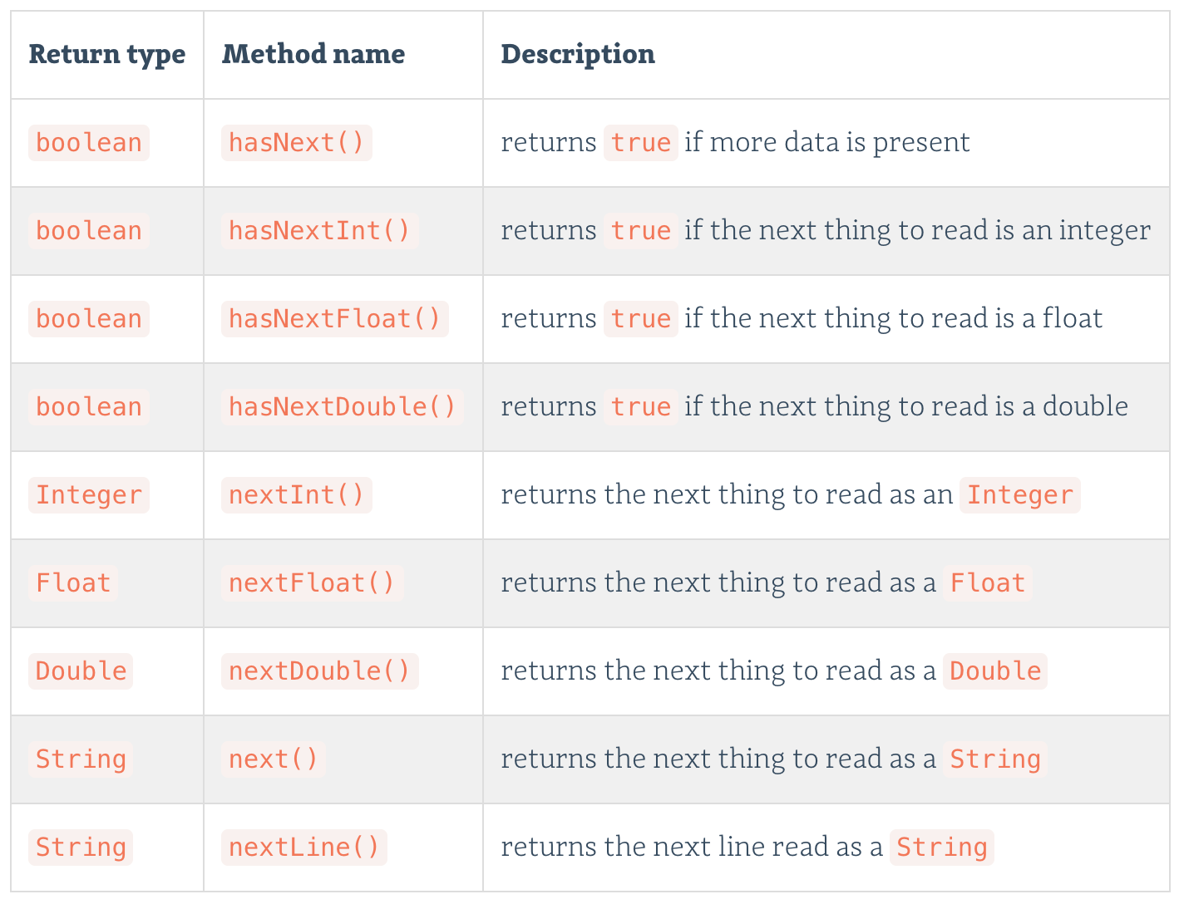
More scanner functions

Slide 18
Instantiating objects (python & Java)
When creating classes in Python and Java, it’s essentially the same. You want to have data and methods for that data represented.
Constructing a new cat in Python: my_cat = Cat()
Constructing a new cat in Java: Cat myCat = new Cat();
The new keyword is used to create an instance of the class Cat in Java.

Slide 19
References in java
Consider these lines of Java code:
int catAge = 11; // Declare a new int (primitive) with catAge set to 11
Cat myCat = new Cat(); // Instantiate a new cat called myCat
Cat sameCat = myCat; // Create a new reference called sameCat that “points” to myCat;

Slide 20
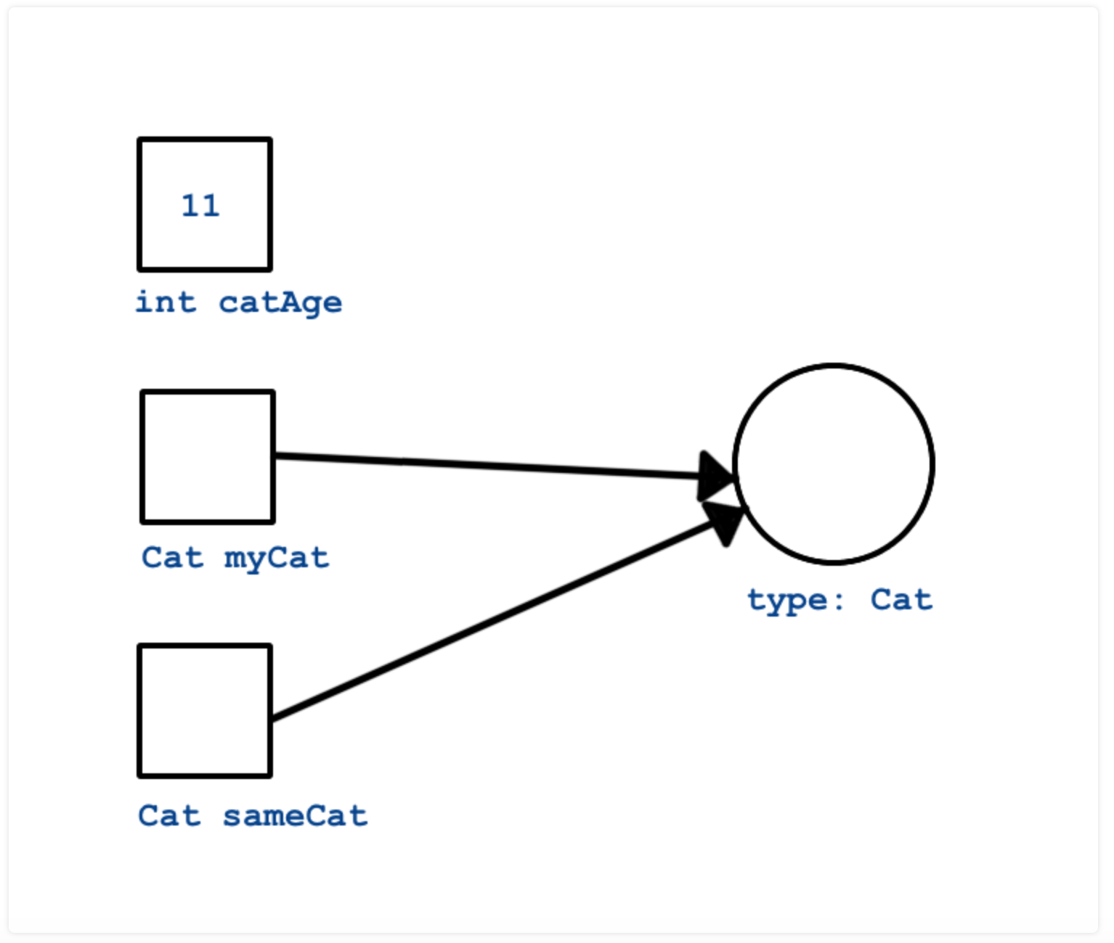
References diagram

Slide 21
Arrays in java
Just like Python, we have arrays to store a collection of items (objects, primitives)
However, unlike in Python, we can only store 1 type of object in a given array.
int[] someInts = new int[10]; // Declares an array for ints to size 10
int[] someOtherInts = {1, 1, 2, 3, 5, 8}; // Declares and initializes an array with values 1,1,2,3,5,8
To access a value in array, we use square brackets (just like Python) with base 0
E.g. int val = someOtherInts[4]; // Sets val to 5

Slide 22
Static methods
Static methods are very similar to functions in Python, they can be called directly without instantiating (or constructing) any objects.
However, that doesn’t mean they don’t need to be put in a class (sorry they do)
Static methods are called like so: ClassName.Method(parameters);
Lets look at an example! (HelloMethods.java & Messages.java)

Slide 23
So…
What have we learned thusfar?
Java is an Object oriented language
Java is type safe (yay!)
There are a lot of similarities to Python with regard to syntax, classes, etc.
This is an introduction to some of the concepts in Java, there’s much more to learn ☺

Slide 24
Next…
Class 1 prep exercises (if you haven’t done them already)
https://education.launchcode.org/skills-back-end-java/class-prep/1/exercises.html
Class 1 studio – Area of a circle console app
https://education.launchcode.org/skills-back-end-java/studios/area/

