Slide 1
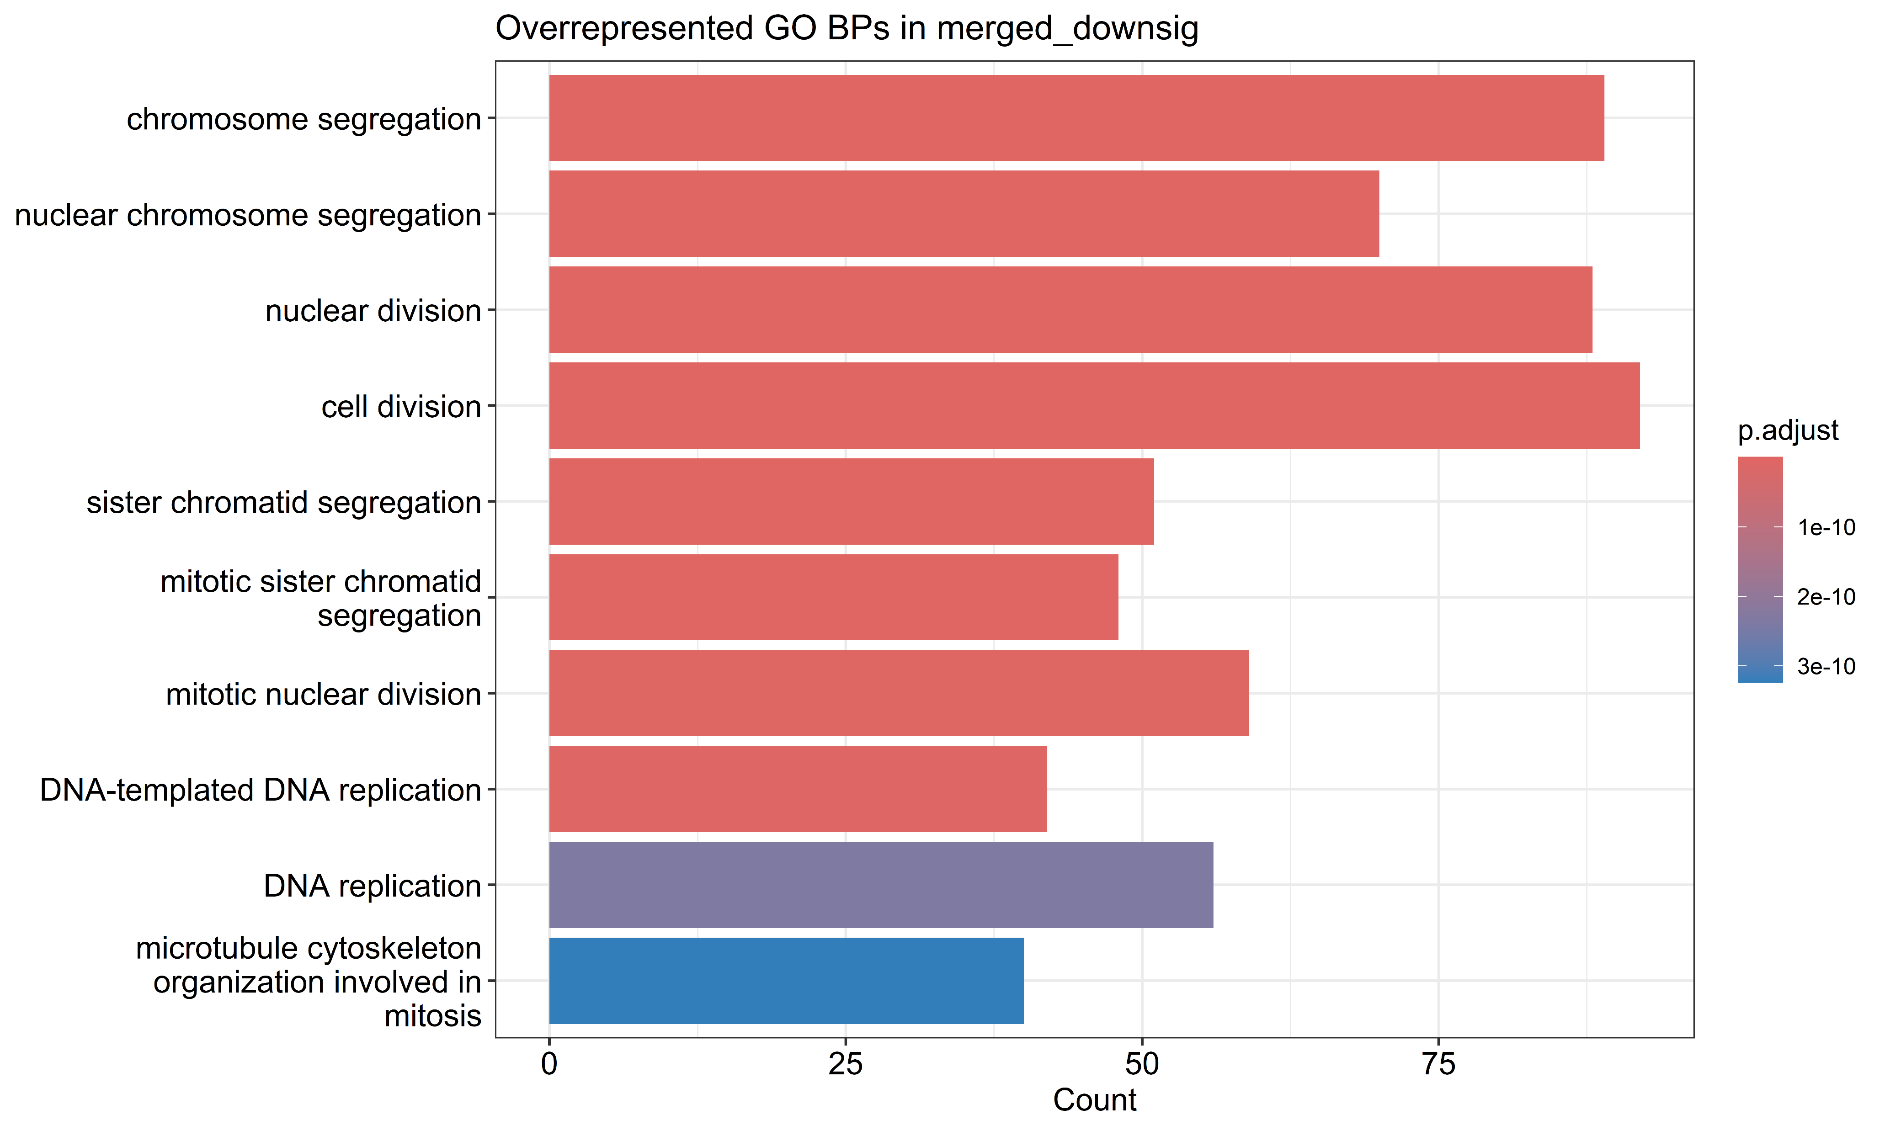
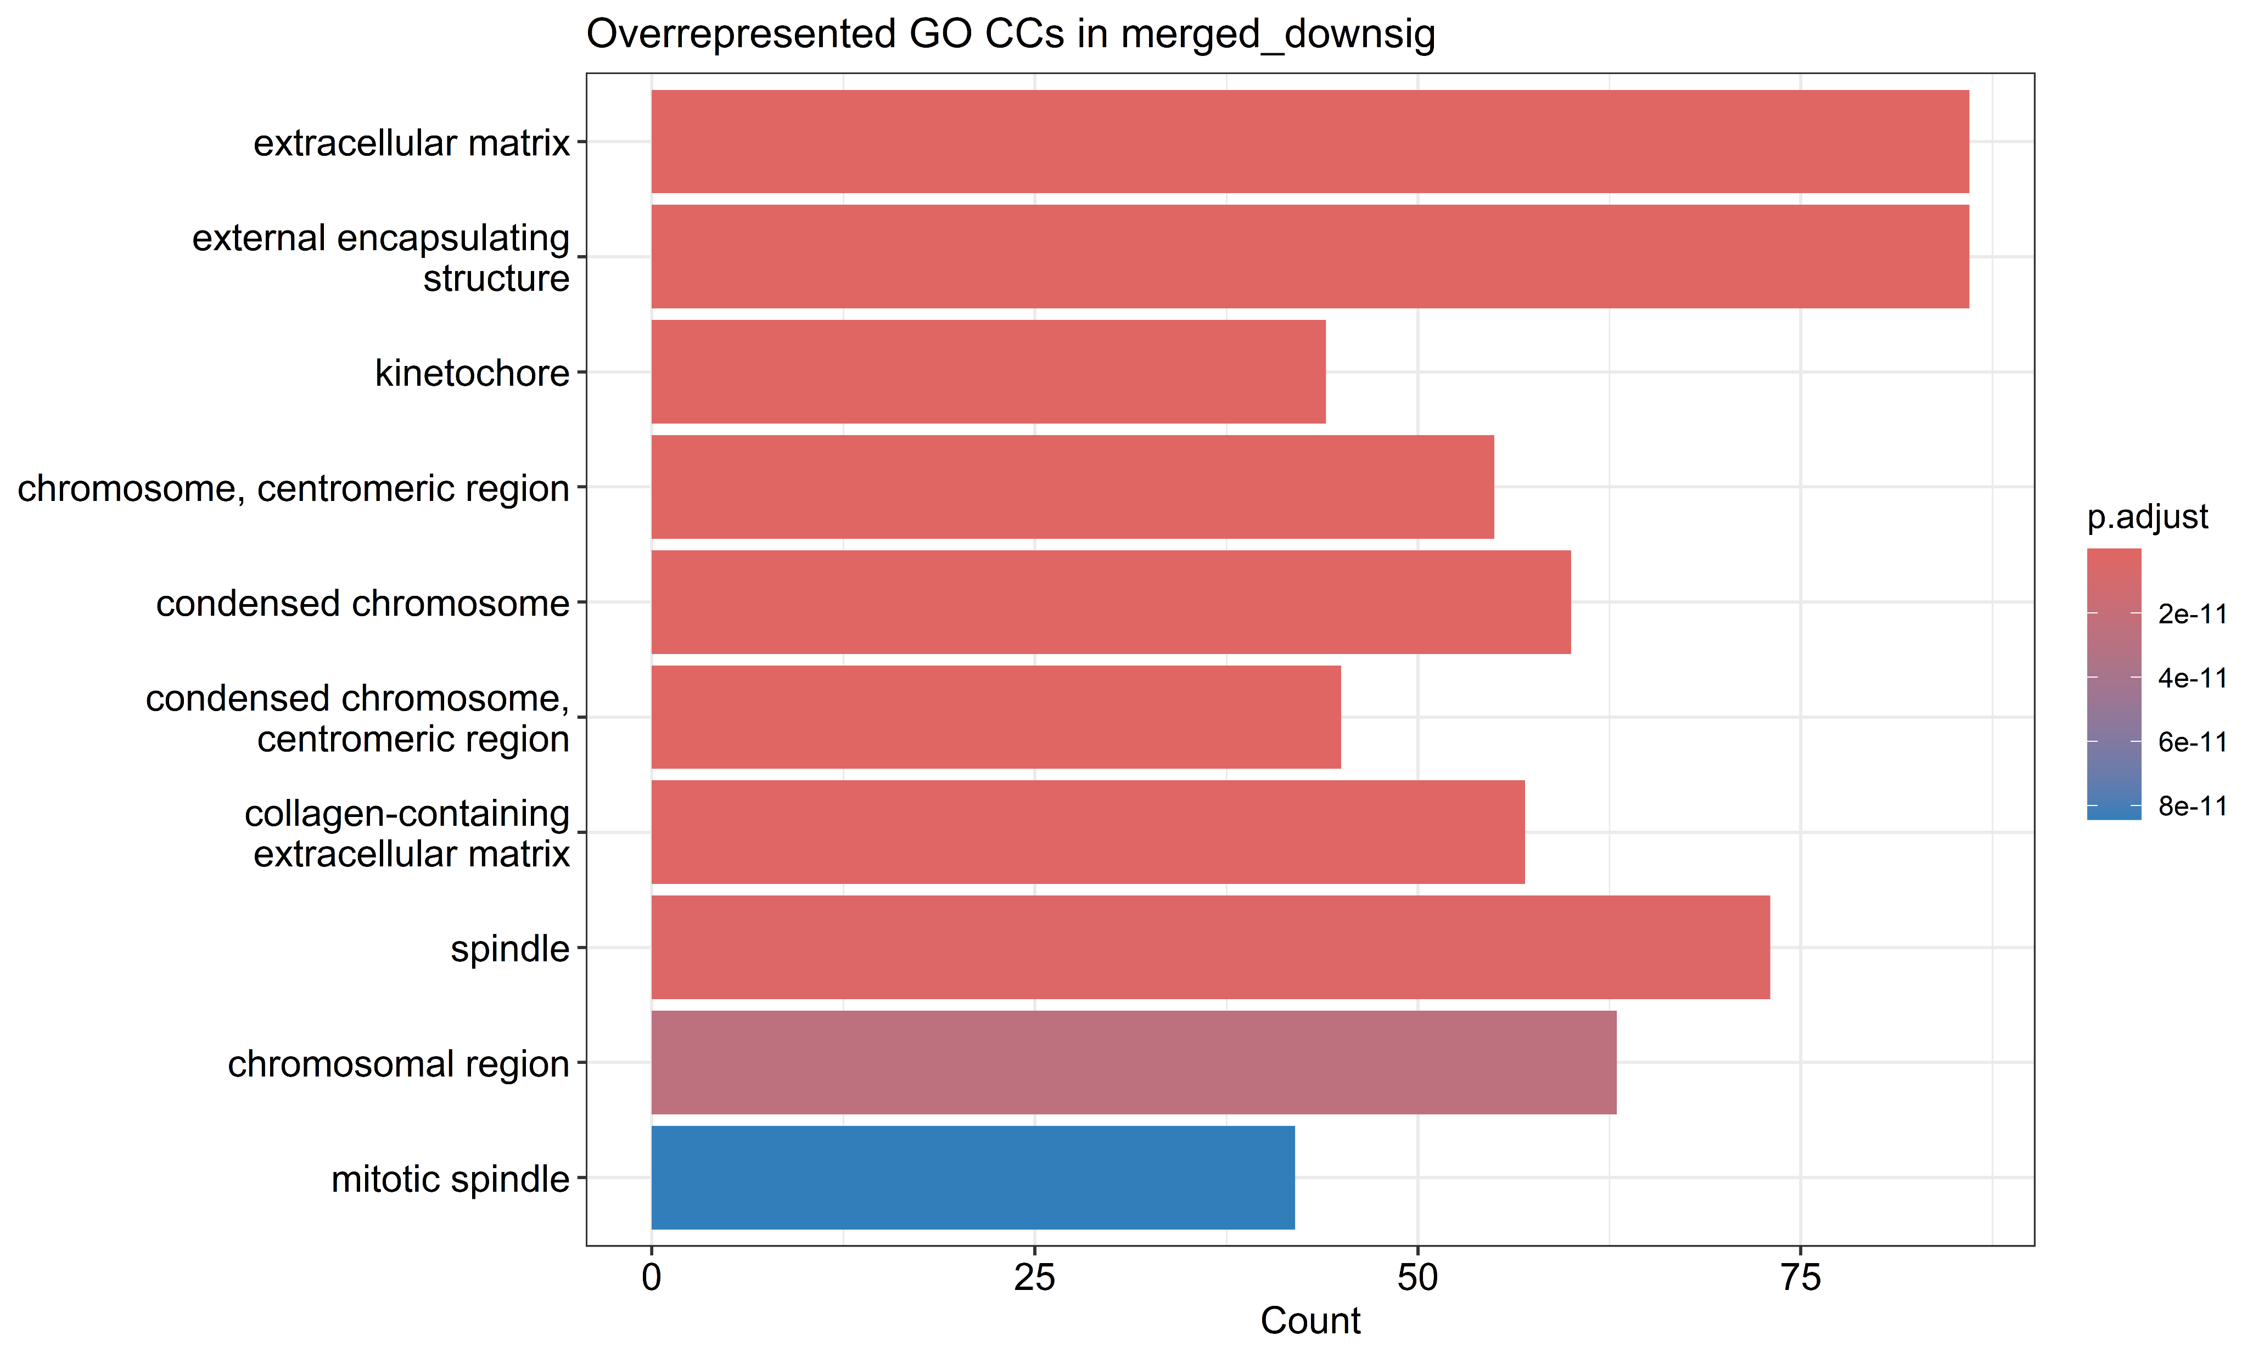
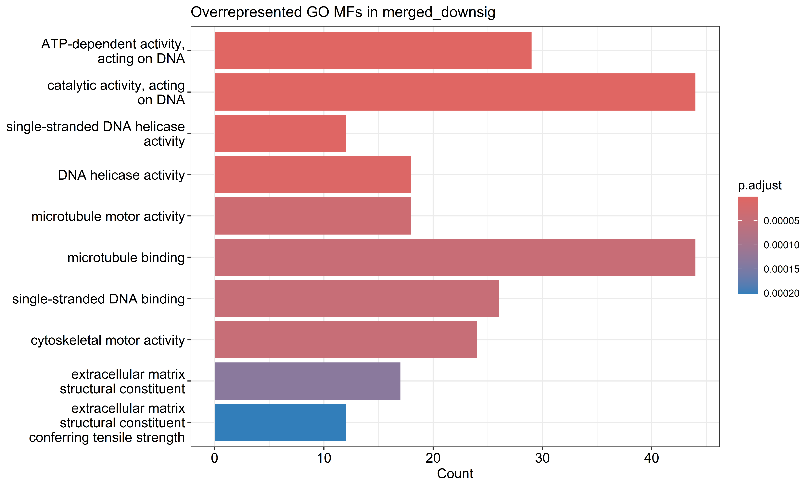
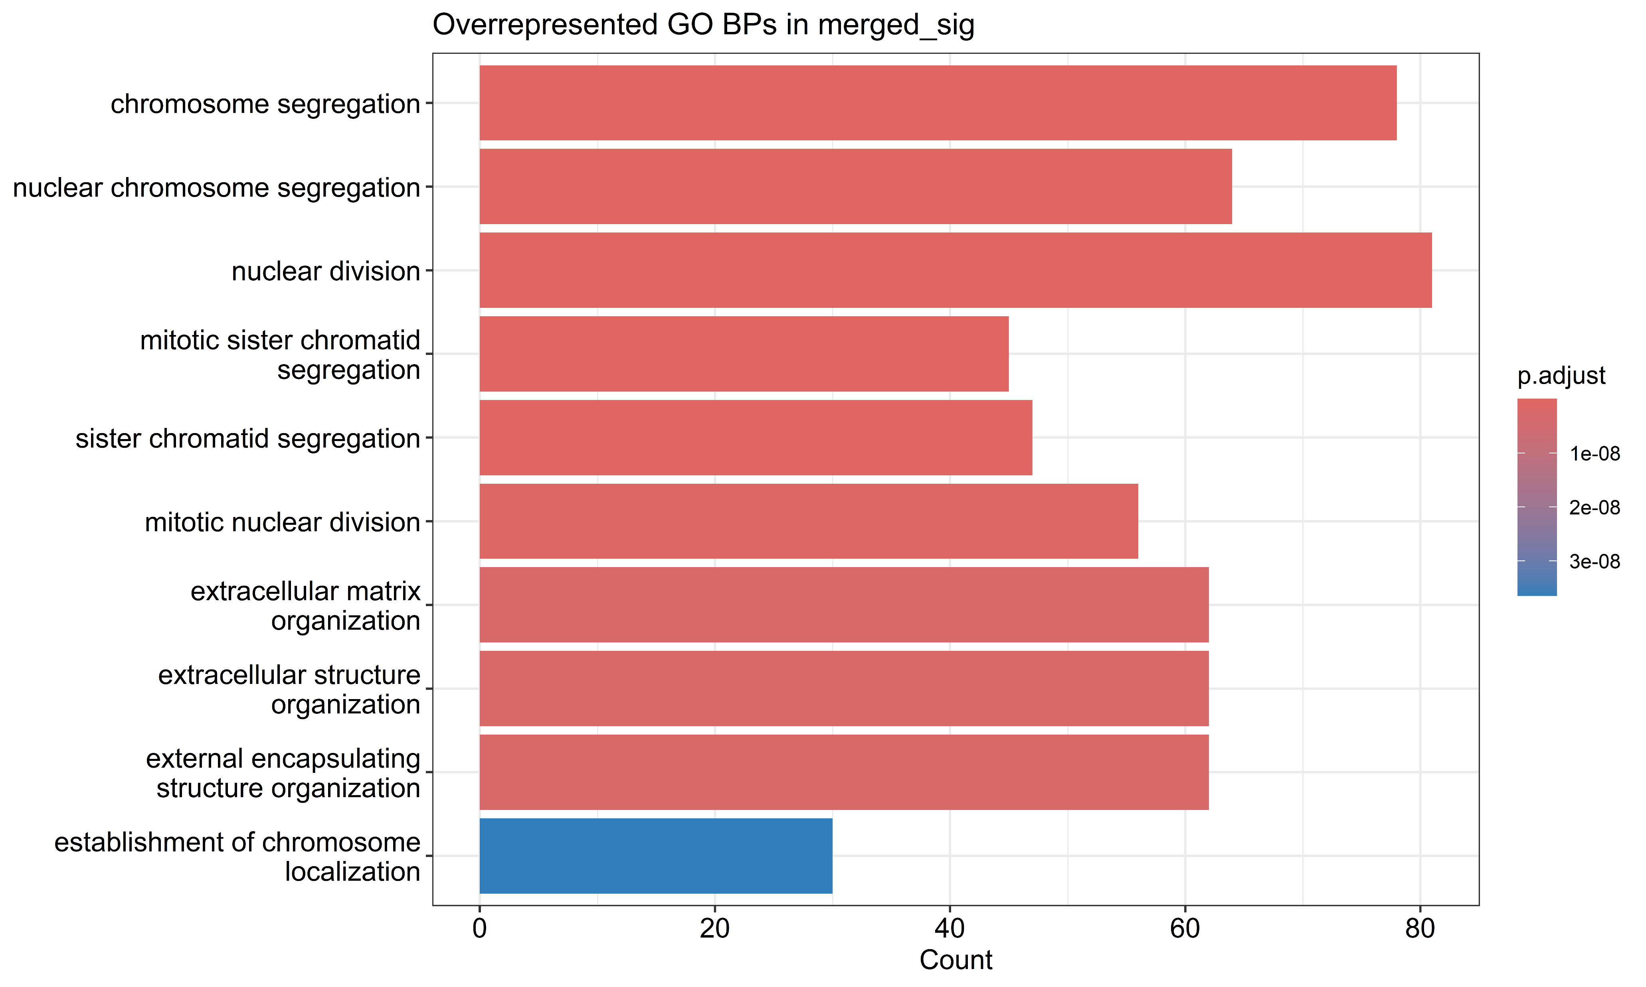
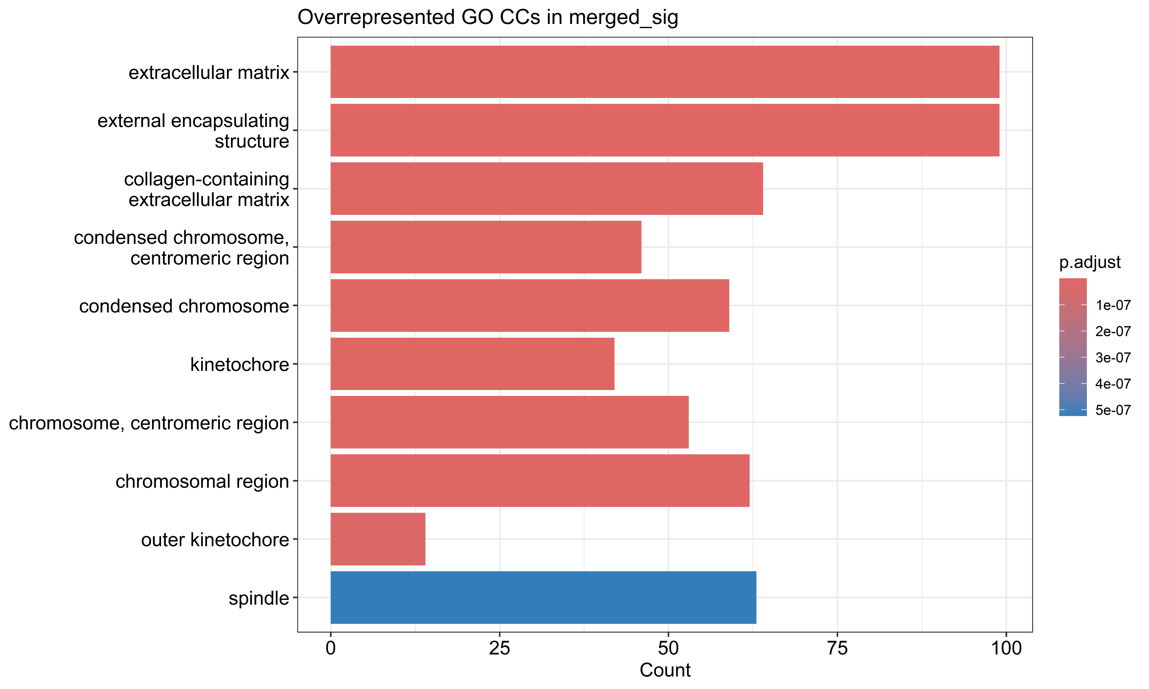
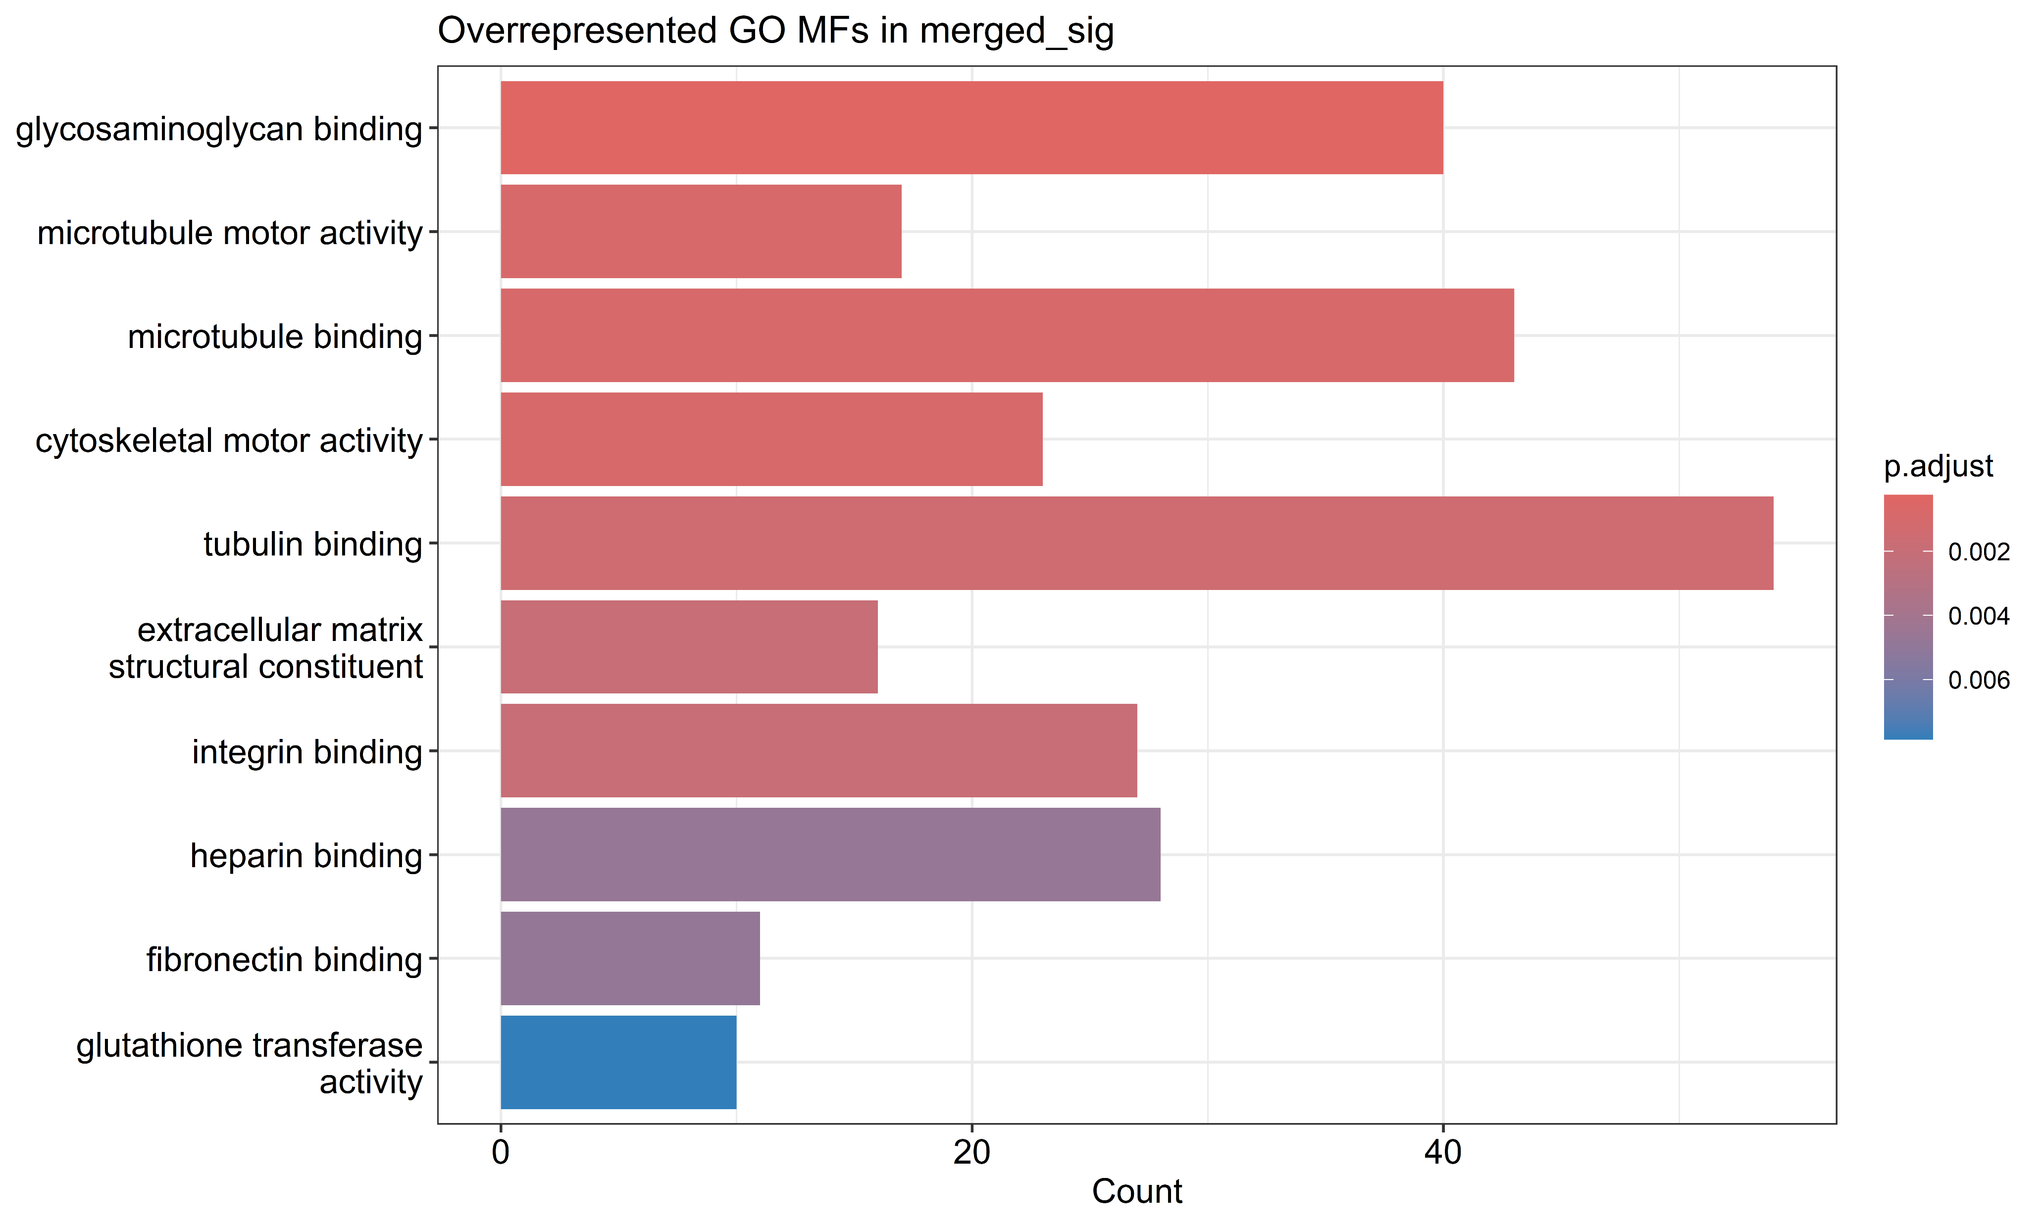
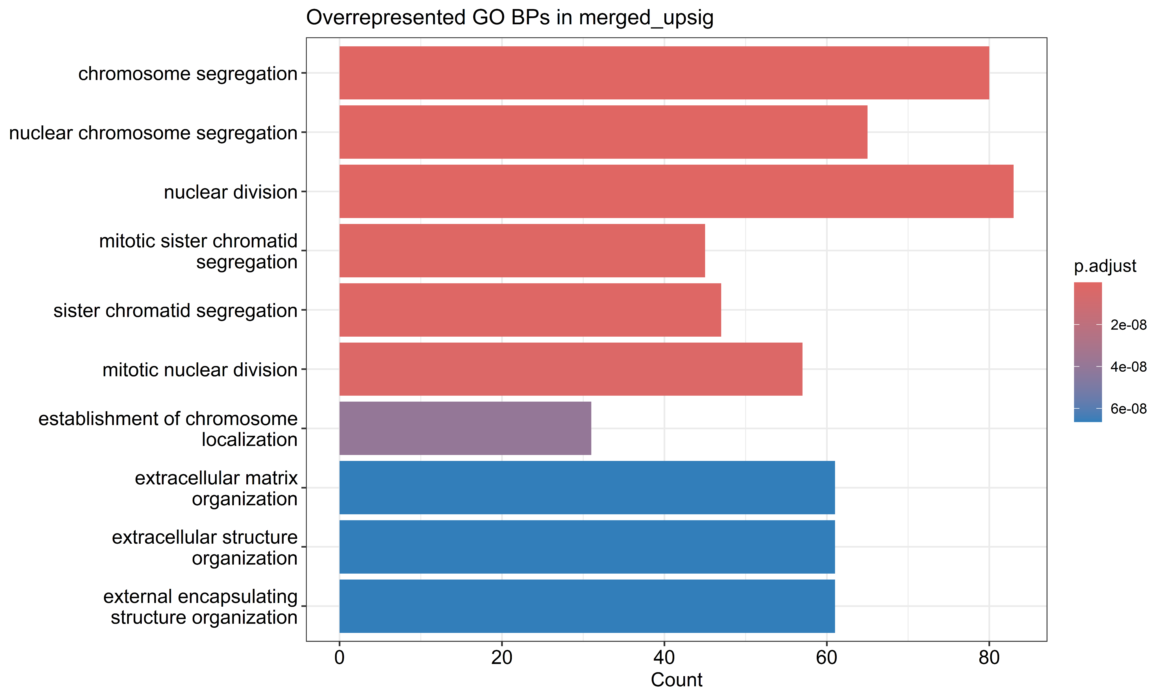
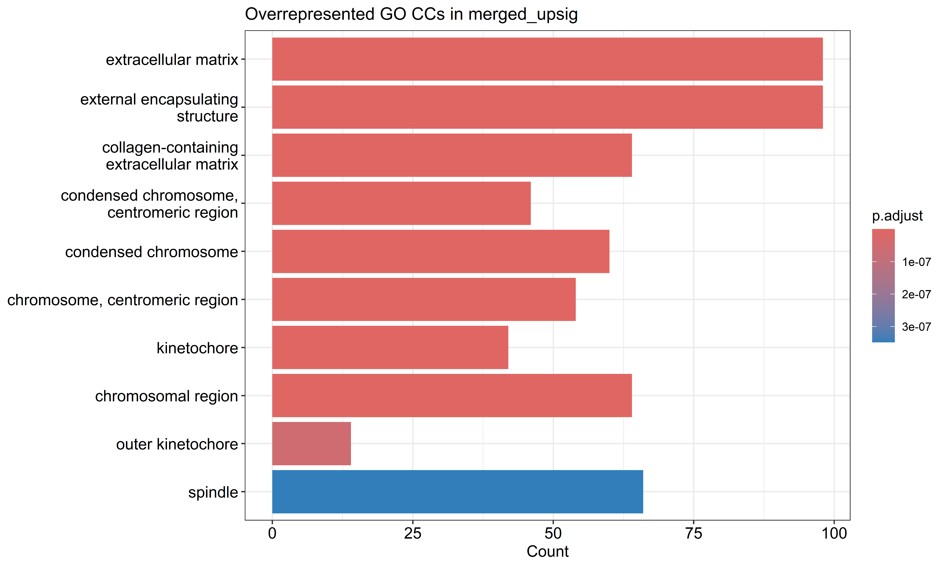
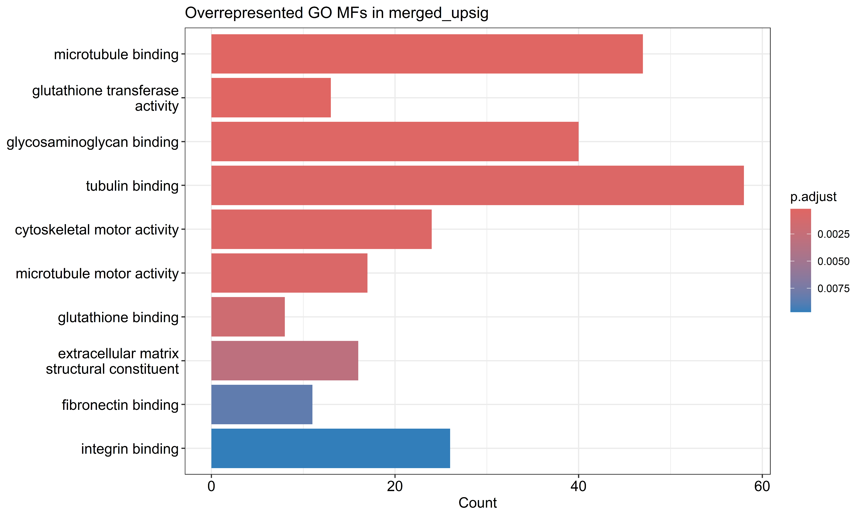
BP
CC
MF
Merged downsig
Merged sig
Merged upsig

Slide 2
Implants – OM, mSLA, PT, TCPS, Titan and BMP2 (control)
Differential gene expression analysis
# genes ~23,000
Significant genes + TFs
Filtered raw count data
miRsig
Regulatory network generation
Pathway enrichment analysis

