Slide 1
Data Frames
load(url('http://www.stat.berkeley.edu/users/nolan/data/afamily.rda'))

Slide 2
Announcements
HW #1 and Lab #1 are due tonight midnight
Quiz #1 on Friday
Covers material from 1st two weeks
Multiple choice, fill in blank, function calls
No crib sheet

Slide 3
REVIEW: Vectors

Slide 4
Variable
A variable contains measurements, e.g. daily temperature (degrees Farenheit) in June
> junetemp
[1] 81 73 86 74 84 75 70 73 66 68 62 64 65
[14] 62 61 66 70 73 72 82 72 75 69 70 66 69
[27] 73 71 68 67
We call a variable in R a vector
They are ordered containers.
There are 30 values in junetemp the first is 81 and 30th is 67

Slide 5
Vectors
junetemp
A vector is an ordered container of a set of values/measurements
The values must be all the same type of information
81
73
.
.
.
68
67

Slide 6
Vector calculations
junetemp
Convert temperature from Farenheit to Celsius
Formula:
C = (F – 32) * 5/9
Element-wise calculation
81
73
.
.
.
68
67
junetempC = (
- 32) * 5/9

Slide 7
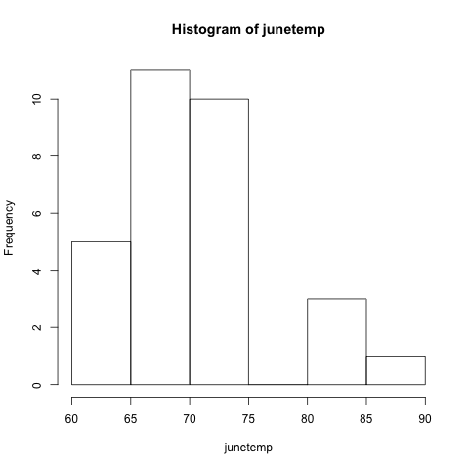
Operating on Vectors
> junetempC = (junetemp – 32) * 5/ 9
> junetempC
[1] 27.22 22.77 30.00 …. 20.00 19.44
> min(junetemp)
[1] 61
> mean(junetemp)
[1] 70.9
> hist(junetemp)

Slide 8
The Family
We have all sorts of information about our family, height, weight, first name, gender, …
The data frame gives us a way to collect all of these variables (vectors) into one object.

Slide 9
> family
firstName sex age height weight bmi overWt
1 Tom m 77 70 175 25.16239 TRUE
2 Maya f 33 64 124 21.50106 FALSE
3 Joe m 79 73 185 24.45884 FALSE
4 Robert m 47 67 156 24.48414 FALSE
5 Sue f 27 61 98 18.51492 FALSE
6 Liz f 33 68 190 28.94981 TRUE
7 Jon m 67 68 185 28.18797 TRUE
8 Sally f 52 65 124 20.67783 FALSE
9 Tim m 59 68 175 26.66430 TRUE
10 Tom m 27 71 215 30.04911 TRUE
11 Ann f 55 67 166 26.05364 TRUE
12 Dan m 24 66 140 22.64384 FALSE
13 Art m 46 66 150 24.26126 FALSE
14 Zoe f 48 62 125 22.91060 FALSE

Slide 10
Vectors
The data frame gives us a way to collect all of these variables (vectors) into one object.
Tom
77
m
TRUE

Slide 11
Data Frame
family
Ordered container of vectors
Vectors must all be the same length
Vectors in a data frame can be different types
Tom
77
m
TRUE

Slide 12
> class(family)
[1] "data.frame"
> length(family) - number of vectors in family
[1] 7
> dim(family) - number of rows and columns
[1] 14 7
> names(family) - names of the vectors in family
[1] "firstName" "sex" "age" "height"
[5] "weight" "bmi" "overWt"

Slide 13
Access a vector: dataframe$vector
> family$sex
[1] m f m m f f m f m m f m m f
Levels: m f
> mean(family$height)
[1] 66.857
> class(family$height)
[1] "numeric"

Slide 14
Sample 3 names at random from family
Sample without replacement
sample(family$name, size = 3)
Sample with replacement
sample(family$name, size = 3,
replace = TRUE)

Slide 15
> dim(family) - number of rows and columns
[1] 14 7
> names(family) - names of the vectors in family
[1] "firstName" "sex" "age" "height"
[5] "weight" "bmi" "overWt"

Slide 16
Subsets of Data Frames with dplyr
library(dplyr)
require(dplyr)

Slide 17
Function for subsetting data frames
Rows
Logical: filter
Position: slice
Exclusion: slice
Columns
Position: select
Exclusion: select
Name: select
Other useful functions:
mutate
transmute
group_by and summarize

Slide 18
Examples of Subsets
Those who are not overweight
Ages and Weights of everyone
Ages and Weights of those not overweight
Those over 50 yr and under 70 in
Sex of those over 50 yr and under 70 in
First and last member of family

Slide 19
Examples of Subsets
Those who are not over weight
filter(family, !overWt)
Age and Weight of all in the family
select(family, weight, age)
select(family, c("weight", "age"))
Age and Weight of those not over weight
select(filter(family,!overWt),
age, weight)

Slide 20
Examples of Subsets
Those over 50 years old and under 70 inches
filter(family, age > 50 & height < 70)
Genders of those over 50 years old and under 70 inches
select(filter(family,
age > 50 & height < 70), sex)
First and last person in the family
slice(family, 1, nrow(family))

Slide 21
Plain Text Data

Slide 22
Plain text files
Table-like format
Rows correspond to records/observation
Columns correspond to variables
Read into a data frame
Examples – delimited values, fixed width format, key-value pairs

Slide 23
Delimited Values
firstName,sex,age,height,weight,bmi,overWt
Tom,m,77,70,175,25.16239,TRUE
Maya,f,33,64,124,21.50106,FALSE
Joe,m,79,73,185,24.45884,FALSE
Robert,m,47,67,156,24.48414,FALSE
Sue,f,27,61,98,18.51492,FALSE
Liz,f,33,68,190,28.94981,TRUE
Other common delimiters: blank space, tab

Slide 24
Fixed Width Format
Tom m777017525.16239TRUE
Maya f336412421.50106FALSE
Joe m797318524.45884FALSE
Robert m476715624.48414FALSE
Sue f2761 9818.51492FALSE
Liz f336819028.94981TRUE
Values appear in the same location in each row, e.g., sex is the 9th character, age is in 10th and 11th characters, and weight is in the 14th-16th position in each row

Slide 25
Key-value pairs
firstName:Tom
sex:m
age:77
height:70
weight:175
bmi:25.16
overWt:TRUE
firstName:Maya
sex:f
age:33
height:64
weight:125
bmi:21.50
overWt:FALSE
Each value has format
key: value
Key is the variable name
Records are separated by blank lines

Slide 26
Functions to read these files into data frames
read_delim() for delimited data
read_fwf() for fixed with formatted data
read.dcf() for key-value pairs
Examples of how to use these functions are in chapter 4

