Slide 1
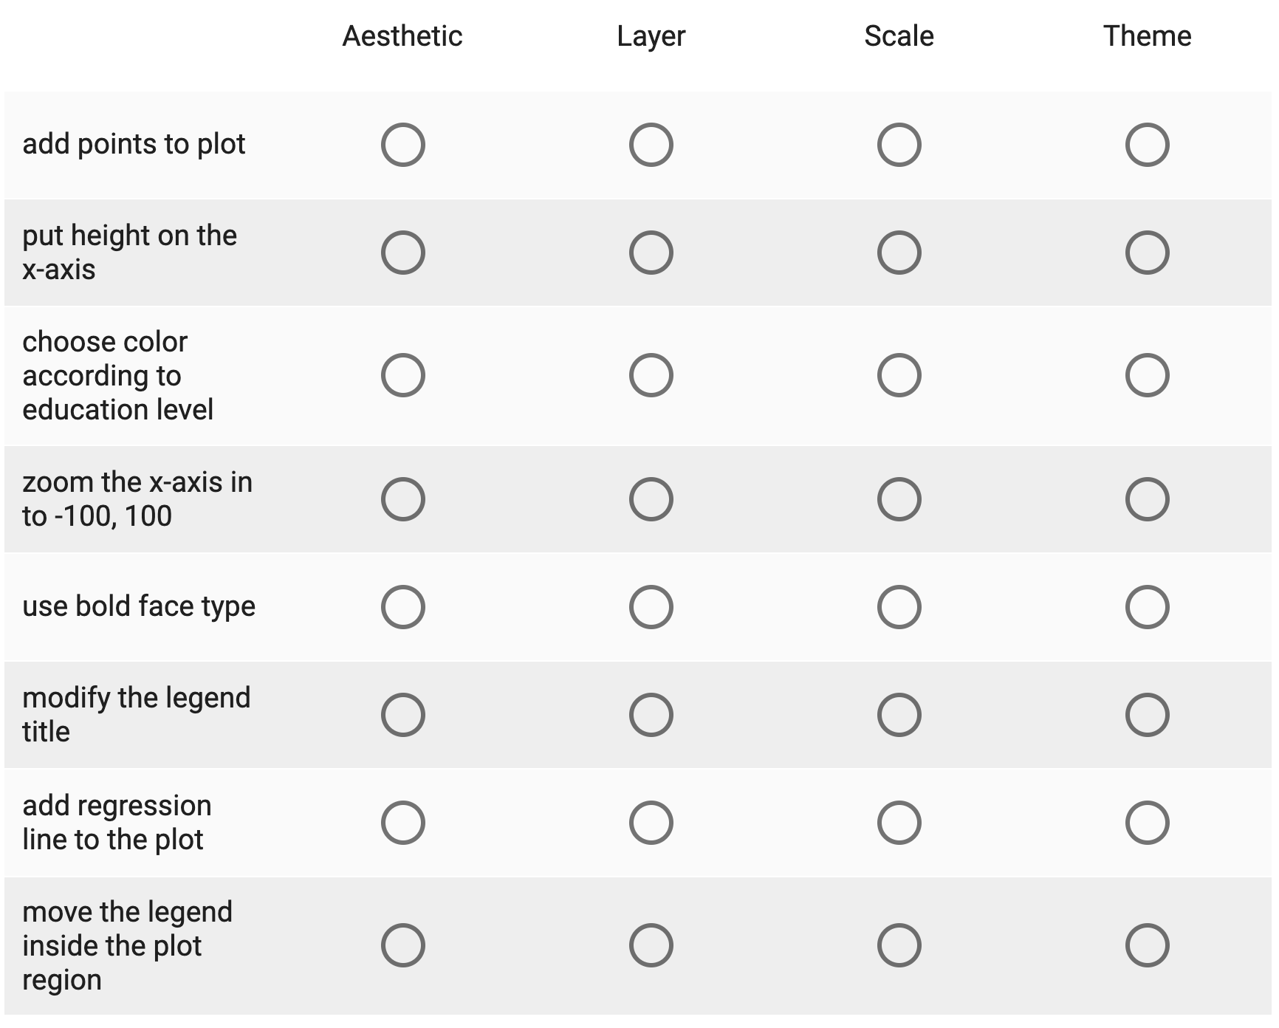

Review

Slide 2
Reshaping Data

Slide 3
Dropping Rows and Columns in a Data Frame

Slide 4
Review
filter – keep rows that meet a condition
filter(data.frame, logical)
select
select(data.frame, character)
slice
slice(data.frame, numeric)
Length matches number of rows in data frame
strings match column names in data frame
Positions of rows to keep in data frame

Slide 5
filter(data frame, logical)
T
F
T
T
F

Slide 6
slice(data frame, numeric)
1
3
4

Slide 7
select(data frame, character)
“x” “y” “z” “w”
“y” “z” “x”
“y” “z” “x”

Slide 8
Gathering and Spreading Vectors in a Data Frame

Slide 9
gather()
gather(df, “key”, “val”, x, y)
“x” “y” “z”
“key” “val” “z”
X
X
X
X
X
X
X
X
Y
Y
Y
Y
Y
Y
Y
y
Gather together/ stack the values of x and y into one vector called “val”
Create vector “key” to label whether these values are from x or y
Duplicate other vectors (e.g., z)

Slide 10
spread()
spread(df, “key”, “val”)
“key” “val”
“x” “y” “z” “w”
X
Y
Z
W
X
Y
Z
W
1
2
1
3
2
4
6
3
1
2
2
4
1
6
3
3
Create new vectors, one for each value in key
Spread the values in val across the vector with the corresponding name in key

Slide 11
Adding New Vectors and Changing Vectors in a Data Frame

Slide 12
mutate()
mutate(df, w = y + z)
“x” “y” “z”
“x” “y” “z” “w”
1
2
3
1
2
3
4
4
1
0
1
0
1
0
1
0
1
2
3
1
2
3
4
4
1
0
1
0
1
0
1
0
2
2
4
1
3
3
5
4
Add a new vector called ”w” to the data frame
w is the elementwise sum of y and z
If we had said x = y + z, then x would have been replaced with new contents

Slide 13
transmute()
transmute(df, w = y + z)
“x” “y” “z”
“w”
1
2
3
1
2
3
4
4
1
0
1
0
1
0
1
0
2
2
4
1
3
3
5
4
Create a new vector called ”w”
that is the element-wise sum of y and z
Put this in the new data frame.

Slide 14
Grouping Rows in a Data Frame

Slide 15
group_by()
df.g = group_by(df, “key”)
“key” “val”
“key” “tot” “n”
X
Y
Z
X
Y
Y
X
X
1
2
1
3
2
4
6
3
X
Y
Z
13
8
1
4
3
1
summarize(df.g, tot = sum(val), n = n()
Create a summary statistic for each group. Here, we sum the values in val and assign to tot, and count the rows and assign to n.
Group the rows according to the unique values of key. Three are 4 rows in the x-group, 3 in the y, and 1 in the z group.

Slide 16
Examples

