Slide 1
Toy Boat Data Frames
sailor1
## sid sname rating age ## 1 22 dustin 7 45 ## 2 31 lubber 8 55 ## 3 58 rusty 10 35
sailor2
## sid sname rating age ## 1 28 yuppy 9 35 ## 2 31 lubber 8 55 ## 3 44 guppy 5 35 ## 4 58 rusty 10 35
boat
## bid bname color ## 1 101 Interlake blue ## 2 102 Interlake red ## 3 104 Marine red ## 4 103 Clipper green
reservations
## sid bid day ## 1 22 101 16 ## 2 58 102 17 ## 3 58 102 18 ## 4 28 101 18 ## 5 44 103 18 ## 6 22 104 18 … ## 18 31 101 24 ## 19 58 104 24 ## 20 58 102 25

Slide 2
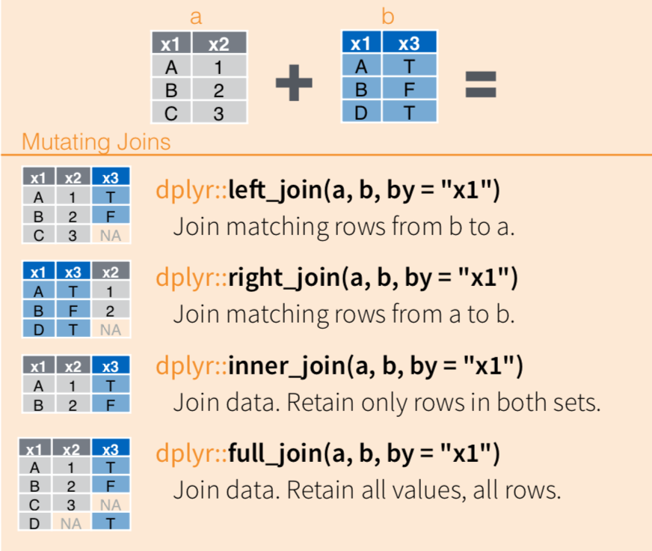
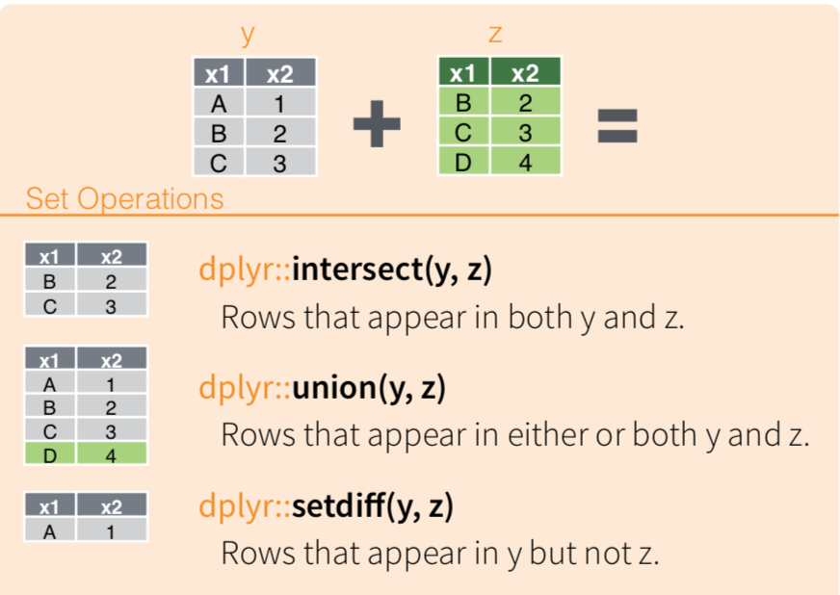
Joining Data Frames

Slide 3
group_by()
df.g = group_by(df, “key”)
“key” “val”
“key” “tot” “n”
X
Y
Z
X
Y
Y
X
X
1
2
1
3
2
4
6
3
X
Y
Z
13
8
1
4
3
1
summarize(df.g, tot = sum(val), n = n()
Create a summary statistic for each group. Here, we sum the values in val and assign to tot, and count the rows and assign to n.
Group the rows according to the unique values of key. Three are 4 rows in the x-group, 3 in the y, and 1 in the z group.

Slide 4
Exercises

Slide 5
Base R Subset Techniques
We can subset all kinds of objects

Slide 6
Subset by position

Slide 7
Subset by position

Slide 8
Subset by exclusion

Slide 9
Subset by logical

Slide 10
Subset by name
What would happen if the names were:
"a", "c", "c", "c"?
Is it possible for the subset values to be in a different order than the original vector?

Slide 11
Suppose we want the:
BMI of the 10th person in the family
> fbmi[10]
[1] 30.04911
Ages of all but the first person in the family
> fage[-1]
[1] 33 79 47 27 33 67 52 59 27 55 24 46 48
Subset by position
Subset by exclusion

Slide 12
Suppose we want the:
Height of person “j”
> fheight["j"]
j
71
Genders of the family members who are over weight
> fsex [foverWt]
[1] m f m m m f
Levels: f m
Subset by name
Subset by logical

Slide 13
Suppose we want the:
Genders of all the family members
> fsex [ ]
[1] m f m m f f m f m m f m m f
Levels: f m
Subset by all
Why would you ever want to do this?

Slide 14
Assign values to elements of a vector
In general, the same indexing may be used to assign values to elements of a vector.
Make sure the vector exists first, or you will get an error.
Notes:
Hint: letters is built in character vector

Slide 15
Assign values to elements of a vector
Can you guess what fheight will look like after each of the following lines?
> fheight
a b c d e f g h i j k l m n
70 64 73 67 61 68 68 65 68 71 67 66 66 62
fheight[2] = 61 # By inclusion
fheight[-13] = 62 # By exclusion
fheight["e"] = 67 # By name
fheight[overWt] = NA # By logical
fheight[] = 70 # By all
fheight = 70 # Watch out!
Notes:
Hint: letters is built in character vector

Slide 16
a b c d e f g h i j k l m n 70 64 73 67 61 68 68 65 68 71 67 66 66 62
fheight[2] = 61
a b c d e f g h i j k l m n
70 61 73 67 61 68 68 65 68 71 67 66 66 62
fheight[-13] = 62
a b c d e f g h i j k l m n
62 62 62 62 62 62 62 62 62 62 62 62 66 62
fheight["e"] = 67
a b c d e f g h i j k l m n
62 62 62 62 67 62 62 62 62 62 62 62 66 62

Slide 17
T F F F F T T F T T T F F F
fheight[foverWt] = NA
a b c d e f g h i j k l m n
NA 62 62 62 67 NA NA 62 NA NA NA 62 66 62
fheight[] = 70
a b c d e f g h i j k l m n
70 70 70 70 70 70 70 70 70 70 70 70 70 70
fheight = 70
[1] 70

Slide 18
Five ways to subset a vector
Position – indices of element wanted
Exclusion – indices of elements to exclude
Logical – logical vector the same length as the vector. Keep elements corresponding to TRUE.
Name – character vector of names of elements to keep.
All – all the elements

Slide 19
Taking a Subset of a Data Frame

Slide 20
Access a vector: dataframe$vector
> family$gender
[1] m f m m f f m f m m f m m f
Levels: m f
> mean(family$height)
[1] 67.07143
> class(family$height)
[1] "numeric"

Slide 21
family[ c("sex", "firstName") ]
sex firstName
1 m Tom
2 f Maya
3 m Joe
4 m Robert
5 f Sue
6 f Liz
7 m Jon
8 f Sally
9 m Tim
10 m Tom
11 f Ann
12 m Dan
13 m Art
14 f Zoe
Subset columns by name
The order of the columns is different than the order in the data frame. It matches the order of the names

Slide 22
Subsetting Data frames Using Row and Column Indexing
> family[ 10:13, -(3:14)]
firstName sex
10 Tom m
11 Ann f
12 Dan m
13 Art m
We can take subsets rows and columns
We subset by position, exclusion, logical, name, and all

Slide 23
> family[family$weight > 180, c("height", "bmi")]
height bmi
3 73 24.45
6 68 28.94
7 68 28.18
10 71 30.04
We subset the rows using a logical vector
We subset the columns by name

Slide 24
dataframe[ ]
> family[ , "height"]
height
1 70
2 64
3 73
4 67
5 61
6 68
7 68
8 65
9 68
10 71
11 67
12 66
13 66
14 62
We subset
ALL of the rows, and
the column named height
It returns a data frame with 14 rows and 1 column

