Slide 1
Toy Boat Data Frames
sailor1
## sid sname rating age ## 1 22 dustin 7 45 ## 2 31 lubber 8 55 ## 3 58 rusty 10 35
sailor2
## sid sname rating age ## 1 28 yuppy 9 35 ## 2 31 lubber 8 55 ## 3 44 guppy 5 35 ## 4 58 rusty 10 35
boat
## bid bname color ## 1 101 Interlake blue ## 2 102 Interlake red ## 3 104 Marine red ## 4 103 Clipper green
reservations
## sid bid day ## 1 22 101 16 ## 2 58 102 17 ## 3 58 102 18 ## 4 28 101 18 ## 5 44 103 18 ## 6 22 104 18 … ## 18 31 101 24 ## 19 58 104 24 ## 20 58 102 25

Slide 2
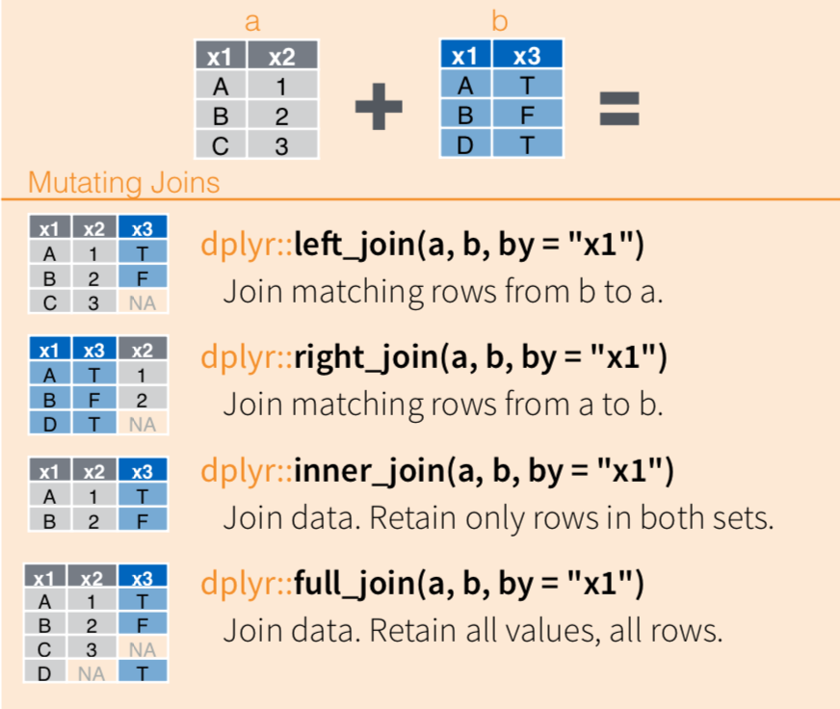
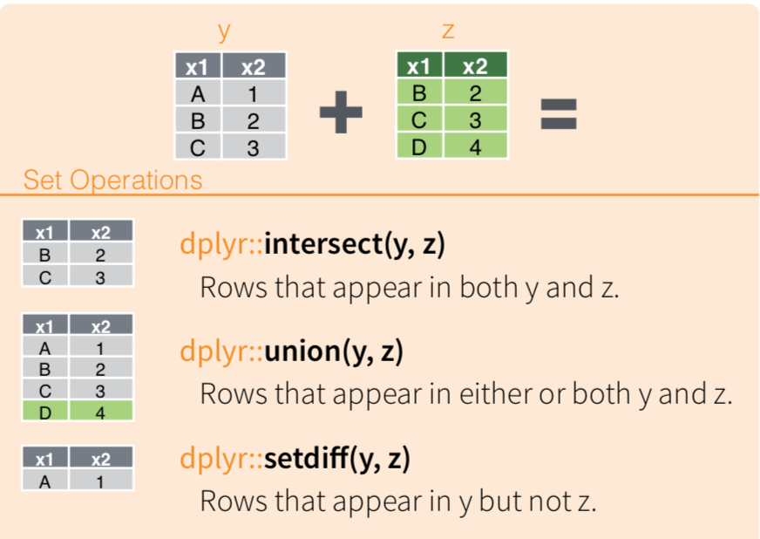
Joining Data Frames

Slide 3
group_by()
df.g = group_by(df, “key”)
“key” “val”
“key” “tot” “n”
X
Y
Z
X
Y
Y
X
X
1
2
1
3
2
4
6
3
X
Y
Z
13
8
1
4
3
1
summarize(df.g, tot = sum(val), n = n()
Create a summary statistic for each group. Here, we sum the values in val and assign to tot, and count the rows and assign to n.
Group the rows according to the unique values of key. Three are 4 rows in the x-group, 3 in the y, and 1 in the z group.

Slide 4
Exercises

