Slide 1
Intro to Functions

Slide 2
Example
height = c(72, 66, 50, 65, 69, 70, 65, 74)
We want to convert the heights from inches to centimeters.
height * 2.54
[1] 182.88 167.64 127.00 165.10 175.26 177.80 165.10 187.96

Slide 3
Encapsulate code in a function
convertCM = function(x)
{
x*2.54
}
convert(height)
[1] 182.88 167.64 127.00 165.10 175.26 177.80 165.10 187.96
We just wrote a one line function!
We just called our one line function!

Slide 4
Encapsulate code in a function
convertCM = function(x)
{
return(x * 2.54)
}
Create a function through an assignment of name to function()
The return value from the last evaluation is the return value of the function!
The arguments are x (required)

Slide 5
convertCM = function(x)
{
x * 2.54
}
Call function() to
Create (and return)
a function
Function Signature:
Required argument
Function Name
Function Body
Between { }

Slide 6
function (arguments) body
The call to function() asks R to create a function.
Recall that the parameters to a function are its inputs, which may have default values.
> args(median)
function (x, na.rm = FALSE, …)
Here, if we do not explicitly specify na.rm when we call median, it will be assigned the default value of FALSE.

Slide 7
The Arguments
When you write a function,
Put the most important arguments first.
Often these will not have default values.
This allows the user to easily specify the arguments by position.
We don’t have to think of this argument’s name.

Slide 8
Function Body
The body of the function consists of expressions surrounded by curly brackets.
{
expression 1
expression 2
  expression 3
}
When the function contains one expression, we don’t need brackets, e.g.,
function(arguments) expression 1

Slide 9
Return Value
The return() function hands control back to the caller of the function and returns a given value
{
expression 1
expression 2
  return(value)
}
If the function returns more than one thing, use a named vector or list, e.g.,
return(c(total = sum(x), avg = mean(x)))

Slide 10
Return Value
In the absence of a return( ) expression, the function returns the last evaluated expression.
This is particularly common if the function is short, e.g.,
convertCM = function(x) x*2.54
A return expression anywhere in the function will cause the function to return control to the user immediately, without evaluating the rest of the function.

Slide 11
Steps in Writing a Function

Slide 12
Steps In Writing a Function
Concrete: Start with code that addresses a problem with specific data
Abstract: Change the code to refer to general variables rather than your specific data
Encapsulate: Wrap the code into a function where the parameters are the general variables
Test: Check the function works as expected with your original data AND try the function on test cases with other data

Slide 13
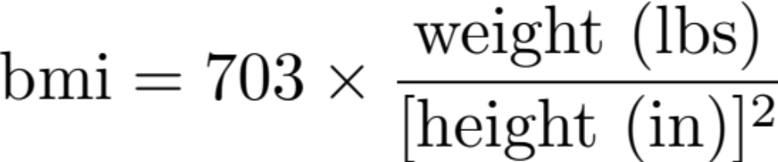
1. Write code to calculate bmi
Our variables
family$weight
family$height
703 * family$weight / family$height^2
[1] 25.10714 21.28223 … 24.20799 22.86030

Slide 14
2. Abstract
Change the code to refer to general variables rather than your specific data
703 * wt / ht^2

Slide 15
3. Encapsulate
Wrap the code into a function where the parameters are the general variables
calcBMI = function(wt, ht) {
703 * wt / ht^2
}

Slide 16
4. Test
Check the function works as expected with your original data AND try the function on test cases with other data
calcBMI(family$weight, family$height)
[1] 25.10714 21.28223 … 24.20799 22.86030
calcBMI(c(150, 200), c(66, 72))
[1] 24.20799 27.12191

Slide 17
Your Turn

Slide 18
Example
rain1 = c(3, 2, 0, 5, 5, 5, 20, 5, 5, 20)
mean(rain1)
[1] 7
We want to compute the mean, ignoring trace amounts of rain, e.g., when it rains at least 5 hundredths inch.
mean(rain1[rain1 > 5])
[1] ?
yellkey.com/adult

Slide 19
Example
What should we name the function?
What arguments should our function have?
What defaults (if any) should the arguments have?
Use an active verb or description of the return value , e.g., traceMean
x - numeric vector ov values to average
traceAmt – value of cutoff
x - required
traceAmt – 0 for default

Slide 20
Function Signature
traceMean =
function (x, traceAmt = 0) {
}

Slide 21
Encapsulate code in function
traceMean = function (x, traceAmt = 0)
{
mean(x[x>= traceAmt])
}
traceMean(rain1)
[1] 7
traceMean(rain1, 5)
[1] 9.29
We just wrote a one line function!

Slide 22
Test function
test1 = 1:10
traceMean(test1)
[1] 5.5
traceMean(test1, 5)
[1] 7.5
mean(5:10)
[1] 7.5

Slide 23
Extend Function to compute summary statistics
Rather than take means, we can provide a summary function as an argument:
traceSummary =
function(x, traceAmt=0,
sumFun = mean) {
sumFun(x[x >= traceAmt])
}

Slide 24
Test
Make sure that your function still works as before
traceSummary(test1)
[1] 5.5
traceSummary(test1, 5)
[1] 7.5
test2 = c(test1, 100)
traceSummary(test2, 5)
[1] 20.71429
Create and example where mean and median will be different.

Slide 25
Test
traceSummary(test1, 5, median)
[1] 7.5
traceSummary(test2, 5, sumFun = median)
[1] 8
median(c(5:10, 100))
[1] 8
Our revised function works as expected!

Slide 26
Apply traceSumary to rain
Rain is a list with 5 vectors of different lengths.
We can apply our new function to each element with:
sapply(rain, traceSummary, 5)
st050183 st050263 st050712 st050843 st050945
25.02009 21.21340 30.32159 30.86817 27.75768
sapply() calls our function on each element of the list, i.e., on each vector.
It simplifies the return value if possible.

Slide 27
Apply traceSumary to rain
Rain is a list with 5 vectors of different lengths.
We can apply our new function to each element with:
sapply(rain, traceSummary, 5, median)
st050183 st050263 st050712 st050843 st050945
16 10 17 20 19
sapply() passes the median function as an argument to our function.

Slide 28
What if
We wanted to update calcBMI() to work for metric system (kg and m) and the English system (lb and in)?
What if we want to check the input x to traceSummary() to make sure it is a numeric vector?
These require control flow statements, specifically
if-statements

Slide 29
Everything that happens [in R] is a function call.
— John Chambers

Slide 30
Infix Functions
> `+`(200, 20)
[1] 220
> `+`(200, `*`(4, 5))
[1] 220
> `=`(x, 6:3)
> x
[1] 6 5 4 3
> 200 + 20
[1] 220
> 200 + (4 * 5)
[1] 220
> X = 6:3
> x
[1] 6 5 4 3

