Slide 1
Flow Control - Loops

Slide 2
Loop Constructs
for() loop
while() loop
replicate()

Slide 3
Caution
Looping is the repeated evaluation of a block of code.
Much of what is handled using loops in other languages can be more efficiently handled in R using vectorized calculations or one of the apply() mechanisms.
However, certain algorithms, such as those requiring recursion, can only be handled by loops.

Slide 4
The for loop
for (var in vector) {
statement block
}
For each element in vector, the variable var is set to the value of that element and the block of code is evaluated.
vector can be any valid type

Slide 5
Explore the Distribution of the sum of random uniforms

Slide 6
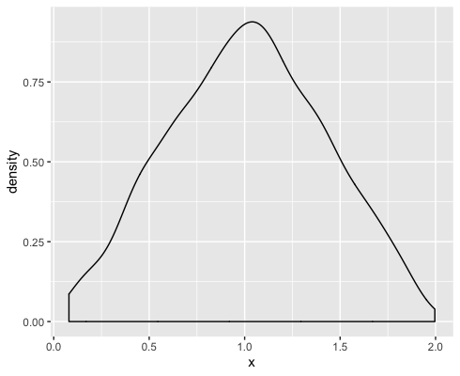
Investigation
We want an idea of the distribution of the sum of 2 random uniform variables.
X = runif(1000) + runif(1000)
ggplot(data.frame(X), aes(x = X)) +
geom_density()

Slide 7
Generalize to sum of n uniforms
sumUnifs = function(n, R = 1000) {
x = vector(mode="numeric", length = R)
for (j in 1:n) {
x = x + runif(R)
}
ggplot(data.frame(x), aes(x=x)) +
geom_density() +
labs(title=paste("sum of ", n," uniforms"))
}

Slide 8
sumUnif(2)
sumUInif = function(n, R = 1000 ) {
x = vector(…) | x
for (j in 1:n) { |  | x |  |  | x |  |  | x
x = x + runif(R) |  |  | x |  |  | x
} |  |  |  | x |  |  | x
ggplot(… |  |  |  |  |  |  |  |  | x
} |  |  |  |  |  |  |  |  |  | x

Slide 9
The while loop

Slide 10
Syntax
while (condition){
statement block
}
The condition is evaluated, and if it is TRUE, the statement block is evaluated. This process continues until condition evaluates to FALSE.

Slide 11
replicate()
replicate(n, statement block)
The statement block is evaluated over and over for a total of n times.
The block typically returns a value or vector of values, and these are collected into the simplest structure possible,
e.g., single values into a vector of length n
e.g., vectors of length m into an m by n matrix

Slide 12
Cautions
Pre-allocate the output container.
z = vector(mode = ‘numeric’,
length = length(x)
Use seq_along(x) rather than 1:length(x) in the for loop.
for (i in seq_along(x)) {
z[i] = sample(x[i], 1)
}

Slide 13
Early Termination
next exits the current iteration of the loop.
break exits the entire for loop.
These can be particularly helpful with while loops
Note: stop() causes an error

Slide 14
Double the Bet Until We Win

Slide 15
Game Rules
Bet $1 on a fair game (chance 50-50 to win)
If you win, then you keep your $1 and receive $1 in winnings. Stop and go home
If you lose, then bet again. This time $2.
If you win on the 2nd bet, keep your $2 and receive $2. In total you gained $2 - $1 (from the 1st round) = $1. Stop and go home.
CONTINUE IN THIS WAY DOUBLING DOWN UNTIL WIN ONCE. THEN GO HOME!

Slide 16
Number of bets until win $1
Let’s use a while loop to write a function that place bets (doubling each time) until we win $1.
We are interested in the number of bets it takes to win $1.

Slide 17
What does the while condition check?
A. The number of bets placed
The total amount of money lost
The result from a single bet

Slide 18
doubleWhile = function(){
bets = 0
urn = c(-1, 1)
res = -1
while (res < 0) {
res = sample(urn, 1)
bets = bets + 1
}
return(bets)
}

Slide 19
doubleWhile() suppose draws -1, 1
doubleWhile = function( ) {
bets = 0 | x
urn = c(-1, 1) |  | x
res = -1 |  |  | x
while (res < 0) { |  |  |  | x |  |  | x |  |  | x
res = sample(urn, 1) |  |  |  |  | x |  |  | x
bets = bets + 1 |  |  |  |  |  | x |  |  | x
}
return(bets) |  |  |  |  |  |  |  |  |  |  | x
}

Slide 20
doubleWhile() suppose samples from urn: -1, -1, 1
doubleWhile = function( ) {
bets = 0 | x
urn = c(-1, 1) |  | x
res = -1 |  |  | x
while (res < 0) { |  |  |  | x |  |  | x |  |  | x |  |  | x
res = sample(urn, 1) |  |  |  |  | x |  |  | x |  |  | x
bets = bets + 1 |  |  |  |  |  | x |  |  | x |  |  | x
}
return(bets) |  |  |  |  |  |  |  |  |  |  |  |  |  | x
}

Slide 21
Your Turn
Write your own summary function, called mySummary
Inputs:
x – numeric vector want to summarize
funs = list of functions you want to summarize x with. Default is a list of length 2 – mean and median functions
Output: a vector of summary statistics

Slide 22
mySummary = function(x, funs = list(mean, median)) {
out = vector(mode = "numeric", length = length(funs))
for (i in seq_along(funs)) {
out[i] = funs[[i]](x)
}
return(out)
}
> z =(c(1:10, 100)
> mySummary(z, funs=list(min, median, max))
[1] 1 6 100
> mySummary(z)
[1] 14.09091 6.00000

