Slide 1
The Bootstrap

Slide 2
Recap – Simulation Topic
We have a population
We have a probability mechanism for generating our sample
We can use theory or simulation to understand the sampling behavior of our statistic
BUT – what happens when we don’t know the population? Which is the case most of the time!

Slide 3
Food Safety Scores for SF Restaurants
All inspected restaurants in San Francisco in 2016
Measurement of interest: inspection score
Note this is an administrative data set
AND it is the population of interest

Slide 4
Population Distribution
Percentages will be more useful
52: 0.022
55: 0.066
56: 0.044
58: 0.022
59: 0.088
60: 0.066
61: 0.110
88: 4.182
90: 6.934
92: 8.695
94: 8.871
96: 11.534
98: 6.692
100: 14.440
Population mean = 90
Population SD = 8.3

Slide 5
Our Sample of 100
Empirical Distribution of
100 Sample Restaurant Scores
Population Distribution of
4543 Restaurant Scores
Sample Mean: 89.8
Population Mean: 90.0
These are very close,
but not identical
Simple Random Samples tend to look like the population

Slide 6
BUT, We Got One Sample….
How do we use this to make statements about the population?

Slide 7
Here it is!
Note: If we only want to make statements about the sample, then we simply use the average loss, etc.
NOW WHAT?

Slide 8
Now What?
We know:
the sample should look like the population
The Sample Average is an estimator for the population mean
For large n, the sampling distribution of the Sample Average looks roughly normal

Slide 9
But What If:
The sample size is large, but is it large enough?
We are interested in a statistic and parameter other than the Sample Average?

Slide 10
Our Data Generation Gives Us an Approach
Population
Sample
AVG
Values chosen with Replacement from Population
How does the average vary?
Standard Error of AVG
What are the likely values?
Sampling Distribution of the AVG

Slide 11
With Simulation Studies we repeat the process many times
Sample
AVG
Population
Sample
AVG
Sample
AVG
Sample
AVG
Collect together the AVGs, make histogram of the AVGs, and answer the questions

Slide 12
Now We don’t know the Population
We have seen that the sample looks like the underlying population (data generator)
Create a Bootstrap Population from the sample
Mimic the process of generating samples – draws from the population

Slide 13
Apply the Chance Process to the Bootstrap Population
Bootstrap
Sample
STAT
Bootstrap
Population
Bootstrap
Sample
STAT
Bootstrap
Sample
STAT
Bootstrap
Sample
STAT
Mimic the process of choosing samples

Slide 14
Core Idea
We generate bootstrap samples from the bootstrap population in a similar manner as the way the sample was generated from the population –
To Do This We Ned To Understand the Chance Process That Generated Our Data
We compute the bootstrap statistic from the bootstrap sample, in the same way we compute the statistic from the sample

Slide 15
Core Idea
bootstrap population ≈ population
bootstrap sample relates to bootstrap population
≈ sample relates to the population
bootstrap statistic’s distribution shape & variability
≈ statistic’s distribution shape and variability

Slide 16
Bootstrap the sample mean
What is the average of this bootstrapped distribution?
The average of the original sample

Slide 17
Bootstrapping other statistics

Slide 18
Bootstrapping the sample proportion
Use the sample as the bootstrap population
Draw a sample of 100 with replacement from the bootstrap population
Calculate the proportion of scores over 95
Repeat steps 2 and 3 many times

Slide 19
Bootstrap sample proportion
Notice that our bootstrap proportions look roughly normal but there are funny gaps
The red dot is the true population proportion
The green interval is the inner 95% of the bootstrapped distribution (0.22, 0.40)

Slide 20
Bootstrap Percentile Confidence Interval
The green interval is the inner 95% of the bootstrapped distribution (0.22, 0.40)
It’s a confidence interval for the true proportion.
Notice that the true proportion is in the interval
Does this always happen?

Slide 21
Simulate Bootstrap Confidence Intervals
Take a SRS of 100 from our population
Bootstrap 4000 sample proportions from this sample
Find the 2.5 percentile and 97.5 percentile of the bootstrap sampling distribution
Repeat many times

Slide 22
Bootstrapping the 75th Percentile

Slide 23
Bootstrap the 75th percentile
Notice that due to the separation of the values in the population, the 75th percentile are quite separated.
Nearly 6000 of the 10000 bootstrap 75th percentiles are 96
The 95% confidence interval is (94, 100) – the whole range

Slide 24
95% Confidence Intervals for the 75th percentile
Notice that due to the separation of the values the intervals are sometimes quite short and other times quite long
All 100 of them include the true value, but for many the true value is at the endpoint of the interval

Slide 25
Bootstrapping is powerful BUT
Make sure that the original sample is large and random so that the sample resembles the population
Repeat the bootstrap process many times. Typically 10000 replications is a reasonable number
The bootstrap tends to have difficulties when
Parameter estimate is influenced by outliers
Parameter is based on extreme values of the distribution
Sampling distribution of the statistic is far from bell-shaped

Slide 26
Other Kinds of Bootstrapping

Slide 27
Bootstrapping in Regression

Slide 28

Question: Do 720 5-kg cats produce more heat than 1 3600 kg elephant?
Or, the story of the spherical cat

Slide 29
Kleiber’s Equation
Does a horse produce more heat per day per kilogram of body mass than a rat?
This is a question studied by Kleiber (1947), Clarke (2010)
Metabolic Rate: kilocalories per day
Mass in kg
He measured 19 animals (mouse, dog, cat, goat, man, cow, elephant…)

Slide 30
Scatter plot and fitted line
Line has slope 0.75
Response
Explanatory

Slide 31
Inference & Bootstrapping
Why is the slope ¾?

Slide 32

Why is the slope ¾?
An alternative theory is that the exponent should be 2/3 because of the relationship between mass and surface area.
The spherical cat:

Slide 33
Explain 2/3

Slide 34
Test the hypothesis: slope = 2/3
Null Hypothesis: true slope is 2/3 AND
the observed difference between fitted coefficient and the true coefficient of 2/3 is due to chance in the sampling of the mammals
How to get a sense of this chance?

Slide 35







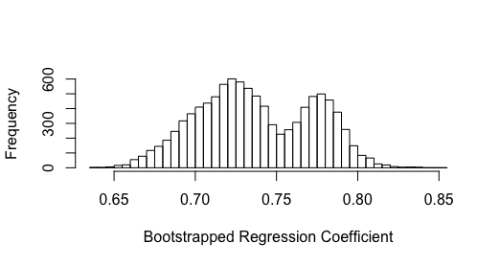
Bootstrapping
Population
My Sample
Bootstrap
Population
Bootstrap Sampling Distribution of the Coefficient
Bootstrap Coefficients
Bootstrap Samples

Slide 36
Bootstrap the coefficient
Bootstrap population: 19 (x,y) pairs of mass and metabolic rate
Bootstrap sample gives us a bootstrap statistic - the slope of the regression line
Take 10,000 bootstrap samples from the bootstrap population
Examine the distribution of bootstrapped coefficients.
If 2/3 is not within the (0.025, 0.975) percentiles of the bootstrapped distribution of the coefficient, then reject the hypothesis

Slide 37
Bootstrap Sampling Distribution
Based on these percentiles we would reject the hypothesis that the slope is 2/3. But…
Why does it look like that?
Does this mean that we shouldn’t be doing the bootstrap?
Percentiles:
0.025 percentile is 0.673
0.975 percentile is 0.799

Slide 38
Kleiber’s rule studied by Clarke (2010)
Slope remains 3/4

Slide 39
The Studentized Bootstrap

Slide 40
We often studentize our statistic before we bootstrap:
Bootstrap the studentized statistic :
Bootstrap version
Then find the 2.5 and 97.5 %-tiles of the studentized distribution and use them to create an interval for
* Statistic for bootstrap population Typically
Estimating the SE may require a second bootstrap

Slide 41
Response Times for Network Service

Slide 42
NY Commission monitors response time for service repairs in the state
The commission requests data on the repair times for a 3-month time period
They are interested in average repair time

Slide 43
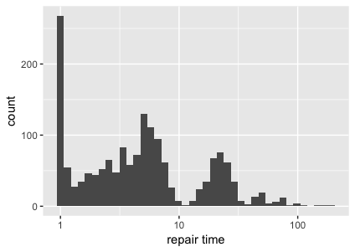
Wait time Distribution
Now see a spike at 0, indicating many repairs are completed immediately
Gap around 10, indicating that some repairs wait to the next day
Large mode - Most repairs completed in a day

Slide 44
Average Repair Time
AVG = 9.4 hours
Another time period will have a different average time
Would like to give an interval estimate of the repair time
The interval reflects the typical deviation in average repair time
SE ≈ SD(sample)/√n = 0.36 hours

Slide 45
Average Repair Time
We expect the distribution of repair times will be similar to our sample
We can use our sample as the population of repair times
We generate new samples of repair times from this “population” and examine the variability in the average

Slide 46
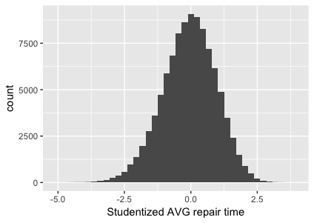
Bootstrapped Sampling Distribution of the studentized sample average
2.5% is -2.16
97.5% is 1.81
9.4 - 1.81*0.36
9.4 + 2.16 *0.36
Or
(8.7, 10.2) hours

