Slide 1
Case Study:
The Data Science Life Cycle

Slide 2
Data Science Life Cycle
Design
Data Collection
Data Cleaning
Test-train split
Context
Question
Refine Question to an one answerable with data
?
Modeling
Loss function choice
Feature engineering
Transformations,
Dummy Variables
Model selection
Best-subset regression
Cross-Validation
Model evaluation
Prediction error

Slide 3
Notes on the Approach
Question refinement
Visualization to clean data
Connection between regression and supervised learning
Test-train split before EDA
Multivariate problem
Physical model vs Statistical model

Slide 4
Notes on the Approach
Model fitting as an optimization problem
Alternative loss functions
Feature engineering and interpretability of coefficients
Inference vs Prediction
Cross-validation for model selection
Model Assessment with relative error

Slide 5
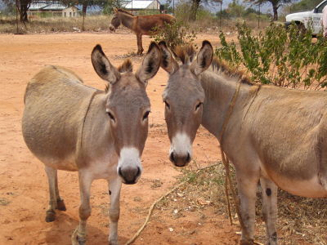
Context
How to weigh a donkey in the Kenyan countryside,
Significance, 2014, Milner and Rougier

Slide 6
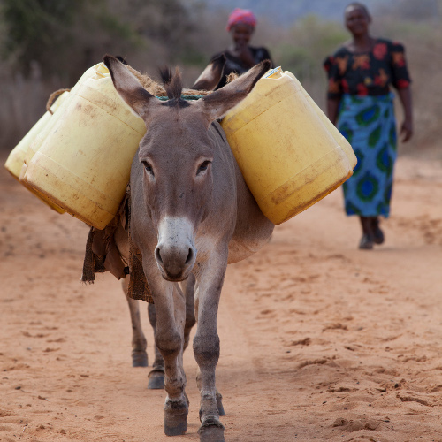
Context
Rural Kenya
Donkeys very important for transport - crops, water, people, ploughing
When donkeys fall sick, vets need to prescribe medicine
Dosage depends on weight, but no scale in the countryside
1.8 million donkeys in Kenya

Slide 7
Question
How can a vet prescribe medication without knowing the weight of the donkey?

Slide 8
Refined Question
Can we accurately estimate the weight of a donkey from other more easily obtained measurements?

Slide 9
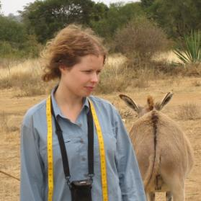
Design /
Sampling Frame
Kate Milner received a grant from The Donkey Sanctuary to Design a Study to Answer this question

Slide 10
Design
Measuring girth (cm)
Donkeys are routinely brought to The Donkey Sanctuary for de-worming
At the sanctuary, they can be weighed and additional measurements taken, such as girth and height.
Measuring height (cm)

Slide 11
Other Design Considerations
Donkeys were randomly selected at the de-worming site
Donkeys were marked after being measured
Thirty donkeys were weighed twice, with other donkeys weighed between the 2 measurements
Why random selection?
Why marked?
Why weigh other donkeys in between?

Slide 12
Data Collection
BCS – Body Condition Score 1=emaciated, 3=healthy, 5=obese, with ½ scales
Age – categories < 2, 2-5, 5-10, 10-15, 15-20, > 20 years
Sex – stallion, gelding, female
Length (cm)
Girth (cm)
Height (cm)
Weight (kg) - RESPONSE

Slide 13
Data Cleaning

Slide 14
Data Cleaning
Compare the second weighing to the first weighing for the 30 donkeys
Conclusion: measurement error in weight is negligible

Slide 15
Data Cleaning
Further investigation reveals
1 donkey has BCS 1
1 donkey has BCS 4.5
1 donkey weighs 27 kg and is determined to be a baby
What to do with these 3 donkeys? - Eliminate from the data set

Slide 16
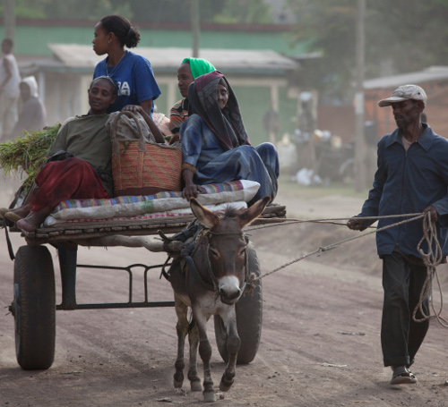
Modeling

Slide 17
Supervised Learning
We have ”labeled” data – we know the weight of each donkey (the response)
We want to build a model for predicting weight of a donkey when we don’t have the donkey’s weight
The model needs to perform well enough to be used in the field
The model needs to be simple enough for implementation in the field (paper, pencil, and tape measure)

Slide 18
The Variables in Our Model:
Column/feature space
n
n
p+1
1
n records in p+1 dimensions (columns or features)

Slide 19
Columns space of X
n
n
p
1
Ŷ minimizes the L₂ empirical risk
y
Ŷ is the PROJECTION of Y into the subspace spanned by the columns of X
Subspace spanned by X¹ and X²
X¹
Normal to subspace
Spanned by X
Definition of orthogonal
X²

Slide 20
How can we assess our model?
How well does our model predict the weight of a new donkey?
The risk: For a new donkey with p features:
(p+1) x 1
Only problem is that we can’t take this expectation
1 x (p+1)
E.g., a row in the design X

Slide 21
Train – Test Split
Set aside some data before we begin our EDA and model fitting

Slide 22
How can we assess our model?
If we use the same data to fit and assess the model, then we overestimate how well our model does at prediction.
Instead, use a test set:
Fitted (AKA trained) on n-m observations
Assessed (AKA tested) on m independent observations

Slide 23
Training vs Test Error
← Underfitting
Overfitting →
Error from new m observations
Best Fit
Test Error
Error (Loss)
Training Error
Error from original n-m observations
Model “complexity”
(e.g., number of features)

Slide 24
Train-Test Split
Training Data: used to fit model
Test Data: check generalization error
How to split?
  Randomly, Temporally, Geo…
  Depends on application (usually randomly)
What size? (90%-10%)
  Larger training set → more complex models
  Larger test set → better estimate of generalization error
  Typically between 75%-25% and 90%-10%
Train - Test
Split
Train
Data
Test
You only use the test dataset once after deciding on the model.

Slide 25
Split our data before we begin EDA
Set aside 20% of the records
We will use these to assess the accuracy of our model
n = nrow(donkeys)
set.seed(12321)
testIndex = sort(sample(n,
size = ceiling(0.2*n)))
donkeyTest = slice(donkeys, testIndex)
donkeyTrain = slice(donkeys, -testIndex)

Slide 26
Train Model then Test Model
Optimize on Train set
Minimizer:
Evaluation on Test set
0.8n x 1
0.8n x p
p x 1
0.2n x 1
0.2n x p
p x 1

Slide 27

EDA

Slide 28
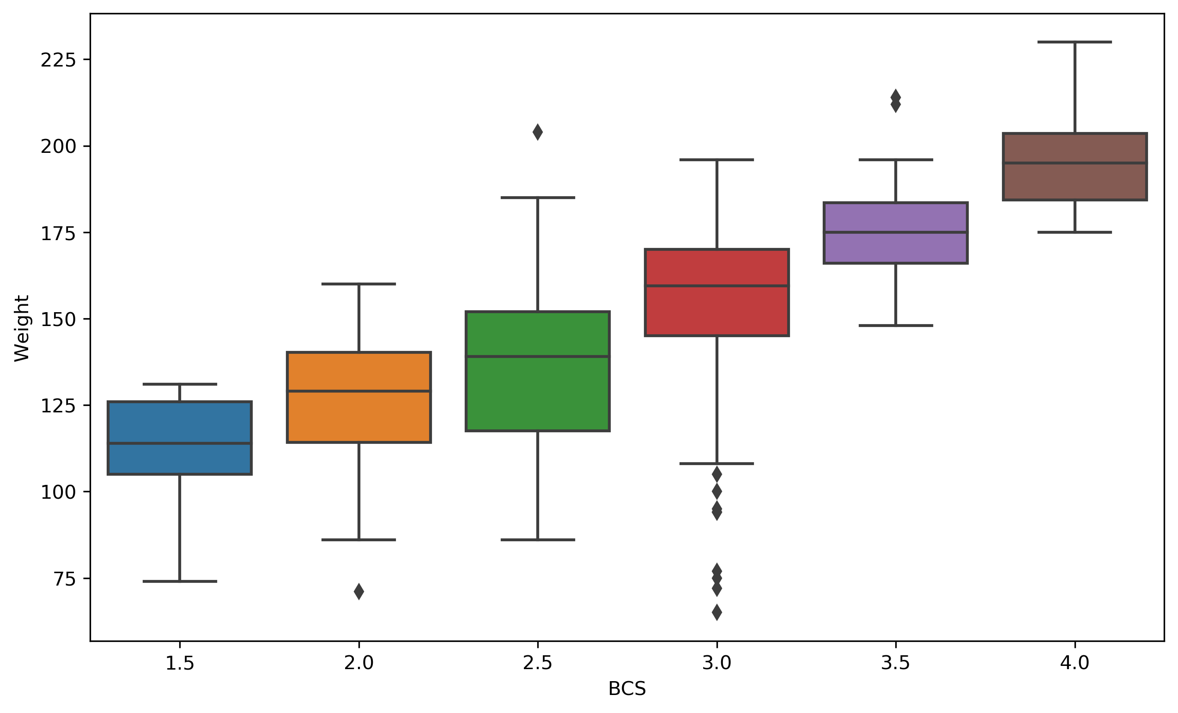
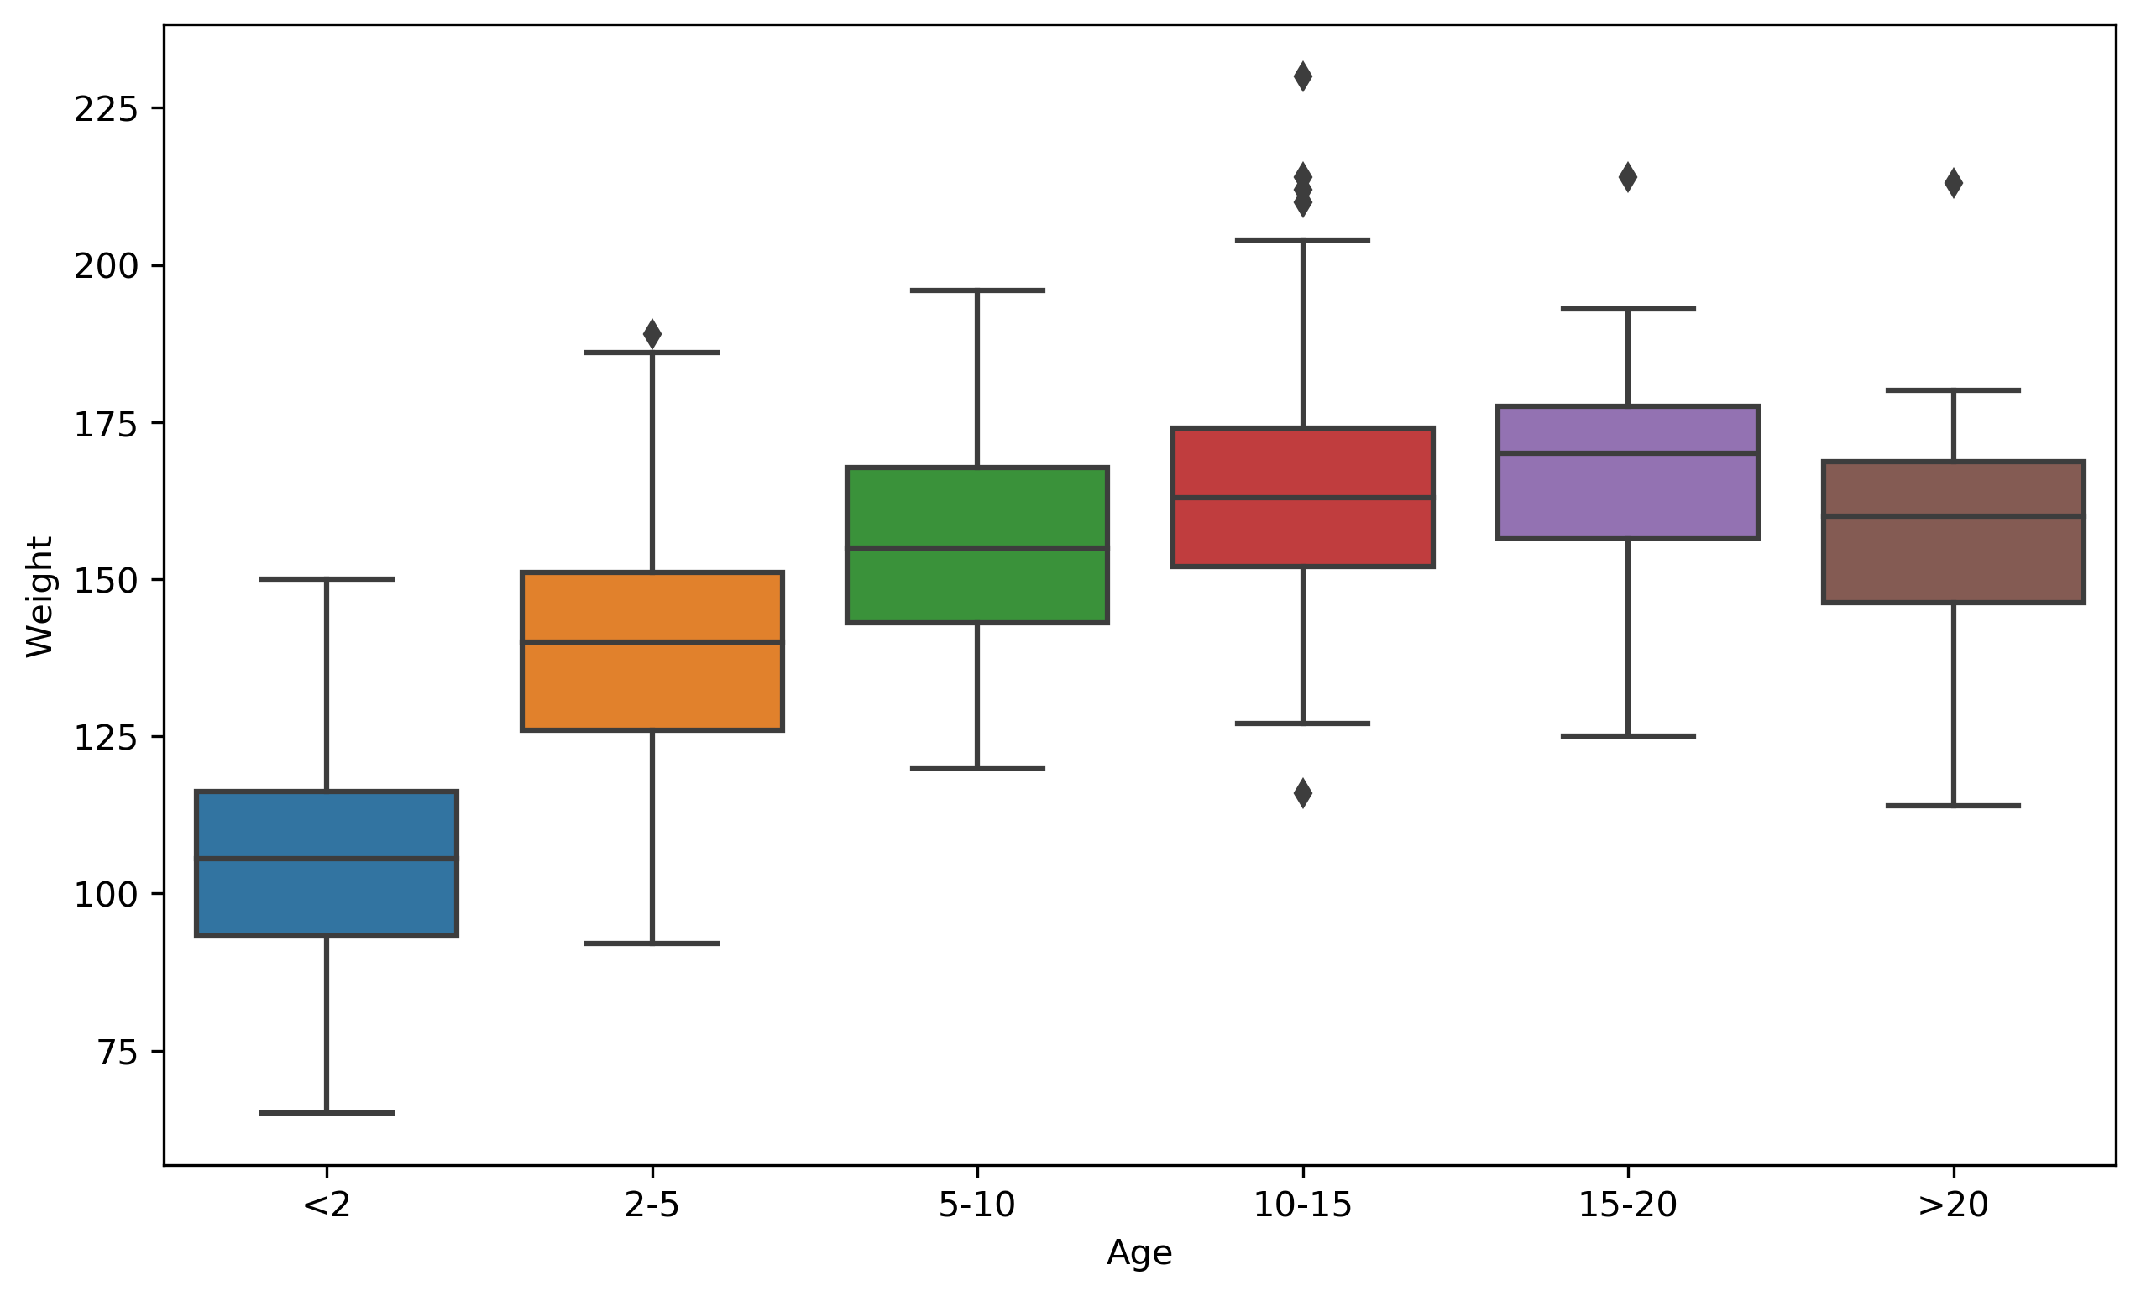
Weight and Body Condition score do not have a linear association
Donkeys over 10 seem to have the same weight distribution

Slide 29
Not a big difference between stallions and females
Girth and length are correlated
(as are Girth and height)

Slide 30
Starting Point for Model

Slide 31
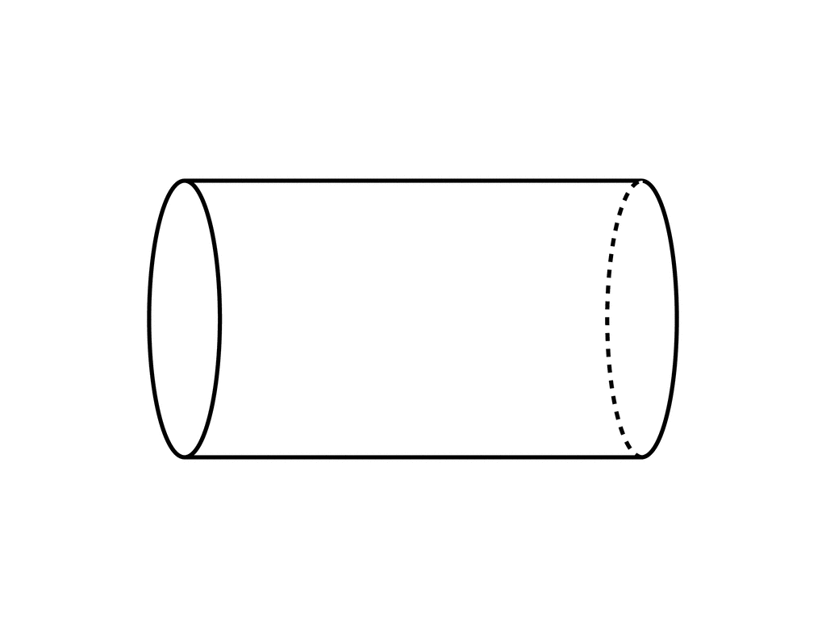
Physical Model
The donkey as a cylinder with appendages
Suggests Model:
Statistically, consider other variables and transformations may not be necessary

Slide 32
Loss Function

Slide 33
Two Scenarios
Loss function should reflect the cost to the donkey’s health of prescribing the wrong dose
Antibiotics:
  Effect is less sensitive to the weight of the donkey
  Better to overdose - otherwise infection might not be treated
  An under-dose could lead to drug resistance
Anesthetics:
  Effect is more sensitive to the weight of the donkey
  Better to under-dose: the effect can be observed and adjusted

Slide 34
Anesthetics Scenario
The x-axis is relative error as a percentage
A value of -10% corresponds to the situation where the actual weight is 10% smaller than the predicted weight

Slide 35
Feature Engineering

Slide 36
Feature Engineering
The process of transforming the inputs to a model to improve prediction accuracy.
  A key focus in many applications of data science
  An art …
Feature Engineering enables you to:
  encode non-numeric features to be used as inputs to models
  capture domain knowledge (e.g., periodicity or relationships between features)
  transform complex relationships into simple linear relationships

Slide 37
Basic Transformations
Uninformative features: (e.g., UID)
  Is this informative (probably not?)
  Transformation: remove uninformative features
Quantitative Features (e.g., Age)
  Transformation: May apply non-linear transformations (e.g., log)
  Transformation: Normalize/standardize
    Example: (x – mean)/stdev
Categorical Features (e.g., Gender)
  How do we convert into meaningful numbers?
    female =1 , gelding = 2, stallion = 3 ?
    Implies order/magnitude means something … we don’t want that ...
  Transformation: Make a factor

Slide 38
We have 3 numeric variables
Use 1, 2, or 3 variables in the model?
There are only 7 combinations of these variables, so we try all of them.
What would you do?

Slide 39
Take Stock
Dropped 3 records
Divided the data into 20%-80% split and set 20% aside
EDA showed that some of the categorical variables may be useful
Selected a loss function that erred on the side of under-dosing
Examined models for weight based on the numeric variables and selected girth and length to explain weight

Slide 40
Categorical Data

Slide 41
Dummy encoding
Transform categorical feature into many binary features:
Sex
gelding
stallion
female
female
stallion
gelding | stallion | female
1 | 0 | 0
0 | 1 | 0
0 | 0 | 1
0 | 0 | 1
0 | 1 | 0
QUESTION: What happens when we add these 3 variables together?

Slide 42
Model with girth and sex dummies
Vectors (n by 1) of 0s and 1s for geldings, stallions, and females respectively
Girth measurements
Weight measurements

Slide 43
Model with girth and sex dummies
For a gelding, what does this linear model reduce to?
The stallion and female dummies are both 0
The stallion model is
The female model is

Slide 44
Adding Dummy variables to a model yields parallel fitted lines
Group 1
Group 2
Group 3

Slide 45
Why not treat BCS as numeric?
BCS
15
2.0
2.5
2.5
2.0
The relationship need not be linear in the numeric values.
This coding is more flexible

Slide 46
We may want to collapse categories
It appears that for donkeys over 10, the weight distributions are quite similar so we collapse them into one group.

Slide 47
Final Model
Keep all levels of BCS
Collapse Age levels over 10 into one
Drop Sex all together
Keep Girth and Length

Slide 48
How we chose the model
We use a physical model as a starting point
We considered model complexity
We made residual plots
We examined MSE (Mean Square Error, AKA Empirical Risk)
BUT, we didn’t look at all possible models
What are other ways to choose a model?

Slide 49
Model Selection &
Cross-Validation

Slide 50
Variables
Girth, Length, Height, BCS, Age, Sex
Not including transformations, how many possible models could we have examined?
2⁶ - 1 = 63

Slide 51
Best Subset Regression
Fit all 63 models:
  6 one-variable models
  15 two-variable models
  20 three-variable models
  15 four-variable models
  6 five variable models
  1 6-variable model
(Note that I am counting each qualitative variable as 1, which isn’t quite right)
For each degree, (one-variable, two-variable, etc.),
find the model that minimizes the empirical risk
We still have a problem: how many variables do we settle on for the model?

Slide 52
How to choose the best size model?
Ideally we want to do well in predicting a donkey in the future
We used the 500+ donkeys to fit the models
We want the model to do well at predicting the weight of a donkey that we have not seen/measured.

Slide 53
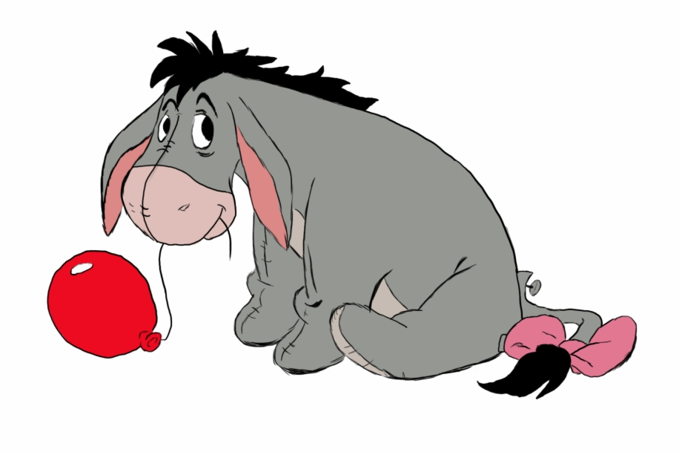
Along comes a new donkey…

Slide 54
How to choose the best size model?
The unseen donkey will be from the same distribution of donkeys as the ones that we have seen already.
We want the expected loss for this new donkey to be small
Recall, that to estimate the prediction error, we set aside 20% of the data to assess our model after we chose it
But we need help choosing the model!

Slide 55
The Train-Test Split
Training Data: used to fit model
Test Data: check generalization error
Train - Test
Split
Train
Data
Trained on 0.8xn observations
Test
Tested on
m = 0.2n observations

Slide 56
Generalization: Validation Split
Training Data: used to fit model
Test Data: check generalization error
How to split?
  Randomly, Temporally, Geo…
  Depends on application (usually randomly)
What size? (90%-10%)
  Larger training set → more complex models
  Larger test set → better estimate of generalization error
  Typically between 75%-25% and 90%-10%
V
Train - Test
Split
Validation
Split
Train
Train
V
Train
Train
V
Train
Data
V
Train
Validate
Generalization
V
5-Fold
Cross-Validation
Test
Cross validation simulates multiple train test-splits on the training data.
You can only use the test dataset once after deciding on the model.

Slide 57
Generalization: Validation Split
Training Data: used to fit model
Test Data: check generalization error
How to split?
  Randomly, Temporally, Geo…
  Depends on application (usually randomly)
What size? (90%-10%)
  Larger training set → more complex models
  Larger test set → better estimate of generalization error
  Typically between 75%-25% and 90%-10%
Train
Fit model with data not in first fold
Compute square error for data in the first fold
V

Slide 58
Generalization: Validation Split
Training Data: used to fit model
Test Data: check generalization error
How to split?
  Randomly, Temporally, Geo…
  Depends on application (usually randomly)
What size? (90%-10%)
  Larger training set → more complex models
  Larger test set → better estimate of generalization error
  Typically between 75%-25% and 90%-10%
REPEAT
V
Train
Train
V
Train
V
Train
V
Train
V
These 5 sums are not independent of one another, but each summand has independence between the data used to fit the model and the data used to assess prediction error
How many times does
get used?

Slide 59
How to Implement with Best Subset Regression
Find the best one-variable model for data not in fold 1.
Obtain the loss for that one-variable model using fold 1.
Repeat for folds 2, 3, 4, 5
Combine into one assessment for the best one-variable model
Repeat for each size model.
Select the model size according to the minimum cross-validated error.
Find the best model for that size using all of the training data.

Slide 60
Training vs Test Error
← Underfitting
Overfitting →
Best Fit
Test Error
Error
Training Error
Model “complexity”
(e.g., number of features)

Slide 61
Final Model Assessment

Slide 62
Test Data Returns!
Nearly all (95%) of the actual weights are within 10% of the predicted weights
Note that we use relative error here

Slide 63
Data Science Life Cycle
Design
Data Collection
Data Cleaning
Test-train split
Context
Question
Refine Question to an one answerable with data
?
Modeling
Loss function choice
Feature engineering
Transformations,
Dummy Variables
Model selection
Best subset regression
Cross-Validation
Model evaluation
Prediction error

