Slide 1
Combiners in MapReduce
Mahmoud (Max) Parsian
Ph.D. in Computer Science

Slide 2
MapReduce job
Input path
Output path
map() function
reduce() function
combine() [OPTIONAL]

Slide 3
Typical MapReduce Job
A typical MapReduce job has two functions:
map()
reduce()
But, you can further optimize the output of mappers by adding a combiner function:
combine()

Slide 4
What is a Combiner?
combine() [OPTIONAL]
Combiner is also known as “Mini-Reducer” that summarizes the mappers output with the same key before passing to the Reducer.
The primary job of Combiner is to process the output data from the mappers, before passing it to reducer.
The combine() function runs after the mapper and before the reducer

Slide 5
Informal Example
Mappers output from partition-1:
Partition-1: (K, v1), (K, v2), (K, v3)
Partition-2: (K, t1), (K, t2), (K, t3), (K, t4)
Rather than sending (K, [v1, v2, v3, t1, t2, t3, t4]) to a reduce() function, we can send
(K, [V, T])
where
V = combine([v1, v2, v3])
T = combine([t1, t2, t3, t4])

Slide 6
Informal Example
Mappers output from partition-1:
Partition-1: (K, v1), (K, v2), (K, v3)
Partition-2: (K, t1), (K, t2), (K, t3), (K, t4)
Rather than sending (K, [v1, v2, v3, t1, t2, t3, t4]) to a reduce() function, we can send (K, [V, T])
where
V = combine([v1, v2, v3])
T = combine([t1, t2, t3, t4])
Note that you have to guarantee that:
Type(V) = Type(v1) = Type(v2) = Type(v3)
Type(T) = Type(t1) = Type(t2) = Type(t3) = Type(t4)
AND combine() is a commutative and associative function.

Slide 7
What about Combiners?
Combiner is also known as “Mini-Reducer” that summarizes the mapper output record with the same Key before passing to the Reducer.

Slide 8
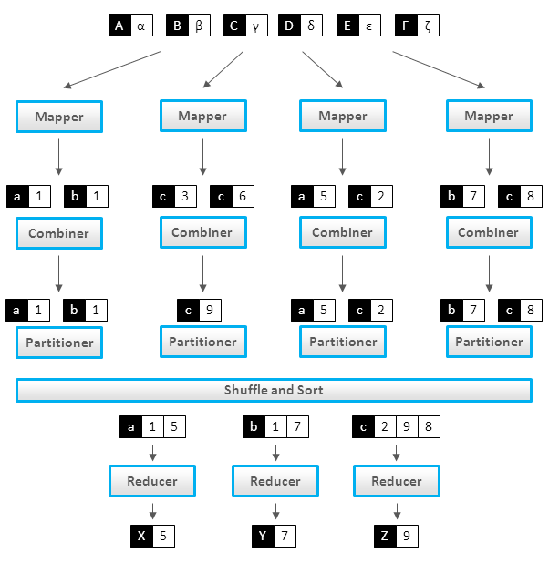
What about Combiners?

Slide 9
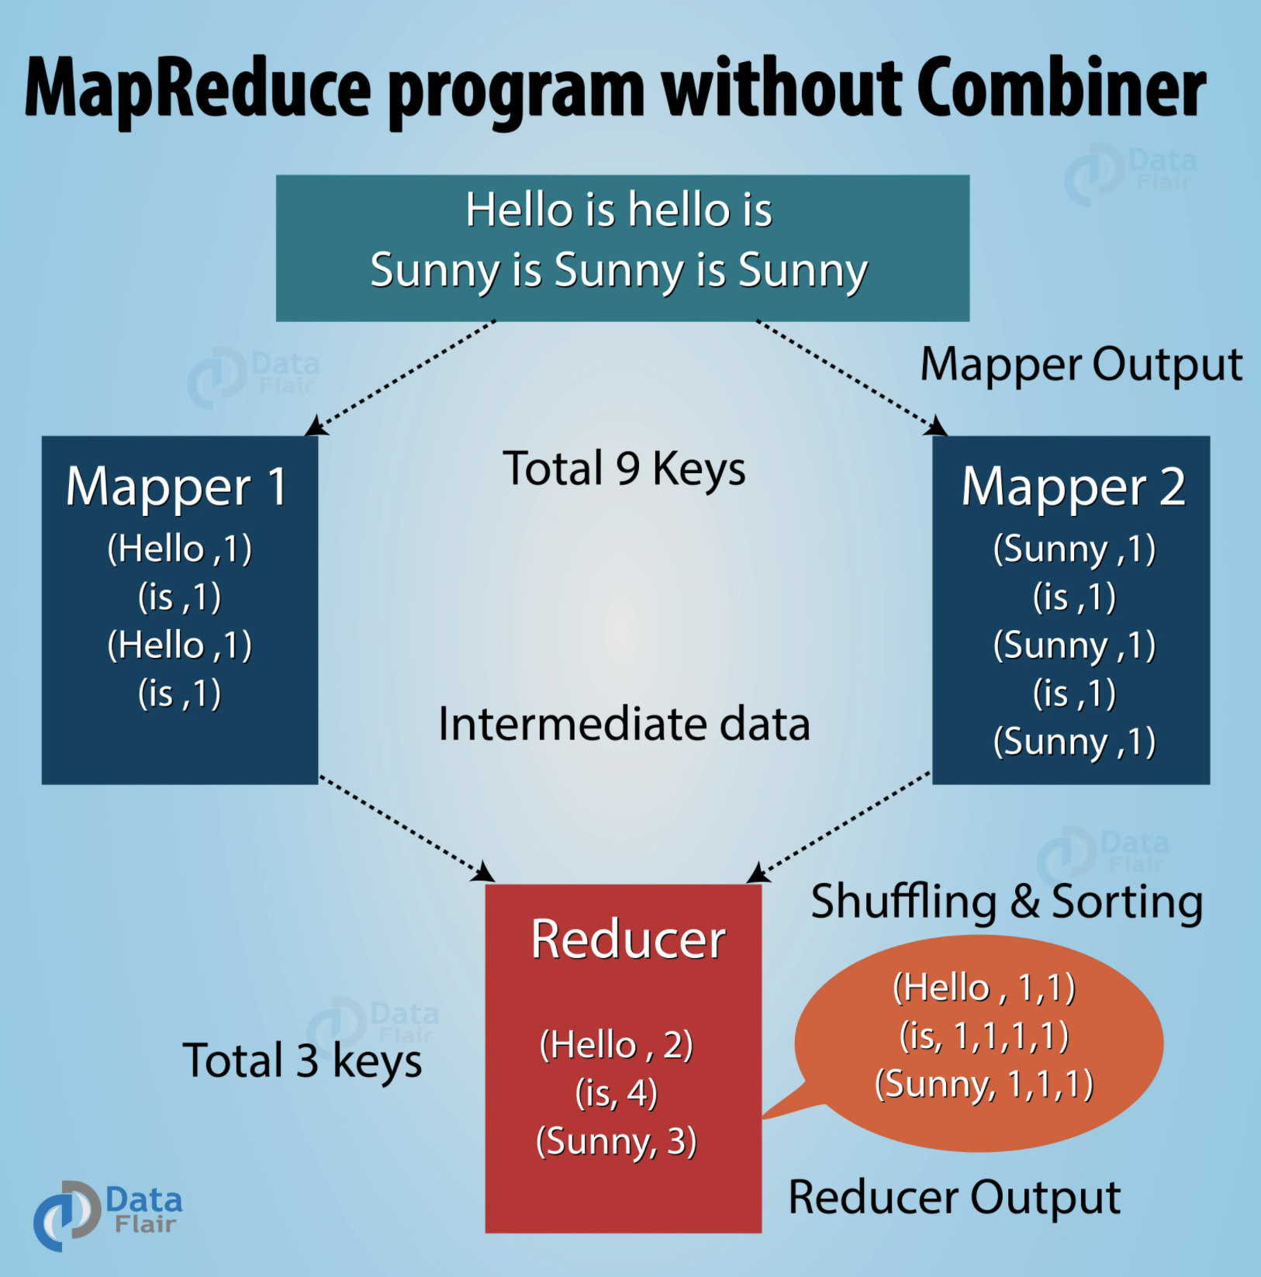
MapReduce without Combiners

Slide 10
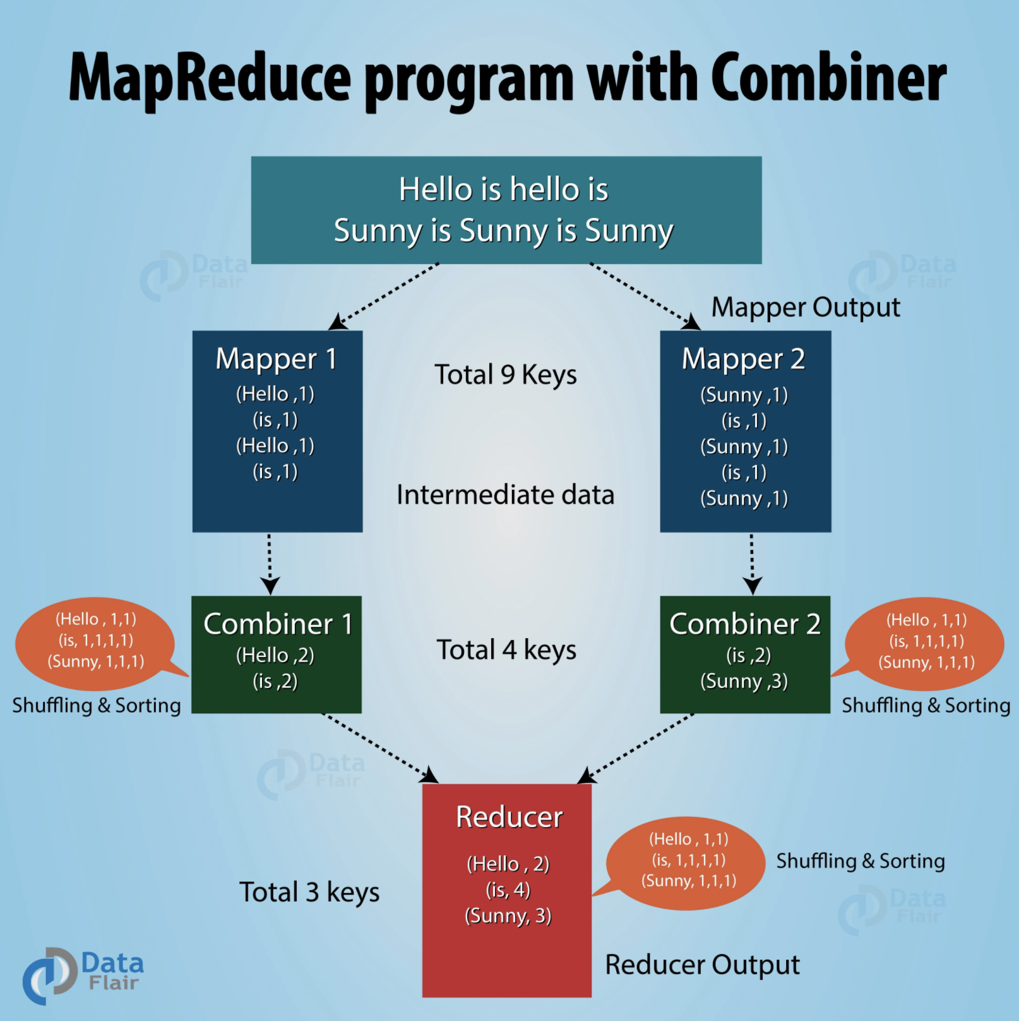
MapReduce with Combiners

Slide 11
How do we write Combiners? For Averages?
We need to write 3 functions:
map()
combine()
reduce()
BUT note that average of an average is not an average
What does this mean?

Slide 12
Average of an Average is not an Average
Let say we have 2 partitions
Partition-1: (K, 6), (K, 7)
Average of Partition-1: (6+7)/2 = 6.5
Partition-2: (K, 8)
Average of Partition-2: (8)/1 = 8.0
Average of Partition-1 and Partition-2:
(6.5 + 8.0)/2 = 7.25
Average(6, 7, 8) = (6+7+8)/3 = 21/3 = 7.0
Hmmmmmm? How to solve this?

Slide 13
Make Average of an Average as an Average By Changing Output of Mappers
Let say we have 2 partitions
Partition-1: (K, 6), (K, 7)
Partition-2: (K, 8)
Change map() to create (K, (sum, count))
(K, 6) --> (K, (6, 1))
(K, 7) --> (K, (7, 1))
(K, 8) --> (K, (8, 1))

Slide 14
Make Average of an Average as an Average
Let say we have 2 partitions:
Partition-1: (K, (6, 1)), (K, (7, 1))
Partition-2: (K, (8, 1))
Average(P1): (K, (6+7, 1+1)) = (K, (13, 2))
Average(P2): (K, (8, 1))
Average(P1, P2) =
(K, (13+8, 2+1)) =
(K, (21, 3)) =
(K, (sum, count))
=> (K, 21/3) = (K, 7)

Slide 15
Sample output of Mappers
Let say we have 2 partitions:
Partition-1: (K, (6, 1)), (K, (7, 1))
Partition-2: (K, (8, 1))
combine(P1): (K, (6+7, 1+1)) = (K, (13, 2))
combine(P2): (K, (8, 1))

Slide 16
Tuples in Python
>>> a = (78, 3)
>>> a[0]
78
>>> a[1]
3

Slide 17
What to consider for combiners & reducers
Make their functions to be associative and commutative:
Let + be a binary function
Commutative Laws
a + b = b + a
Associative Laws
(a + b) + c = a + (b + c)

Slide 18
Addition and Multiplication is Commutative
2 + 3 = 3 + 2 = 5
100 + 200 = 200 + 100 = 300
2 * 5 = 5 * 2 = 10
20 * 30 = 30 *20

Slide 19
Subtraction and Division is NOT Commutative
5 - 3 = 2
3 - 5 = -2
2 NOT EQUAL to -2
10 / 2 = 5
2 / 10 = 0.2
5 NOT EQUAL to 0.2

Slide 20
Average function is not Associative
Avg (1, 2, 3) = 2.0
Avg(1, Avg(2, 3)) = Avg(1, 2.5) = 1.75
2.0 NOT EQUAL to 1.75

Slide 21
References
1. Monoidify! Monoids as a Design Principle for Efficient MapReduce Algorithms by Jimmy Lin
2. Data Algorithms (book) by Mahmoud Parsian
3. Data Algorithms with Spark (book) by Mahmoud Parsian

