Slide 1

Introduction to
Mahmoud (Max) Parsian
Ph.D. in Computer Science

Slide 2
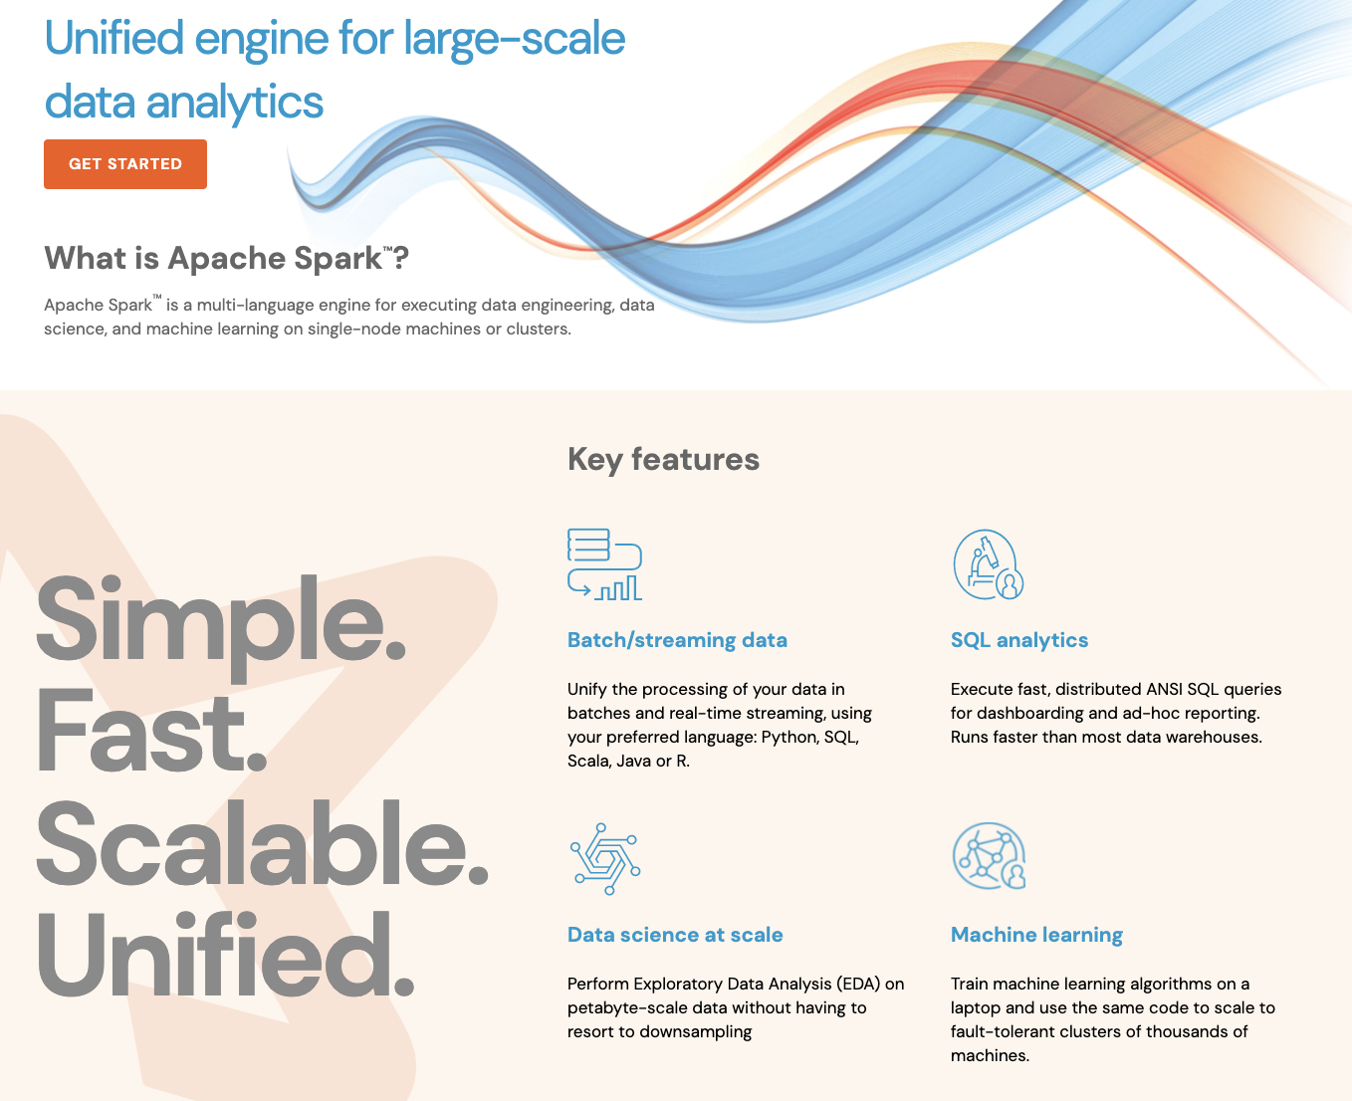
What is

Slide 3
What is
Fast and expressive cluster computing engine
Compatible with Hadoop File System
HDFS
Compatible with many data sources
Amazon S3 (Simple Storage System)
Parquet File (columnar data format)
CSV file, Text File
Relational Database Systems
…

Slide 4
What is
Improves efficiency through in-memory computing:
1 second = 1000 milliseconds
Memory data access: 10 milliseconds
Disk data access: 1000 milliseconds
General computation graphs (DAG)
As much as 100x faster

Slide 5
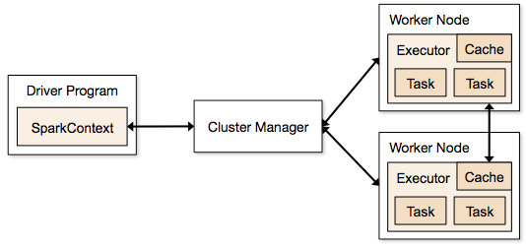
Architecture of

Slide 6
What is
Improves usability by rich API
Scala
Java
Python (simple & expressive API)
PySpark (interactive shell and batch)
SQL
Often 2-10x less code

Slide 7
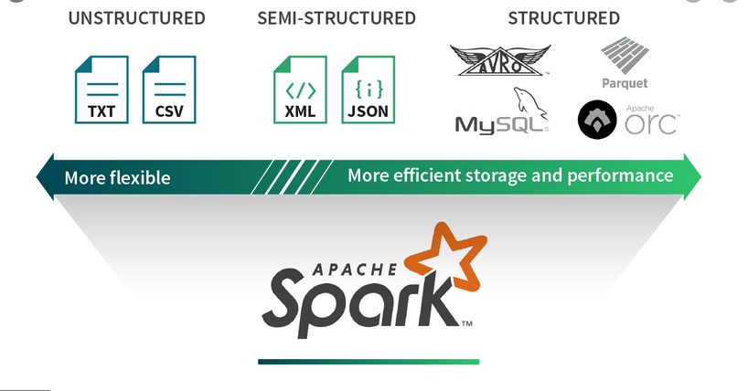
Spark Data Sources

Slide 8
Language Support
Python
# sc : SparkContext
# lines : RDD[String]
lines = sc.textFile(input_path) lines.filter(lambda s: “ERROR” in s).count()
Standalone Programs
Python, Scala, & Java
Interactive Shells
Python & Scala
Performance
Java & Scala are faster due to static typing
…but Python is often fine
Scala
val lines = sc.textFile(input_path) lines.filter(x => x.contains(“ERROR”)).count()
Java
JavaRDD<String> lines = sc.textFile(input_path); lines.filter(new Function<String, Boolean>(){ Boolean call(String s) { return s.contains(“ERROR”); } }).count();

Slide 9
Data Abstractions in
RDDs: Resilient Distributed Datasets
Immutable (read-only)
Partitioned collection of objects
Partitioned for distributed and parallel processing
Low-level API
DataFrames
A table of named columns
Partitioned for distributed and parallel processing
High-Level API

Slide 10
Data Abstractions in
RDDs: Resilient Distributed Datasets
Immutable, partitioned collection of objects
Partitioned for distributed and parallel processing
Low-level API
Example: keep records longer than 80 characters
# rdd : source RDD as RDD[String]
# filter() is a transformation
# x refers to an element of rdd
rdd2 = rdd.filter(lambda x: len(x) > 80)
# rdd2: target RDD as RDD[String]

Slide 11
Data Abstractions in
RDDs: Resilient Distributed Datasets
Immutable, partitioned collection of objects
Partitioned for distributed and parallel processing
Low-level API
# rdd : source RDD as RDD[String]
# filter() is a transformation
rdd2 = rdd.filter(lambda x: len(x) > 80)
# rdd2: target RDD as RDD[String]
Transformation: source_RDD → target_RDD

Slide 12
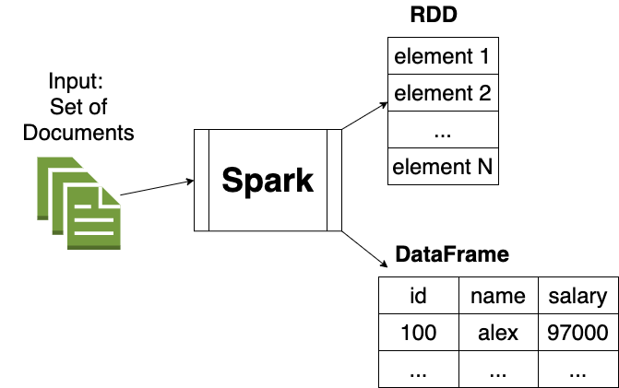
Data Abstractions in

Slide 13
RDDs in
Resilient Distributed Datasets
Immutable,
Partitioned collection of objects
Basic mechanism for distributed and parallel processing
RDD[String]
RDD[(String, Integer)]
RDD[(String, (Integer, Integer))
RDD[((String, Integer), (Double, Double))]
RDD[(String, String, Integer)]
RDD[(String, Integer, String, Float)]

Slide 14
RDDs in
RDD[String]
Every element is a String
RDD[(String, Integer)]
Every element is a tuple of 2 elements
RDD[(String, (Integer, Integer))
Every element is (K, V) pair
K is String
V is (Integer, Integer)
RDD[(String, Integer, Integer)]
Every element is a triplet

Slide 15
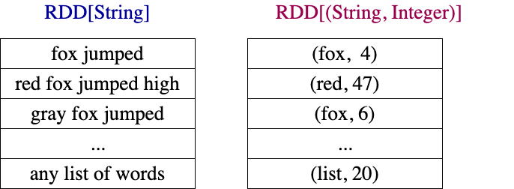
RDDs Examples

Slide 16
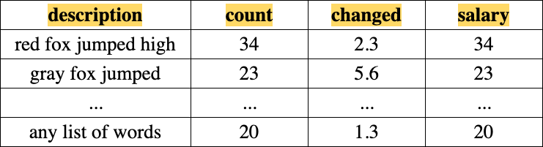
DataFrame Example: with 4 columns and Billions of rows

Slide 17
Operations in
Transformations
map()
flatMap()
mapPartitions()
filter()
reduceByKey()
groupByKey()
rdd1.join(rdd2)
…
Actions
count()
collect()
save()
…

Slide 18
Working With RDDs
# sc : SparkContext
textFile = sc.textFile(”SomeFile.txt”)
RDD
RDD
Action
RDD
Transformations
RDD
Value
linesWithSpark.count()
74
linesWithSpark.first()
# Apache Spark
linesWithSpark = textFile.filter(lambda line: "Spark” in line)

Slide 19
Key Concepts in Spark
Write programs in terms of transformations on distributed datasets
RDDs & DataFrames
Collections of objects spread across a cluster, stored in RAM or on Disk
Built through parallel transformations
Automatically rebuilt on failure
Operations
Transformations (e.g. map, filter, groupBy)
Actions (e.g. count, collect, save)
Notes:
RDD ➔ Colloquially referred to as RDDs
(e.g. caching in RAM)
Lazy operations to build RDDs from other RDDs
Return a result or write it to storage

Slide 20
DataFrame API
DataFrames evolve Spark’s RDD model, making operations with structured datasets even faster and easier.
# Constructs a DataFrame from a JSON dataset.
users = spark.load("s3n://path/to/users.json", "json")
# Create a new DataFrame that contains “young users” only
young = users.filter(users.age < 21)
# Alternatively, using Pandas-like syntax
young = users[users.age < 21]
# DataFrame's support existing RDD operators
print("Young users: " + young.count())

Slide 21
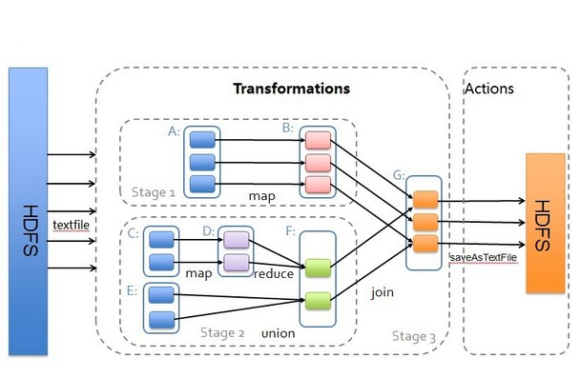
Transformations & Actions

Slide 22

Example: Log Mining
Load error messages from a log into memory, then interactively search for various patterns
Base RDD
Transformed RDD
Cache 1
lines = spark.textFile(“hdfs://...”)
errors = lines.filter(lambda s: “ERROR” in s)
messages = errors.map(lambda s: s.split(“\t”)[2])
messages.cache()
results
Worker
tasks
Block 1
Driver
Action
messages.filter(lambda s: “mysql” in s).count()
Cache 2
messages.filter(lambda s: “php” in s).count()
Worker
Cache 3
. . .
Full-text search of Wikipedia
60GB on 20 EC2 machine
0.5 sec vs. 20s for on-disk
Worker
Block 2
Block 3
Notes:
Add “variables” to the “functions” in functional programming

Slide 23
Interactive Shell
The Fastest Way to Learn Spark
Available in Python and Scala
Python: PySpark ($SPARK_HOME/bin/pyspark)
Scala: Spark-Shell
Runs as an application on an existing Spark Cluster…
OR Can run locally
Run Spark in your laptop/macbook

Slide 24
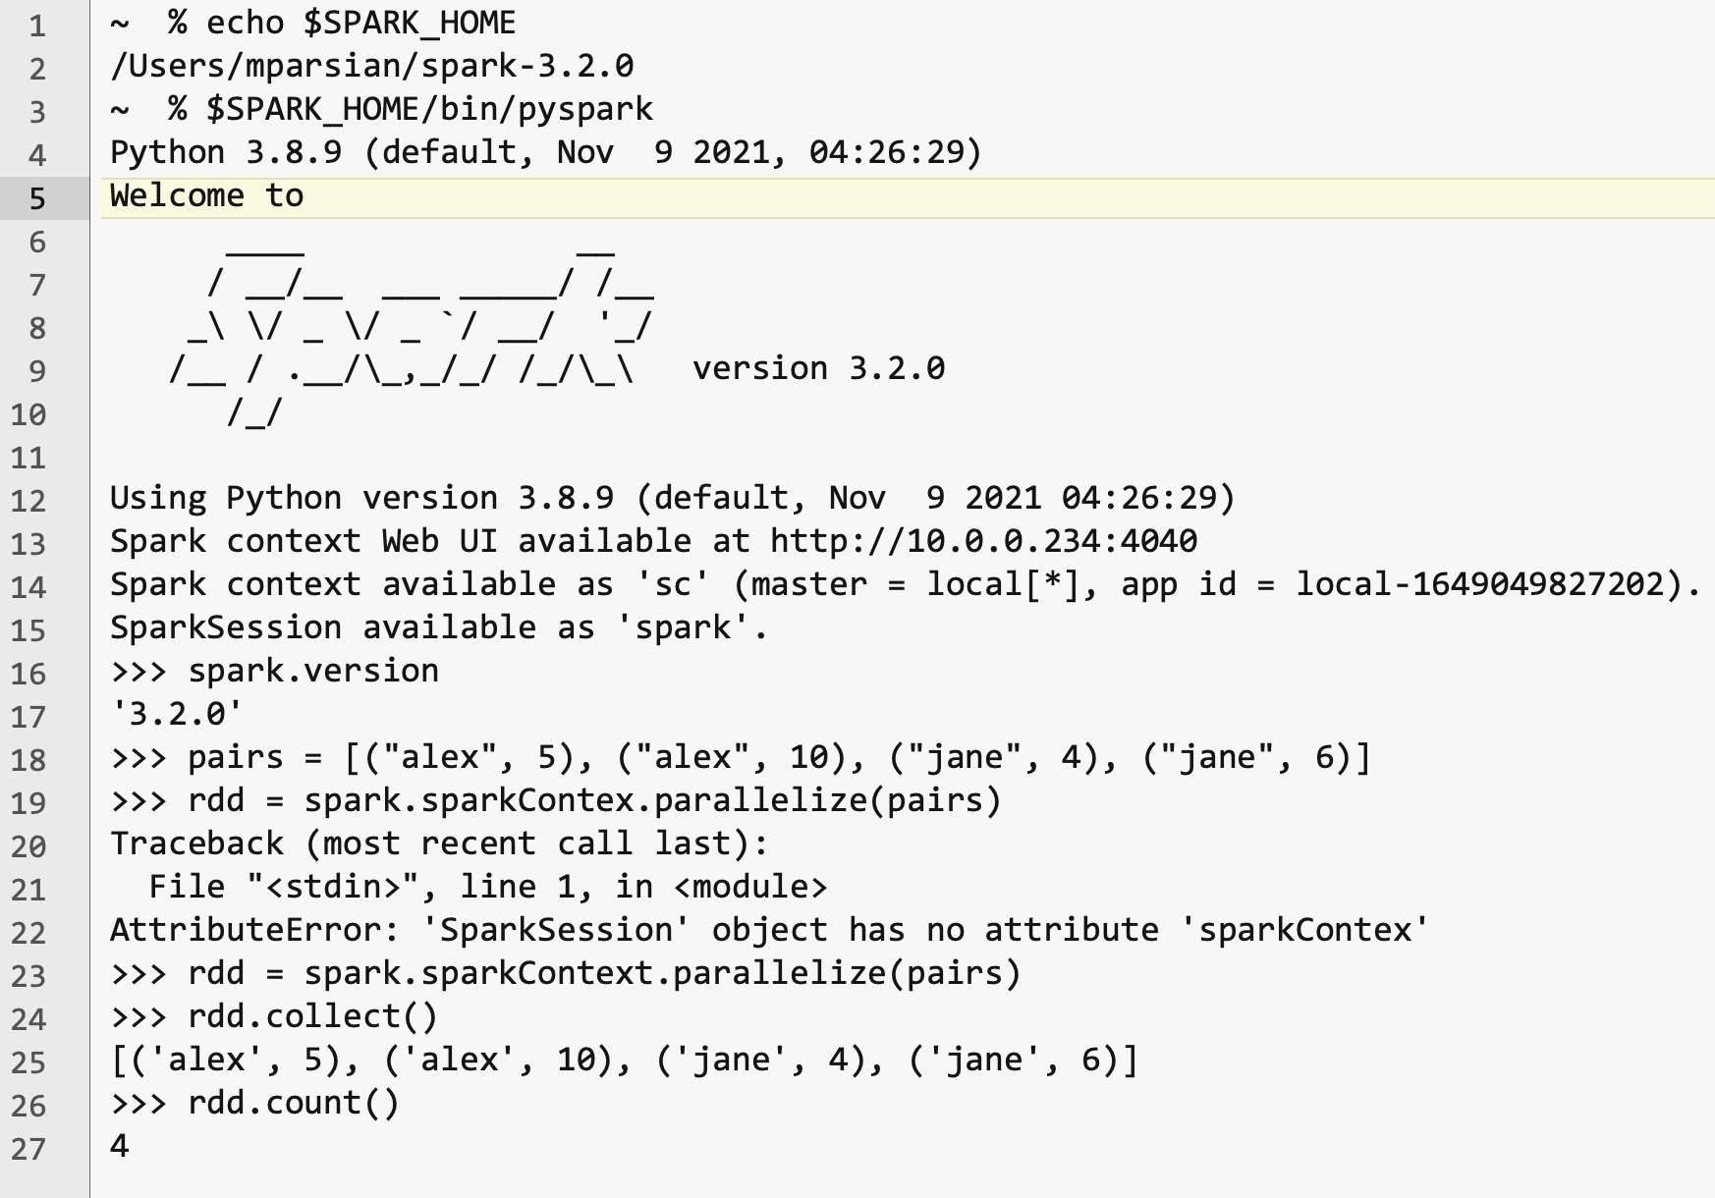
Interactive Shell

Slide 25
PySpark: interactive shell
Write Spark jobs in Python
Run interactive jobs in the shell
$ cat data.txt
fox jumped high
fox is crazy
crazy fox is here
$SPARK_HOME/bin/pyspark
>>> # read input and create rdd : RDD[String]
>>> rdd = spark.sparkContext.textFile("data.txt")
>>> rdd.collect()
[
'fox jumped high’,
'fox is crazy’,
'crazy fox is here’
]

Slide 26
SparkContext (sc)
Main entry point to Spark functionality
Available in shell as variable sc
# use sc for RDDs
# spark : SparkSession
# sc : SparkContext
sc = spark.sparkContext

Slide 27
Creating RDDs from Collections
# sc : SparKContext
# Turn a Python collection into an RDD
nums_rdd = sc.parallelize([1, 2, 3])
# Turn (key, value) pairs into an RDD
pairs = [(‘A’, 2), (‘A’, 3), (‘B’, 4)]
rdd = sc.parallelize(pairs)

Slide 28
Creating RDDs from Text Files
# sc : SparkContext
# Load text file from local FS, HDFS, or S3
rdd1 = sc.textFile(“file.txt”)
rdd2 = sc.textFile(“directory/*.txt”)
rdd3 = sc.textFile(“hdfs://namenode:9000/path/file”)

Slide 29
Basic Transformations
# Create an RDD[Integer]
nums = sc.parallelize([1, 2, 3, 4]) # [1, 2, 3, 4]
# Pass each element through a function
# squares : RDD[Integer]
# x refers to an element of nums
squares = nums.map(lambda x: x*x) # [1, 4, 9, 16]
# Keep elements passing a predicate
# even : RDD[Integer]
even = squares.filter(lambda x: x % 2 == 0) # {4, 16}
Notes:
All lazy

Slide 30
Basic Transformations
# sc : SparkContext
# nums : RDD[Integer]
nums = sc.parallelize([1, 2, 3, 4])
# map each element to zero or more others
rdd = nums.flatMap(lambda x: => range(x))
rdd.collect()
{0, 0, 1, 0, 1, 2, 0, 1, 2, 3}
rdd.count()
10
Range object (sequence of numbers 0, 1, …, x-1)
Notes:
All lazy

Slide 31
Basic Actions
# nums : RDD[Integer]
nums = sc.parallelize([1, 2, 3, 4])
# Retrieve RDD contents as a local collection
my_list= nums.collect() # => [1, 2, 3, 4]
# Return first K elements
nums.take(2) # => [1, 2]
# Count number of elements
nums.count() # => 4
# Merge elements with an associative function
nums.reduce(lambda x, y: x + y) # => 10
# Write elements to a text file
nums.saveAsTextFile(“hdfs://file.txt”)
Notes:
Launch computations

Slide 32
Working with Key-Value Pairs
Spark’s “distributed reduce” transformations operate on RDDs of key-value pairs
Python: pair = (a, b) pair[0] # => a pair[1] # => b
Scala: val pair = (a, b) pair._1 // => a pair._2 // => b
Java: Tuple2 pair = new Tuple2(a, b); pair._1 // => a pair._2 // => b

Slide 33
Some Key-Value Operations
# rdd : RDD[(String, Integer)]
pets = [(“cat”, 2), (“dog”, 3), (“dog”, 5), (“cat”, 4)])
rdd = = sc.parallelize(pets)
# apply reduction on (key, value) pairs
reduced = pets.reduceByKey(lambda x, y: x + y) # => {(cat, 6), (dog, 8)}
# apply reduction on (key, value) pairs
grouped = pets.groupByKey()
# => {(cat, [2, 4]), (dog, [3, 5])}
sorted = pets.sortByKey()
=> {(cat, 2), (cat, 4), (dog, 3) (dog, 5)}
NOTE: reduceByKey() also automatically implements combiners on the map side

Slide 34
Example: Word Count
# sc : SparkContext
lines = sc.textFile(“hamlet.txt”)
counts = lines.flatMap(lambda line: line.split(“ ”)) .map(lambda word => (word, 1)) .reduceByKey(lambda x, y: x + y)
“to” “be” “or”
(to, 1) (be, 1) (or, 1)
(be, 2) (not, 1)
“to be or”
“not” “to” “be”
(not, 1) (to, 1) (be, 1)
(or, 1)
(to, 2)
“not to be”

Slide 35
Word Count in JDK8
JavaSparkContext sc = new JavaSparkContext();
JavaRDD<String> rdd = sc.textFile(inputPath);
// counts = (word: K, frequencey: V)
JavaPairRDD<String, Integer> counts = rdd
.flatMap(x -> Arrays.asList(x.split(" ")))
.mapToPair(x -> new Tuple2<String, Integer>(x, 1))
.reduceByKey((x, y) -> x + y);
counts.saveAsTextFile(outputPath);

Slide 36
Other Key-Value Operations
visits = sc.parallelize([ (“index”, “4”), (“about”, “6”), (“index”, “1”) ])
pageNames = sc.parallelize([ (“index”, “Home”), (“about”, “About”) ])
visits.join(pageNames) # (“index”, (“4”, “Home”)) # (“index”, (“1”, “Home”)) # (“about”, (“6”, “About”))
visits.cogroup(pageNames) # (“index”, ([“4”, “1”], [“Home”])) # (“about”, ([“6”], [“About”]))

Slide 37
PageRank Performance
Notes:
54 GB Wikipedia dataset

Slide 38
Other Iterative Algorithms
Time per Iteration (s)
Notes:
100 GB datasets

Slide 39
Conclusion
Spark offers a rich API to make data analytics fast: both fast to write and fast to run
Achieves 100x speedups in real applications
Growing community with 50+ companies contributing

Slide 40
SUMMARY: What is Spark?
Fast and Expressive Cluster Computing System Compatible with Apache Hadoop
Up to 10× faster on disk, 100× in memory
2-5× less code
Efficient
Usable
General execution graphs
In-memory storage
Rich APIs in Java, Scala, Python
Interactive shell
Notes:
Generalize the map/reduce framework

Slide 41
Get Started on Spark
Up and Running in a Few Steps
Download
Unzip
Shell
Project Resources
Examples on the Project Site
Examples in the Distribution
Documentation
http://spark.apache.org

Slide 42
Demo of PySpark

