Slide 1
Introduction to PySpark PySpark = { Python + Spark }
Mahmoud (Max) Parsian
Ph.D. in Computer Science

Slide 2
Outline
Apache Spark
Resilient Distributed Datasets (RDD)
Transformation and Actions in Spark
RDD Partitions
DataFrames

Slide 3
What is Spark?
Spark is a multi-language engine for executing data engineering, data science, and machine learning on single-node machines or clusters.
Simple (uses high-level API)
Fast (uses RAM/memory)
Scalable (runs in cluster environment)
Unified (can run anywhere…)

Slide 4
Spark and PySpark
Spark is written in Scala , but it supports:
Python (PySpark) (code is compact)
Java (code is bulky)
Scala
SQL

Slide 5
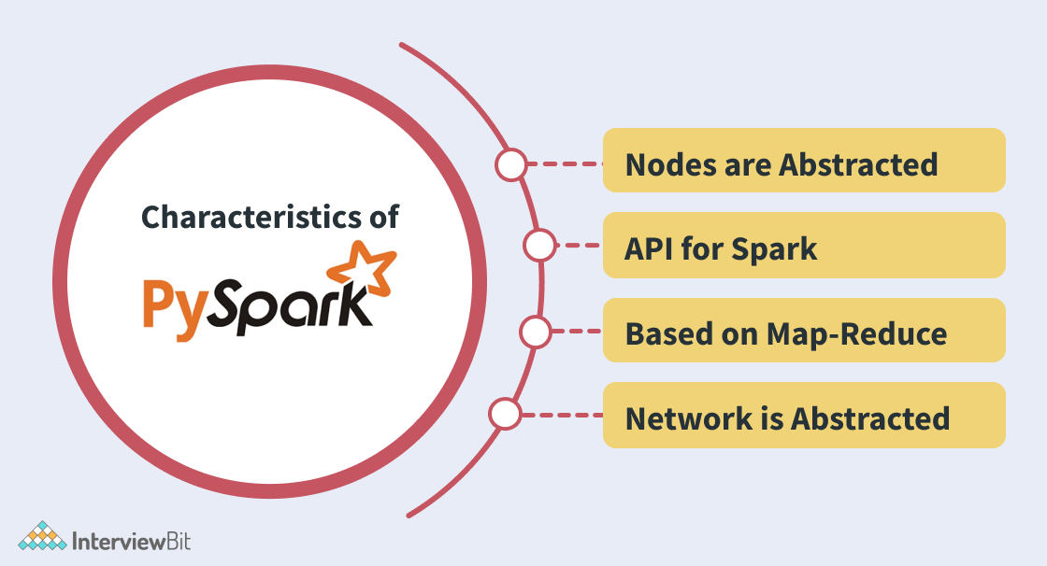
PySpark Characteristics

Slide 6
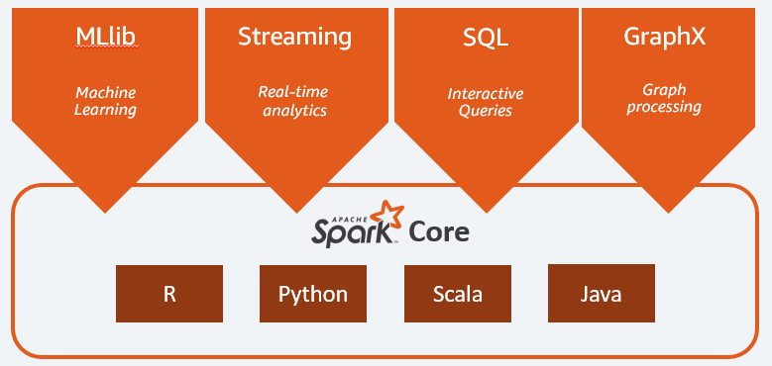
What is Spark? Why Use It?
Spark enables big data processing through parallel processing
Have choice of multiple languages to run Spark applications
We will be conducting this class in PySpark or “Python Spark”
PySpark operates on distributed
RDDs
DataFrames

Slide 7
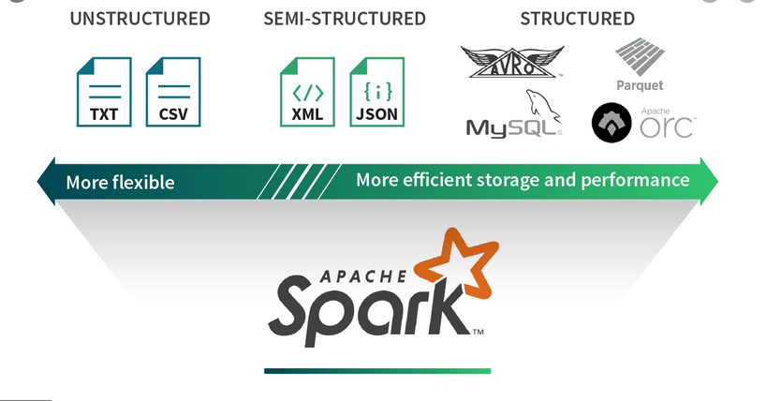
Spark Data Sources

Slide 8
Advantages of PySpark
Simple to use:
Parallelized code can be written in a simpler manner.
Error Handling:
PySpark framework easily handles errors.
Inbuilt Algorithms:
PySpark provides many of the useful algorithms in Machine Learning or Graphs.
Library Support:
Compared to Scala, Python has a huge library collection for working in the field of data science and data visualization.
Easy to Learn:
PySpark is an easy to learn language.

Slide 9
PySpark: can be used in 2 ways
PySpark shell ($SPARK_HOME/bin/pyspark)
Interactive
Testing
Debugging
Batch submit ($SPARK_HOME/bin/spark-submit <prog> <params>)
Production environment

Slide 10
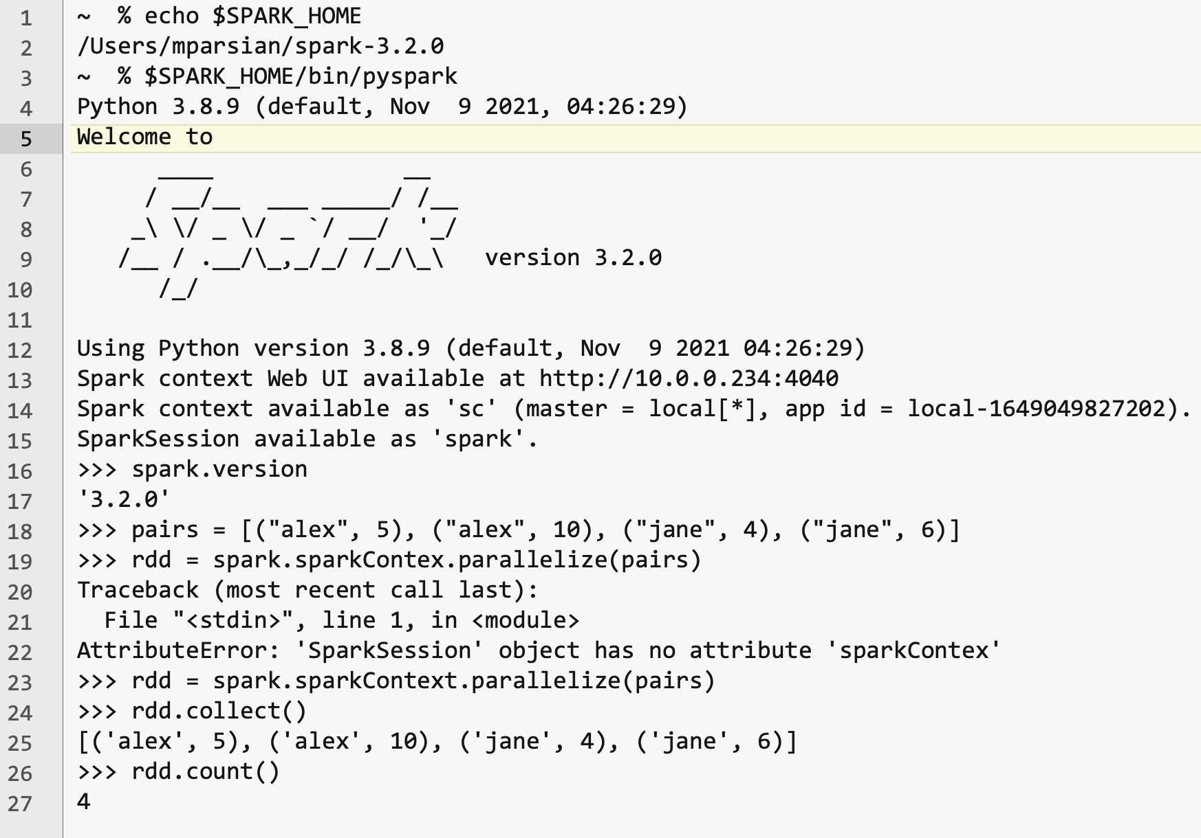
PySpark shell

Slide 11
$SPARK_HOME/bin/spark-submit
export SPARK_HOME=<spark-installed-dir>
$SPARK_HOME/bin/spark-submit <prog> <parameters>
where,
<prog> is your PySpark program (such as my_prog.py)
<parameters> are program parameters
Example:
INPUT_PATH=“s3://my_bucket/project7/data/”
OUTPUT_PATH=“s3://my_bucket/project7/output/”
$SPARK_HOME/bin/spark-submit --verbose
my_prog.py ${INPUT_PATH} ${OUTPUT_PATH}

Slide 12
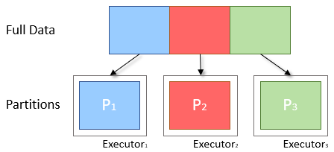
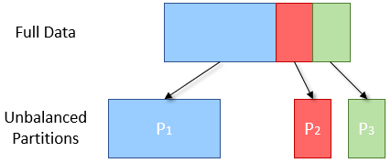
Data Partitioning
Spark breaks data into chunks, or a group of rows
Parallelism: Groups of data (chunks) on multiple cluster nodes simultaneously
Processing data in smaller chunks allows you to process larger data sets more quickly
Can scale from 1 to thousands of executors based on data size
Ideal
Reality

Slide 13
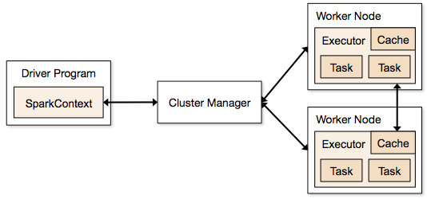
SparkContext
SparkContext is the object that manages the connection to the clusters in Spark and coordinates running processes on the clusters themselves.
SparkContext connects to cluster managers, which manage the actual executors

Slide 14

Spark Architecture
Spark Driver
Converts user applications to smaller execution “tasks”
Schedules tasks on clusters
Cluster Manager
Manages and allocates resources to cluster nodes
Worker Nodes
Runs application code in the cluster
Spark Executor
Executes tasks on each worker node
Communicates with the driver program
Keeps data in memory or disk storage
Task
A unit of work sent to one executor

Slide 15
Resilient Distributed Datasets (RDD)
An RDD is Spark's representation of a dataset that is immutable, distributed across the RAM, or memory, of lots of machines.
An RDD object is essentially a collection of elements that you can use to hold lists of tuples, dictionaries, lists, etc.
Lazy Evaluation : the ability to lazily evaluate code, postponing running a calculation until absolutely necessary.
# spark : SparkSession
num_partitions = 3
lines = spark.sparkContext.textFile(“example.txt”, num_partitions)
lines.take(5)
Notes:
The core data structure in Spark is an RDD, or a resilient distributed dataset. As the name suggests,
In the code above, Spark didn‘t wait to load the txt file into an RDD until lines.take(5) was run. When lines = spark.textFile(“hw10/tweets_sm.txt”, numPartitions) was called, a pointer to the file was created, but only when lines.take(5) needed the file to run its logic was the text file actually read into lines.
This brings the concept of actions and transformations.

Slide 16
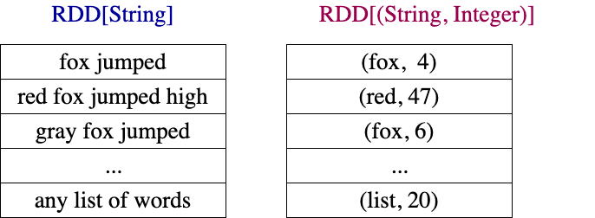
RDDs Examples

Slide 17
Creating RDDs
RDDs can be created from many data sources:
Python collections (lists, arrays, …)
Text files
Amazon S3
HDFS
Relational Database tables
DataFrames
Notes:
take(5) is an action

Slide 18
Creating RDDs: Example
# spark : SparkSession
pairs = [(“alex”, 2), (“alex”, 4), (“jane”, 3)]
# rdd : RDD[(String, Integer)]
rdd = spark.sparkContext.parallelize(pairs)
rdd.count()
3
rdd.collect()
[
(“alex”, 2),
(“alex”, 4),
(“jane”, 3)
]
Notes:
take(5) is an action

Slide 19
Creating RDDs: Example
rdd.collect()
[
(“alex”, 2),
(“alex”, 4),
(“jane”, 3)
]
# x denotes a single element of source rdd
rdd2 = rdd.filter(lambda x : x[1] > 2)
rdd2.collect()
[
(“alex”, 4),
(“jane”, 3)
]
Notes:
take(5) is an action

Slide 20
Transformation and Actions in Spark
RDDs have
Actions, which return values, and
Transformations, which return pointers to new RDDs.
RDDs’ value is only updated once that RDD is computed as part of an action
Transformation: source_RDD → target_RDD
rdd2 = rdd1.map(lambda x: x.lower())
Action: source_RDD → non-RDD
total = rdd.count()
Notes:
take(5) is an action

Slide 21
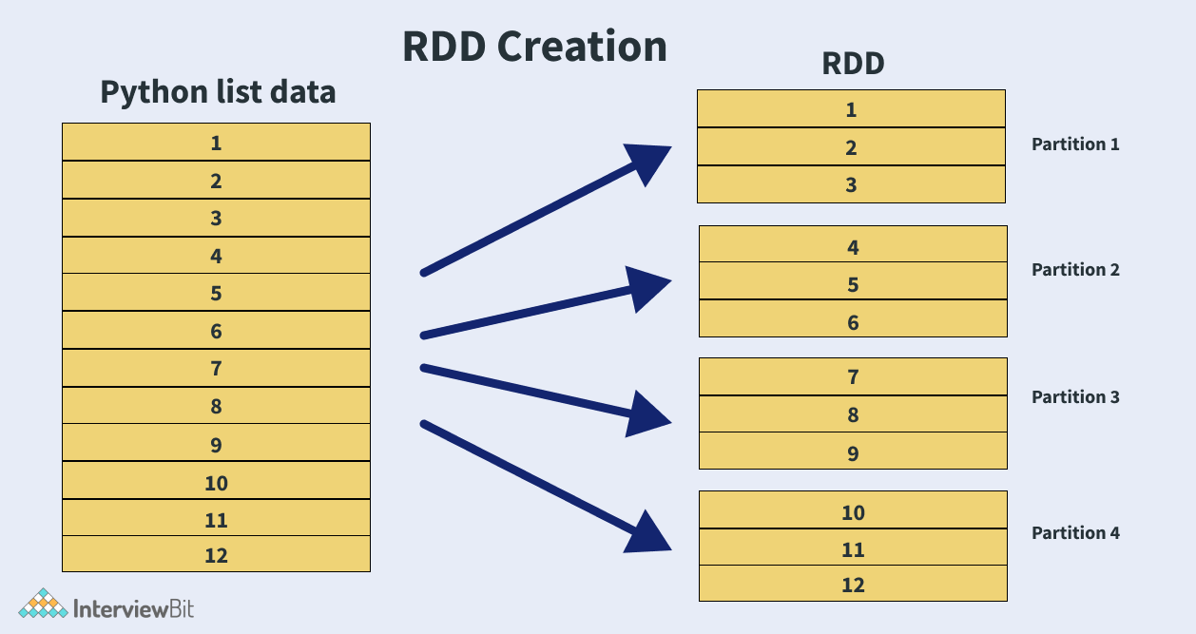
RDD Partitions: units for parallelism

Slide 22
Transformations vs. Actions
Transformations
Actions
Changes a Spark DataFrame into a new DataFrame without altering the original data (i.e. immutable)
Evaluated lazily or not computed immediately
Adds a step into the Spark query plan
Examples: select(), filter()
Triggers a computation
Causes Spark to execute a query plan (a series of transformations)
Returns a result
Example: count(), collect()

Slide 23
Lazy Evaluation
Spark has “lazy” or delayed execution
Spark inspects query and optimizes them by:
Generates multiple plans and chooses the best one with a cost model
Reorders transformations
Breaking them into stages
Optimizes “shuffles” where data is “shuffled” between workers

Slide 24
Transformation and Actions
Spark Transformations
map()
mapValues()
flatMap()
filter()
mapPartitions()
reduceByKey()
groupByKey()
…
Spark Actions
collect()
count()
take()
takeOrdered()
save()
…

Slide 25
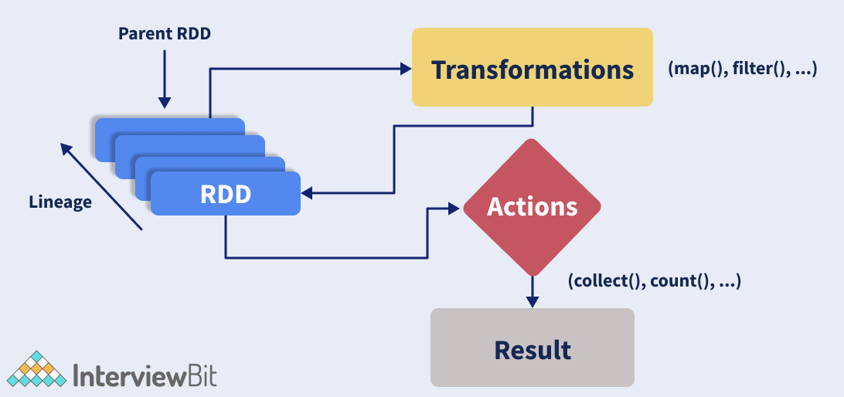
Transformation and Actions

Slide 26
Mapper Transformations: map()and flatMap()
map(): 1-to-1
map() transformation applies the mapper function on each element of the RDD and returns the transformed RDD
flatMap(): 1-to-Many
Return a new RDD by first applying a function to all elements of this RDD, and then flattening the results.

Slide 27
map() Example
# spark : SparkSession
strings = [“fox jumped”, “fox not jumped”]
# rdd: RDD[String]
rdd = spark.sparkContext.parallelize(strings)
# apply a map() transformation:
rdd2 = rdd.map(lambda x: (x, len(x))
rdd2.collect()
[
(“fox jumped”, 10),
(“fox not jumped”, 14)
]

Slide 28
flatMap() Example
# spark : SparkSession
lists = [ [4, 5, 6], [7, 8, 9], [], [3] ]
# rdd: RDD[[Integer]]
rdd = spark.sparkContext.parallelize(lists)
rdd.count()
4
# apply flatMap() transformation
rdd2 = rdd.flatMap(lambda x: x)
rdd2.collect()
[4, 5, 6, 7, 8, 9, 3]
rdd2.count()
7

Slide 29
map() vs. flatMap()
# spark : SparkSession
lists = [ [4, 5, 6, 7], [8, 9], [], [2], [] ]
# rdd: RDD[[Integer]]
rdd = spark.sparkContext.parallelize(lists)
rdd.count()
5
# apply a flatMap() transformation
rdd2 = rdd.flatMap(lambda x: x)
rdd2.collect()
[4, 5, 6, 7, 8, 9, 2]
rdd2.count()
7
# apply a map() transformation
rdd3 = rdd.map(lambda x: x)
rdd3.collect()
[ [4, 5, 6, 7], [8, 9], [], [2], [] ]
rdd3.count()
5
Notes:
Confused !!! Ok. Let’s clear this confusion with an example …

Slide 30
filter(f): Return a new RDD containing only the elements that satisfy a Boolean predicate.
# spark : SparkSession
lists = [ [4, 5, 6], [7, 8], [], [3] ]
# rdd: RDD[[Integer]]
rdd = spark.sparkContext.parallelize(lists)
rdd.count()
4
# apply a filter() transformation
rdd2 = rdd.filter(lambda x: len(x) > 1)
rdd2.collect()
[ [4, 5, 6], [7, 8] ]
rdd2.count()
2

Slide 31
Reduction Transformation: reduceByKey()
Merge the values for each key using an associative and commutative reduce function.
# spark : SparkSession
pairs = [(“A”, 2), (“A”, 3), (“B”, 5), (“B”, 7), (“C”, 1)]
# rdd: RDD[(String, Integer)]
rdd = spark.sparkContext.parallelize(pairs)
rdd.count()
5
# apply a reduction transformation
rdd2 = rdd.reduceByKey(lambda x, y: x+y)
rdd2.collect()
[(“A”, 5), (“B”, 12), (“C”, 1)]]
rdd2.count()
3

Slide 32
RDD Partitions
Map and Reduce operations can be effectively applied in parallel in apache spark by dividing the data into multiple partitions.
rdd.getNumPartitions()
returns the number of partitions
A copy of each partition within an RDD is distributed across several workers running on different nodes of a cluster so that in case of failure of a single worker the RDD still remains available.
Notes:
Parallelism is the key feature of any distributed system where operations are done by dividing the data into multiple parallel partitions. The same operation is performed on the partitions simultaneously which helps achieve fast data processing with spark.

Slide 33
RDD Partitions: Example
rdd.count(): 800,000,000,000
rdd.getNumPartitions(): 40,000
Therefore, each partition will have about
20,000,000 elements
Maximum parallelism: 40,000 tasks
800,000,000,000 = 40,000 x 20,000,000
Notes:
Parallelism is the key feature of any distributed system where operations are done by dividing the data into multiple parallel partitions. The same operation is performed on the partitions simultaneously which helps achieve fast data processing with spark.

Slide 34
mapPartitions(func) Transformation
mapPartitions(func) implements design summarization pattern.
mapPartitions(func) transformation is similar to map(), but runs separately on each partition of the RDD, so func() must be of type Iterator<T> => Iterator<U> when running on an RDD of type T.

Slide 35
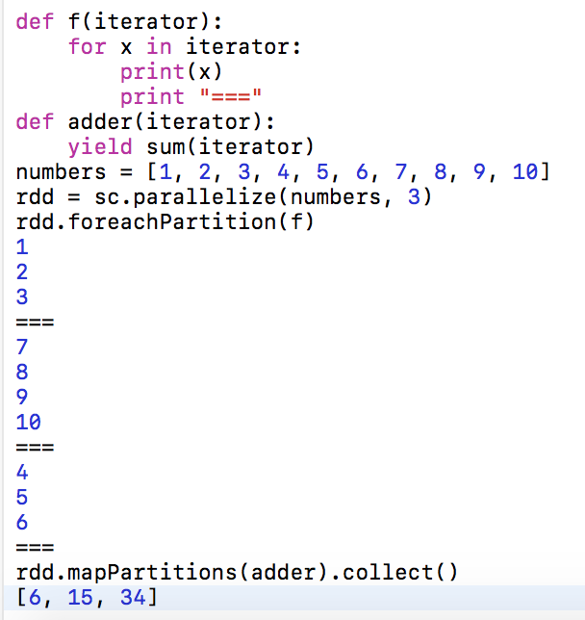
Example-1: Sum Each Partition

Slide 36
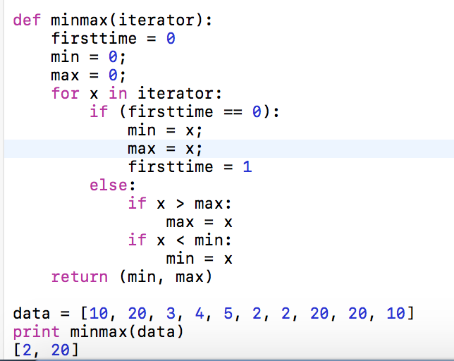
Example-2: Find Minimum and Maximum

Slide 37
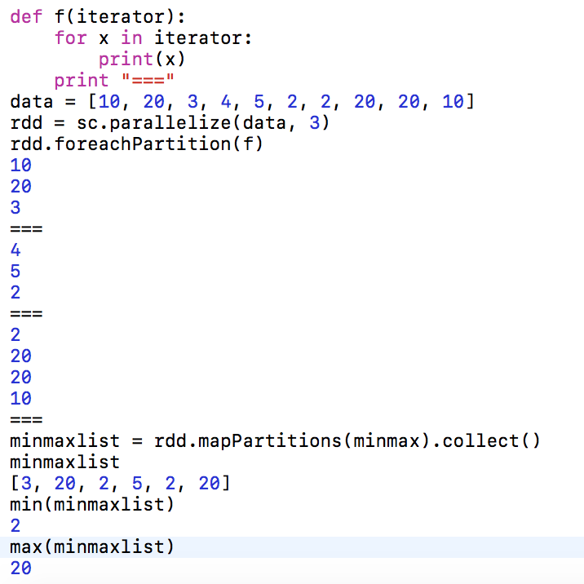

Slide 38
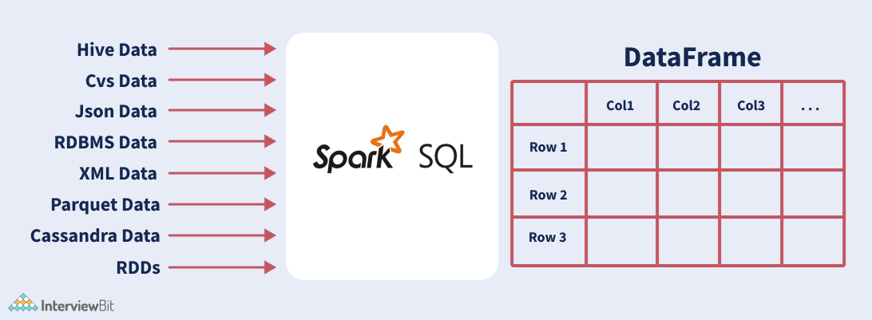
PySpark DataFrames

Slide 39
DataFrame Creation
>>> # SparkSession available as 'spark'.
>>> triplets = [(100, 'alex', 24), (200, 'jane', 35), (300, 'david', 56)]
>>> column_names = ["id", "name", "age"]
>>> df = spark.createDataFrame(triplets, column_names)
>>> df.show()
+---+-----+---+
| id| name|age|
+---+-----+---+
|100| alex| 24|
|200| jane| 35|
|300|david| 56|
+---+-----+---+

Slide 40
Summary
Spark: an open source, distributed computing framework and set of libraries for real-time, large-scale data processing.
PySpark is the Python API for Spark
If you're already familiar with Python and libraries such as Pandas, then PySpark is a good language to learn to create more scalable analyses and pipelines.

Slide 41
More Reading…
Resilient Distributed Datasets: A Fault-Tolerant Abstraction for In-Memory Cluster Computing
Reference
https://www.dezyre.com/apache-spark-tutorial/pyspark-tutorial
http://www.kdnuggets.com/2015/11/introduction-spark-python.html
https://github.com/mahmoudparsian/pyspark-tutorial/blob/master/tutorial/map-partitions/README.md

