Slide 1
Introduction to MapReduce
Mahmoud (Max) Parsian
Ph.D. in Computer Science

Slide 2
MapReduce?
A programming model or abstraction.
It is not a programming language
A novel way of thinking about designing a solution to certain problems…
It enables us to
1. Partition data into small chunks
2. Execute tasks in parallel

Slide 3
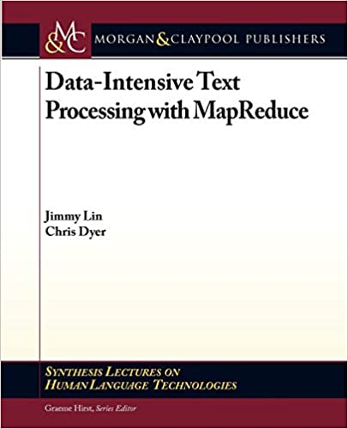
How to Understand MapReduce?

Slide 4
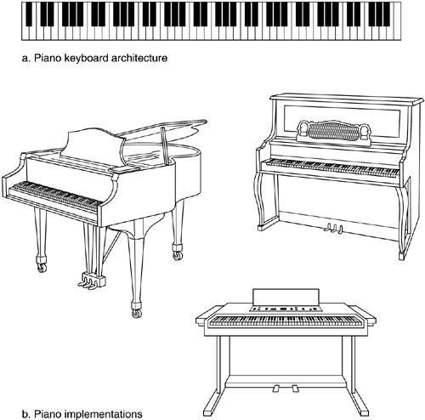
MapReduce: as a Model/Architecture

Slide 5
MapReduce as a Model/Paradigm/Architecture
Implementations of MapReduce:
Google App Engine
Apache Hadoop
Apache Tez
Apache Spark
Snowflake
Amazon Athena

Slide 6
Motivation of MapReduce
Process lots of data
Google processed about 24 petabytes of data per day in 2009.
Facebook processed 60 petabytes of data per day in 2020
A single machine cannot serve all the data
You need a distributed system to store and process in parallel
Parallel programming

Slide 7
Motivation
Parallel programming?
Concurrency/Threading/Parallelism is hard!
How do you facilitate communication between servers/nodes?
How do you scale to more machines?
How do you handle machine failures?
How do we handle disk failures?

Slide 8
MapReduce reintroduced…
Google created the awareness by publishing a paper
Hadoop made it into a sensation
Hadoop is an open-source MapReduce implementation based on Google’s paper.
Spark implements superset of MapReduce
MapReduce: Simplified Data Processing on Large Clusters
By Jeffrey Dean and Sanjay Ghemawat, Google
OSDI'04: Sixth Symposium on Operating System Design and Implementation. December, 2004.

Slide 9
MapReduce reintroduced…
Google’s big problem:
Index billions of web documents everyday!
Takes too much time and effort!
Solution:
Use MapReduce to utilize 100’s or 1000’s of servers (cluster computing) to index billions of documents

Slide 10
Hadoop implements MapReduce
Partition input into small chunks
Parallelize chunks in many servers
Apply map()and reduce()

Slide 11
Components of MapReduce Job
Partition input into small chunks
Parallelize chunks in many serers
Apply map()and reduce()
TBDL

Slide 12
MapReduce Example
MapReduce works with (key, value) pairs
Mappers Input: as (key, value) pair
(123, “fox jumped and fox jumped and jumped and jumped”)
Where 123 as a key is a record number (ignored here)
Mappers output:
(fox, 1), (jumped, 1), (and, 1),
(fox, 1), (jumped, 1), (and, 1),
(jumped, 1), (and, 1), (jumped, 1)

Slide 13
MapReduce Example continued…
Mappers output:
(fox, 1), (jumped, 1), (and, 1),
(fox, 1), (jumped, 1), (and, 1),
(jumped, 1), (and, 1), (jumped, 1)
Sort & Shuffle output: GROUP BY KEY
(fox, [1, 1])
(jumped, [1, 1, 1, 1])
(and, [1, 1, 1])

Slide 14
MapReduce Example continued…
Sort&Shuffle output: (used as input to reducers)
(fox, [1, 1])
(jumped, [1, 1, 1, 1])
(and, [1, 1, 1])
Reducers output:
(fox, 2)
(jumped, 4)
(and, 3)

Slide 15
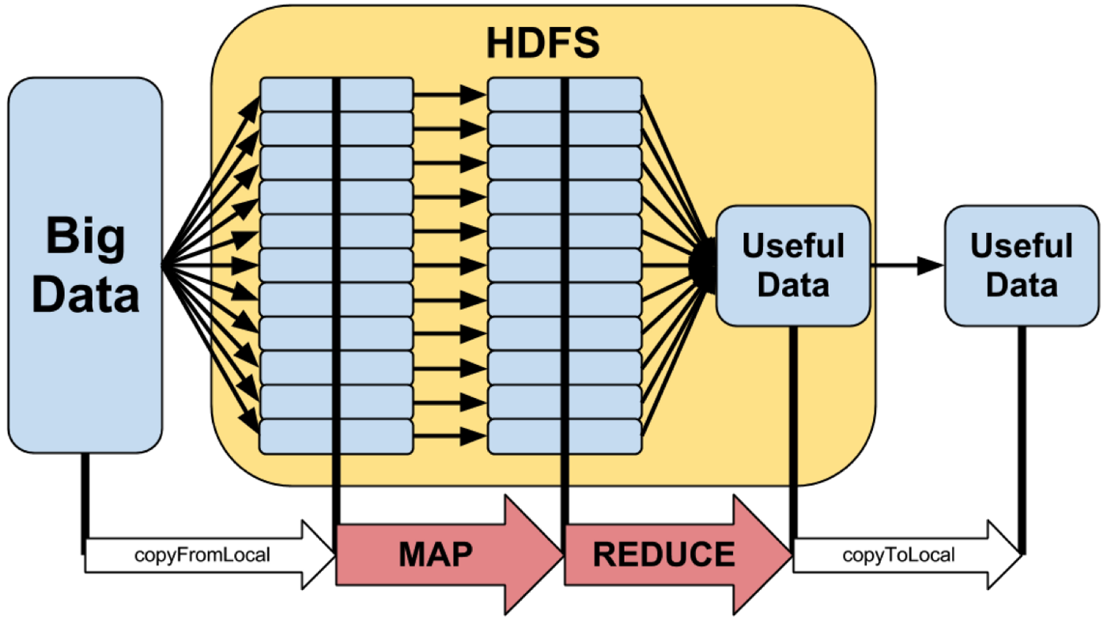
MapReduce Model: Hadoop Implementation

Slide 16
MapReduce provides:
Partition data into small chunks
Automatic parallelization, distribution
I/O scheduling
Load balancing
Network and data transfer optimization
Fault tolerance
Handling of machine failures

Slide 17
MapReduce: Scale-Out, but do NOT Scale-Up
Need more power: Scale-Out
Large number of commodity servers
Not expensive to add or replace servers
Add more servers any time
Do NOT Scale-Up
Do NOT use high end specialized servers
Very Expensive
Replacement very costly

Slide 18
MapReduce Implementations
Google App Engine
(proprietary, not open-source)
Apache Hadoop:
implementation of MapReduce
(open-source, based on Google’s paper)
Apache Spark:
open-source, superset of MapReduce
In-memory computing, very fast

Slide 19
Typical problem solved by MapReduce
Read a lot of data
Partition data into small chunks
map(key, value): extract something you care about from each record
output: set of (key2, value2) pairs
Shuffle and Sort [done by MapReduce Implementation]
Output as (key, [value_1, value_2, …])
reduce(key, values): aggregate, summarize, filter, or transform
Output: set of (key3, value3) pairs
Write the results

Slide 20
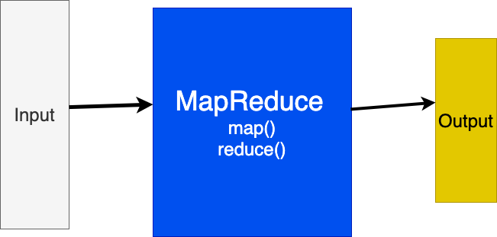
MapReduce model

Slide 21
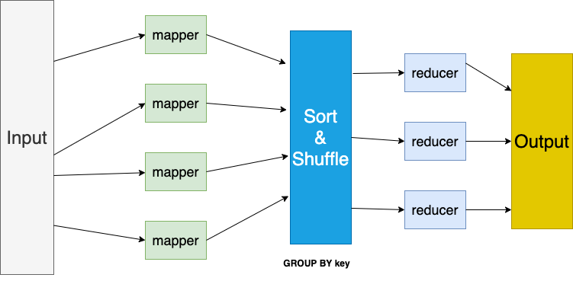
MapReduce model

Slide 22
Mappers in parallel
map() run in parallel.
Each mapper operates on a set of chunks assigned to it by the job tracker.
Mappers write to local disk.
# key: a record number or hash of a record
# value: a single record (actual data)
map(key, value):
can emit any number of (K, V) pairs:
(K_1, V_1), (K_2, V_22), … (K_n, V_n)

Slide 23
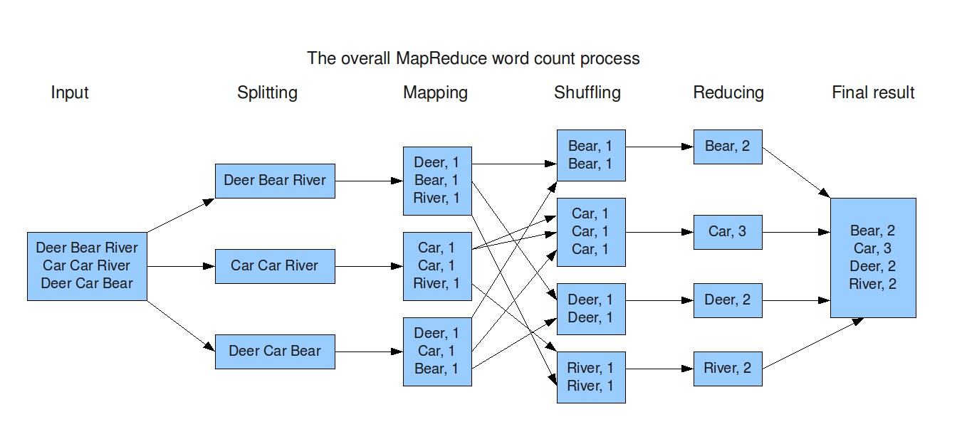
MapReduce model

Slide 24
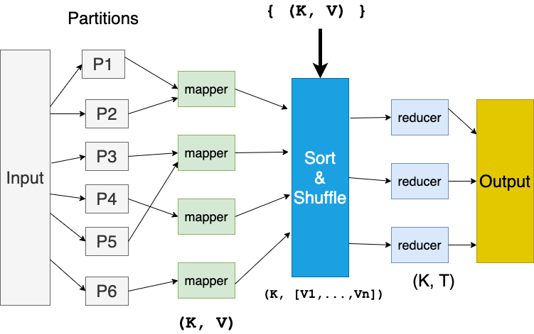
MapReduce model

Slide 25
Reducers in parallel
reduce() run in parallel.
Each reducer() operates on
(key, [V_1, V_2, …, V_n])
reduce((key, [V_1, V_2, …, V_n]):
Reducers create final outputs as:
(K1, T1)
(K2, T2)
…

Slide 26
MapReduce workflow
Input Data
Output Data
Worker
write
Output
File 0
local
write
Worker
Split 1
read
Split 2
Worker
Output
File 1
Split 3
Worker
Split 4
Worker
remote
read,
sort
Map
extract something you care about from each record
Reduce aggregate, summarize, filter, or transform

Slide 27
Mappers and Reducers
Need to handle more data?
Just add more Mappers/Reducers!
No need to handle multithreaded code ☺
Mappers and Reducers are typically single threaded and deterministic
Determinism allows for restarting of failed jobs
Mappers/Reducers run entirely independent of each other
Mappers/Reducers run in separate JVM processes

Slide 28
Word Count Problem: solve it by MapReduce
INPUT: Given a set of text documents/files
OUTPUT: Find frequencies of each unique word
Input: “gray fox red fox jumped over red gray fox”
Output: dictionary[(word, frequency)]
(gray, 2)
(red, 2)
(fox, 3)
(jumped, 1)
(over, 1)

Slide 29
Mapper: map(key, value)
Reads in input pair as (Key, Value)
Outputs a set of pairs (K’, V’)
Let’s count number of each word in user queries (or Tweets/Blogs)
The input to the mapper will be (Query_ID, Query_Text):
<Q1,“the teacher went to the store. the store was closed; the store opens in the morning. the store opens at 9am.” >
The output would be:
(the, 1) (teacher, 1) (went, 1) (to, 1) (the, 1) (store, 1) (the, 1) (store, 1) (was, 1) (closed, 1) (the, 1) (store,1) (opens, 1) (in, 1) (the, 1) (morning, 1) (the 1) (store, 1) (opens, 1) (at, 1) (9am, 1)

Slide 30
Sort & Shuffle: SQL’s GROUP BY
Accepts the Mapper output, and aggregates values on the key
For our example, the mappers output would be:
(the, 1) (teacher, 1) (went, 1) (to, 1) (the, 1) (store, 1) (the, 1) (store, 1) (was, 1) (closed, 1) (the, 1) (store, 1) (opens,1) (in, 1) (the, 1) (morning, 1) (the, 1) (store, 1) (opens, 1) (at, 1) (9am, 1)
The output of Sort & Shuffle would be:
(the, [1, 1, 1, 1, 1, 1])
(store, [1, 1, 1])
…
Notes:
Input is typically sorted, output is output exactly as is
All inputs with the same key must go to the same reducer!

Slide 31
Reducer: reduce(key, values)
Accepts the Sort & Shuffle output,
and aggregates values on the key
Input to reducer: (store, [1, 1, 1])
Output: (store, 3)
Input to reducer : (the, [1, 1, 1, 1, 1, 1])
Output: (the, 6)
…
Notes:
Input is typically sorted, output is output exactly as is
All inputs with the same key must go to the same reducer!

Slide 32
MapReduce Job Components
1. Input path (identify your input files)
2. Output path (where to write output)
3. map() function
map(key, value)
3.5 [Sort & Shuffle is done by MapReduce]
4. reduce() function
reduce(key, [value_1, value_2, …])
5. OPTIONAL combine() function
Notes:
Input is typically sorted, output is output exactly as is
All inputs with the same key must go to the same reducer!

Slide 33
MapReduce Job: Input Path
Input path: 3 files will be read
Example: s3://my_bucket/project7/
s3://my_bucket/project7/file1
s3://my_bucket/project7/file2
s3://my_bucket/project7/file3
Notes:
Input is typically sorted, output is output exactly as is
All inputs with the same key must go to the same reducer!

Slide 34
MapReduce Job: Output Path
Output path:
Example: s3://my_bucket/output7/
s3://my_bucket/output7/_SUCCESS
s3://my_bucket/output7/part1
s3://my_bucket/output7/part2
s3://my_bucket/output7/part3
s3://my_bucket/output7/part4
Notes:
Input is typically sorted, output is output exactly as is
All inputs with the same key must go to the same reducer!

Slide 35
MapReduce Job: map() function
# key: may be a record number
# value: single record of your input data
# “fox jumped and jumped”
map(key, value) {
# tokenize record
words = value.split(“ “)
# array index: 0 1 2 3
# words = [“fox”, “jumped”, “and”, “jumped”]
for word in words {
emit (word, 1)
}
}
Notes:
Input is typically sorted, output is output exactly as is
All inputs with the same key must go to the same reducer!

Slide 36
MapReduce Job: map() function Ignore words with length of less than 3 Chars.
# 103 is a record number
INPUT: (103, “a fox of jumped over red fox and jumped”)
Mappers output:
(a, 1)
(fox, 1)
(of, 1)
(jumped, 1)
(over, 1)
(red, 1)
(fox, 1)
(and, 1)
(jumped, 1)
Notes:
Input is typically sorted, output is output exactly as is
All inputs with the same key must go to the same reducer!

Slide 37
MapReduce Job: map() function Ignore words with length of less than 3 Chars.
# key: may be a record number
# value: the entire record such
# as “fox jumped and jumped”
map(key, value) {
words = value.split(“ “)
for word in words {
# filter non-desired words
if (len(word) > 2) {
emit( word, 1)
}
}
}
Notes:
Input is typically sorted, output is output exactly as is
All inputs with the same key must go to the same reducer!

Slide 38
MapReduce Job: map() function Ignore words with length of less than 3 Chars.
INPUT: (103, “a fox of jumped over red fox and jumped”)
Mappers output:
(fox, 1)
(jumped, 1)
(over, 1)
(red, 1)
(fox, 1)
(and, 1)
(jumped, 1)
NOTE: FILTERING: “a” and “of” were dropped
since their length is less than 3
Notes:
Input is typically sorted, output is output exactly as is
All inputs with the same key must go to the same reducer!

Slide 39
MapReduce Job: map() function Ignore records with length of less than 80 chars
# key: may be a record number
# value: the entire record such as “fox jumped and jumped”
map(key, value) {
# filter
if (len(value) < 80) {
return
}
words = value.split(“ “)
for word in words {
# filter
if (len(word) > 2) {
emit( word, 1) # filter non-desired words
}
}
}
Notes:
Input is typically sorted, output is output exactly as is
All inputs with the same key must go to the same reducer!

Slide 40
MapReduce Job: map() function
# key: may be a record number such as 100 (is ignored)
# value: the entire record such as
# (103, “fox jumped and jumped”)
map(key, value) output:
(fox, 1)
(jumped, 1)
(and, 1)
(jumped, 1)
Notes:
Input is typically sorted, output is output exactly as is
All inputs with the same key must go to the same reducer!

Slide 41
MapReduce Job: map() function
# key: may be a record number such as 1234 (is ignored)
# value: the entire record such as
# (1234, “fox jumped over fox”)
map(key, value) output:
(fox, 1)
(jumped, 1)
(over, 1)
(fox, 1)
Notes:
Input is typically sorted, output is output exactly as is
All inputs with the same key must go to the same reducer!

Slide 42
Sort & Shuffle: Receives Mappers Output
Sort & Shuffle is the genie of MapReduce
Similar to SQL’s GROUP BY
Output of Sort & Shuffle
(key_1, [V_11, V_12, …])
(key_2, [V_21, V_22, …])
…
(key_N, [V_N1, V_N2, …])
Notes:
Input is typically sorted, output is output exactly as is
All inputs with the same key must go to the same reducer!

Slide 43
Input to Reducers
(key_1, [V_11, V_12, …])
(key_2, [V_21, V_22, …])
…
(key_N, [V_N1, V_N2, …])
NOTE:
All keys are unique
A key may have any number of values
Values are not sorted (they can be in any order)
Notes:
Input is typically sorted, output is output exactly as is
All inputs with the same key must go to the same reducer!

Slide 44
MapReduce Job Components: reduce()
Reducers receive output of Sort & Shuffle phase.
reduce(key, values) accepts a
key: a single unique key
values: [V_1, V_2, …, V_n]
Creates any number of new (K’, V’) pairs
Notes:
Input is typically sorted, output is output exactly as is
All inputs with the same key must go to the same reducer!

Slide 45
MapReduce Job: reduce() function
# handle (key, [v1, v2, …])
# key: is a unique word
# values: [1, 1, …, 1]
reduce(key, values) {
count = 0
# iterate values
for v in values {
count += v
}
emit(key, count)
}
Notes:
Input is typically sorted, output is output exactly as is
All inputs with the same key must go to the same reducer!

Slide 46
MapReduce Job: reduce() function + what if we want to ignore words with frequencies of less than 5
# key: is a unique word
# values: [1, 1, …, 1]
reduce(key, values) {
count = 0
for v in values {
count += v
}
# filter
if (count >= 5) {
emit(key, count)
}
}
Notes:
Input is typically sorted, output is output exactly as is
All inputs with the same key must go to the same reducer!

Slide 47
MapReduce Job: reduce() function + what if we want to ignore words with frequencies of less than 5 Ignore words with length of less than 3 Chars.
# key: is a unique word
# values: [1, 1, …, 1]
reduce(key, values) {
# not a proper filter for reducer (should be done in mapper)
if (len(key) <= 2) { return }
count = 0
for v in values {
count += v
}
# filter
if (count < 5) {
return
}
else {
emit(key, count)
}
}
Notes:
Input is typically sorted, output is output exactly as is
All inputs with the same key must go to the same reducer!

Slide 48
MapReduce Job: reduce() function and output length of key
# key: is a unique word
# values: [1, 1, …, 1]
reduce(key, values) {
count = 0
for v in values {
count += v
}
# create a new composite value
new_value = (len(key), count)
emit(key, new_value)
}
Notes:
Input is typically sorted, output is output exactly as is
All inputs with the same key must go to the same reducer!

Slide 49
MapReduce
Hadoop
Program
fork
fork
fork
Master
assign
map
assign
reduce
Input Data
Output Data
Transfer peta-scale data through network
Worker
write
Output
File 0
local
write
Worker
Split 0
read
Split 1
Worker
Split 2
Output
File 1
Worker
Worker
remote
read,
sort
Map
Reduce

Slide 50
Failure in MapReduce
Failures are norm in commodity hardware
Worker failure
Detect failure via periodic heartbeats
Re-execute in-progress map/reduce tasks
Master failure
Single point of failure; Resume from Execution Log
Robust
Google’s experience: lost 1600 of 1800 machines once!, but finished fine

Slide 51
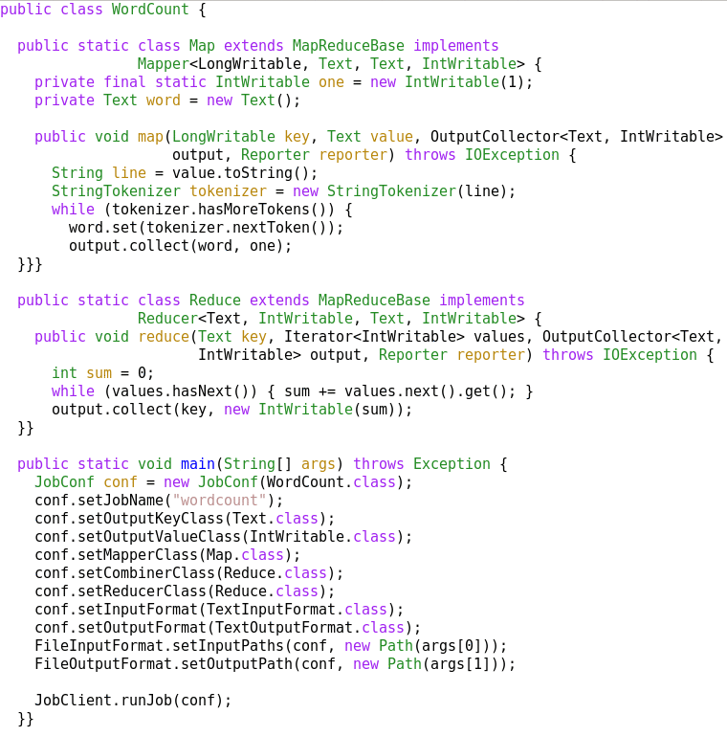
A MapReduce Job
Mapper
Reducer
Run this program as
a MapReduce job

Slide 52
Complete Word Count Solution in MapReduce/Hadoop
Word Count Solution in MapReduce/Hadoop
Driver Program
Mapper Program
Reducer Program

Slide 53
Summary: MapReduce
Programming paradigm for data-intensive computing
Distributed & parallel execution model
Simple to program
The MapReduce framework automates many tedious tasks:
Data partitioning
Machine selection,
Failure handling
Sort & Shuffle

