Slide 1
Fully Booked
By Kelsey de boer

Slide 2
About the topic
Fully Booked is a website design for a bookstore
It features new releases, store hours, and the mission and values of the store

Slide 3

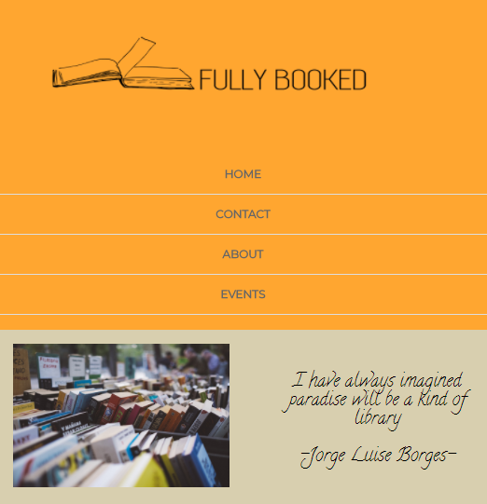
Homepage - Desktop
This is the homepage of Fully Booked
You can clearly see the navigation buttons along the top of the page in both the desktop and mobile versions

Slide 4
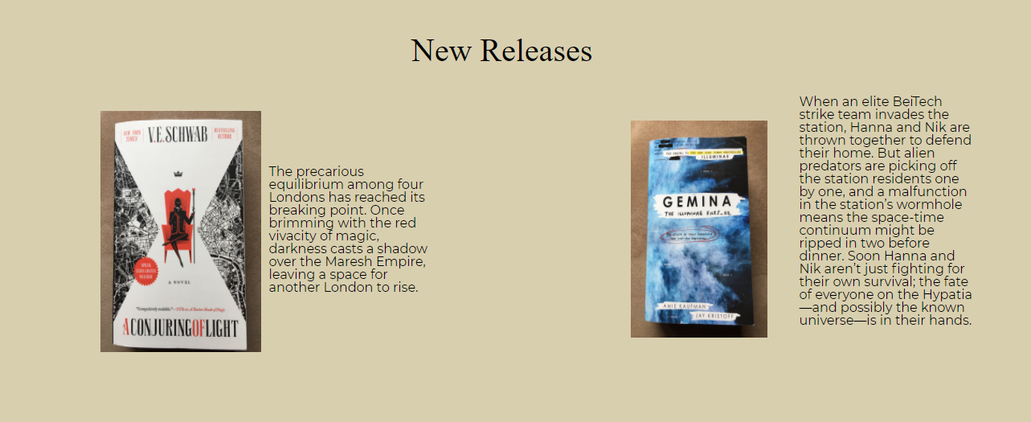

HomePage

Slide 5
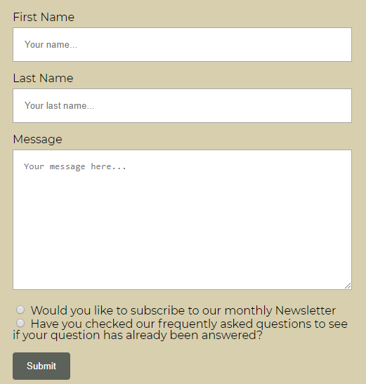
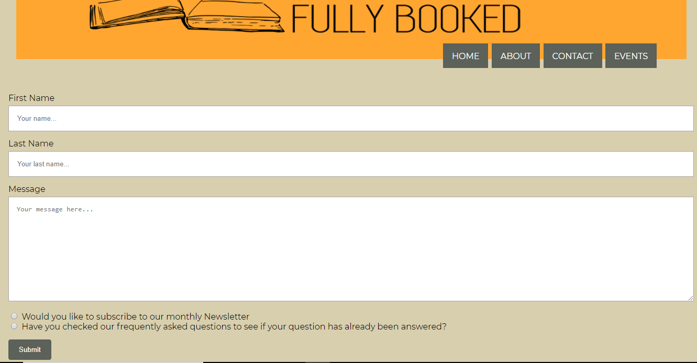
Contact Page
The contact page looks very similar for every format

Slide 6
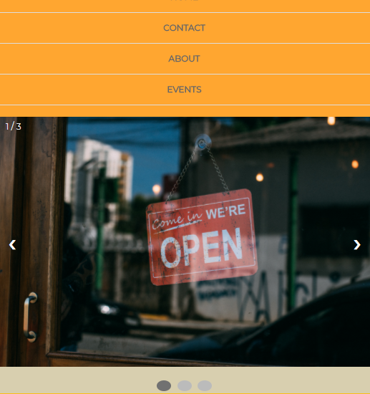
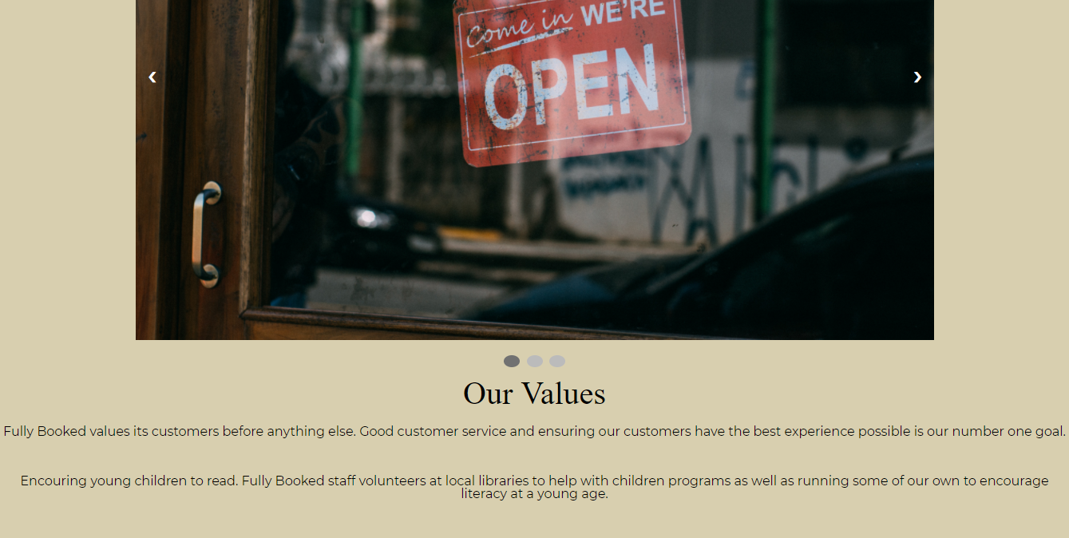
About Page
The about page features the companies story as well as their core values.
It also features a slide show of photos

