Slide 1
NYC Taxi Data Analysis for 2013
By Deboshree Bose

Slide 2
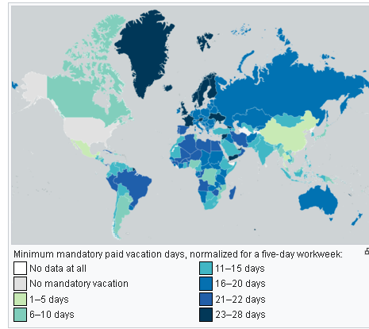
Choice of month
File size
Eqvt. bit depth
Therefore rows of data dep
#days
2 files trip & fares
Trip- distance & time, rates, drop/pick time & date, coordinates, payment type, vendor, taxi &driver ids.
Fare amount, taxes, tolls & surcharges, total amount

Slide 3

Cleaning Data – Initial Glance
Passengers
Nulls
Latitude-Longitude
Zeros
Distance
Zeros
Time
[1-6]

Slide 4
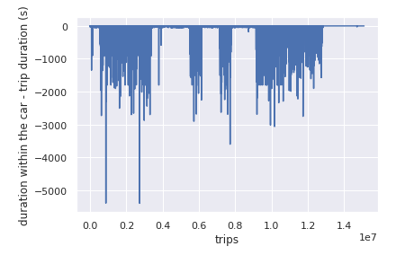
Scrubbing Dropoff & Pick up times
Drop off time must always be > pick up time for any given trip
Car_{hire time} must always >Trip_{time}

Slide 5
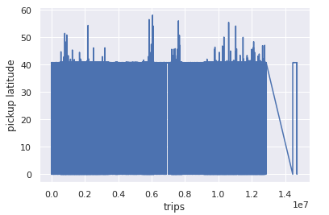
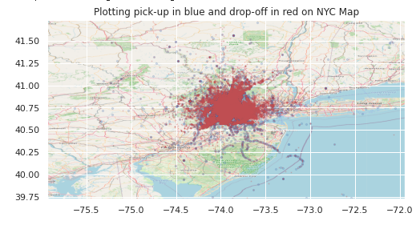
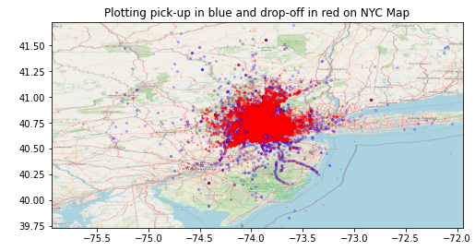
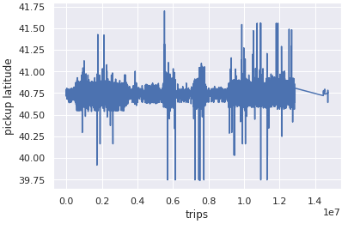
Scrubbing Coordinates
Generic checking if latitude and longitude [72
Lat 1deg ~ 69 miles
Long 1deg at that (40deg Lat) ~ 40 miles
More detailed contouring removing points from ocean

Slide 6
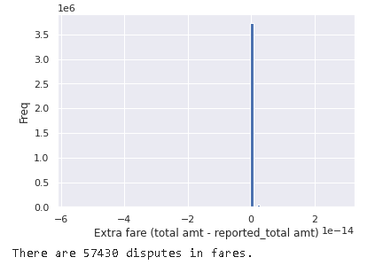
Total Fare = Sum(all Fares subsets)
Assumption is that all other fare values (toll, tax, etc.) are recorded correctly.
Have updated inconsistencies in total fare amount.

Slide 7
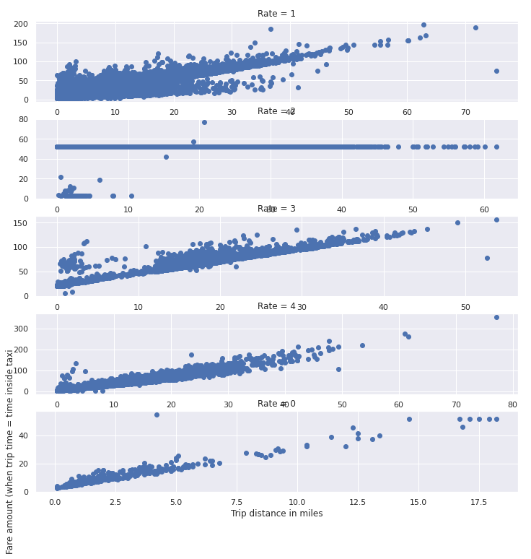
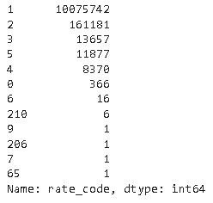
Scrubbing Fare codes (Rates)
For code _rate =2, remove all <52
Code_rate = {all}-{5}; remove all < 2.50
Code rate 3 (not sure, the documentation says it’s Airport, so the flat rate is 52, but it looks linear so I’m assuming it must be correct)

Slide 8
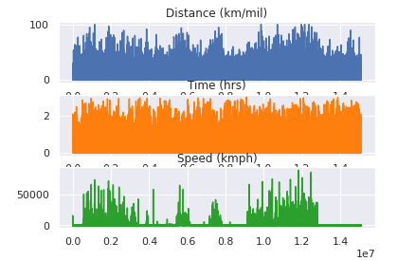
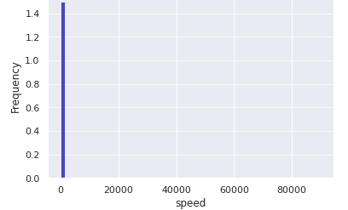
Speed based Scrubbing
After removing trip_{time} < 1 minute and distances less than 100 meters or 0.01 mile, speed was calculated.
Within city limits 30-45 mph (48-72 km/h)
Highways outside cities 55 mph (89 km/h)
Interstates 55-65 mph (89-105 km/h)
I added over 25% excess speed cap to the above limits. Beyond that speed limits for the approx. area its likely that the license will be cancelled.

Slide 9
Further Improvements
Scrubbing may be improved by double-checking:
Pickup and Drop-off coordinates based on rate_code
reassigning rate codes according to lat-long information instead of removing them(presuming lat-long information is correct)
information on trip_time vs. duration in a car (i.e. drop-off - pick up)
Information on wait_charges
rate_codes of 2013

Slide 10
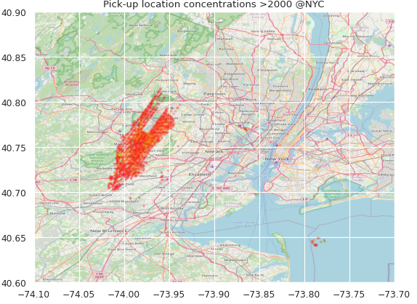

Exploratory Analysis
Busiest Locations => concentration of pickup/dropoff points
69 miles ~ 111 km (3 dec ~ 100m)
Busiest hours =>taxi employed
Each trip: $hr_{employ}∈ℝ_{\left[0,1\right]}^{\left(1×24\right)}$
E.g. Trip from 17:45 to 21:35, then
hr_employ = [zeros(17,1), 45/60 ,ones(3), 35/60, zeros(2)]
664, Lexington Avenue, Manhattan Community Board 5, Manhattan, New York County, City of New York, New York, 10022
137, West 33rd Street, Chelsea District, Manhattan, New York County, City of New York, New York, 10001
1270 Avenue of the Americas, 1270, 6th Avenue, Manhattan Community Board 5, Manhattan, New York County, City of New York, New York, 10020

Slide 11
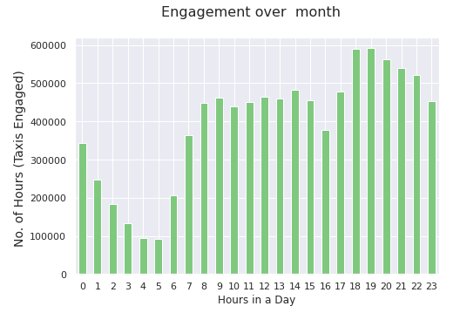
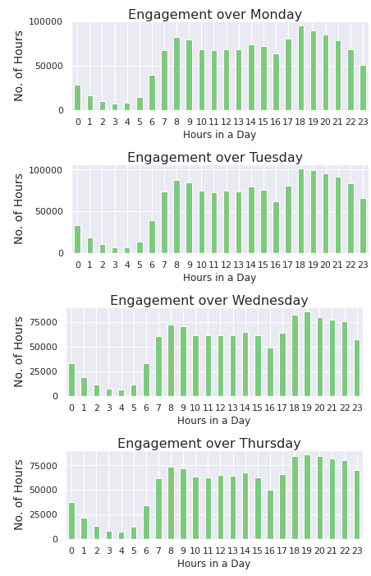
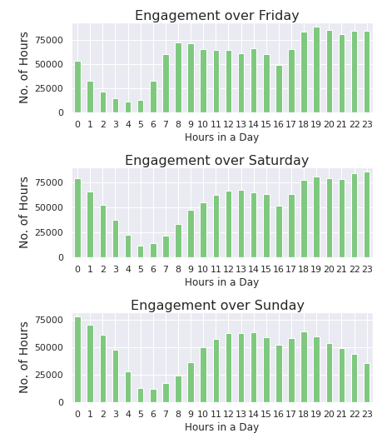
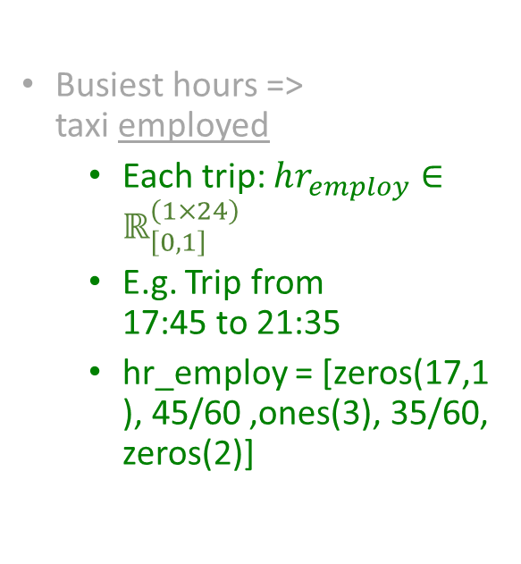
Busiest Locations (Q1)
Busiest hours => taxi employed
Each trip: $hr_{employ}∈ℝ_{\left[0,1\right]}^{\left(1×24\right)}$
E.g. Trip from 17:45 to 21:35
hr_employ = [zeros(17,1), 45/60 ,ones(3), 35/60, zeros(2)]

Slide 12
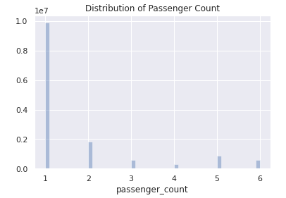
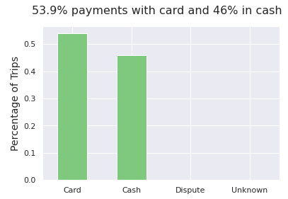
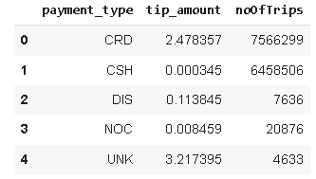
Distribution of Passengers, Payment Type
N(card) ~ N(cash) customers.
However , <tip_{card}> >> <tip_{cash}>

Slide 13
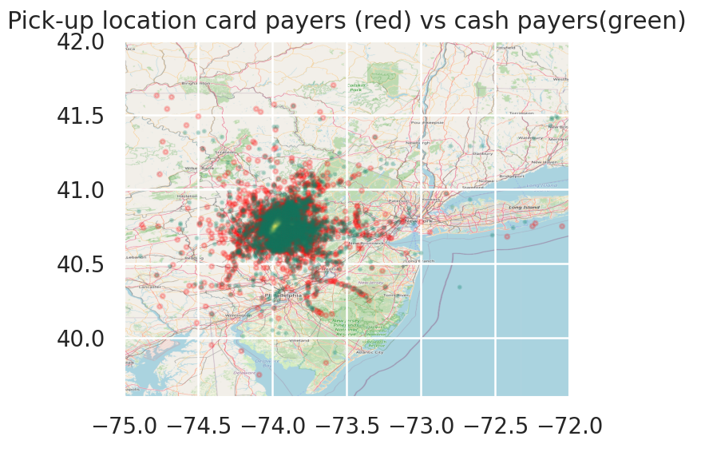
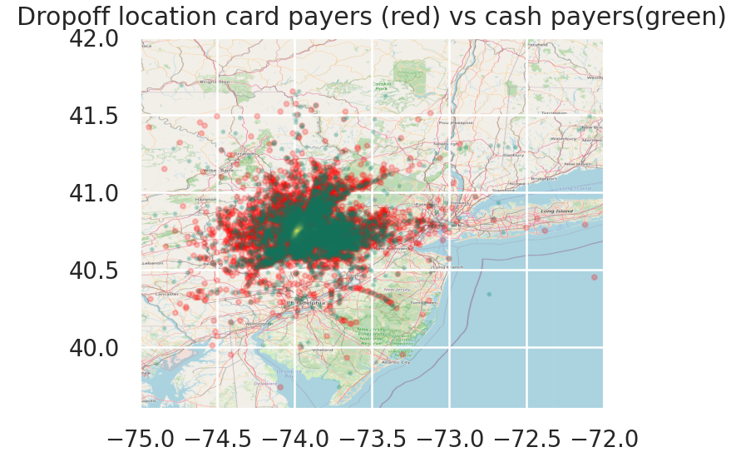
CRD: Greater spatial spread of drop & pick loc

Slide 14
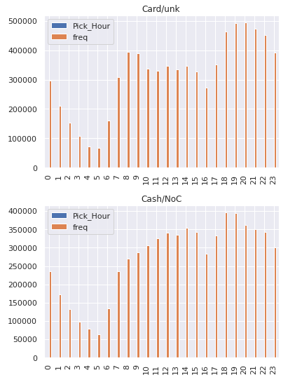
When can card customers be found vs. cash customers?
Data visualization indicates that their locations and timings are similar.
The drop-off and pick-up zones are more spread out for card customers.
Regardless of the hour, the numbers indicate that more customers for the day will pay by card.

Slide 15

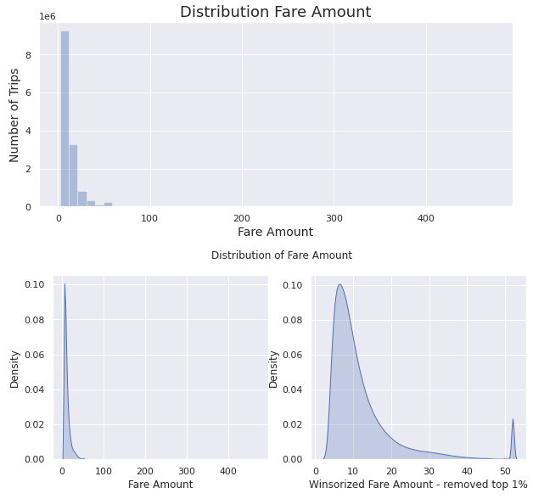
Distribution of Fare Amount
Fare is predominantly a function of:
distance
rate code
time in the taxi
Trip time

Slide 16
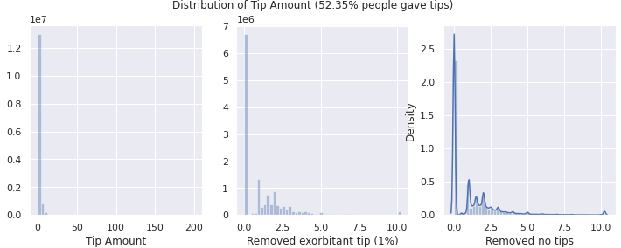
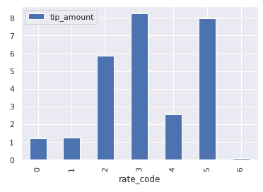
Distribution of Tip Amount
Primarily no tips paid for
shorter trips
Rate_code =1,2
More information is required to examine rate_code 6, if it is a genuine rate code.
Airport trips get high average tips.
Negotiated fare trips also get high average tips these are prominent for less populated areas.

Slide 17
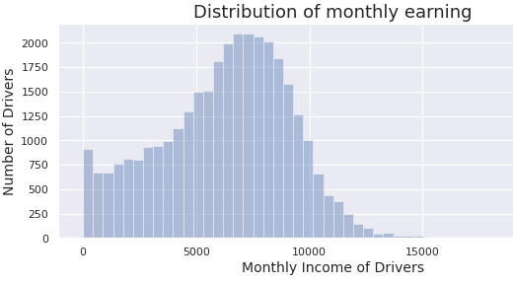
Characterization of Taxi workers on Work Hours and Income
To differentiate between income classes of drivers, the monthly income is plotted
The maximum income >$22000
Mean is about $6500, so brackets accordingly for random driver samples

Slide 18
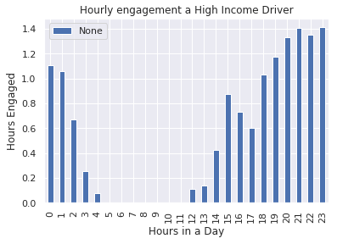
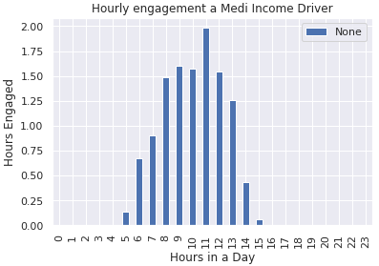
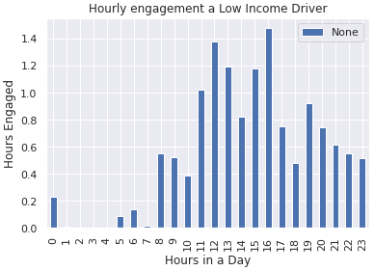
Characterization of Taxi workers on Work Hours and Income

Slide 19
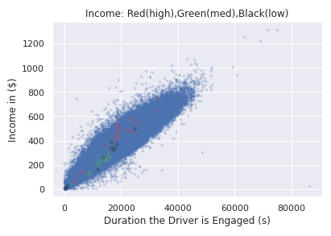
Scatter Plot of Trips (Work Hours and Income)
Role of certainty
Blue patch shows trips in space of income vs. driver engagement.
Roughly the points above the orange line are more rewarding than those below.
High-income driver , more trips and rewarding trips.
Mid- income driver is working more hours than high income but making less.
Low income driver has not made many trips in the month

Slide 20
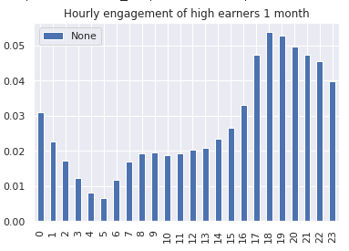
Average Hourly Engagement of High-Income Drivers
High-income drivers seem to be determining the shape of the resource engagement over the month although they make only a small percentage of total number of trips in a month.

Slide 21
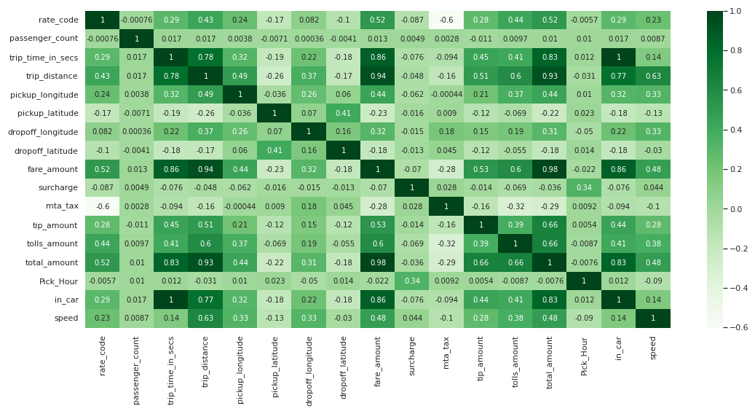

Slide 22
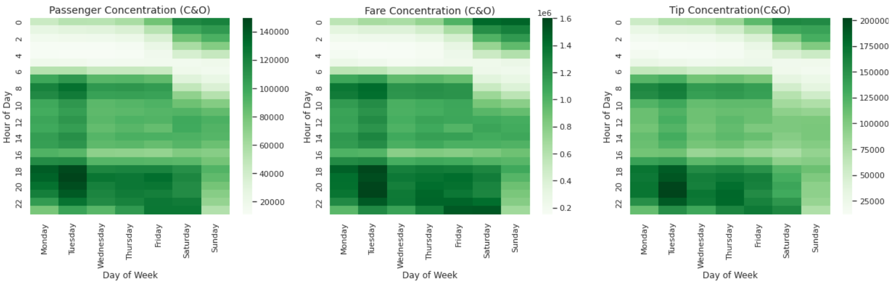
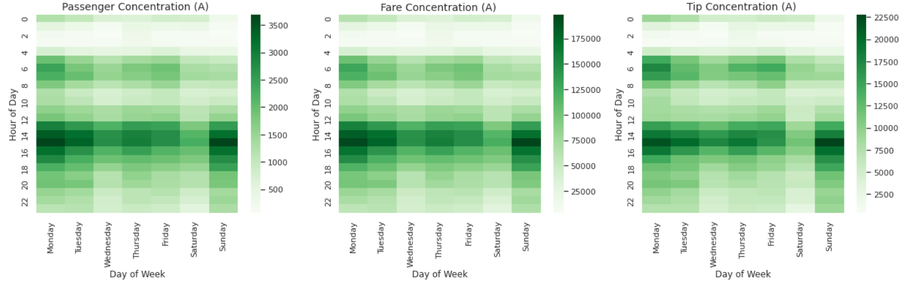

Slide 23
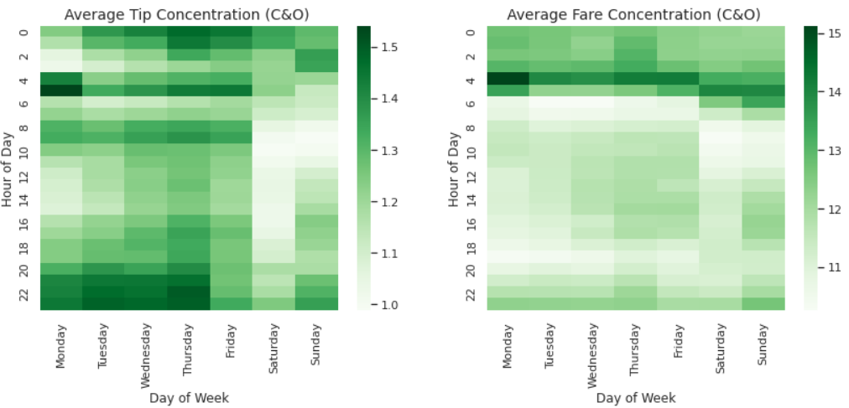
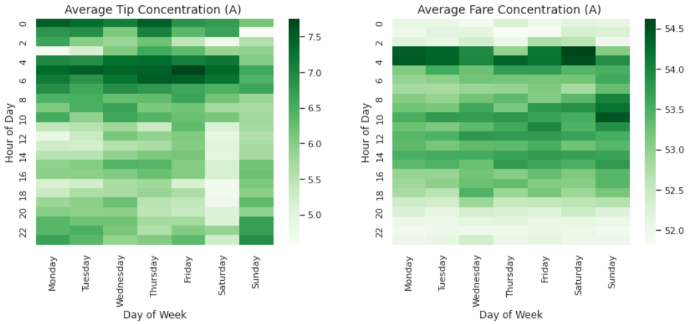

Slide 24
Thank you

Slide 25
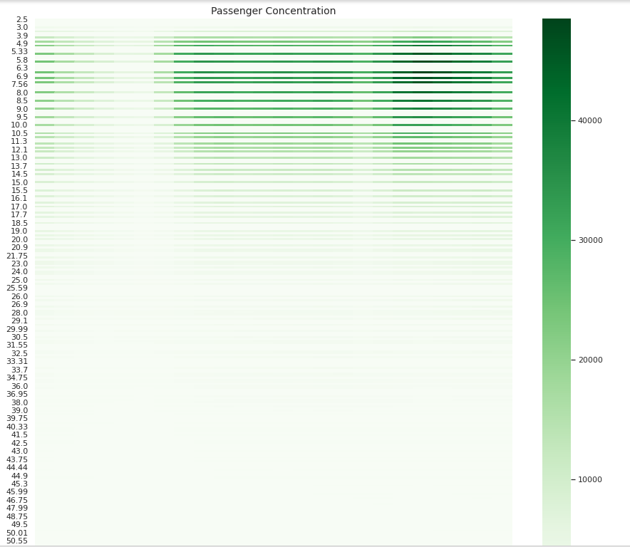

Slide 26
