Slide 1
INFO 492 C
CONSTRUCTION INFORMATICS
Week 1 / Orientation
AI LAB SERIES

Slide 2
Week 1 class objectives
Meet instructional team, students
Provide high-level orientation about the class
Assign teams (8 teams of 4; GC ↔ subcontractor pairs for the RFI Lab)
First assignment lecture
Lab: RFI Lab
Teams check-in
AI LAB SERIES

Slide 3
Week 1 schedule
1:30 - 2:30 Instructional team, student introductions
2:30 - 3:00 Intensive Capstone Overview
3:00 - 3:30 Lecture: how information flows through construction
3:30 - 5:00 RFI Lab, check-in with teams
5:00 - 5:20 RFI Lab debrief
AI LAB SERIES

Slide 4
Quarter Overview
Autumn Quarter / 10 weeks
2 Weeks — Thesis, research, pre-development; RFI Lab + project lens selection
7 Weeks — Coordination demo iterations, site visits, feedback, mid-quarter analysis
1 Wk — Final Analysis
Teams check-ins / deep-dives
Labs: research, development, testing…
Final Presentation / Final Grades
AI LAB SERIES

Slide 5
Your instruction team
Frank Martinez - Instructor
[TA name] - TA
AI LAB SERIES

Slide 6
Roles
Instructor
Instruction, guidance, lectures
Weekly check-ins with each team
Mentoring with student teams, deep dives, problem solving
Assignment review and grading
Connect to external resources (industry partners, site visits)
TA
Labs assistance, coordination
Assignments review
First point of contact for questions
Office hours by appointment
AI LAB SERIES

Slide 7
Communication
Email — Questions about class, assignments… — checked evenings; reply within 1 biz day
Canvas Assignments — Feedback on assignments — following submission
Canvas Announcements — News/updates to all class — weekly Monday 8AM; ad hoc
In-Class — TA check-ins, instructor 1:1 — Fridays 1:30 - 5:20
Office Hours — Student, personal issues — by appointment
DO NOT USE: Slack, MS Teams, social media (LinkedIn, FB etc), text message — never, unless otherwise discussed
AI LAB SERIES

Slide 8
Assignments & Grading
Details Points
Pre-Class Questionnaire — 5
RFI Lab Deliverables — 15
Thesis + Coordination Posture Design — 10
Coordination Demo #1 — 15
Coordination Demo #2 — 15
Mid-quarter Analysis — 25
Coordination Demo #3 — 15
Coordination Demo #4 — 15
Final Analysis — 40
Total — 155
AI LAB SERIES

Slide 9
Grading Policy
Close to a Pass/Fail class
Complete, Incomplete, Fail (A, B- and F)
155 - 150 points 4.0 Completed all or nearly all assignments and requirements on time
< 150 - 124 points 2.5 Missing/rejected assignments, low participation
< 124 - 0 points 0 Non-responsive
AI LAB SERIES

Slide 10
Grading Policy Cont.
Assignment grading
Deadlines 11:59 PM Wednesday
Accept / Reject with comments
Grades released by following Tuesday
If rejected, 1 week to resubmit
* Graded individually
AI LAB SERIES

Slide 11
Typical Friday Class
1:30-5:20 PM:
Announcements
Presentations
Lecture, prep for next week's assignment
Teams check-ins with instructor: per schedule
Lab
Outside these times, you should plan time for research, development, presentations
AI LAB SERIES

Slide 12
Teams
Four students max (32 students → 8 teams of 4)
Each team will:
Pair with a partner team for the Week 1 RFI Lab (one team = GC, one = subcontractor)
Select a project lens: an industry-partner project or a public project dataset
Develop a thesis about where construction information flow breaks down
Teams will focus on their chosen lens and thesis for the entire quarter
Each team meets with instructor for check-ins; end of class each Friday
[TA] will coordinate the team check-in schedule; 15 mins each
Teams also encouraged to meet outside of class time
AI LAB SERIES

Slide 13
What is the class project?
Students will research how information — documents, subcontracts, communications, site data — flows through construction projects, and where it breaks down
Students will engage with industry practitioners (GCs, subs, design teams, owners) to inform their research findings
Students will access public project data and generate synthetic data where proprietary data is unavailable
Students will build LLM-based, agentic systems to run experiments that validate their thesis about construction coordination
AI LAB SERIES

Slide 14
Thesis development
Develop a thesis about construction information flow
See Reading List for background information, material
Write a thesis statement to anchor the point of view…
And what needs to be validated
Validate thesis with LLM and agentic experiments
Informed by field observation, practitioner interviews, and real/synthetic project data
AI LAB SERIES

Slide 15
Where information breaks down
Think about who holds which document…
And what a late or wrong answer costs
RFI example
A subcontractor hits a conflict between drawings and specs
Two dimensions at risk: schedule and contractual exposure
AI LAB SERIES

Slide 16
Industry characteristics: project lifecycle
Preconstruction — estimates, bids, constructability review
Contracting — A201 general conditions, subcontracts, flow-down clauses
Execution — RFIs, submittals, change orders, daily reports, meeting minutes
Closeout — as-builts, O&M data, COBie
AI LAB SERIES

Slide 17
Key information artifacts
RFIs (Requests for Information) — questions, ambiguity, latency, risk
Submittals and shop drawings — approvals, long-lead items
Change orders — cost/schedule impact, negotiation
Daily reports and field observations — where documents meet site reality
Inspection and permit records — compliance, public data
AI LAB SERIES

Slide 18
Data access in construction
Public data — permits, inspections, bidding records, OSHA logs (Seattle Services Portal, L&I, OSHA)
Proprietary data — partner project data, Procore/PlanGrid exports, Dodge reports
NDAs and what partners can and cannot share
Synthetic data generation — when and how to justify it (documented, or it's a reject)
AI LAB SERIES

Slide 19
AI agents in construction coordination
Where agents help: RFI triage, submittal tracking, reference resolution, compliance checks
Where agents over-claim: authority to respond, contractual commitments, safety-critical calls
Multi-party protocols: message formats, escalation, audit trails
Class discussion: what should an agent NEVER do on a construction project?
AI LAB SERIES

Slide 20
Next week's assignment
Finalize your team's thesis about construction information flow
Choose your project lens: partner project or public dataset
Design your coordination posture: parties, artifacts, four demo concepts
Start with a thesis statement
Present a placeholder web app representing thesis and posture
AI LAB SERIES

Slide 21
Today's Lab: RFI Lab
8 teams of 4 — paired as GC ↔ subcontractor
GC team: design a new UW Information School building (program brief) and publish a formal RFI
Subcontractor team: respond with a complete RFI response package by the deadline
One addendum allowed; log every communication
Debrief: where did information flow break down? What would an AI agent have changed?
See Miro board
AI LAB SERIES

Slide 22
Teams check-in
Who's doing what on each team, i.e. roles
Team norms, agreement
GC/sub pairing and RFI topic selection
Quick discussion: what's unique about construction information flow, from a coordination perspective
AI LAB SERIES

Slide 23
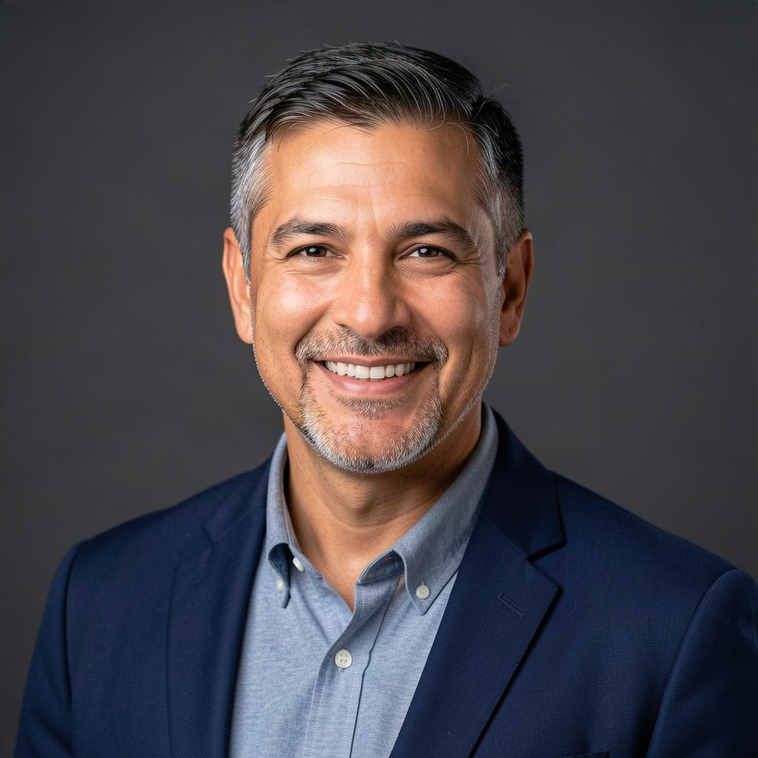
Frank Martinez
Instructor, INFO 492 C — Construction Informatics
• Lecturer, UW Information School — AI LAB series
• Founder, Last Myle Engineering — applied AI and data systems
• Co-founder, ¡Adiós COVID! (2020–24) — public-health informatics with WA DOH / VACCS Center
• Builds with AI agents, LLMs, and agentic systems across regulated industries
• Focus: how information flows (and breaks) in high-stakes, multi-party environments
AI LAB SERIES

