Slide 1
ARTIFICIAL INTELLIGENCE AND EXPERT SYSTEMS LAB
Course Code: CSE 404
Topic: Ecosystem Food Chain Knowledge Base using Prolog.

Slide 2
Presented By:
Debodipto Samadder
Id: 21201079
Roll: 79
Sec: B2
Dept. of CSE, UAP.
Presented To:
Noor Mairukh Khan Arnob
Lecturer,
Dept. of CSE,
UAP.

Slide 3
TABLE OF CONTENT:
Problem Statement
Designed Family Tree
Technical Report
Source Code
Conclusion

Slide 4
PROBLEM STATEMENT
The goal of this project is to model the human food chain within an ecosystem using Prolog. It captures the hierarchical relationships of producers and consumers through logical facts and recursive rules for efficient querying and analysis.

Slide 5
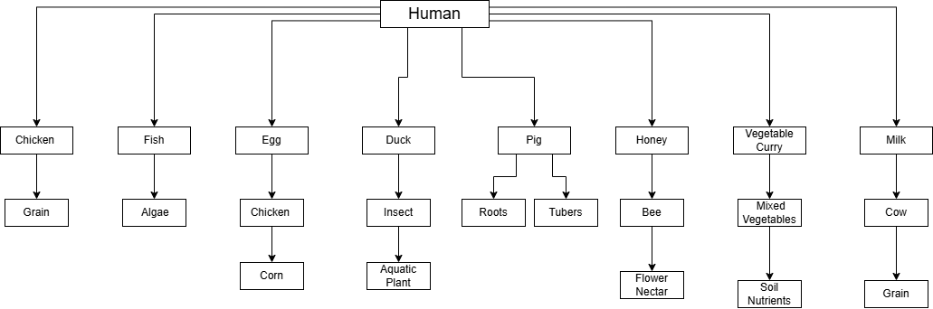
DESIGNED Tree

Slide 6
Technical Report
Report link: Report Link

Slide 7
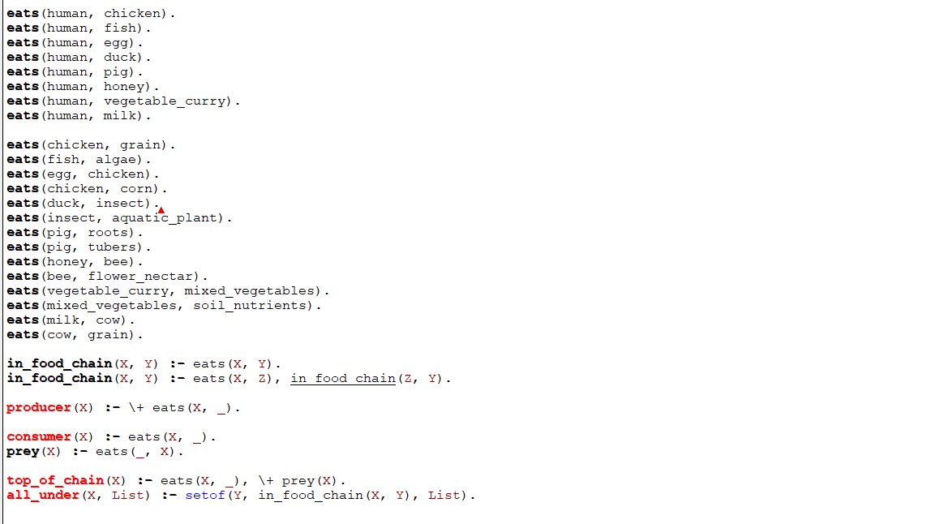
Source Code:

Slide 8
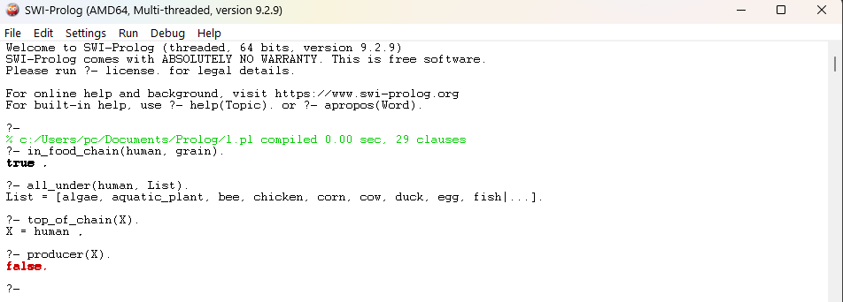
Output
Code link: PRolog Code

Slide 9
Conclusion
In this project, we successfully implemented an Ecosystem Food Chain Knowledge Base in Prolog, focusing on the human food chain. The knowledge base models hierarchical food relationships using facts and recursive rules. It enables complex queries like tracing food sources and identifying producers. This demonstrates how logic programming can effectively represent real-world ecological systems.

