Slide 1
Application of Weighted Essentially Non-Oscillatory Limiting to Compact Interpolation Schemes
Alfred Gessow Rotorcraft Center Aerospace Engineering Department University of Maryland, College Park
Debojyoti Ghosh
Graduate Research Assistant
James D. Baeder
Associate Professor
AIAA Region I Young Professional, Student, and Education Conference 2011
4th November, 2011, Johns Hopkins University / Applied Physics Laboratory Kossiakoff Center, Laurel, MD

Slide 2
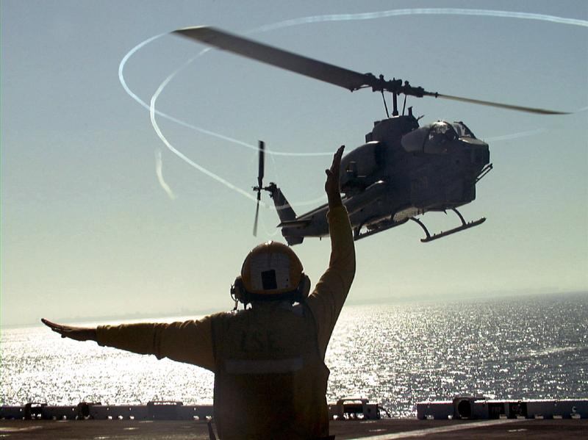
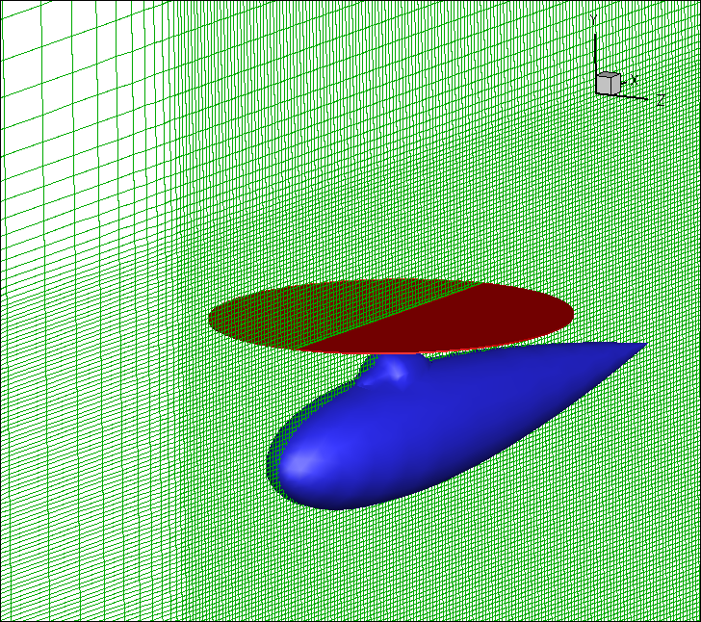
Motivation and Objectives
Accurate numerical simulation of the wake flow field around a rotorcraft
Long term convection and mutual interaction of vortices
Interactions of vortices with fuselage and ground plane
High order accurate Navier-Stokes solver
Lower dissipation to preserve vortices as they convect over large distances
Smaller stencil for same order of accuracy to reduce data transfer costs for multiple-mesh solutions

Slide 3
Introduction
Scalar hyperbolic partial differential equation
Discretization in time leads to an ordinary differential equation (solved by Euler explicit or TVD RK3)
Reconstruction – interpolation of f at the interfaces from the cell centered/averaged values
Upwinding – biased interpolation stencil to model wave nature of the solution

Slide 4
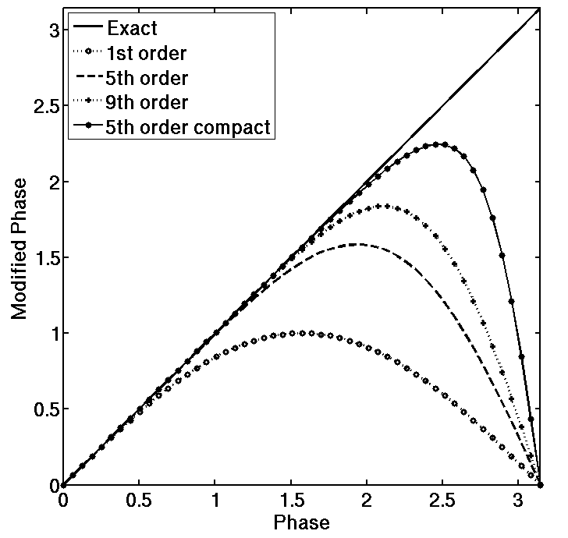
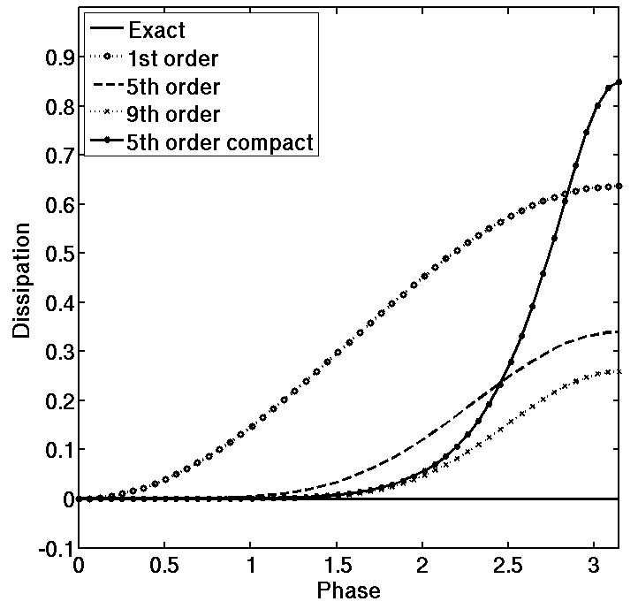
Compact Schemes
High order accuracy with smaller stencils
Better spectral resolution than explicit interpolation
Lower dissipation at well-resolved frequencies
Taylor series error order of magnitude lower

Slide 5
Compact-Reconstruction WENO Schemes
Convex combination of candidate r-th order accurate stencils
Weights of each stencil based on “smoothness” (measured by divided differences of the appropriate order)
Traditional WENO schemes use explicit interpolation
Higher order accuracy ➔ wider stencil ➔ oscillatory solutions
Compact-Reconstruction (CRWENO) schemes constructed by using implicit interpolations as candidates in the WENO algorithm
Advantages of compact interpolation schemes (smaller stencil, lower dispersion and dissipation, lower absolute errors)
Non-oscillatory reconstruction across discontinuities
Optimal Weights
WENO Weights

Slide 6
Example: CRWENO5

Slide 7
Smoothness Indicators
Weights are calculated based on smoothness indicators of corresponding explicit stencils (same as WENO5 scheme)

Slide 8
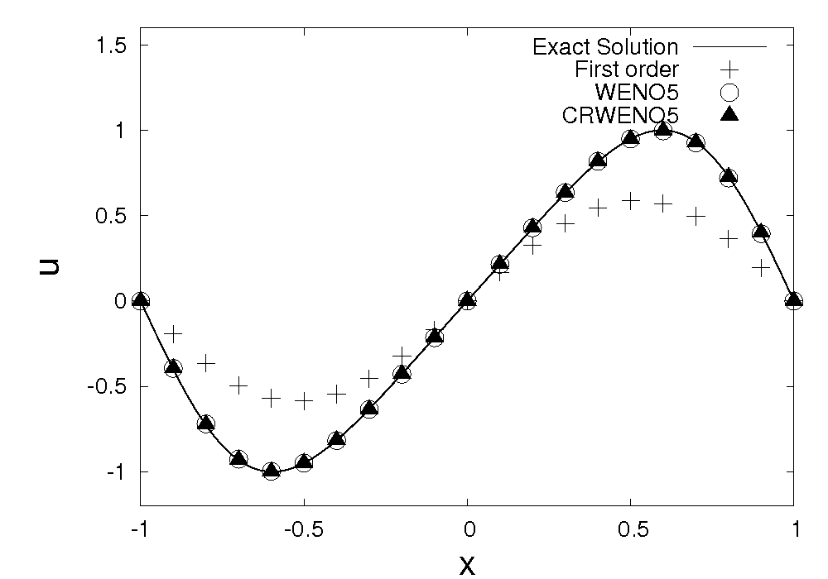
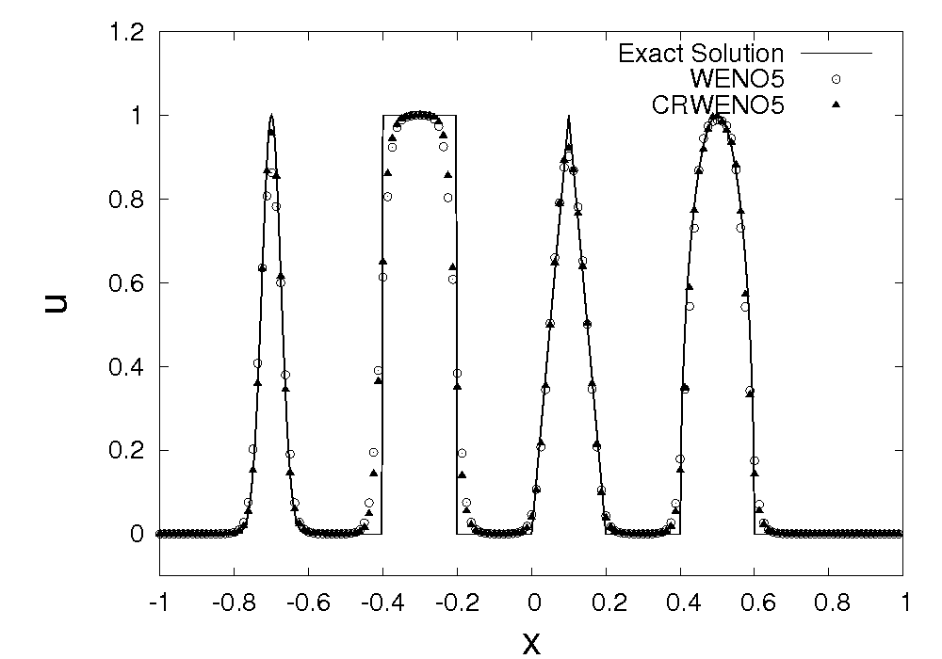
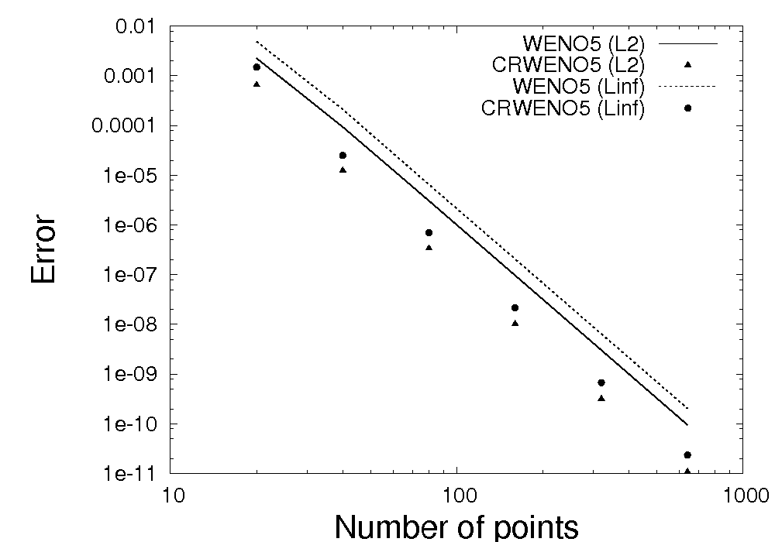
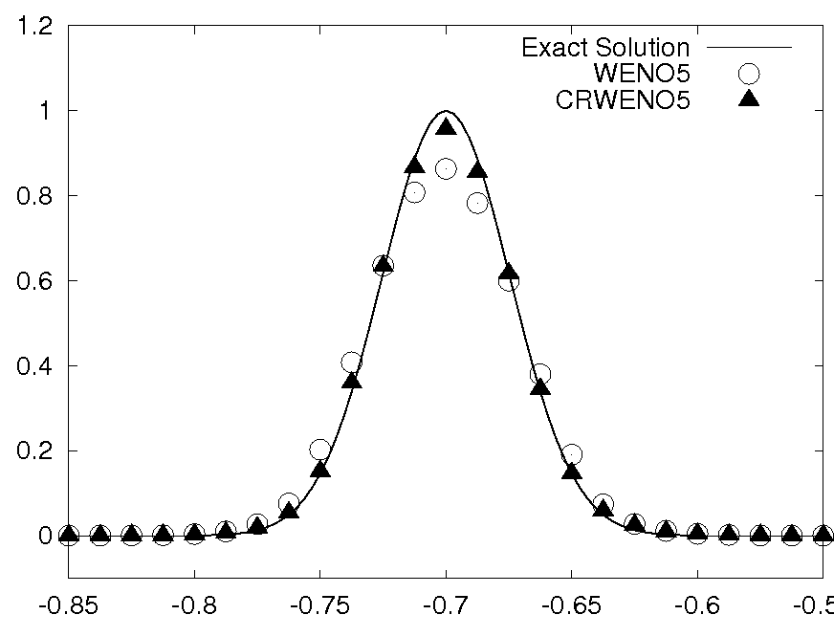
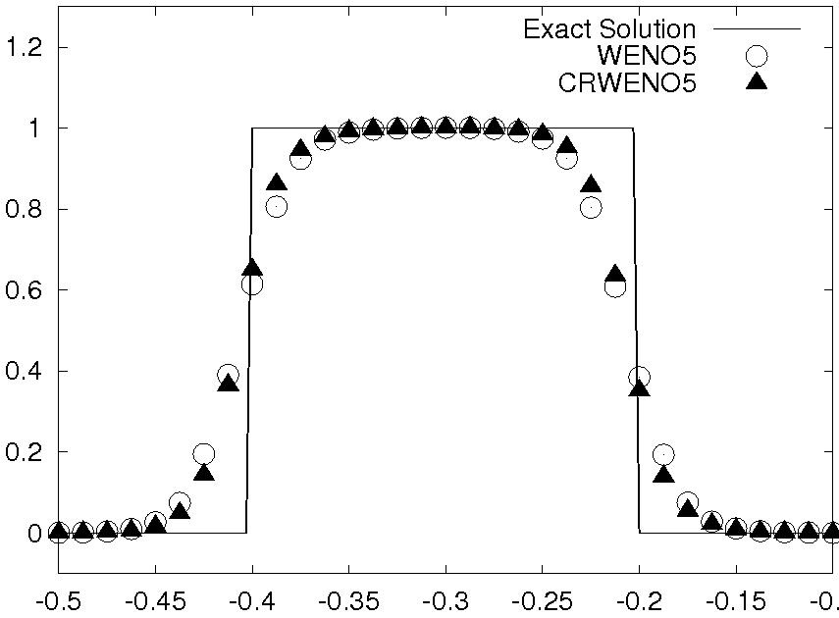
Linear Advection Equation
5th order convergence with lower absolute error than WENO5
Less smearing and clipping than WENO5

Slide 9
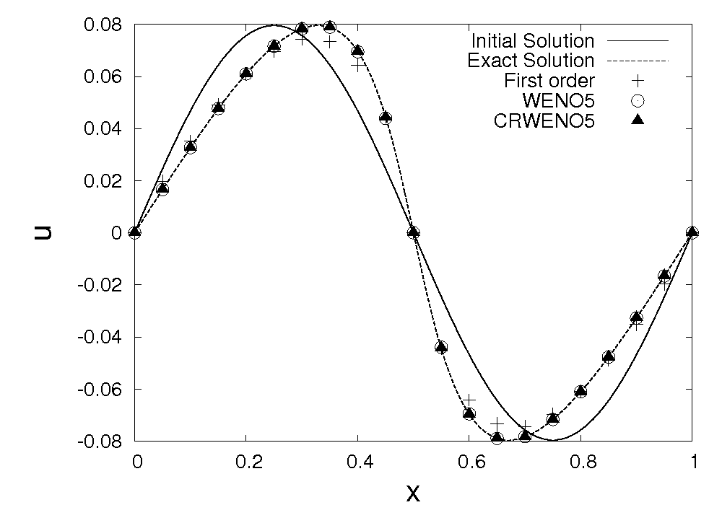
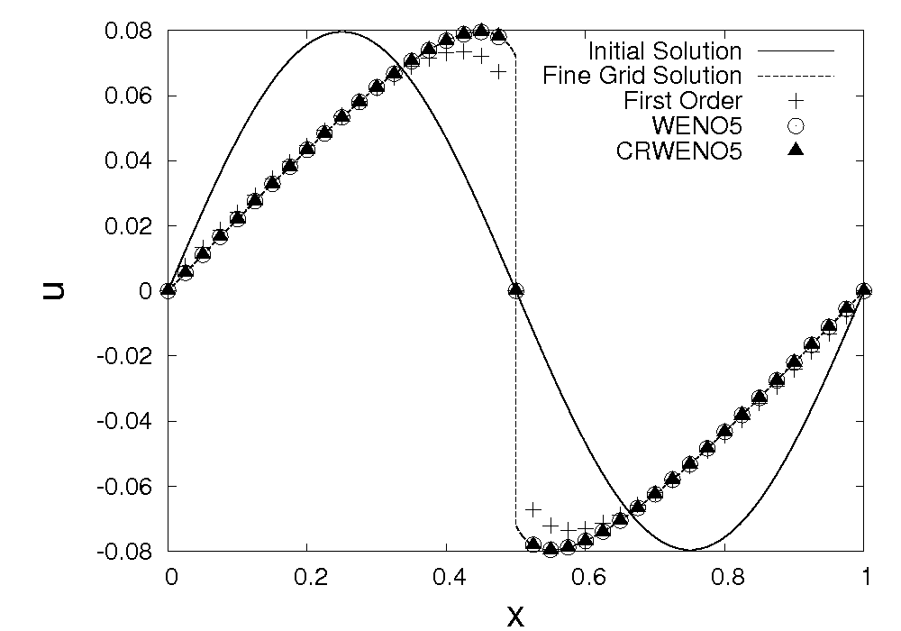
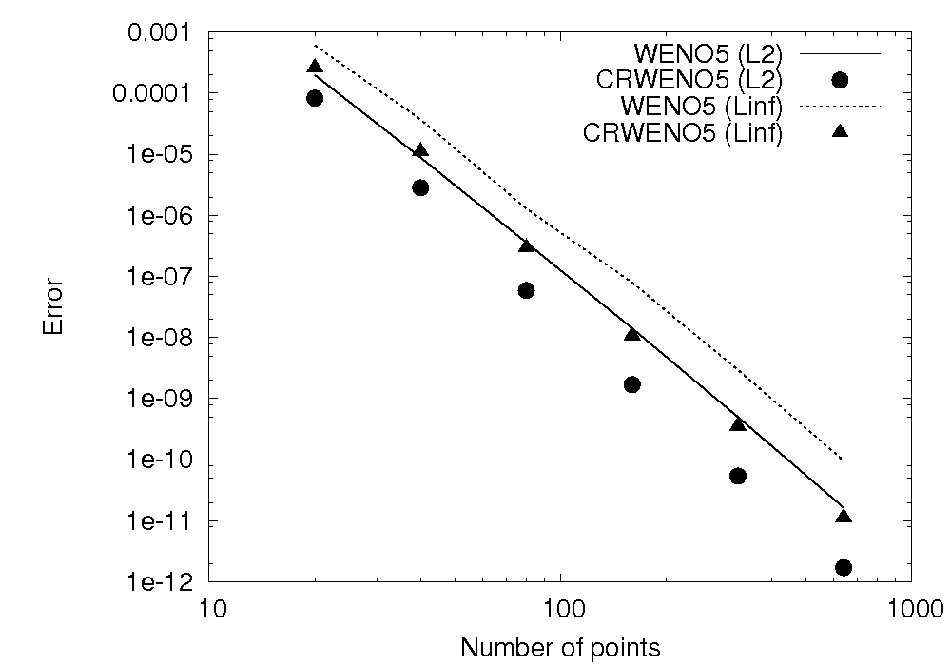
Inviscid Burgers Equation
Initial sinusoidal solution turns into a shock wave (non-linear flux)
5th order convergence (before shock formation) with lower absolute error than WENO5

Slide 10
Extension to the Euler Equations
Compressible Euler equations in 1D given by
In the form of a general hyperbolic PDE
Extension of interpolation schemes for scalar quantities to a system of equations
Component-wise reconstruction of conservative variables (ρ, ρu, e)
Reconstruction of primitive (flow) variables (ρ, u, p)
Reconstruction of characteristic variables

Slide 11
Characteristic-based Reconstruction
Characteristic based reconstruction respects the physics of the problem – 1D scalar wave propagation along each characteristic
For interface j+1/2, characteristic quantities are given by
i
i+1
Reconstruct
U^{avg} (Roe averaged)
Upwinding (Roe-Fixed)
Eigenvalues, left and right eigenvectors
Flux in conservative form

Slide 12
CRWENO5 for 1D Euler Equations
Scalar interpolation scheme applied to the characteristic variables
Results in a block tri-diagonal linear system along each dimension (as compared to tri-diagonal system for component-wise reconstruction)
For multi-dimensions, solution of linear system required along each grid line
k = 1,2,3

Slide 13
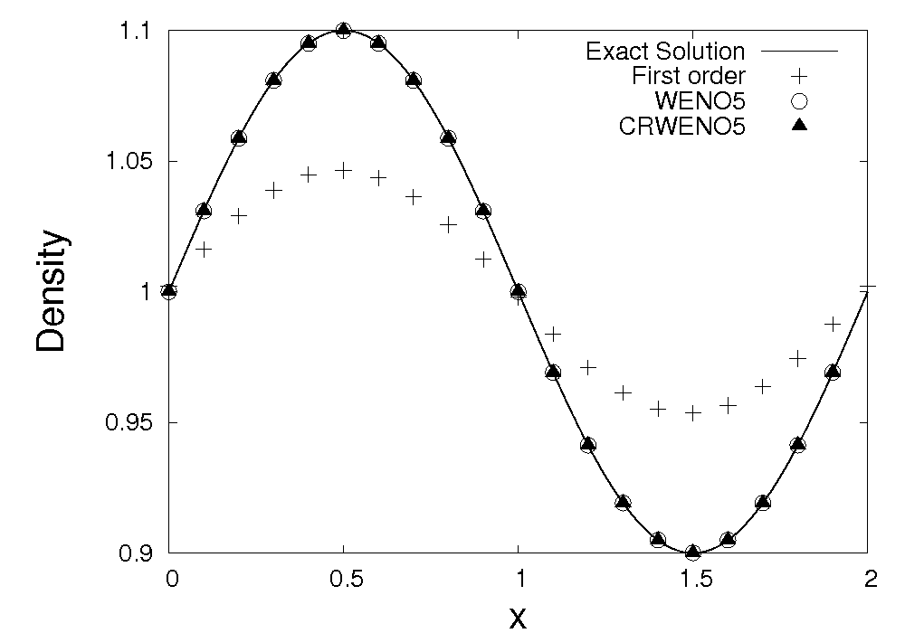
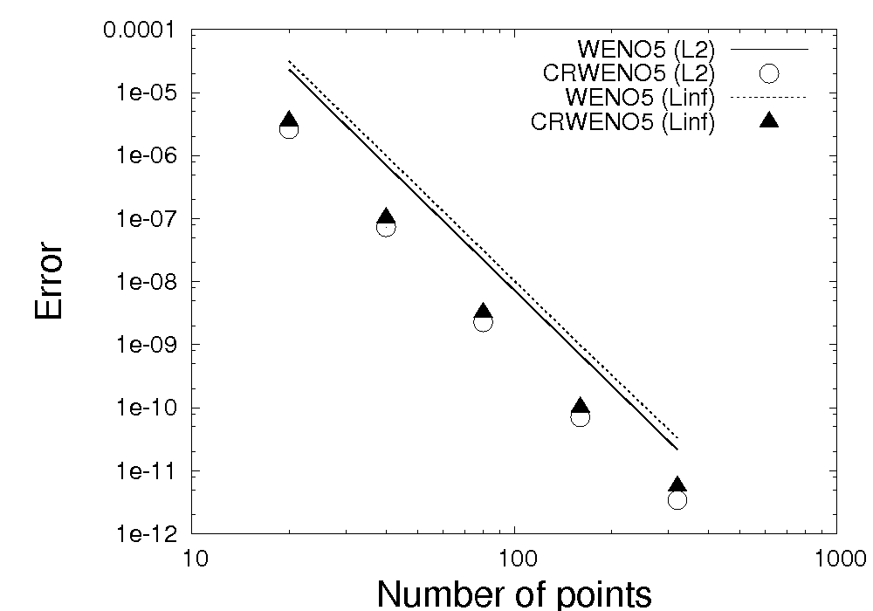
Entropy Wave
Smooth problem involving the convection of an entropy wave
Density wave convects without dissipation, constant velocity and pressure
Exact solution given by
Periodic boundary conditions enforced on both boundaries
Solution compared after one pass over the domain
Errors and order of convergence compared
Lower absolute errors for CRWENO5 at same order of convergence

Slide 14
1D Riemann Problems
RF
CD
S
Initial condition consists of two states separated by a thin partition
Initial discontinuity is decomposed into a rarefaction wave (RF), a contact discontinuity (CD) and a shock wave (S)
Sod’s shock tube problem
Lax’s shock tube problem
Benchmark cases for code validation
Require robust solvers to prevent spurious oscillations

Slide 15
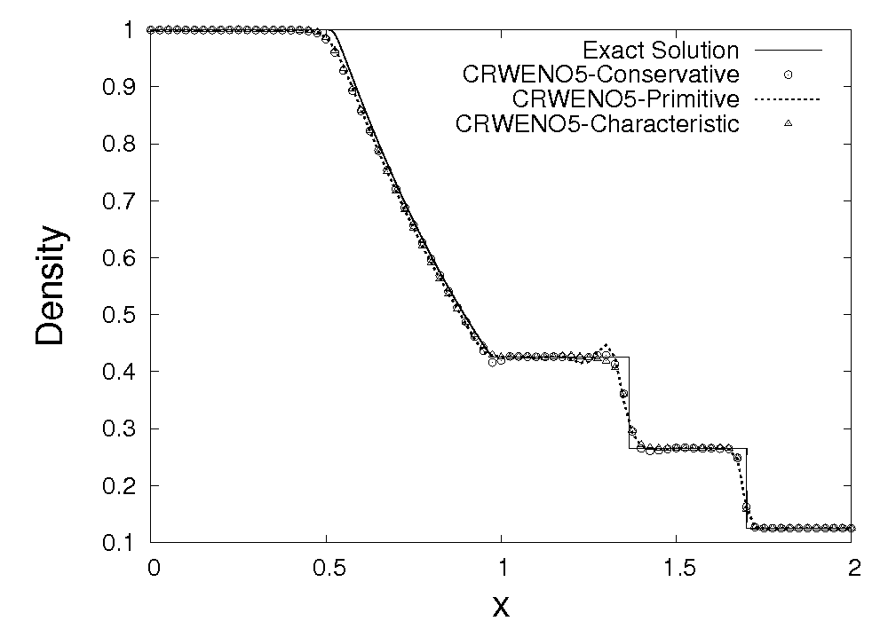
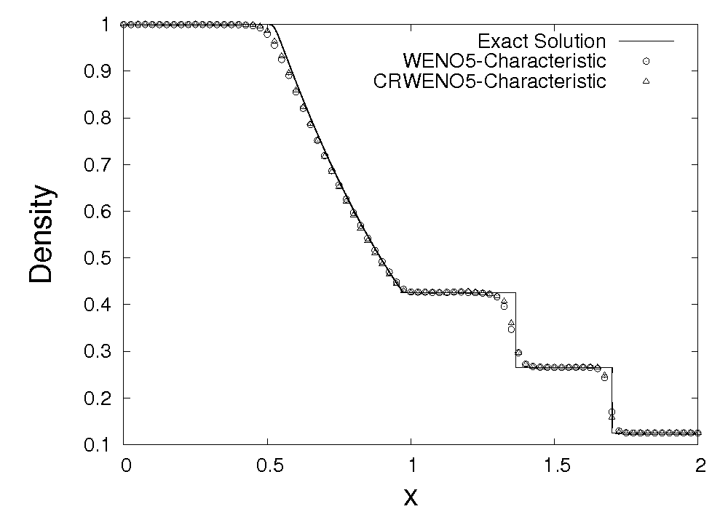
Sod’s Shock Tube
Comparison of different reconstruction methods
Comparison of WENO5 and CRWENO5
Characteristic – based reconstruction yields non-oscillatory results (though computationally more expensive)
Low dissipation of CRWENO5 results in sharper resolution of shock and contact discontinuity

Slide 16
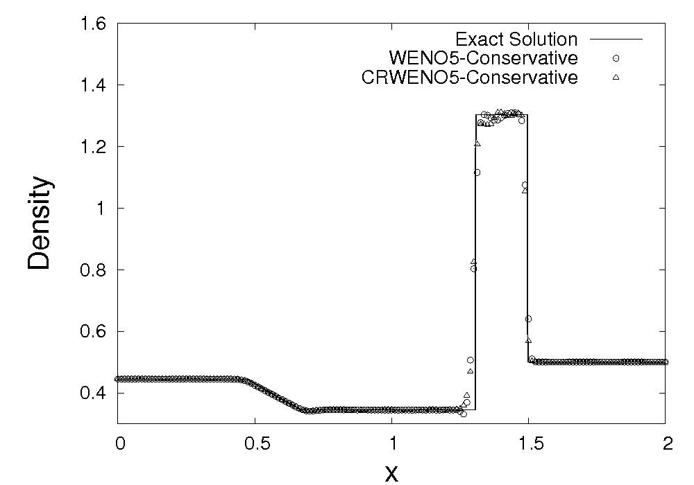
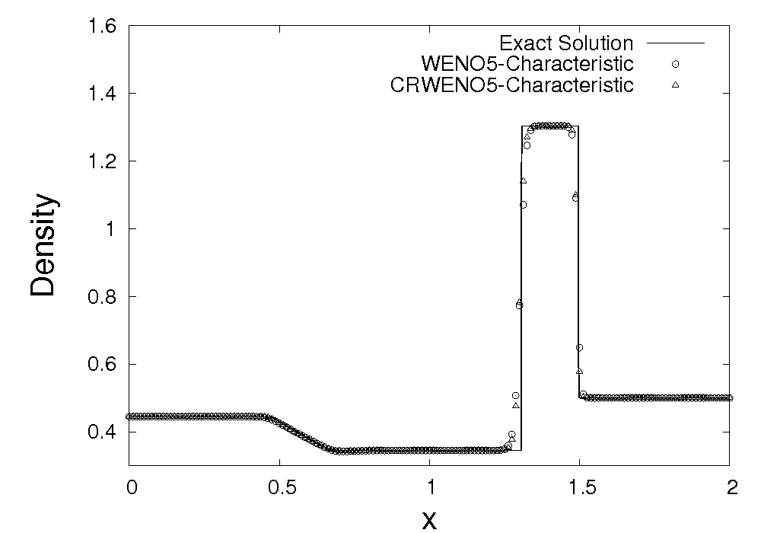
Lax’s Shock Tube
Conservative Variable Reconstruction
Characteristic-based Reconstruction
Oscillations caused by reconstruction of conservative and primitive variables
CRWENO5 shows less smearing of shock and contact discontinuity

Slide 17
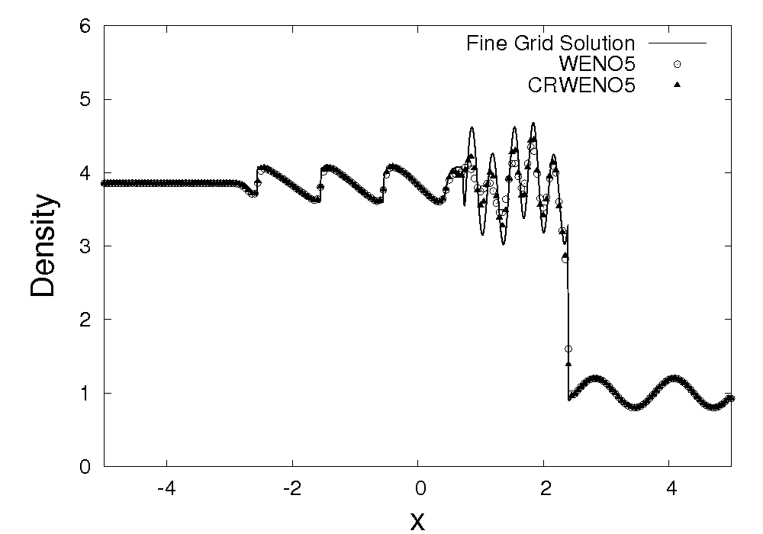
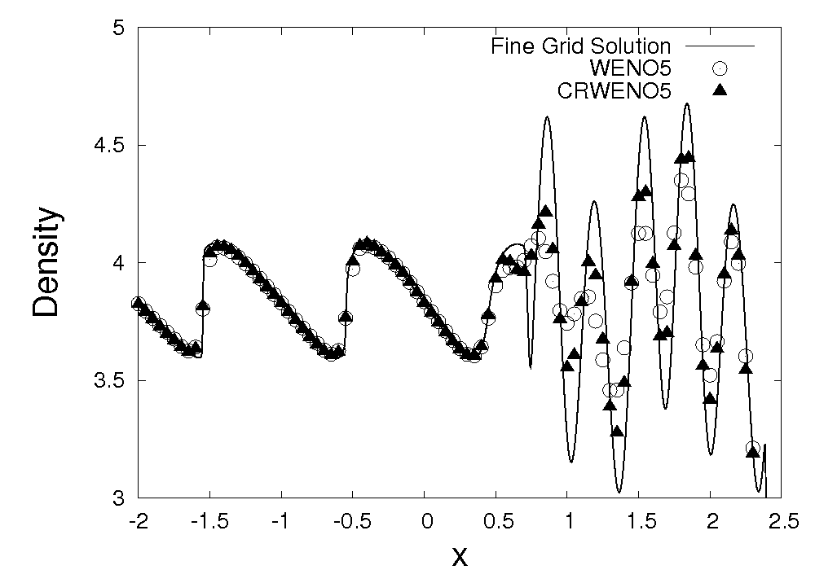
Shock-Entropy Interaction
Interaction between a shock wave and an entropy wave
Solution contains discontinuity and high-frequency waves
Initial condition consists of right-moving shock and density wave
Extrapolation boundary conditions enforced on both boundaries
“Fine Grid Solution” obtained with WENO5 on 2000 point grid
CRWENO shows lower dissipation and clipping of high-frequency waves

Slide 18
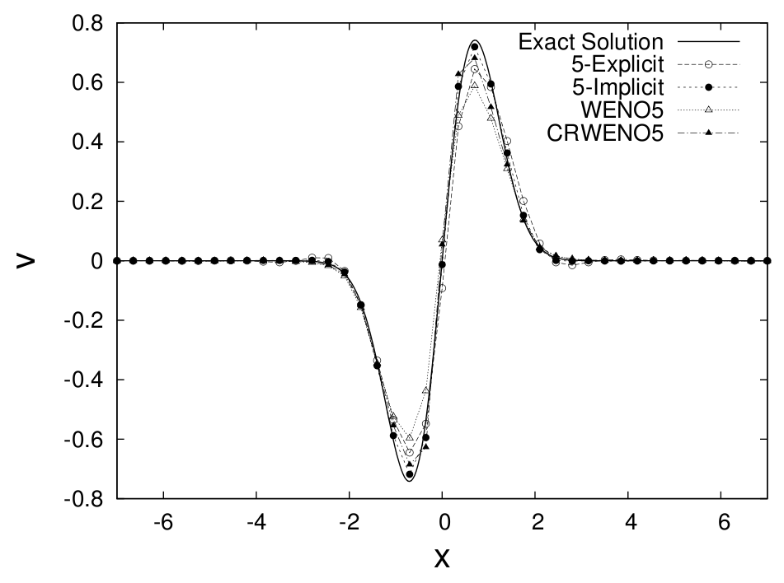
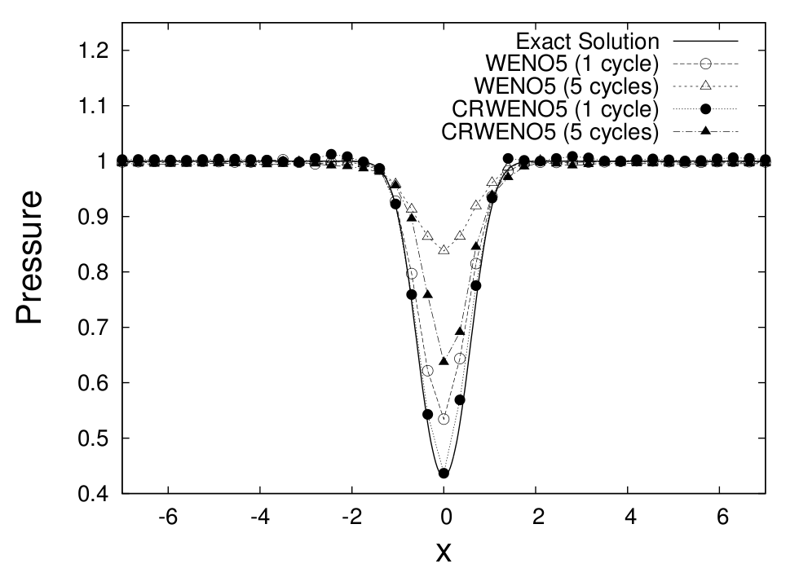
Isentropic Vortex Convection (Euler 2D)
Y-Velocity after 1 cycles over the domain
Pressure after 1 and 5 cycles over the domain
Convection of an isentropic vortex on a periodic domain
Results shown for a 40x40 grid with WENO5 and CRWENO5
Lower dissipation of CRWENO5 preserves vortex for long–term convection

Slide 19
Conclusions and Future Work
Benefits of using the Compact-Reconstruction WENO scheme
Smaller stencil for same order of convergence, lower absolute errors
Lower dissipation leads to better resolution of discontinuities and better long-term convection properties
Computational expense at same grid size is marginally more but coarser grids can be used for same error in solution
Characteristic vs. Component-wise reconstruction
Characteristic reconstruction is costlier, even more so for implicit reconstruction schemes (block tri-diagonal solver)
More robust since physically more accurate – non-oscillatory results for sharp discontinuities
Results similar in case of smooth flows
Implementation of CRWENO for multi-dimensions
2D and 3D Navier-Stokes solvers
Application to airfoil cases, including pitching and plunging airfoils
Simulation of flow field in a rotorcraft wake (convection and interaction of wake vortices)

Slide 20
End

