Slide 1
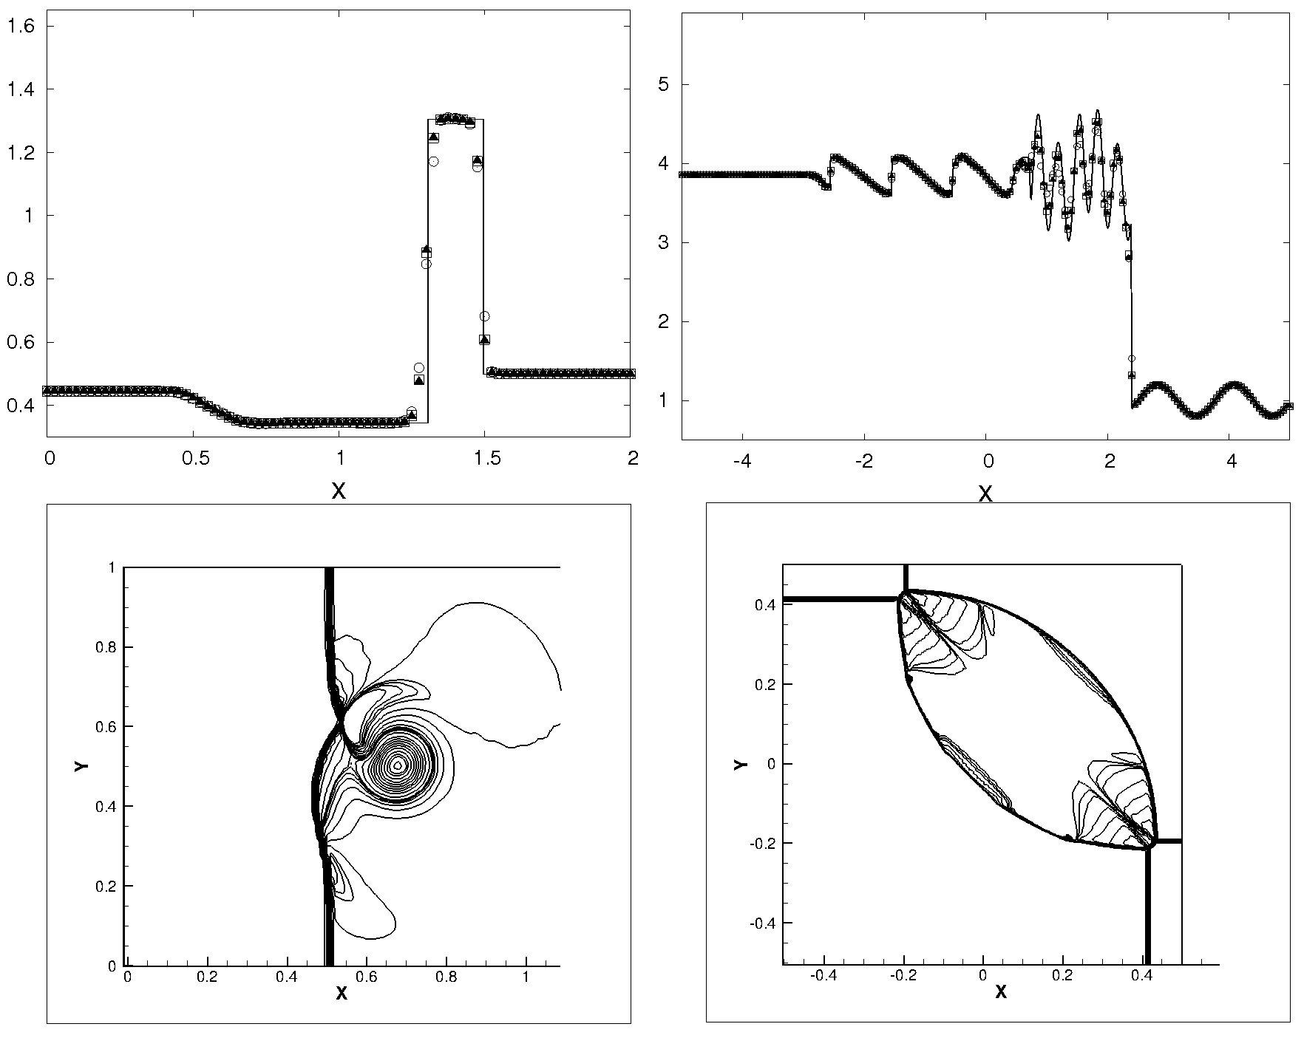
Alfred Gessow Rotorcraft Center Aerospace Engineering Department University of Maryland, College Park
High Order Compact Reconstruction Scheme with Weighted Essentially Non-Oscillatory Limiting
Debojyoti Ghosh
Graduate Research Assistant
James D. Baeder
Associate Professor
Joint Mathematics Meetings
4 – 7 January, 2012
Hynes Convention Center, Boston, MA
Notes:
Add graphic – maybe of riemann 2D or shock vortex interaction

Slide 2
Background
Scalar hyperbolic partial differential equation
Discretization in time leads to an ordinary differential equation (solved by Euler explicit or TVD RK3)
Reconstruction – interpolation of f at the interfaces from the cell centered/averaged values
Upwinding – biased interpolation stencil to model wave nature of the solution

Slide 3
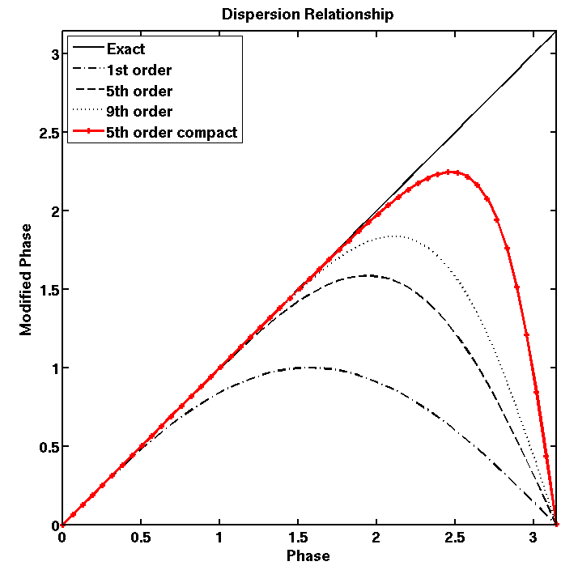
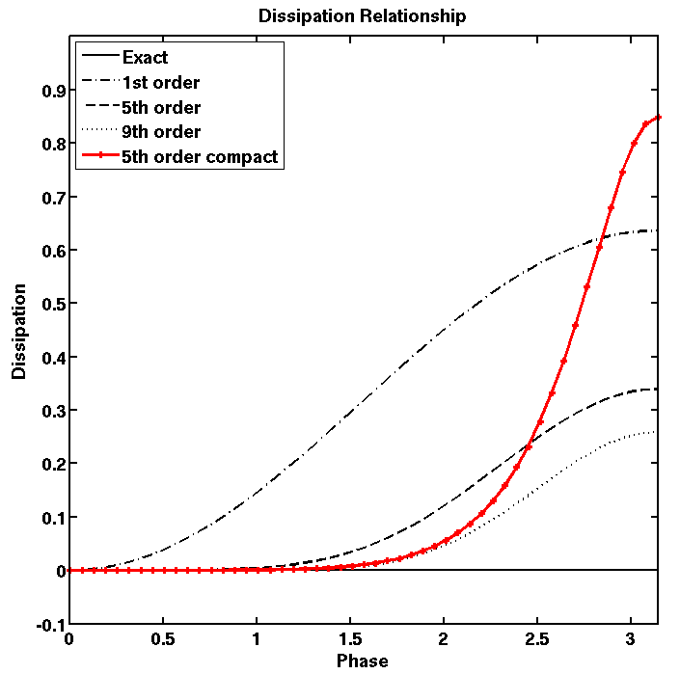
Motivation
The Weighted Essentially Non-Oscillatory (WENO) schemes
Convex combination of r-th order candidate interpolations
Optimal weights in smooth regions → (2r-1)-th order interpolation
Smoothness – dependent weights for discontinuous solutions → Non-oscillatory interpolation
Optimal Weights
WENO Weights
Smoothness Indicators
Replace with compact stencils?
Why Compact Reconstruction?
High order accuracy with smaller stencils
Better spectral resolution than explicit interpolation (bandwidth resolving efficiency)
Lower dissipation at resolved frequencies
Taylor series error order of magnitude lower
Dispersion and dissipation relationships

Slide 4
Objectives
To construct Compact-Reconstruction WENO (CRWENO)schemes
Identify candidate r-th order compact interpolations at each interface
Find optimal weights such that combination results in (2r-1)-th order compact interpolation
Apply WENO limiting on the weights to ensure non-oscillatory behavior across discontinuities
Results in a tridiagonal system of equations
Extend to the Euler equations of fluid dynamics
Trivial extension to reconstruction of primitive and conservative variables
Characteristic – based reconstruction results in non-oscillatory solutions for strong discontinuities
Extension of CRWENO schemes to characteristic variables → Results in a block tridiagonal system of equations

Slide 5
5th Order CRWENO (r = 3) scheme

Slide 6
A Low Dissipation CRWENO scheme

Slide 7
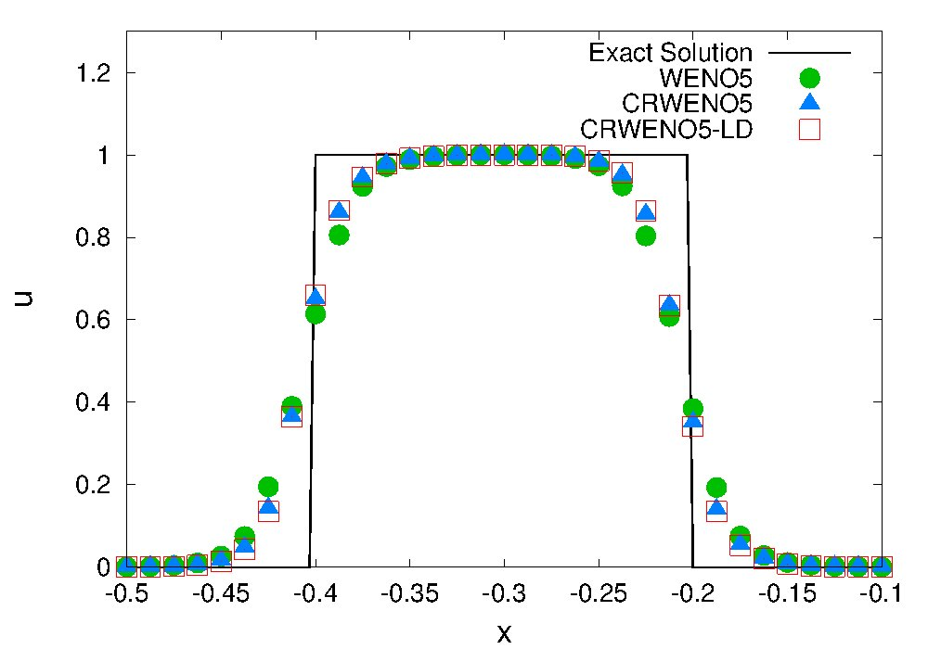
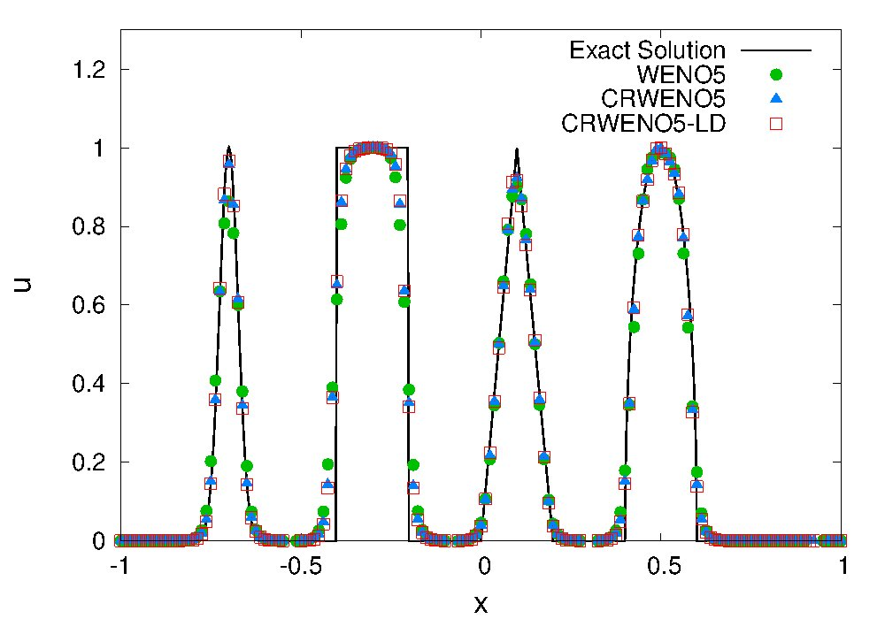
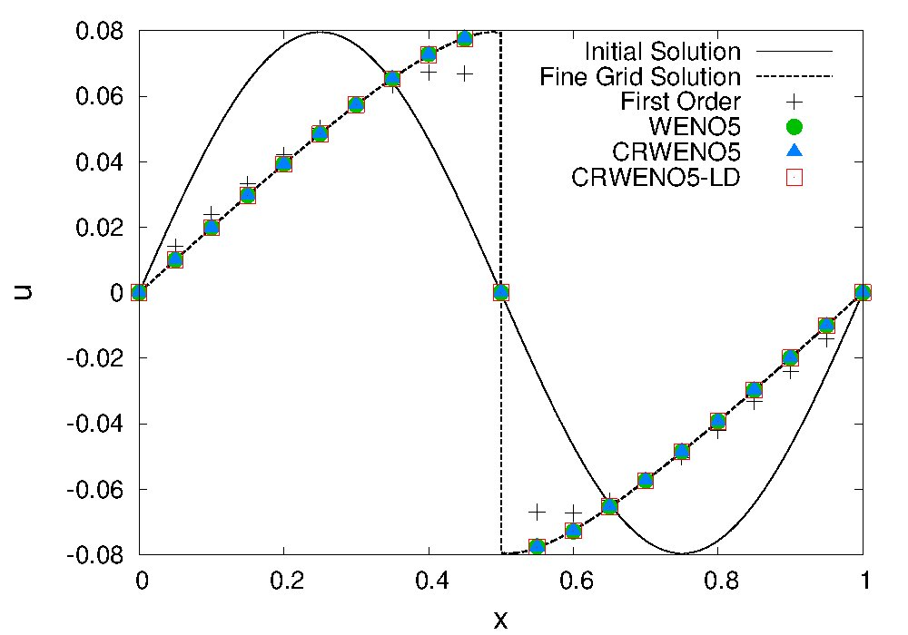
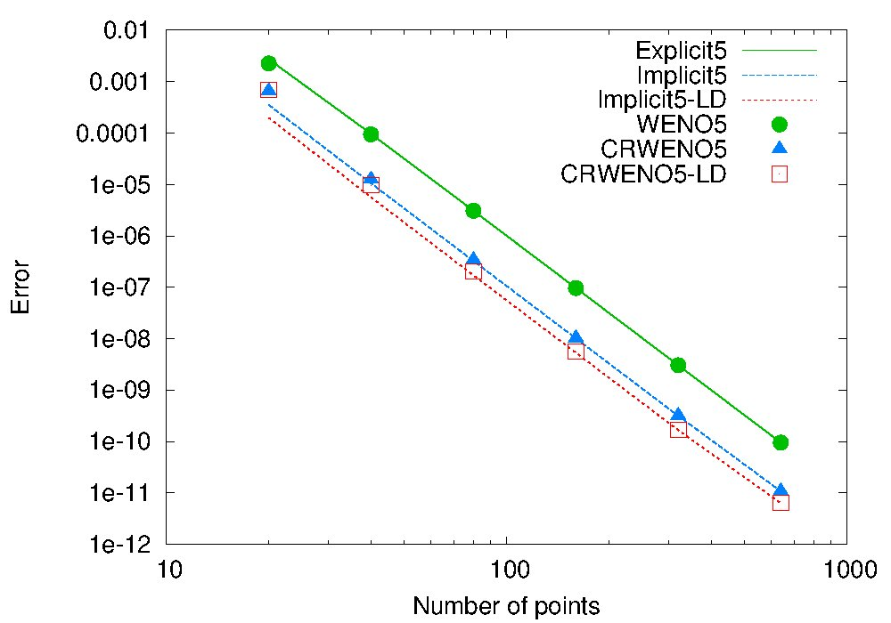
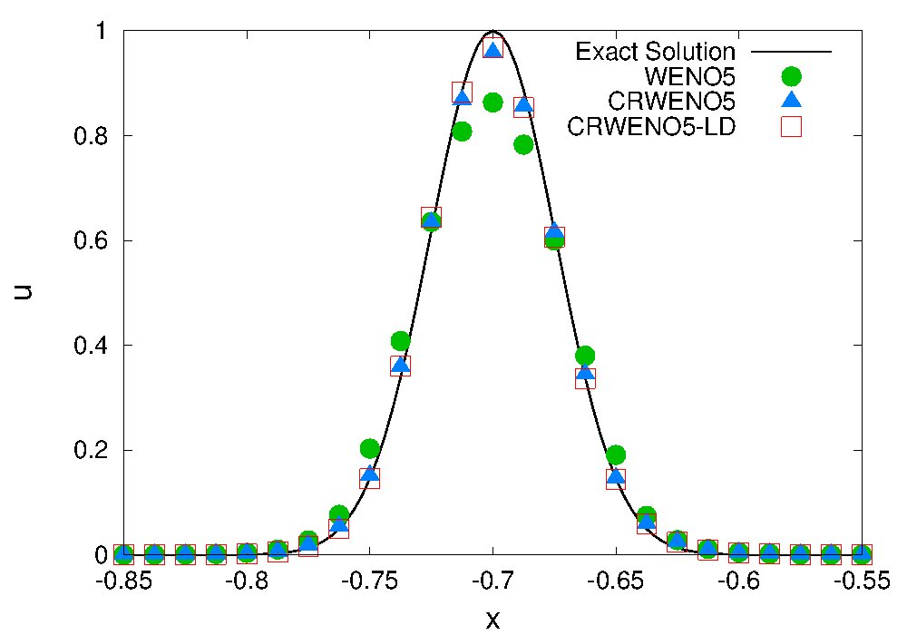
Scalar Partial Differential Equations
Schemes validated for the linear advection equation and the inviscid Burgers equation
Smooth problems
5th order convergence verified for the new schemes
Errors for CRWENO5 order of magnitude lower than WENO5, errors for CRWENO5-LD half those of CRWENO5
Discontinuous problems
Non-oscillatory behavior validated across discontinuities
CRWENO schemes show better resolution of discontinuous data (lower smearing and clipping)
Linear Advection equation
Inviscid Burgers equation

Slide 8
CRWENO5 for Euler Equations
Characteristic based reconstruction respects the physics of the problem – 1D scalar wave propagation along each characteristic
i
i+1
U^{avg} (Roe averaged)
Eigenvalues, left and right eigenvectors
Results in a block tri-diagonal linear system along each dimension (as compared to tri-diagonal system for conservative variable reconstruction)
For multi-dimensions, solution of linear system required along each grid line
Upwinding –
Left and right biased fluxes computed
Roe-Fixed formulation used

Slide 9
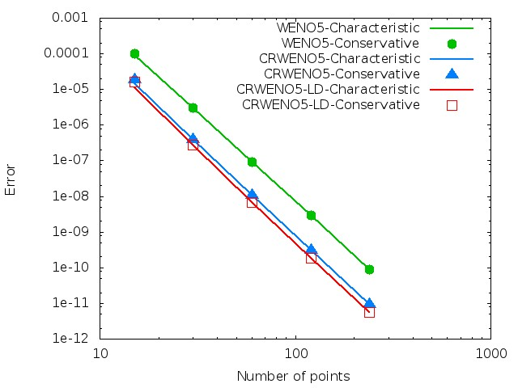
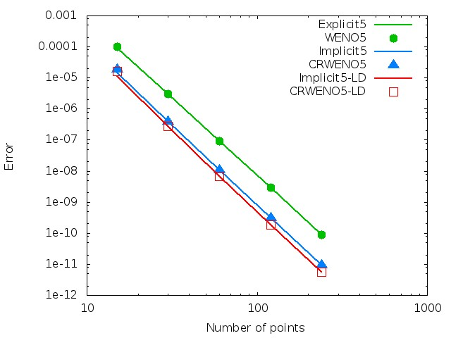
Entropy Wave Advection (1D)
Comparison of characteristic and conservative reconstructions
Conservative Reconstruction
Identical solutions with reconstruction of characteristic and conservative reconstructions
5th order convergence verified (smooth problem) for all schemes
Errors for CRWENO5 order of magnitude lower than WENO5, Errors of CRWENO5-LD half those of CRWENO5

Slide 10
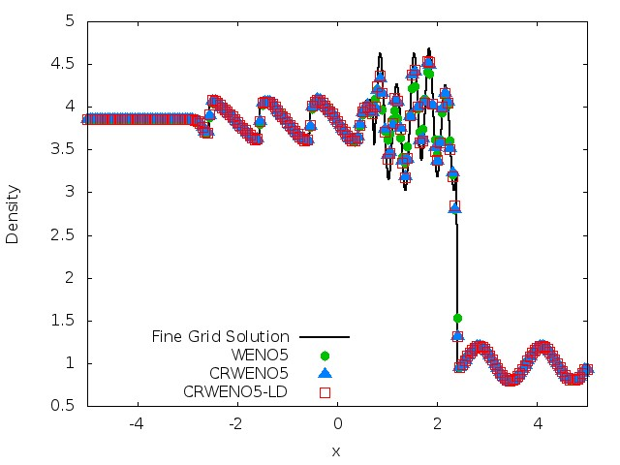
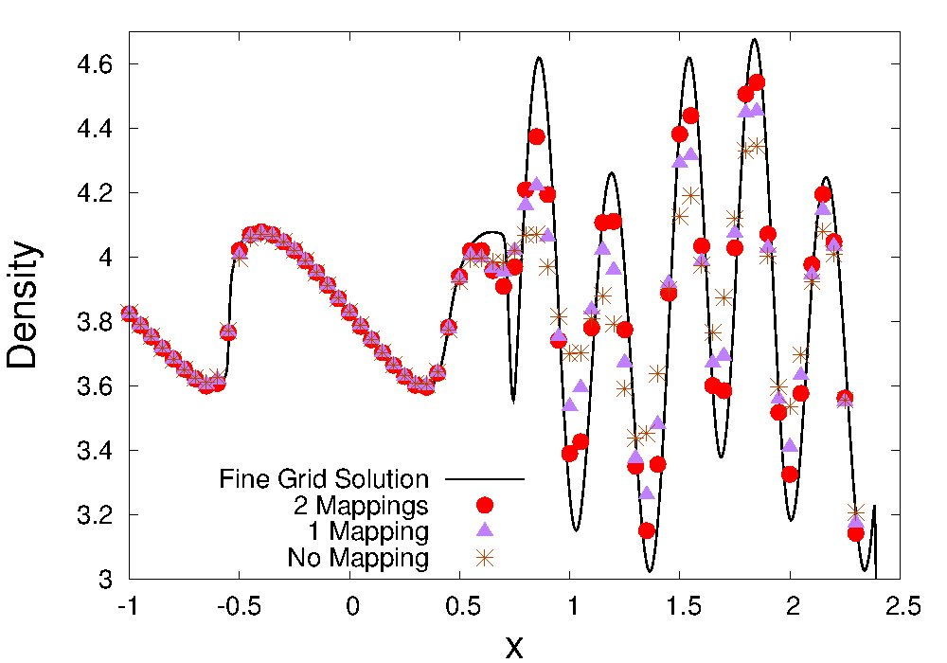
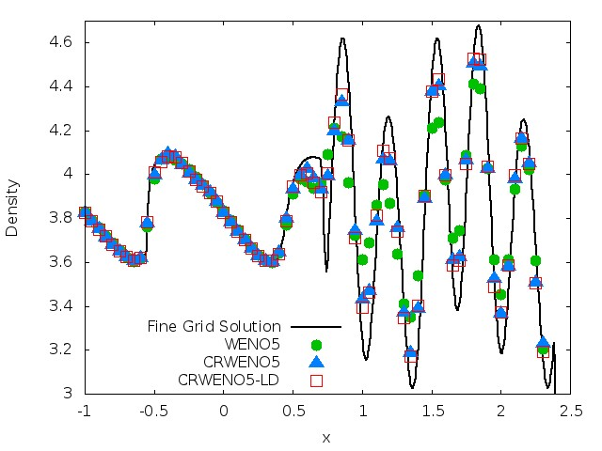
Shock Entropy Wave Interaction (1D)
Interaction of a shock wave with a density wave resulting in high-frequency waves and discontinuities
CRWENO schemes show better resolution of high-resolution waves than WENO5
Mapping the WENO weights twice improves resolution w/o oscillations
6 points per wavelength
Effect of number of mappings (CRWENO)

Slide 11
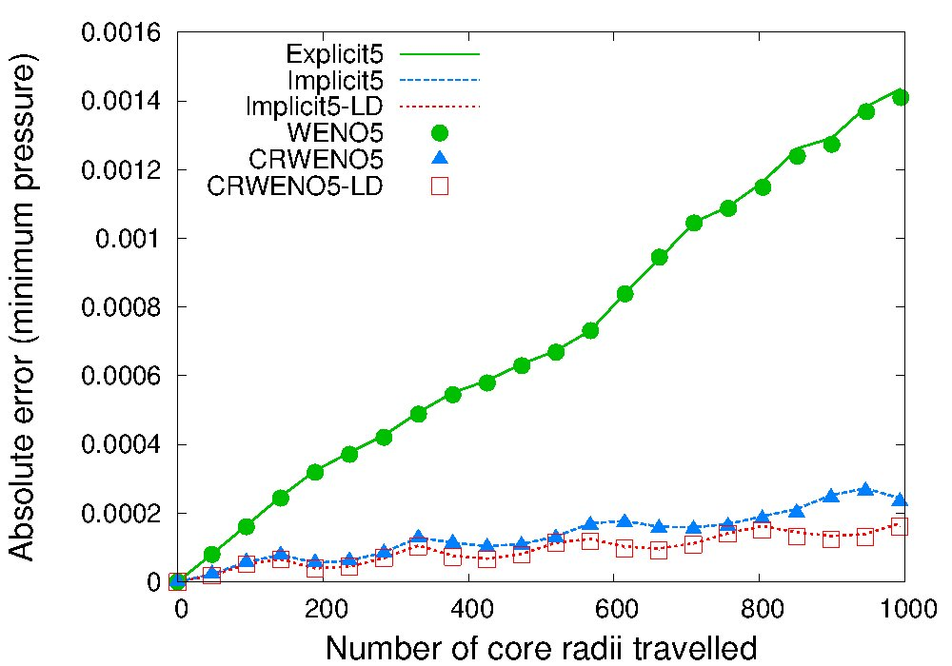
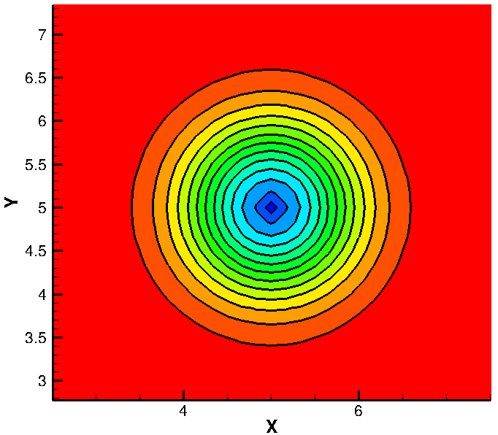
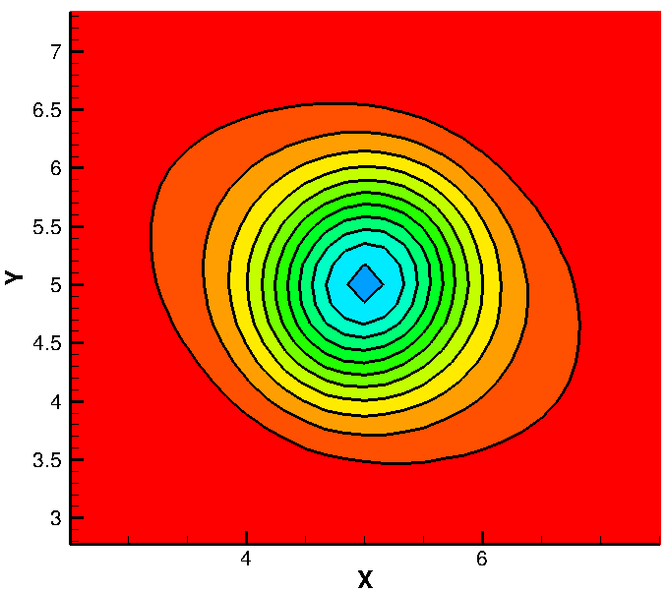
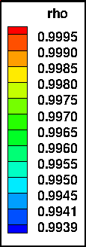
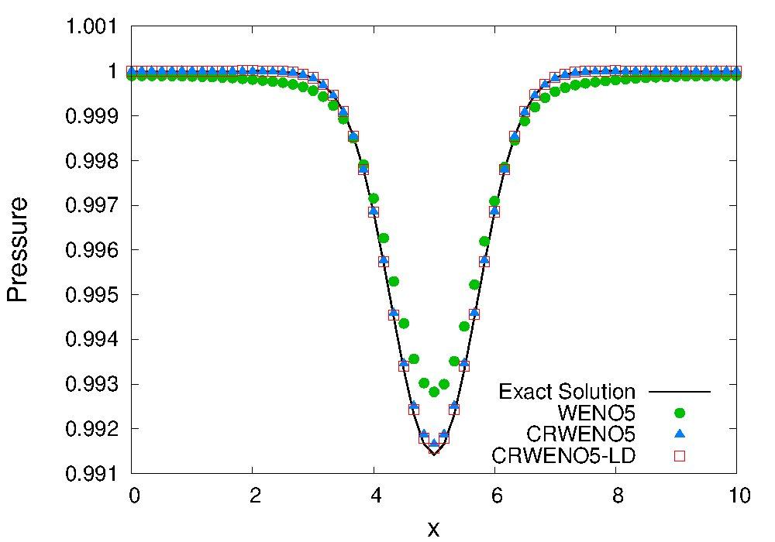
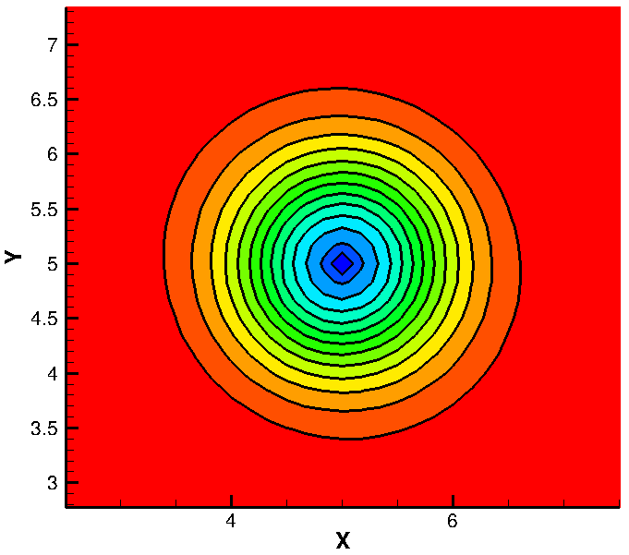

Isentropic Vortex Convection (2D)
Solution after travelling 1000 core radii
Compact schemes show better shape and strength preservation for long term convection
12 points across core
Initial
WENO5
CRWENO5
CRWENO5-LD

Slide 12
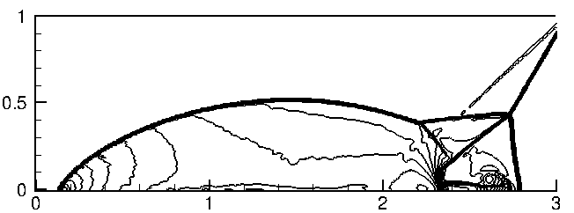
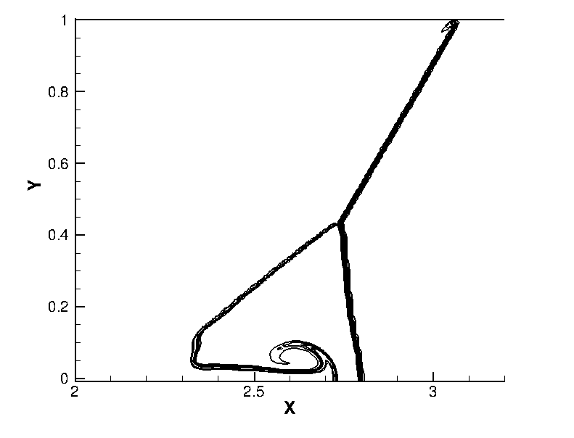
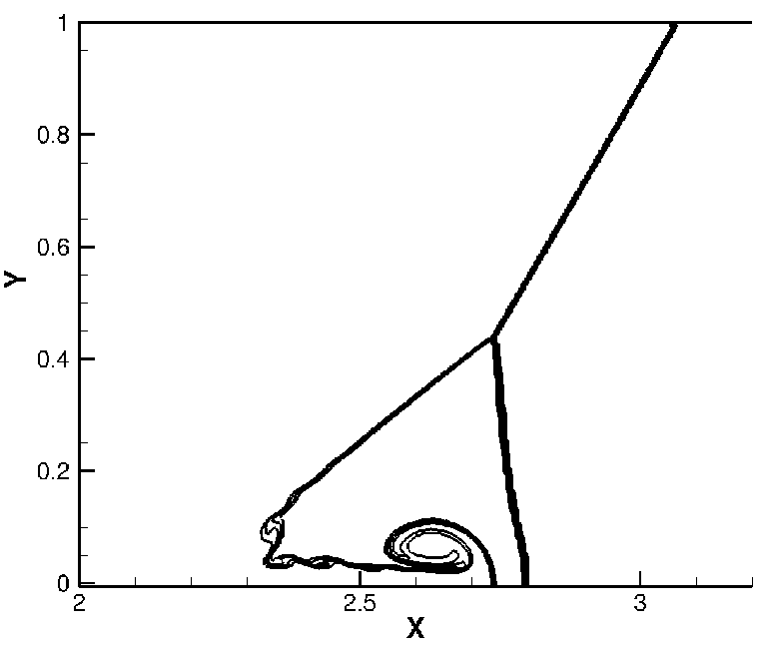
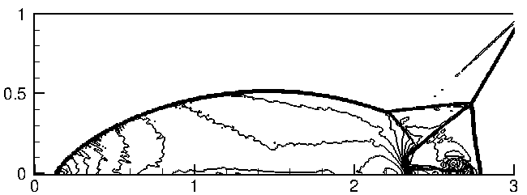
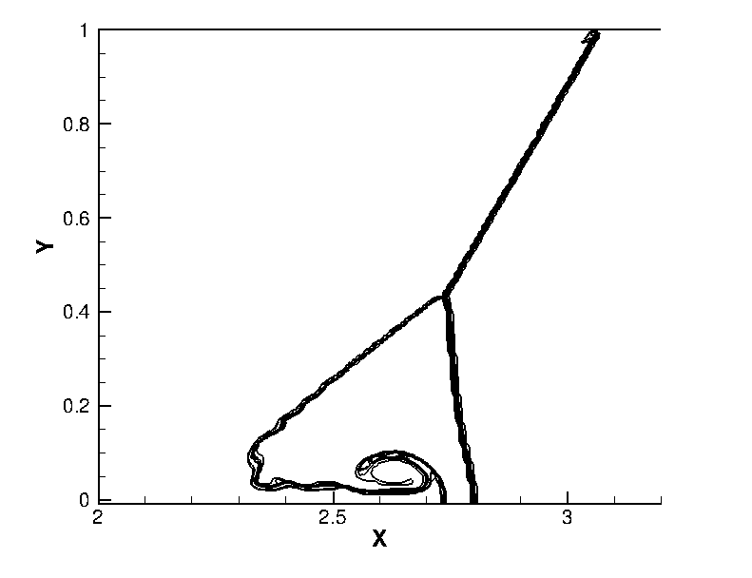
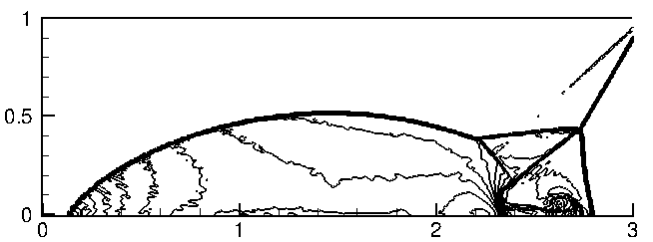

Double Mach Reflection Problem
Double Mach Reflection of a Mach 10 shock on a 480 X 120 grid
CRWENO schemes validation for 2D problem with strong discontinuities
Better capturing of the contact discontinuity roll-up
Density
Entropy
WENO5
720 X 180 grid
CRWENO5
CRWENO5-LD
Notes:
T

Slide 13
Conclusions and Future Work
Benefits of using the Compact-Reconstruction WENO scheme
Smaller stencil for same order of convergence, lower absolute errors
Lower dissipation leads to better resolution of discontinuities and better long-term convection properties
Computational expense at same grid size is marginally more but coarser grids can be used for same error in solution
Characteristic vs. Component-wise reconstruction
Characteristic reconstruction is costlier, even more so for implicit reconstruction schemes (block tri-diagonal solver)
More robust since physically more accurate – non-oscillatory results for sharp discontinuities
Results similar in case of smooth flows
Implementation of CRWENO for multi-dimensions
2D and 3D Navier-Stokes solvers
Application to Direct Numerical Simulation (DNS) of turbulent flows
Application to airfoil cases, including pitching and plunging airfoils
Simulation of flow field in a rotorcraft wake (convection and interaction of wake vortices)

Slide 14
Thank you

