Slide 1
Application of Compact-Reconstruction WENO Schemes to the Navier-Stokes Equations
Alfred Gessow Rotorcraft Center Aerospace Engineering Department University of Maryland, College Park
Debojyoti Ghosh
Graduate Research Assistant
James D. Baeder
Associate Professor
SIAM Annual Meeting
July 9 – 13, 2012, Minneapolis, MN

Slide 2
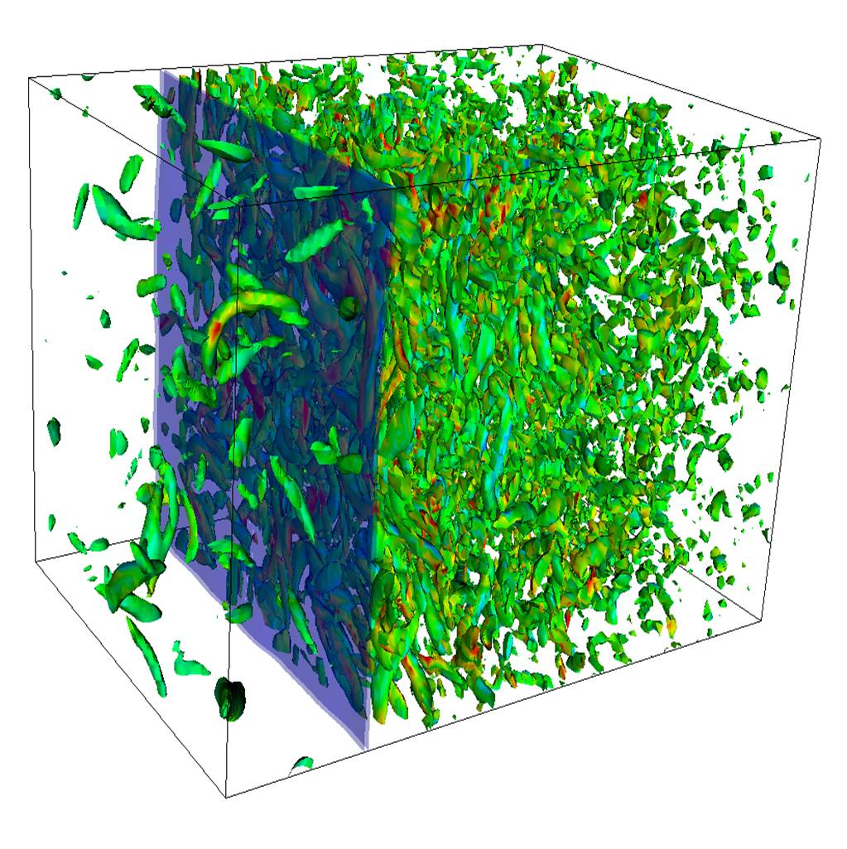
Motivation
Numerical Solution of Compressible Turbulent Flows
Aircraft and Rotorcraft wake flows
Characterized by large range of length scales
Convection and interaction of eddies
Locally supersonic flow → Shocklets
Thin shear layers → High gradients in flow
Shock – Turbulence interaction
http://shocks.stanford.edu/shock_turbulence.html
High order accurate Navier-Stokes solver
High spectral resolution for accurate capturing of smaller length scales
Non-oscillatory solution across shock waves and shear layers
Low dissipation and dispersion errors for preservation of flow structures

Slide 3
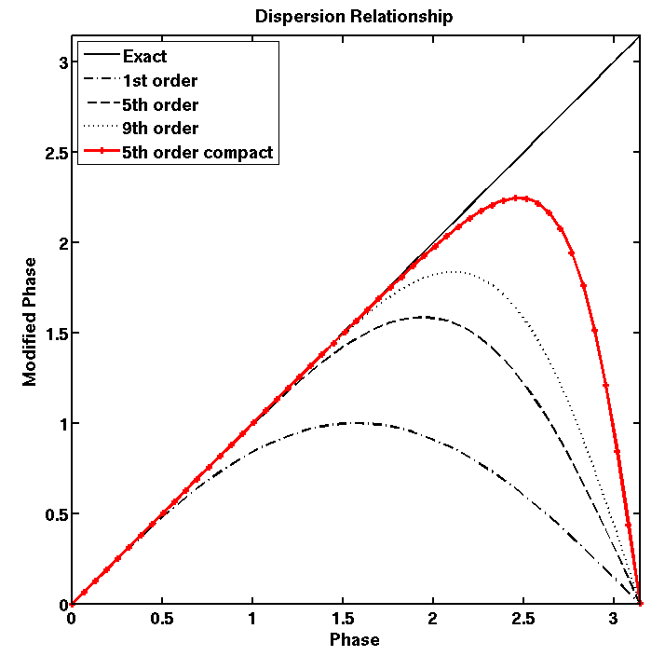
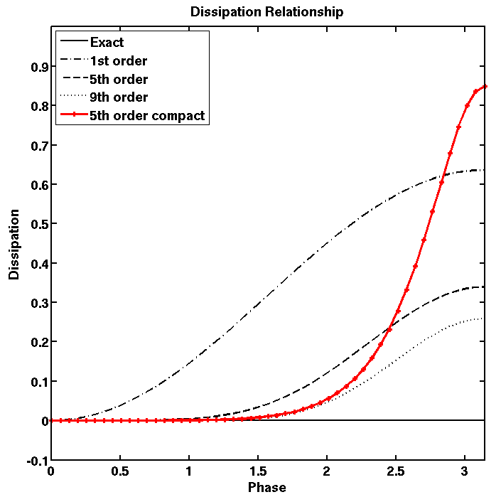
Compact-Reconstruction WENO Schemes
The Compact-Reconstruction WENO (CRWENO)★ scheme
Convex combination of r-th order candidate compact interpolations
Optimal weights in smooth regions → (2r-1)-th order compact interpolation
Smoothness - dependent weights → Non-oscillatory interpolation for discontinuities
Smoothness Indicators
Optimal Weights
WENO Weights
Interface flux
Candidate compact stencils
Why Compact Reconstruction?
High order accuracy with smaller stencils
Better spectral resolution than explicit interpolation (bandwidth resolving efficiency)
Lower dissipation at resolved frequencies
Taylor series error order of magnitude lower
Dispersion and dissipation relationships
★ Ghosh & Baeder, Compact Reconstruction Schemes with Weighted ENO Limiting for Hyperbolic Conservation Laws, SIAM J. Sci. Comp., 34(3), 2012

Slide 4
5th Order CRWENO scheme

Slide 5
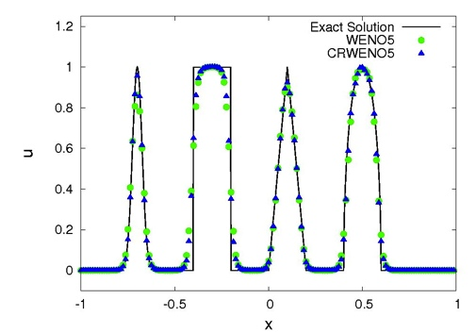
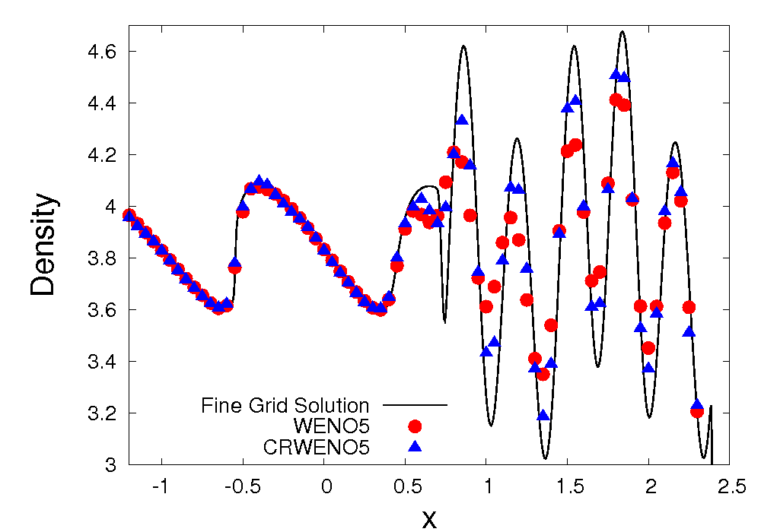
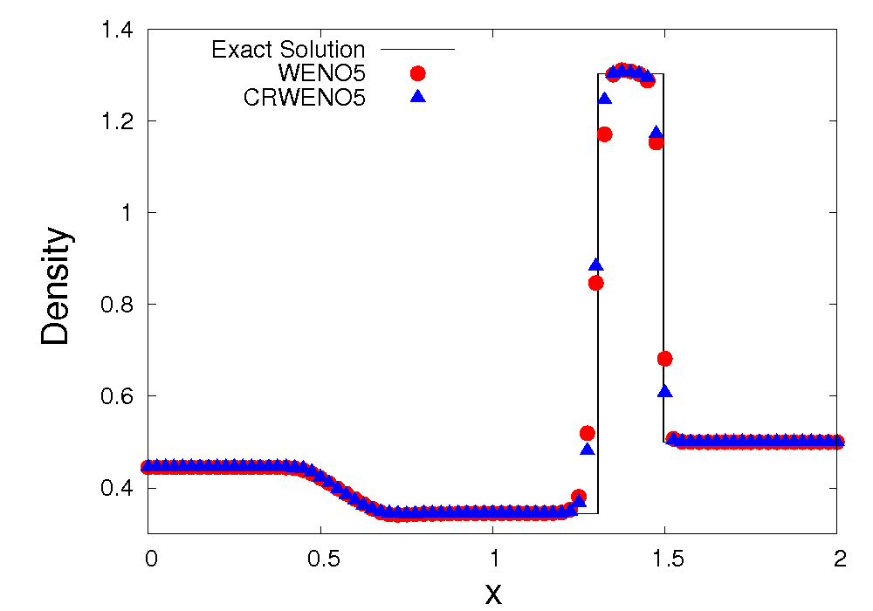
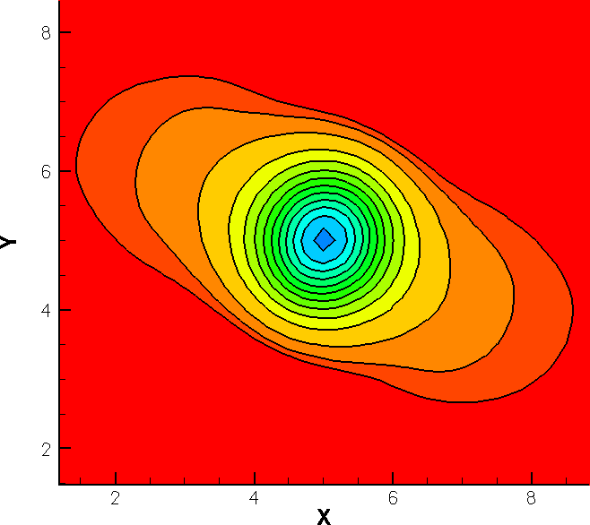
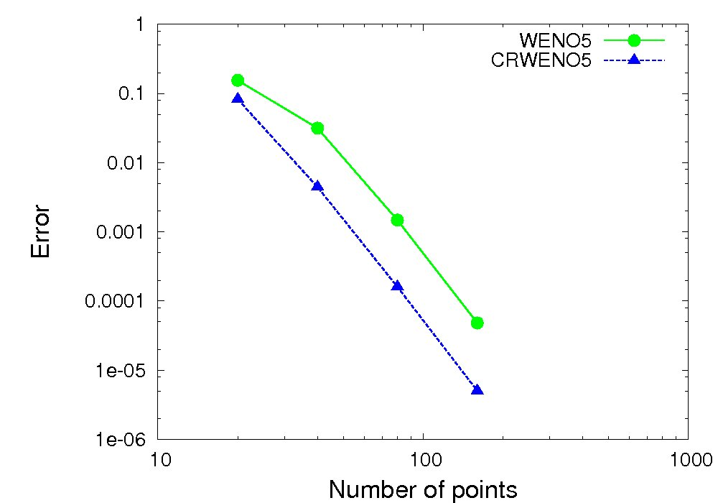
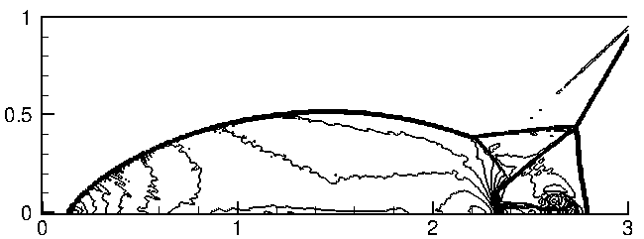
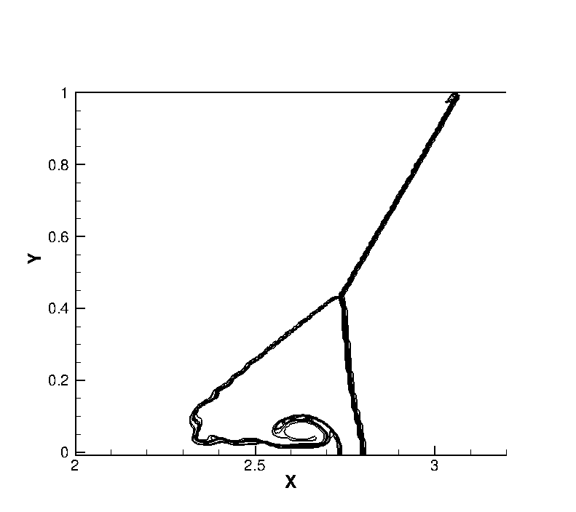
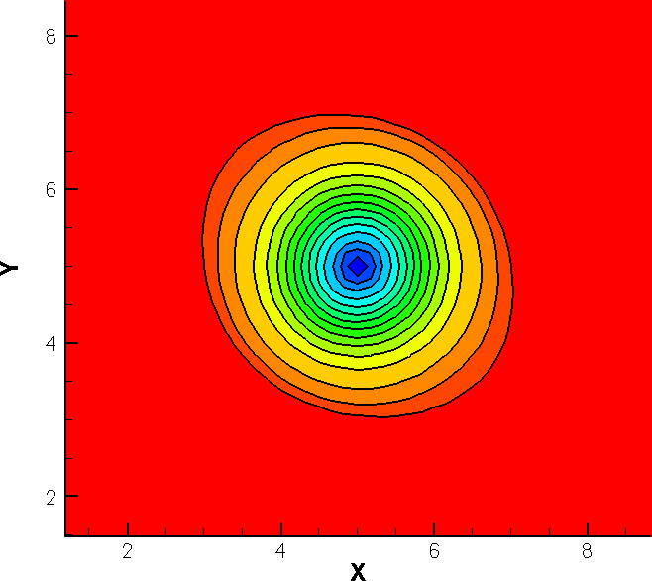
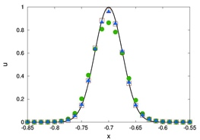
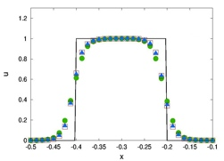
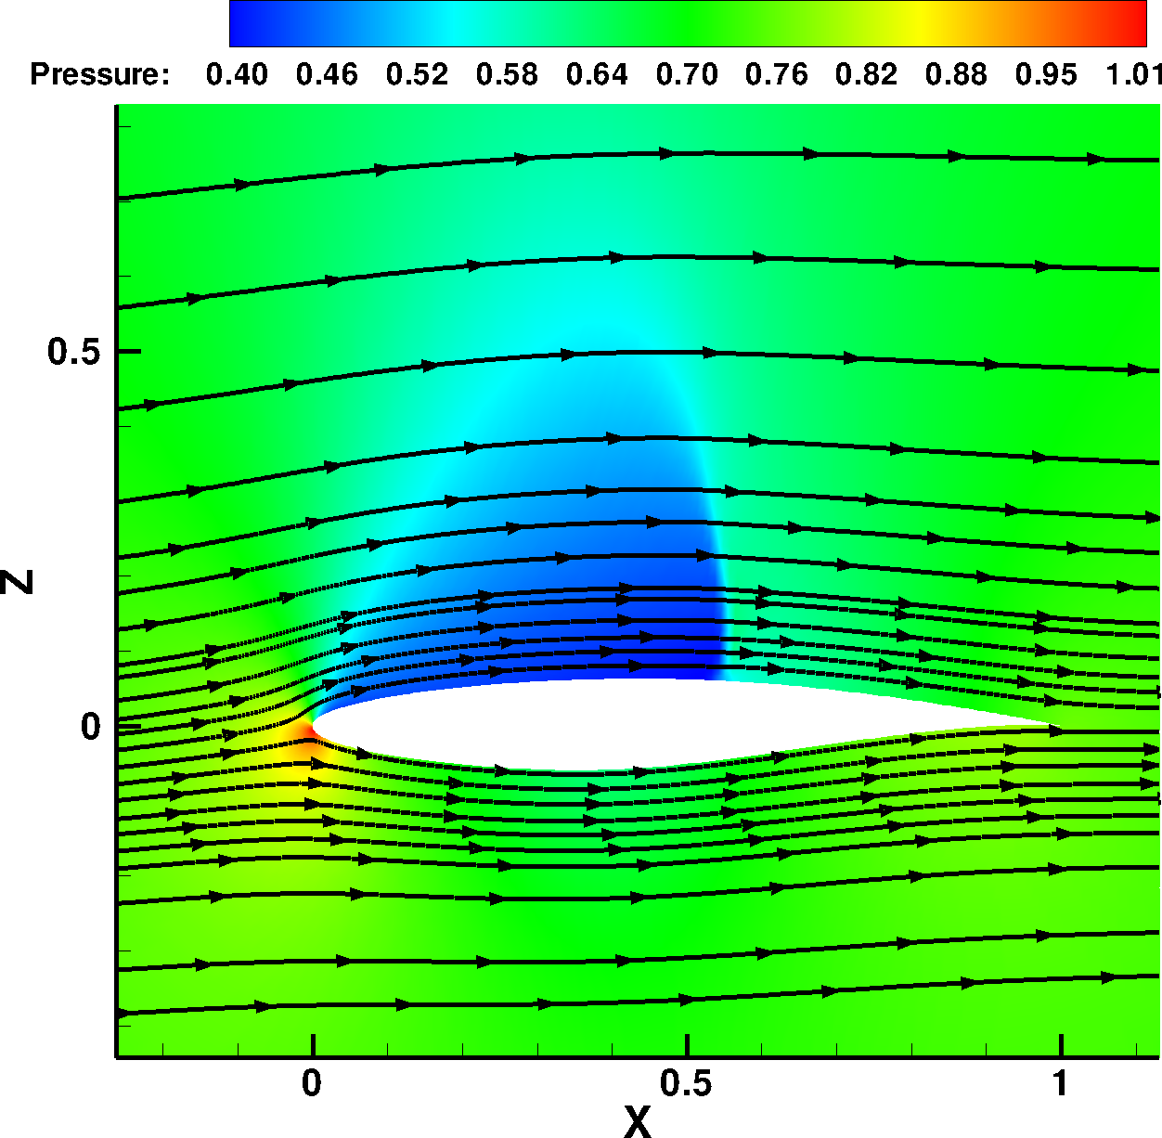
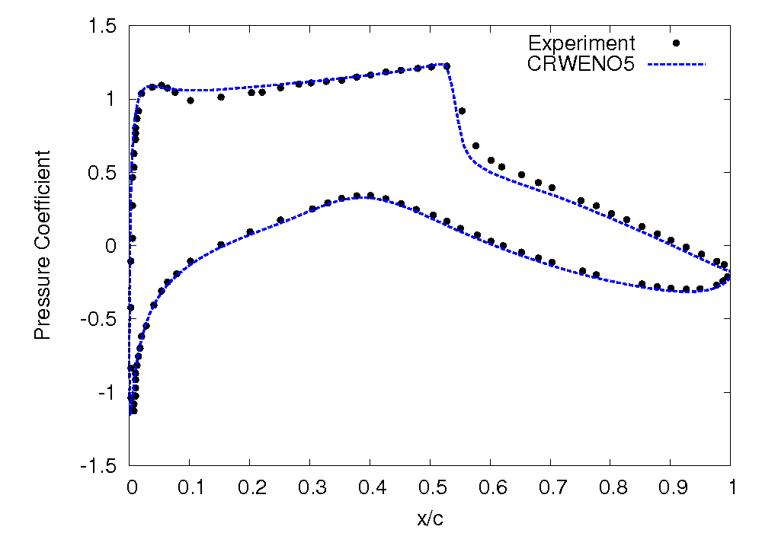
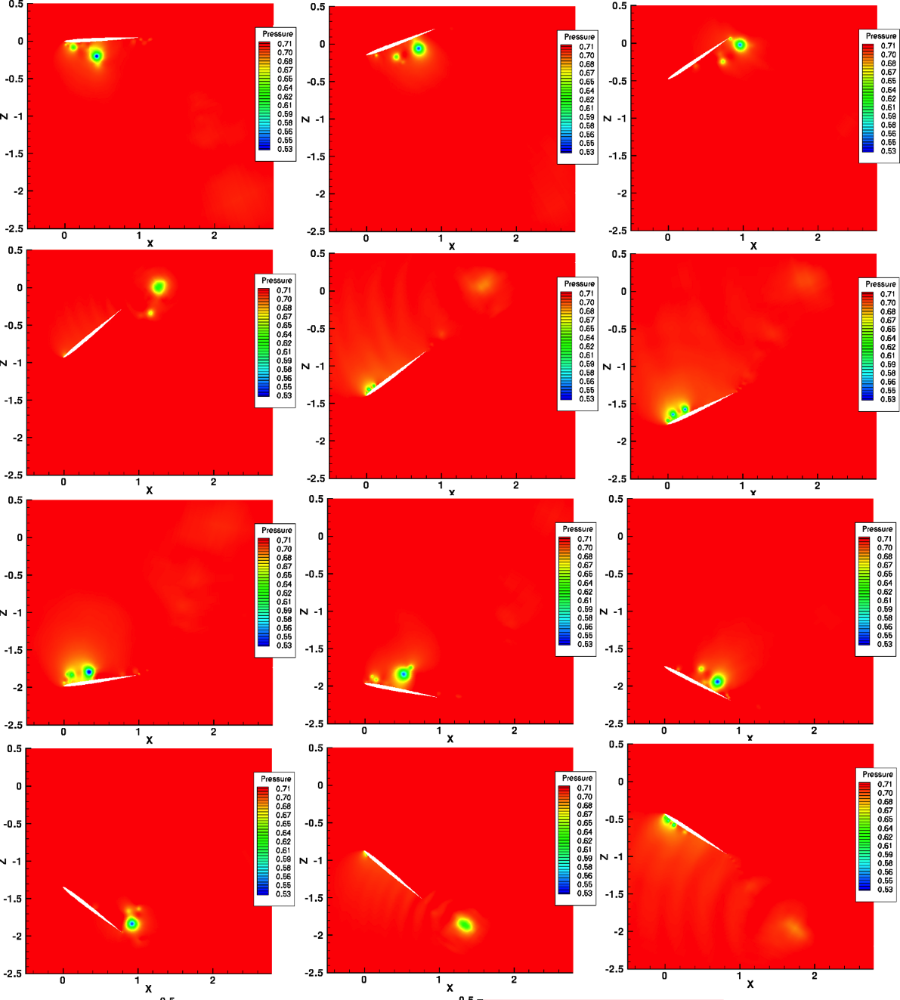
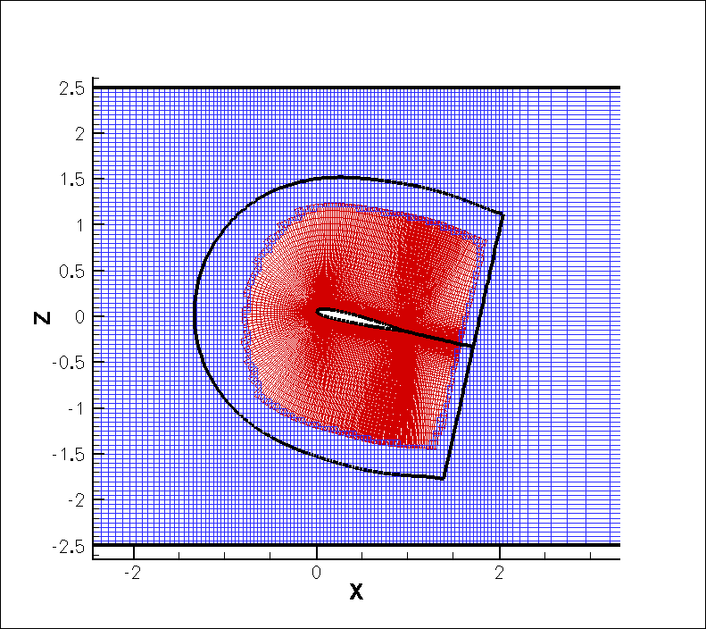
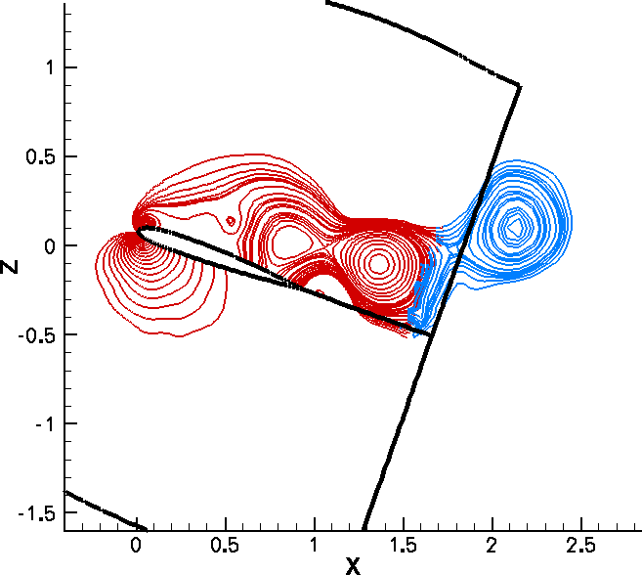
Applications
Scalar Conservation Laws
Inviscid Euler Equations
WENO5
CRWENO5
Navier-Stokes Equations
Order of convergence (smooth problems)
Absolute errors order of magnitude lower than WENO5 scheme (of same order)
Sharper resolution of high-frequency waves and shocks/contact discontinuities
Improved preservation of flow structures over large convection distances
Validated for curvilinear and overset meshes (with relative motion)

Slide 6
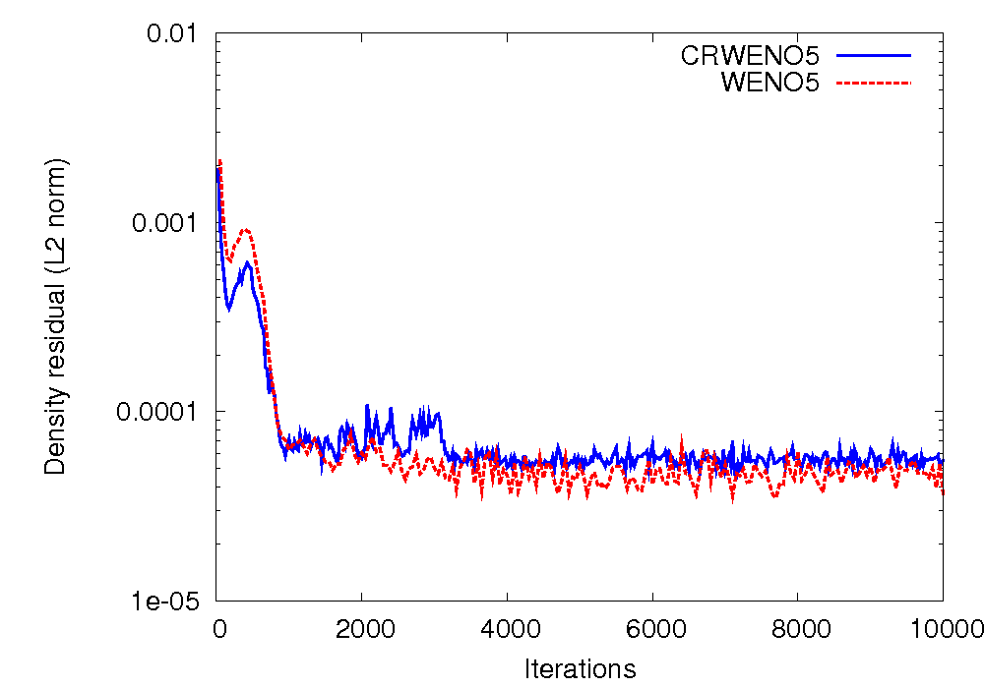
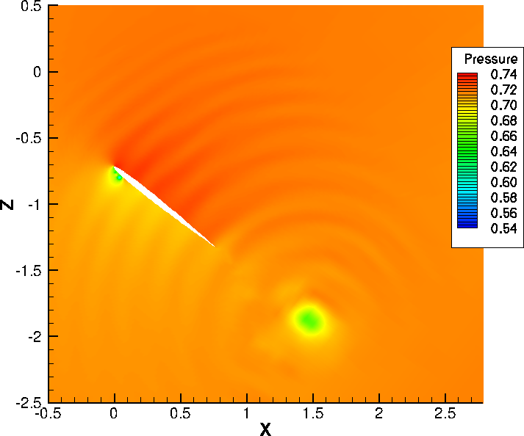
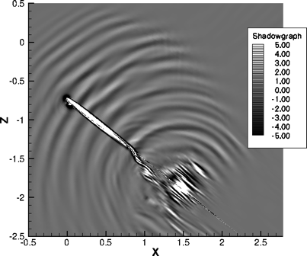
Implementation of WENO Weights
Open Issues with current implementation
Convergence – Poor convergence for airfoil problems, although solution is correct
Smoothness of higher derivatives – Solution smooth, oscillations in 1st and higher derivatives
?
Convergence history for steady, turbulent flow around RAE2822 airfoil
Jiang & Shu, 1996 (ε = 10⁻⁶, p = 2) – Sub-optimal convergence, ε-sensitivity
Mapping of weights (Henrick & Aslam, 2005) – Improve convergence to optimal values
Variable ε (Peer, et. al., 2009) – High ε (10⁻²) for smooth region, low ε (10⁻⁹⁹) for discontinuities
Alternative formulation of WENO weights
Borges, et. al., 2008 (WENO-Z)
Yamaleev & Carpenter, 2009 (ESWENO)
Pressure and numerical shadowgraph of a pitching-plunging NACA0005 airfoil

Slide 7
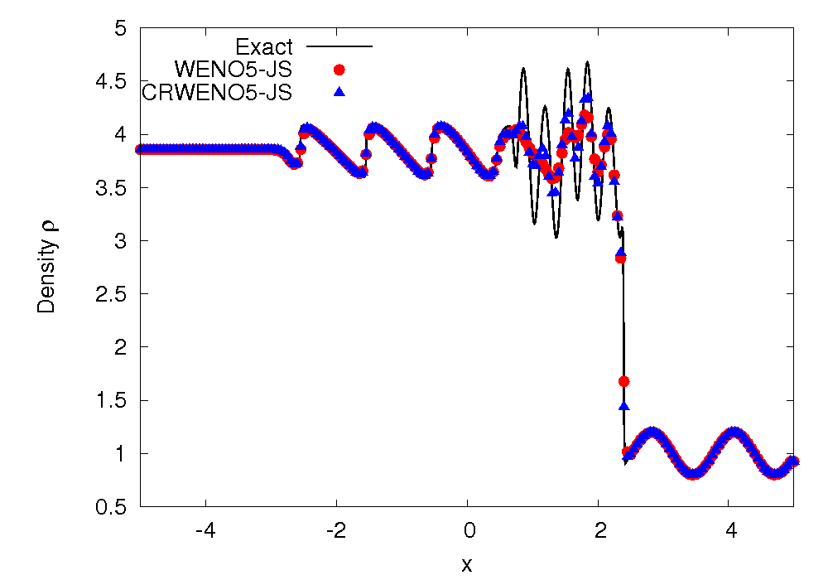
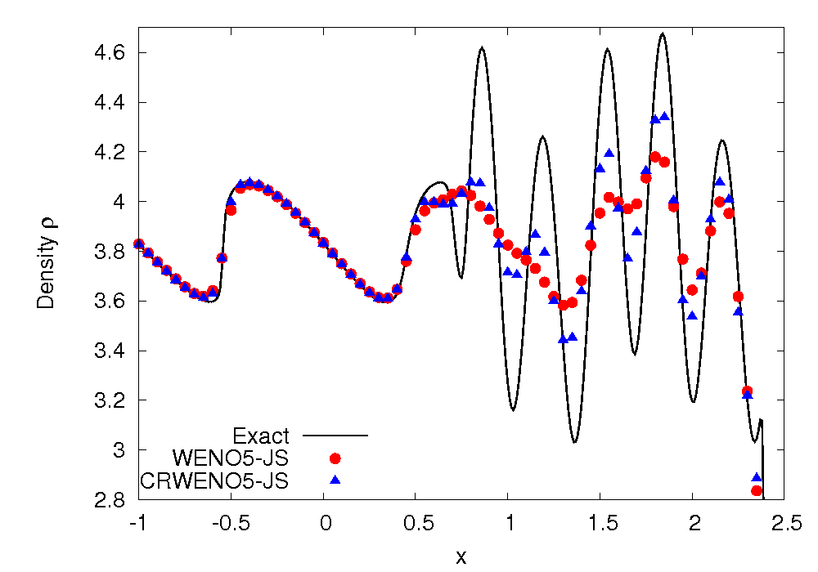
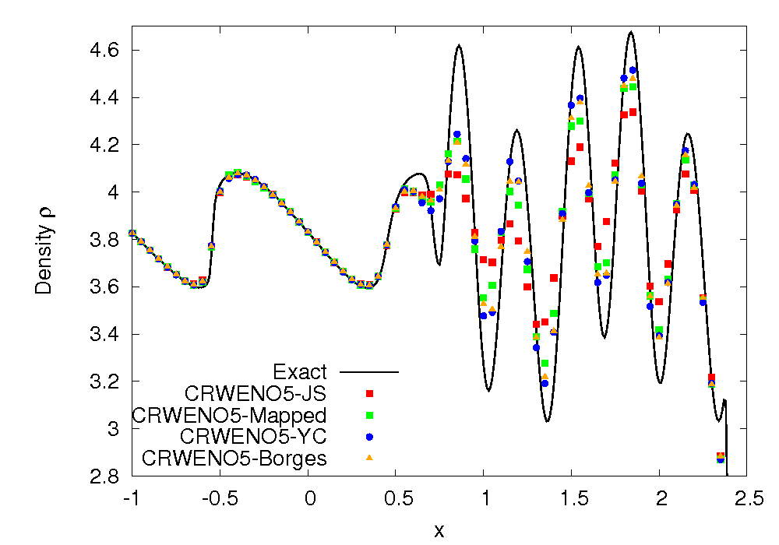
Shock – Entropy Wave Interaction
6 points per wavelength
Interaction of a shock wave with a density wave resulting in high-frequency waves and discontinuities
CRWENO scheme shows better resolution of high-resolution waves than WENO5
ε = 10⁻⁶, p = 1
CRWENO-JS – Jiang & Shu weights
CRWENO-Mapped – Mapped weights
CRWENO-YC – Yamaleev & Carpenter weights
CRWENO-Borges – Borges’ weights

Slide 8
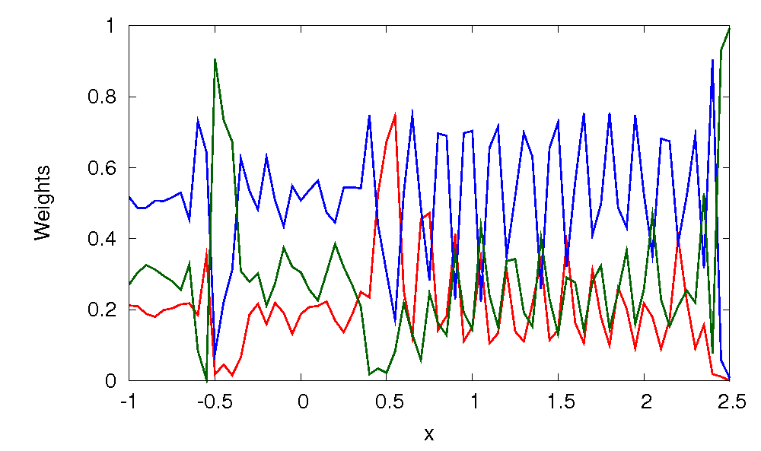
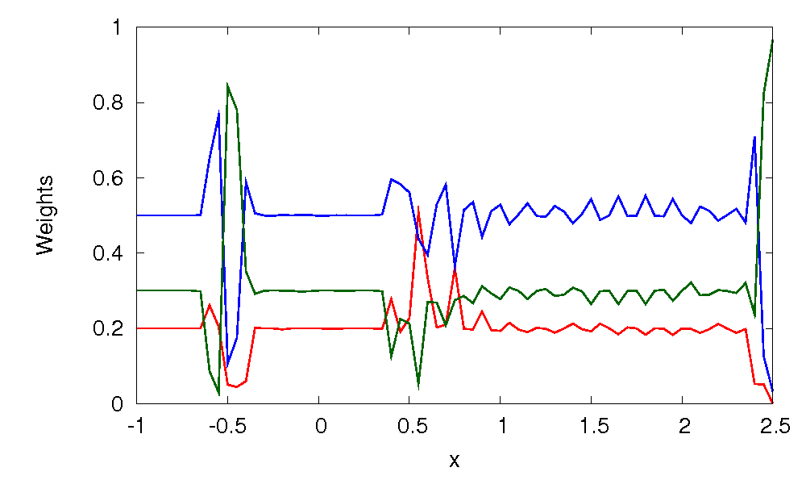
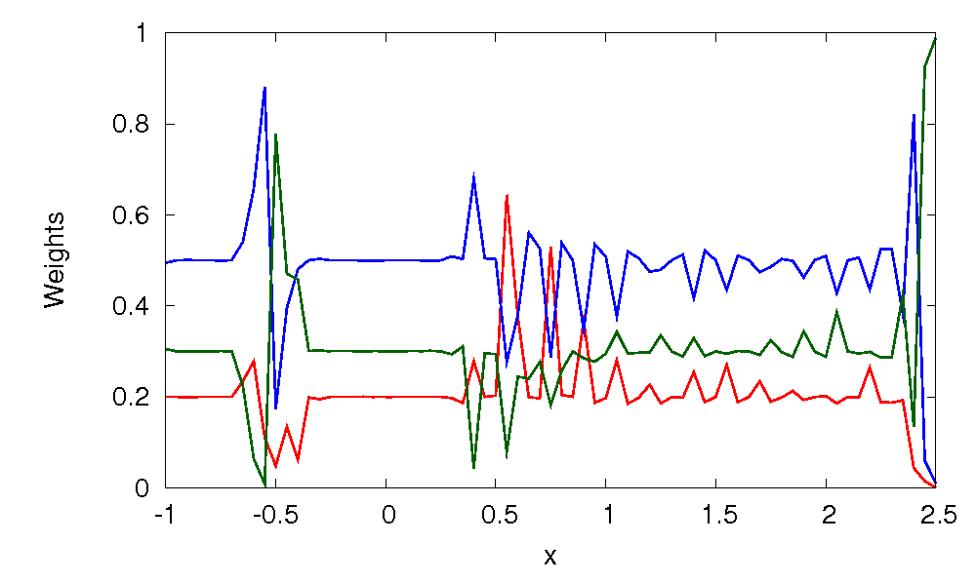
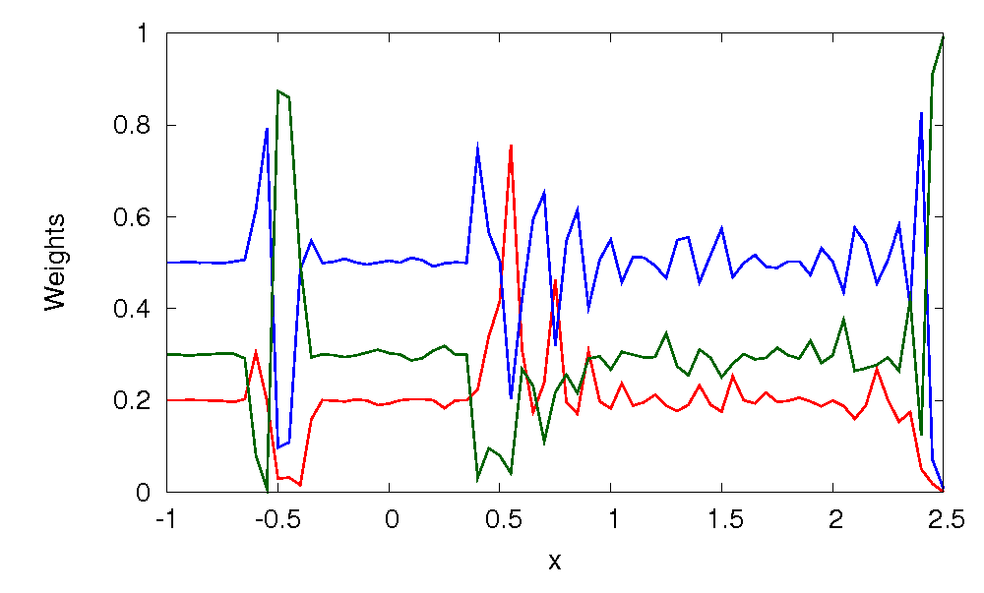
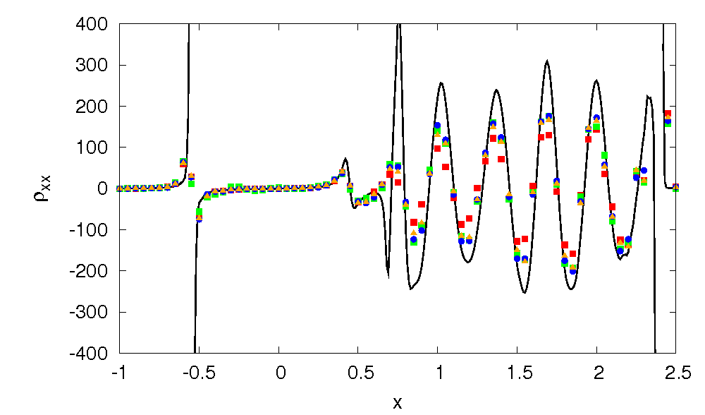
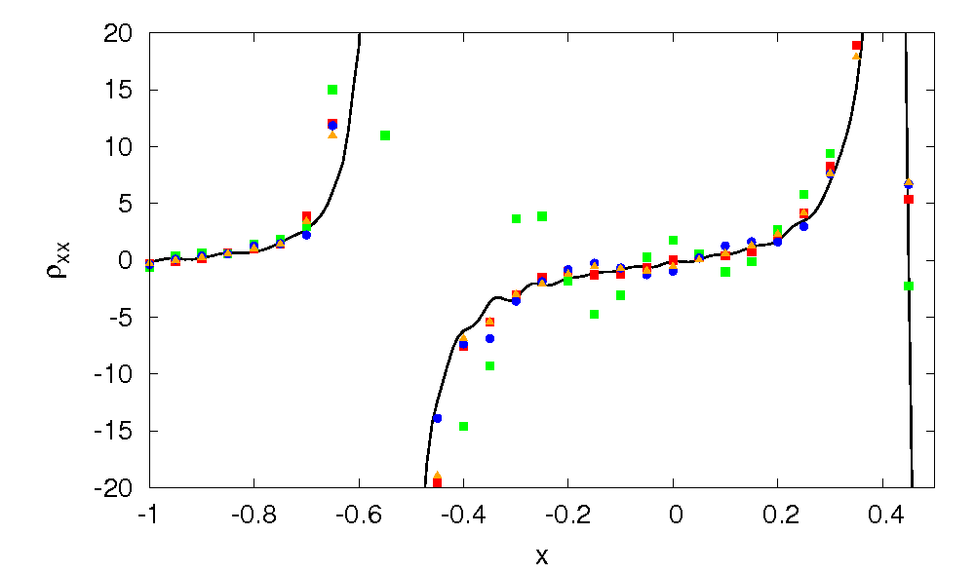
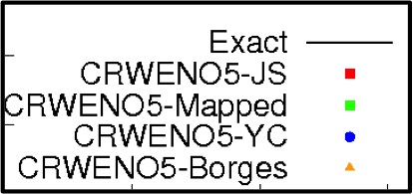
Shock – Entropy Wave Interaction
CRWENO-JS
CRWENO-Mapped
WENO weights closer to optimal values for the high-frequency waves with Mapped, YC and Borges weights
Similar results for ε = 10⁻²⁰ and p = 2
CRWENO-YC
CRWENO-Borges
ω₁
ω₂
ω3
Weights for characteristic field u
ε = 10⁻⁶, p = 1
2nd Derivative of the Density
Oscillations in 2nd derivative for CRWENO-Mapped, CRWENO5-YC & CRWENO5-Borges non-oscillatory

Slide 9
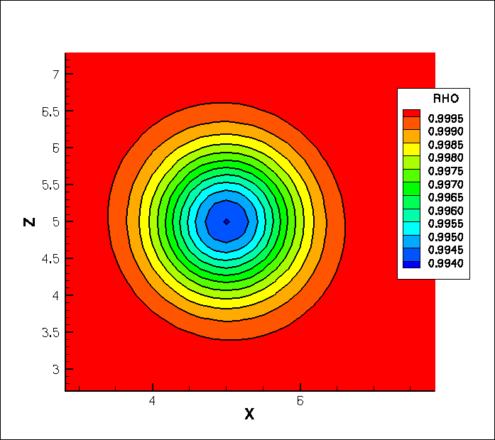
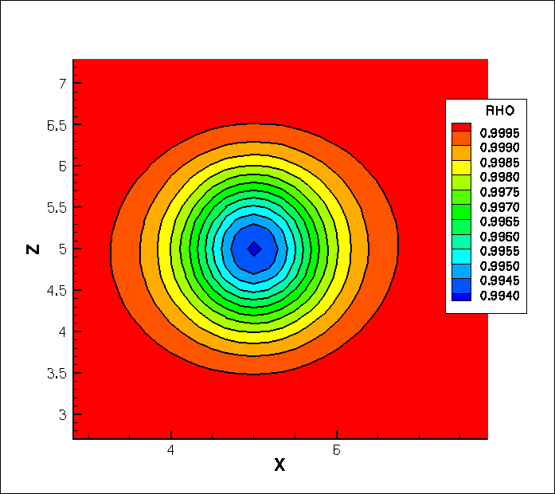
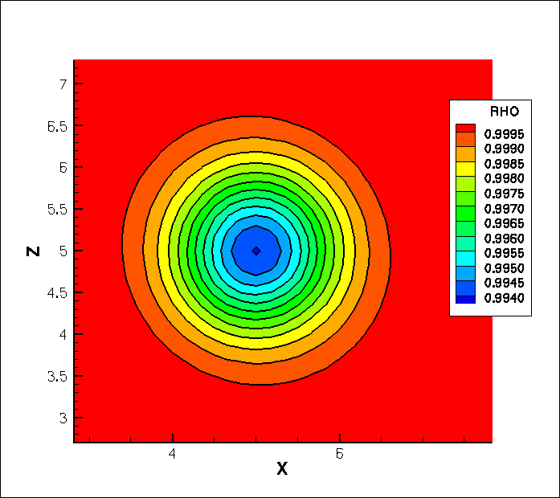


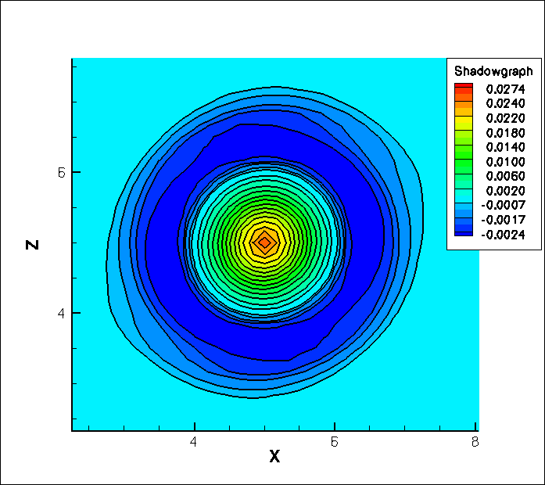
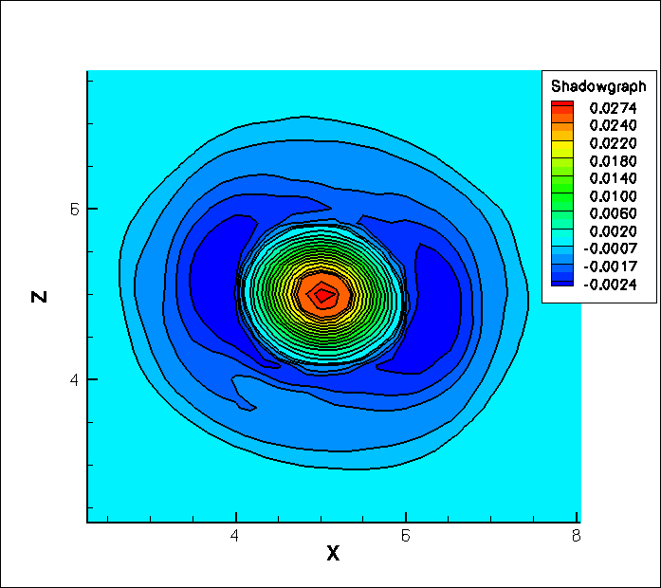


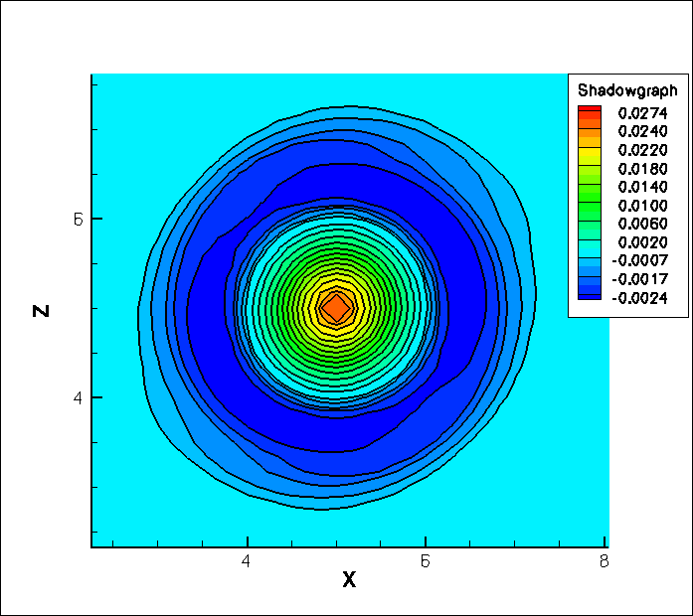
Isentropic Vortex Convection
Long term inviscid convection (1000 core radii) – Preservation of strength and shape
Density Contours
ε = 10⁻⁶, p = 2
No Limiting
(5th order compact)
CRWENO5-JS
CRWENO5-Mapped
CRWENO5-YC
CRWENO5-Borges
Numerical Shadowgraph (Laplacian of density)
Smooth, non-oscillatory density field for all schemes (almost identical)
Oscillations in 2nd derivative for CRWENO5-JS & CRWENO5-Mapped, while CRWENO5-YC and CRWENO5-Borges are smooth

Slide 10
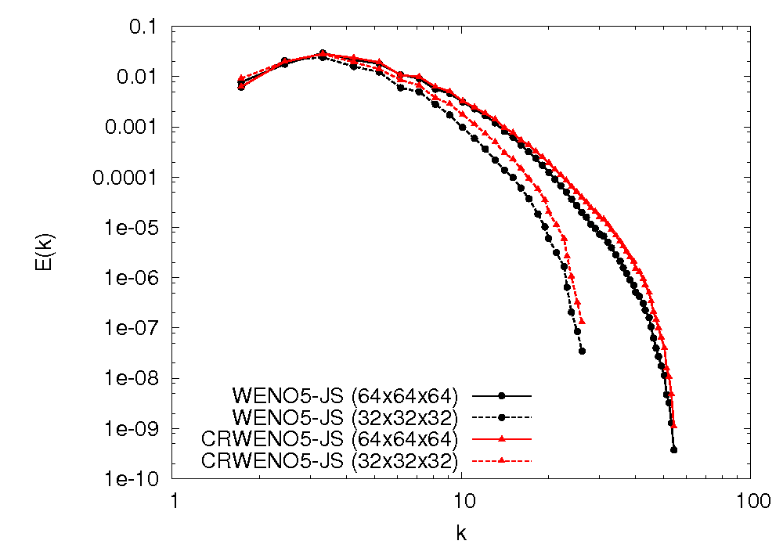
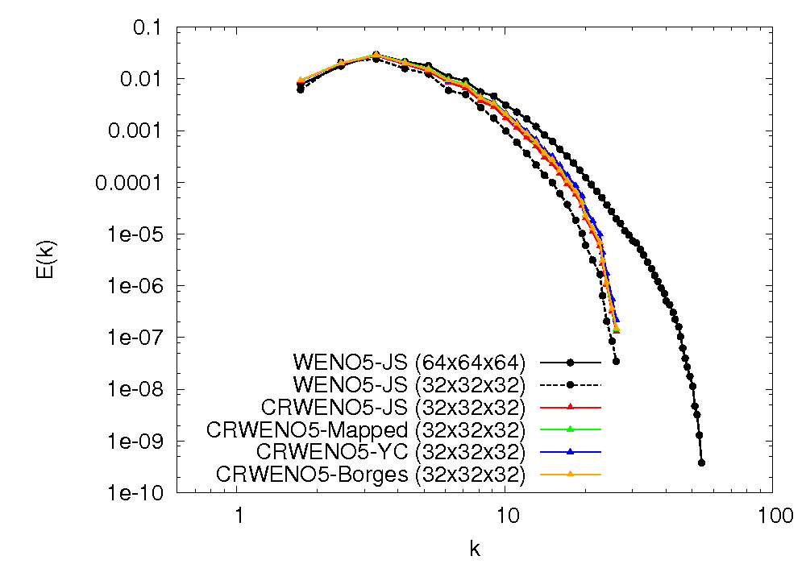
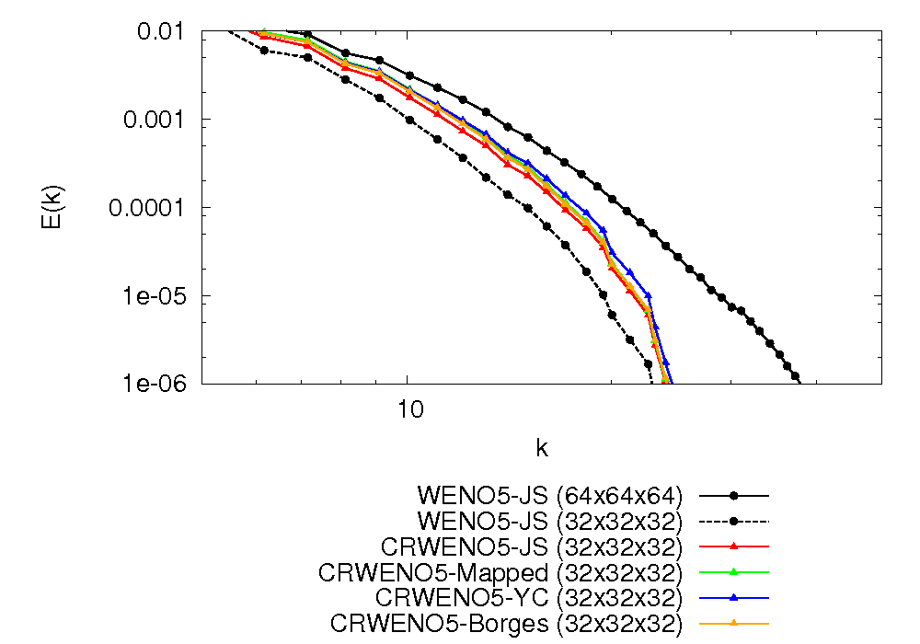
Isotropic Turbulence Decay
Initial Conditions:
Taylor microscale-based Reynolds number Re_{λ} = 50
Turbulent Mach number M_{t} = u_{RMS} / a = 0.3
Wavenumber for maximum energy k₀ = 4
Energy Spectrum obtained at t/τ = 3.0 (τ = λ / u_{RMS})
CRWENO5 shows improved resolution of higher wavenumbers compared to WENO5
ε = 10⁻⁶, p = 2
Comparison of different non-linear weights

Slide 11
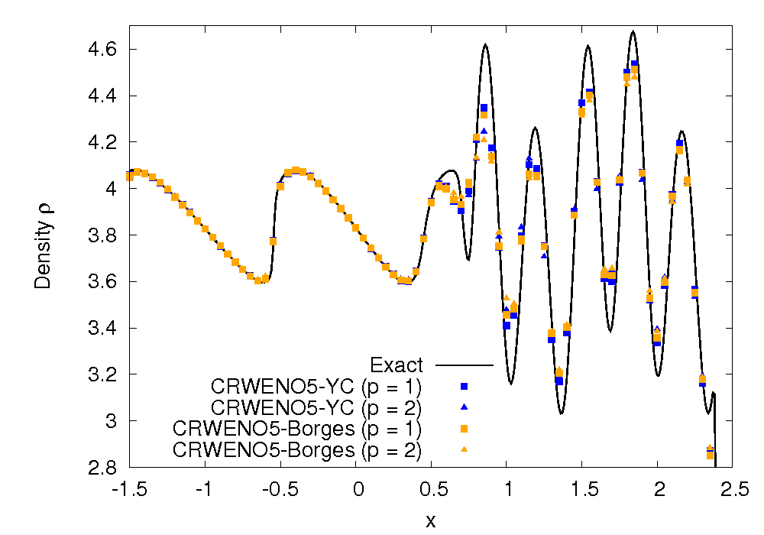
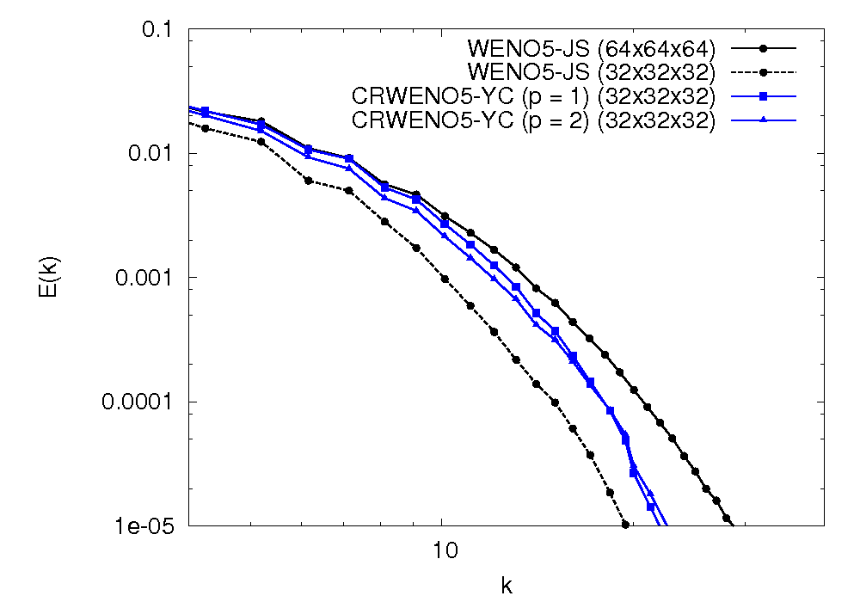
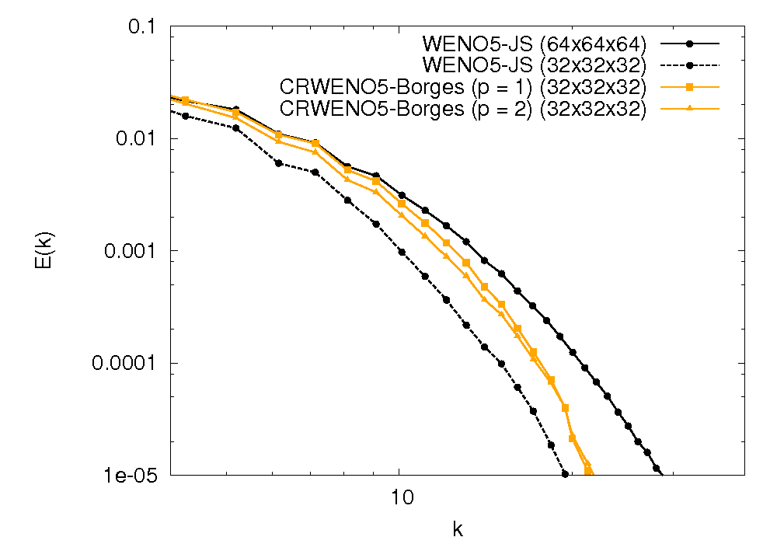
Effect of p
Exponent for the smoothness indicators → Affects convergence to optimal weights (smooth) or zero (discontinuity)
Higher p accentuates difference in weights due to difference in smoothness
High-frequency waves → p = 1 shows sharper resolution (Weights closer to optimal)

Slide 12
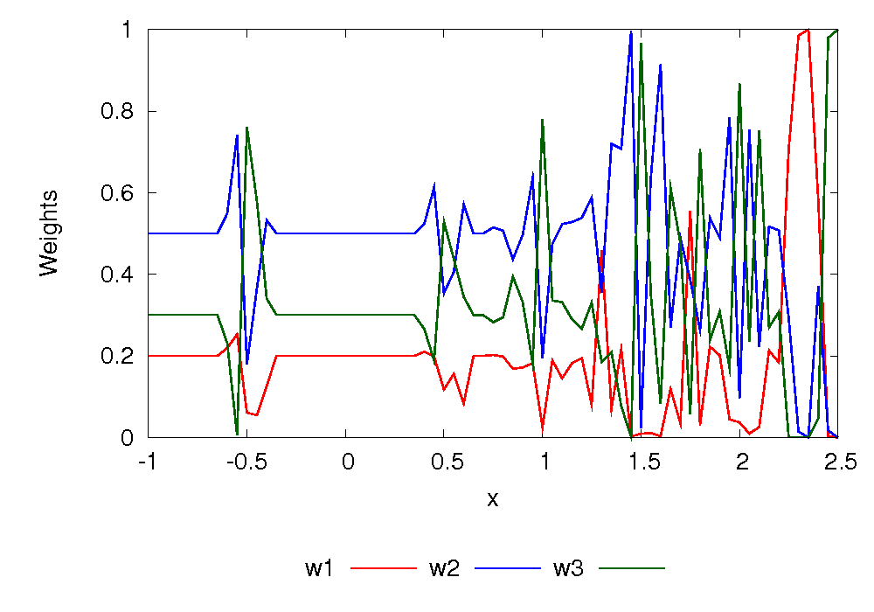
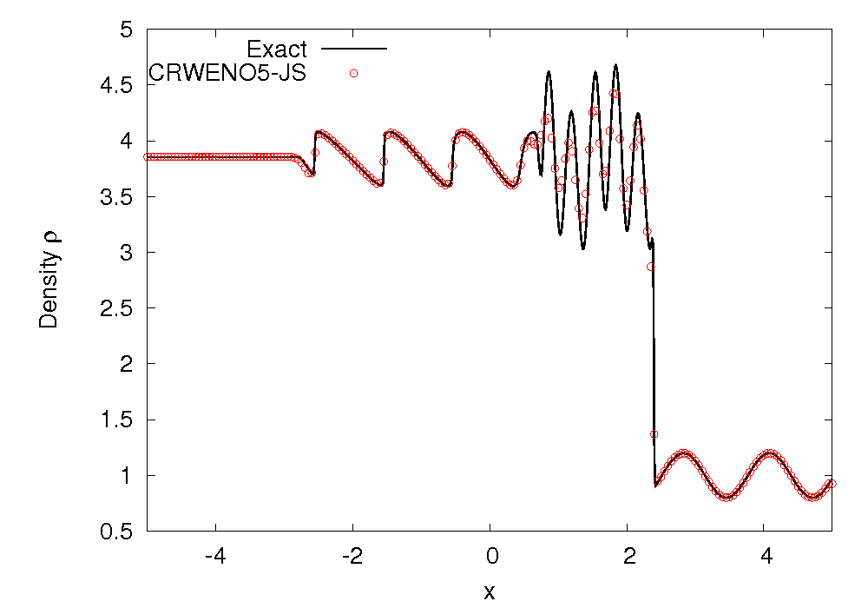
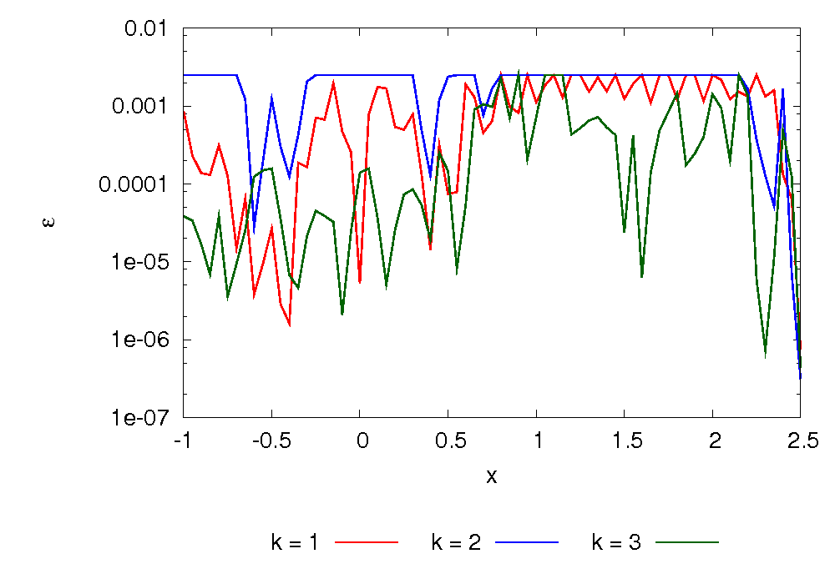
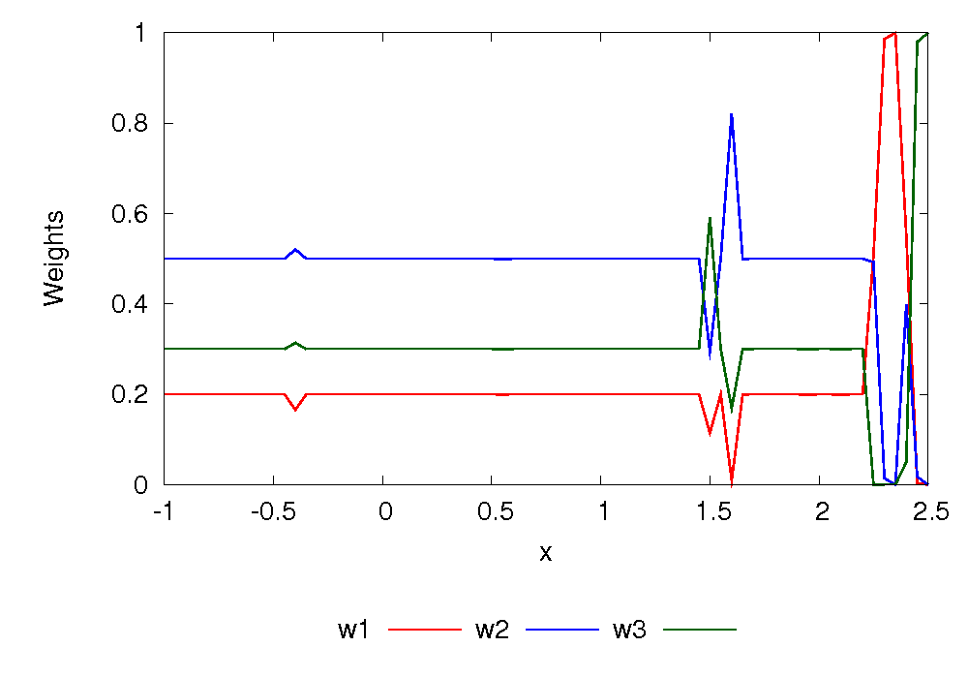
Effect of ε
Jiang & Shu (1996) → Prevent division by zero
What should ε be? (10⁻², 10^{-6,} 10⁻⁴⁰, … )
Sensitivity to value of ε
Convergence for smooth problems
Excessive dissipation around discontinuities
High ε → 5th order polynomial interpolation
Low ε → ENO-type (lower order) interpolation
Variable ε (Peer, et. al., 2009) → Smoothness based value of ε
Upper and lower limits for ε
Yamaleev & Carpenter, 2009
5th order CRWENO
ε = 10⁻⁶
Weights (u+c characteristic)
Variable ε
Variation of ε for the Shu-Osher problem

Slide 13
Conclusions & Future Work
Compact-Reconstruction WENO schemes
Lower absolute errors and higher spectral resolution for same order of convergence as the WENO scheme
Non-oscillatory, yet sharper resolution of discontinuities
Improved preservation of flow features over large convection distances
Implementation of non-linear weights
Jiang & Shu → dissipative for discontinuities, sub-optimal order of convergence for certain classes of smooth problems, sensitivity to ε, oscillations in higher derivatives
Improved resolution using alternative weights (Mapped, Borges’, Yamaleev-Carpenter) → Smooth higher derivatives with Borges’ and Yamaleev-Carpenter
Improved convergence of weights to optimal values with variable ε
Future Work
Improvement in convergence for airfoil problems
Application to direct numerical simulation of turbulent flows

Slide 14
Acknowledgments
This research was supported by the U.S. Army's MAST CTA Center for Microsystem Mechanics with Mr. Chris Kroninger (ARL-VTD) as Technical Monitor.
http://www.mast-cta.org/

