Slide 1
Angewandte Computer- und Biowissenschaften
Convolution Theorem and Key Examples of Fourier Series
Math. Seminar
Debojit Das, MA19w1-B

Slide 2
The Convolution Theorem
- It is one of the most powerful Fourier transform formulas.
- Has applications in Probability & Statistics (i.e.The sum of two random variables is a convolution of their individual distributions), Acoustics, Signal and Image Processing, Engineering, Computer Vision and in many other streams.

Slide 3
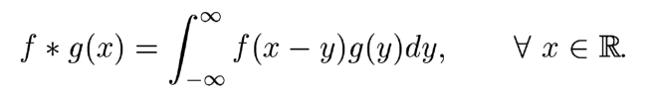

The Convolution Theorem
Definition:
- If f and g are functions on R, their convolution is the function f * g
- With a change of variables we have evidently

Slide 4




The Convolution Theorem
Convolution obeys the same algebraic laws as ordinary multiplication, such as-
(i) The associative law: for a , b constants,
(ii) The commutative law :
(iii) The distributive law :
Theorem: If f and g are differentiable and the convolutions f * g, f’ * g and f * g’ are well defined. Then f * g is differentiable and

Slide 5

The Convolution Theorem
The Convolution Theorem
If f(x) and g(x) are integrable functions with Fourier transforms f̂ and ĝ respectively, then the Fourier transform of the convolution is given by the product of the Fourier transforms f̂ and ĝ. i.e, if f, g ∈ L¹

Slide 6
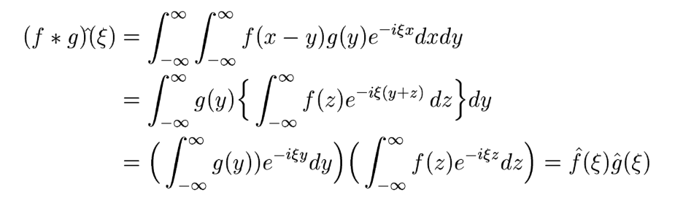


The Convolution Theorem
Proof: By the definition
We can use Fubinis theorem to change the order of integration. Substituting also x – y = z, it follows that
^{thus we have,}

Slide 7
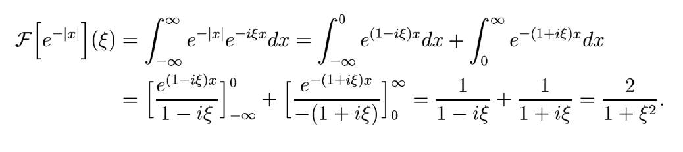
Examples of Fourier Transform
Example : Determine the Fourier transform for the function f(x) = e^{-|x|}
Solution : Using the definition of the Fourier transformation it follows that
Let us try to plot the graph now,

Slide 8

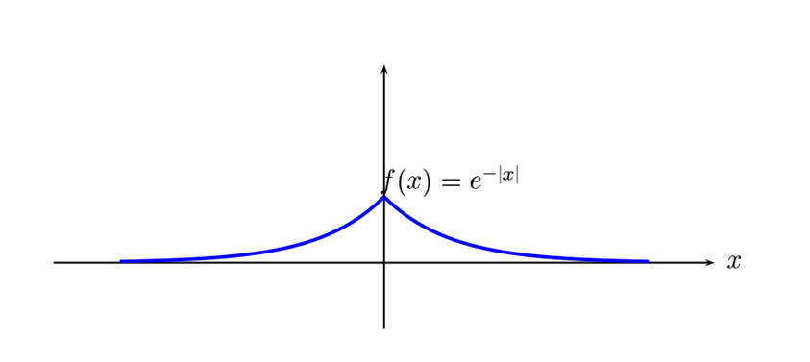
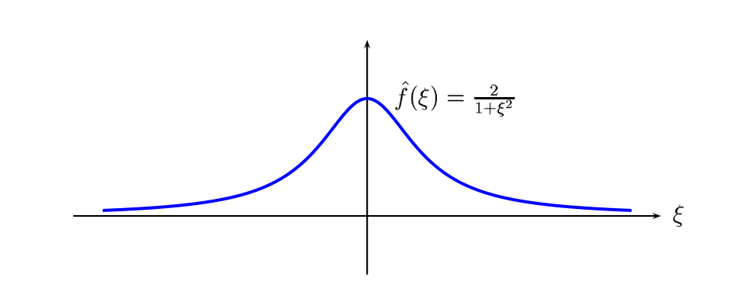
Examples of Fourier Transform

Slide 9

Examples of Fourier Transform
Example: Find the Fourier transform for the function
Solution: I will try to solve it by writing it down.

Slide 10
Thank You For Your Time!
Please feel free to ask, if you have doubts.

