Slide 1

Sprocket Central Pty Ltd
Data analytics approach
DEBOJJAL BAGCHI – Virtual Intern

Slide 2


Agenda
Introduction
Model Development
Data Exploration
Interpretation

Slide 3
Introduction
I shall present through this PPT the various aspects that would determine to select the top 1000 Customers for the Company
I shall back up my points with some Data Exploration, Model Building & My Interpretations of the same
I shall then provide some my advice regarding the company's target Customers

Slide 4
Model Development
The following points was considered while Building a model from Raw Data
First some Data Cleanup & Improvement strategies was sent your company and they were selected and official go ahead was procured,
Next I applied those strategies and built a model on the same.
The Salient Features of the Model are on the next slide

Slide 5
Model Development
All inconsistency in Gender Data Field was resolves to Male, Female & Unspecified.
Age Data Field was created from D.O.B data field and was further used for analysis. DOB data field was dropped from analysis.
Age Groups were Created for Analysis : 0-20 Yr, 20-40 Yr, 40-60 Yr, 60-80 Yr, 80-100 Yr
Job Industries, Wealth Segment & Owns A Car was taken for analysis
Tenure Groups were Created for Analysis : 0-5 Yr, 5-10 Yr, 10-15 Yr, 15-20 Yr, 20-25 Yr
Previous Bike related purchase Groups were Created for Analysis : 0-20, 20-40, 40-60, 60-80, 80-100

Slide 6
Data Exploration
Exploring How Gender affects the amount of Purchases.
Females have slightly more % of purchasing over males.

Slide 7
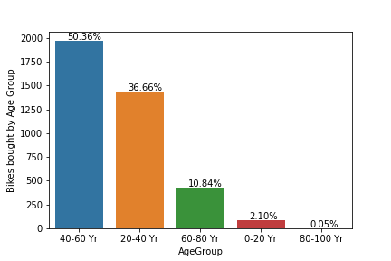
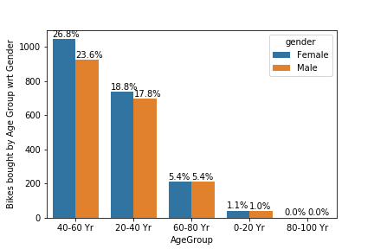
Data Exploration
Exploring How Age Group affects the amount of Purchases.
As we see the most %of customers are
from age group 40-60 & 20-40 years.
Females of both these categories of age
form the major part of the share.

Slide 8
Data Exploration
Exploring How Industry Type affects the amount of Purchases.
The top 3 customer categories from specific industry are:
Manufacturing (24%)
Financial Services (23%)
Health (18%)

Slide 9
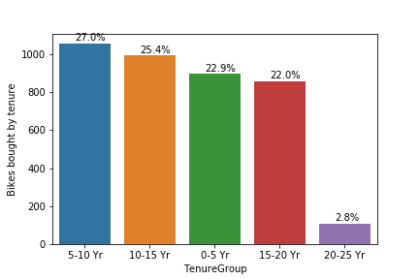
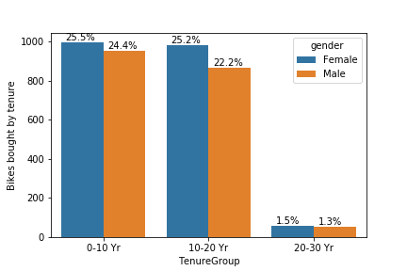
Data Exploration
Exploring How Tenure affects the amount of Purchases.
As we see all tenure groups are more or less have equal contributions except 20-25 years of tenure
Females again tend to dominate as a customer bracket from tenure point of view

Slide 10
Data Exploration
Exploring How Wealth Group affects the amount of Purchases.
Mass Customers contribute to the maximum of Customers %
Females & Males have generally equal contributions here.

Slide 11
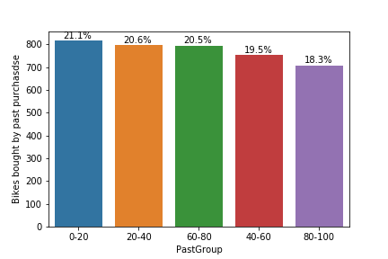
Data Exploration
Exploring How Past Purchases affects the amount of Purchases.
Amount of Past Bike related purchases
doesn’t affect much on the next
purchase.
Although the general trend is
People with less bike related past
purchase have higher chances of
making a new purchase

Slide 12
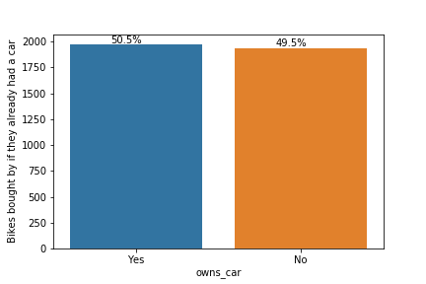
Data Exploration
Exploring How Having a car affects the amount of Purchases.
If a person owns a car or not has no
Relation with if he makes a purchase
Or not.

Slide 13
Interpretation
Females tend to have higher chances of making a purchase.
Age group between 20-60 Years have the highest chances of making a new purchase.
People from Manufacturing , Financial Services & Health have the highest chances of making a new purchase.
Mass Customers tend to purchase the most amount of goods.
People with less than 20 years of tenure are the largest consumers.

Slide 14
Methods used
Data Analysis with Python using Pandas
Exploration of Graphs using Seaborn Library
Personal Interpretations

Slide 15
THANK
YOU
Presentation, Model Development & Analysis by :
Debojjal Bagchi,
Indian Institute of Science,
Virtual Intern, KPMG

