Slide 1
Title: Hospital Data Management system (Database-Only Project)
Subtitle: Database Design and Query of data using SQL and Python

Slide 2
Introduction
Ensure all patient, doctor, appointment, and treatment information is stored in a single database..
Objective:
Tech stack: Mysql workbench , SQL ,python, Jupyter Notebook

Slide 3
Project Goals
Enable healthcare providers to efficiently manage data and retrieve patient records, treatment history, and doctor availability from a single source.
Efficient Patient Record Management
Doctor Information and Scheduling
Appointment Scheduling and Management
Treatment and Diagnosis Tracking
Billing and Payment Tracking
Scalability and Flexibility

Slide 4


Entities in the System
Doctors |  | Treatments |  | Billing |  | Appointments |  | patients
doctor_id |  | treatment_id |  | billing_id |  | appointment_id |  | patient_id
first_name |  | appointment_id |  | treatment_id |  | patient_id |  | first_name
last_name |  | diagnosis |  | amount |  | doctor_id |  | last_name
specialty |  | treatment_details |  | payment_status |  | appointment_date |  | gender
phone_number |  | prescription |  | billing_date |  | appointment_time |  | date_of_birth
email |  | treatment_date |  |  |  | reason |  | phone_number
 |  |  |  |  |  | status |  | city
 |  |  |  |  |  |  |  | email

Slide 5
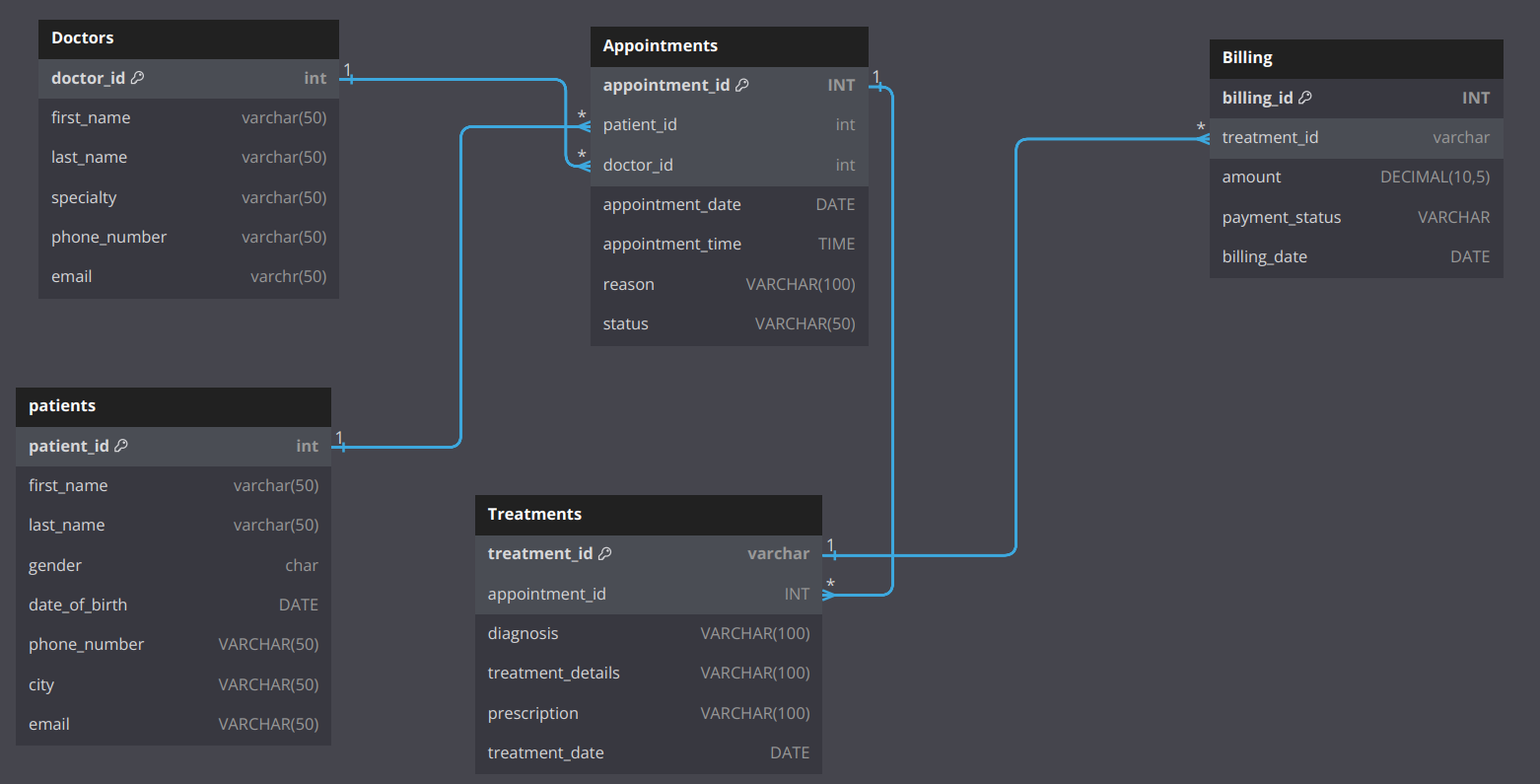
Database Design Overview
ER Diagram:

Slide 6
SQL Queries for Operations
Data Base and Table Creation
Insertion of the data into all table
Track of the appointment.
Monitor and effectively store the patient data.
Implement the store procedure to automate the analysis of billing, appointment , treatment.

Slide 7
Thank you

