Slide 1


Healthcare Ingestion & Clinical Insights Engine
An End-to-End Analytics Framework for Data-Driven Decision Making & Operational Optimization
Technical Analyst Presentation
Debolina Das | 2024

Slide 2
Business Case & Strategic Objective
Bridging the gap between disparate healthcare operational metrics and actionable executive insights.

Slide 3




PROBLEM STATEMENT & SOLUTION ARCHITECTURE
Operational Barriers
Technical Design
Healthcare providers manage disconnected data across demographics, clinical appointments, and financial transactions. This fragmentation prevents a unified view of patient journeys and resource efficiency.
Implementation of an automated Python-based ETL pipeline paired with a relational MySQL repository to centralize tracking, automate KPI reporting, and optimize department-level performance.

Slide 4

END-TO-END TECHNICAL STACK
Ingestion Layer: Python scripting for automated CSV extraction and schema validation.
Storage Layer: Optimized MySQL RDBMS with enforced relational integrity and cascading updates.
Analytical Layer: Deep-dive SQL querying using Window Functions and Stored Procedures for automation.

Slide 5
RELATIONAL SCHEMA & NORMALIZATION
Entity | Primary Keys | Core Attributes | Business Value
Patients | patient_id | DOB, Gender, City, Contact | Demographic cohort profiling
Doctors | doctor_id | Specialty, Email, Phone | Resource availability tracking
Appointments | appointment_id | Date, Time, Reason, Status | Operational workload monitoring
Treatments | treatment_id | Diagnosis, Details, Date | Clinical outcome mapping
Billing | billing_id | Amount, Payment Status | Financial resolution tracking

Slide 6






CORE ENGINEERING CAPABILITIES
Automated ETL
Stored Procedures
Data Integrity
Engineered dynamic data mapping using SQLAlchemy to transition unstructured clinical logs into structured relational assets.
Automated annual diagnosis reporting logic through parametric SQL routines, reducing manual query overhead for admins.
Implemented Foreign Key constraints and schema validation to ensure 100% referential accuracy across the patient journey.

Slide 7
PROJECT DELIVERY EFFICIENCY
20%
Modern Efficiency
By leveraging AI productivity agents (Claude & GitHub Copilot) for prompt-engineered SQL generation and unit testing, development cycles were reduced while maintaining high-quality code standards.
ACCELERATION VIA AI AGENTS

Slide 8
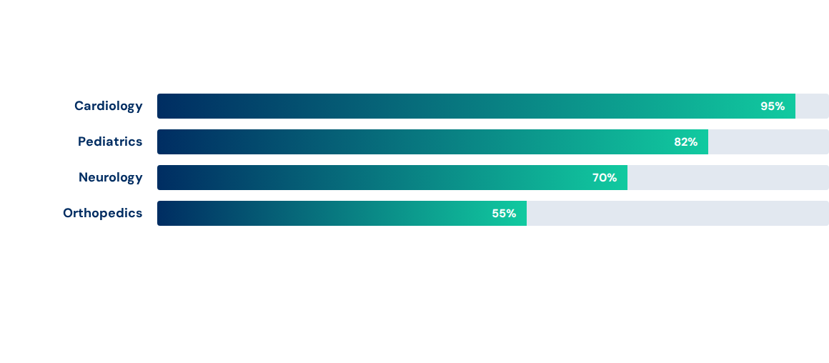
PHYSICIAN UTILIZATION BY SPECIALTY
Analysis derived from the multi-table JOIN aggregation of doctor specialties and patient appointment volumes.

Slide 9

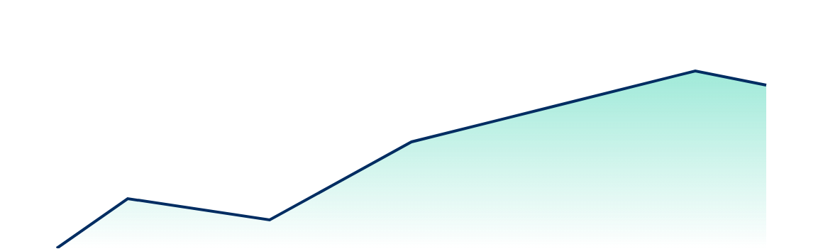
PATIENT DEMOGRAPHIC TRENDS: UNDER 10 YEARS
JanMarMayJulSepNov
Leveraging TIMESTAMPDIFF functions to isolate pediatric diagnostic spikes and inform staffing for pediatric wings.

Slide 10
AUTOMATED INSIGHTS ENGINE
Dynamic Reporting: Parametric Stored Procedures allowing one-click retrieval of annual clinical workload statistics.
Financial Auditing: Integrated billing resolution tracking to identify high-revenue treatment categories.
Data Cleaning: Automated Python-based data normalization for incoming historical records to ensure schema consistency.
Business Scalability: Relational design allows for seamless future integration of Insurance and Lab entities.

Slide 11

"
"True technical analysis is not just about building a database; it is about translating complex, siloed operational problems into a scalable digital blueprint that drives business growth."
PROJECT VISION & TECHNICAL PHILOSOPHY

Slide 12
Questions?
Thank you for your time.
Debolina Das | Technical Analyst
West Bengal | linkedin.com/in/debolinadas24/

Slide 13


IMAGE SOURCES
https://miro.medium.com/1*UV6lmYquXIyAYfszxXuS4A.jpeg
Source: medium.com
https://media.istockphoto.com/id/2243516829/vector/futuristic-technology-circuit-blueprint-pattern-background.jpg?s=612x612&w=0&k=20&c=TYMHqIFL4UL9b79nMoIHHsAaHZ_Jv9j1PFrwoDCwKX0=
Source: www.istockphoto.com

