Slide 1


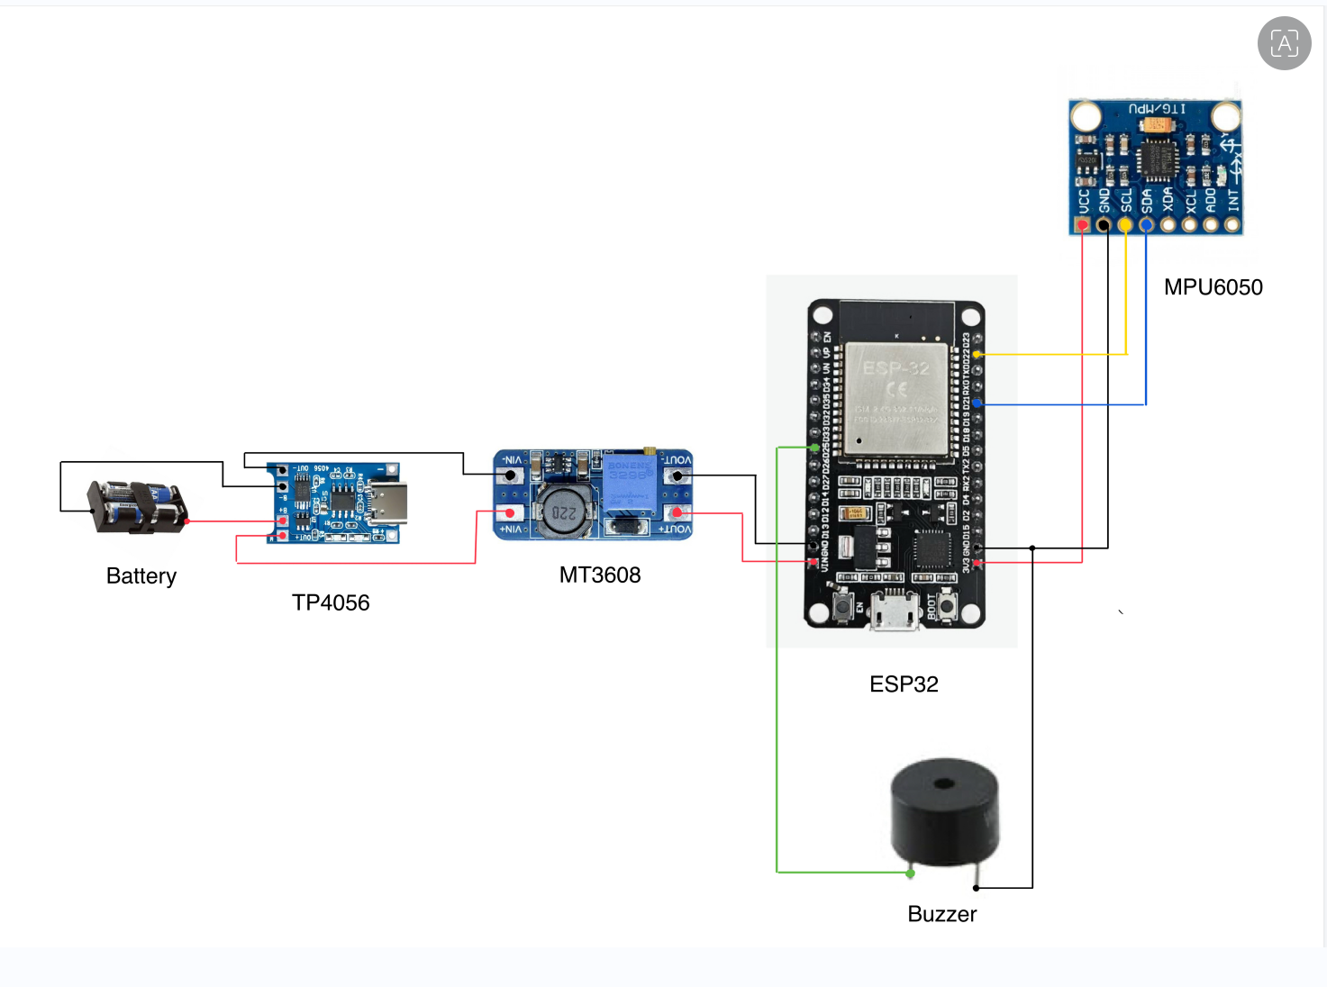
Portable Smart Anti-Theft Protection Module
Project ID: S-5
Introduction
This project is a portable anti-theft module designed to protect personal items, such as backpacks, from unauthorized movement. It provides a simple, low-cost smart security solution for everyday belongings to improve personal safety.
Circuit Diagram
Working Principle
The MPU6050 sensor continuously monitors the object's motion and displacement.
Data is sent to the ESP32 microcontroller for real-time processing.
When abnormal movement is detected, the ESP32 triggers an active buzzer to produce an audible alarm.
The in app buzzer and the hardware buzzer gets triggered when the object goes out of Bluetooth range and the esp32 chip detects motion.
Components used
Controller: ESP32 Microcontroller.
Sensors: MPU6050 Accelerometer & Gyroscope.
Alert: Active Buzzer.
Power: 18650 Li-ion Battery.
Modules: TP4056 Charging Module & MT3608 Boost Converter.
Rating
Efficiency: High.
Portability: Excellent.
Cost: Budget-friendly.
Application
Securing backpacks and travel luggage.
Protecting portable electronics or equipment cases.
Real-time motion alerting for stationary assets.
Novelty
Integrated Power Management: Uses a boost converter and charging module for independent, portable operation.
Compact Design: Small form factor allows for integration into various personal items.
High Sensitivity: Utilizes a 6-axis motion tracking sensor for precise detection.
Future scope
IoT Connectivity: Adding WiFi notifications to alert the owner's smartphone.
GPS Integration: Implementing location tracking if the item is moved away.
Power Optimization: Implementing "Deep Sleep" modes to extend battery life.

