Slide 1
Decoding and other NLG examples
CSE 490 U – Section Week 10

Slide 2
Outline
Decoding from RNNs:
Greedy decoding (in HW5)
How to sample from a probability distribution
Beam search on RNNs
Applications of decoding/MT ideas in non-MT domains:
Stylistic paraphrasing
Twitter Conversation
Notes:
Notes from Yejin:
Make sure to include something technically substantive somewhere. One possibility is to do that with LSTM decoding. (including discussions about how to store different h and why we need to do that)
Maybe this paper is relevant for you (which you would have wanted to read anyway):
https://www.semanticscholar.org/paper/Lattice-decoding-and-rescoring-with-long-Span-Sundermeyer-T%C3%BCske/51f7ff895b854e421fbabf76a1039f1abb41d5d4

Slide 3
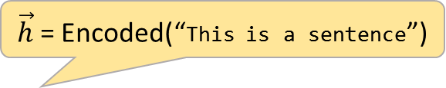

Decoding
Given an input X, encoding turns X into some representation.
With RNN Encoder-Decoder:
Encoded(X) = Hidden State at final step
$\vec{h}$ = Encoded(“This is a sentence”)
$$\vec{h}$$
<BOM>
This
is
a
sentence
<EOM>

Slide 4

Decoding
Given an input X, encoding turns X into some representation.
With RNN Encoder-Decoder:
Encoded(X) = Hidden State at final step
<BOM>
This
is
a
sentence
<EOM>
How to pick the output word?
$$\vec{h}$$
<EOM>
<BOM>
This
is
a
sentence

Slide 5
Decoding – during training
Target output is known!
Just feed that as input => each predicted output depends on previous states and input, not on previous outputs.
<BOM>
This
is
a
sentence
<EOM>
$$\vec{h}$$
<EOM>
<BOM>
This
is
a
sentence

Slide 6
Decoding – during testing
Target output is unknown!
3 main approaches:
Greedy (most probable word)
Sample from the distribution
Beam search
<BOM>
This
is
a
sentence
<EOM>
$$\vec{h}$$
<EOM>
<BOM>
This
is
a
sentence

Slide 7



Reminder: output of RNN
Embedded predicted output
un-embed
#1
Prob dist. over next word
softmax
$$\vec{h}$$
#2
RNN
Input
<EOM>
# Creating prob. dist. over next symbol
out = tf.matmul(emb_out,un_emb) #1
sm = tf.nn.softmax(out) #2

Slide 8
Greedy decoding
At every time-step, take the most probable word
<BOM>
This
is
a
sentence
<EOM>
argmax
$$\vec{h}$$
<EOM>
<BOM>
This
is
a
sentence

Slide 9
Greedy decoding – HW 5
# Here, we're no longer training, so
# at each decoding step, for each word
# that we chose, we have to pick the most
# probable word from the prob.
# dist. given by the softmax. This is
# why this code loops.
state = init_state
# The first symbol is always the “<BOM>”
# (beginning of message) symbol
inp = emb_target_list[0]
with tf.variable_scope("unembedding"):
# defining the un-embedding parameter.
un_emb = tf.transpose(emb)
output_list = []
softmax_list = []
with tf.variable_scope("RNN"):
for i in range(max_seq_len):
if i != 0:
# needed to call cell multiple times
tf.get_variable_scope().reuse_variables()
# Take one pass through the cell
emb_out, state = cell(inp,state)
# Creating prob. dist. over next symbol
out = tf.matmul(emb_out,un_emb)
sm = tf.nn.softmax(out)
# Taking most probable output and
# embedding it again.
inp = tf.nn.embedding_lookup(
emb,tf.argmax(sm,1))
# Saving the output distribution
output_list.append(out)
softmax_list.append(sm)

Slide 10
Greedy decoding
At every time-step, take the most probable word
<BOM>
This
is
a
sentence
<EOM>
Can anyone think of a problem with this?
argmax
$$\vec{h}$$
<EOM>
<BOM>
This
is
a
sentence

Slide 11
Greedy decoding
What if two words were p(word1) = .49, p(word2)=.51?
What about the future?
Usually, greedy decoding is acceptable (especially to save time), but not preferred.
Alternative: Random sampling

Slide 12
Random sampling decoding
For every word, randomly sample from the distribution
As far as I know, have to do this “offline” i.e. not in the computation graph definition
# Sampling from a prob. Distribution “softmax”
import numpy as np
next_word_id = np.random.choice(
len(softmax), # choose from [0,|V|-1]
p=softmax # according to these probabilities
)

Slide 13
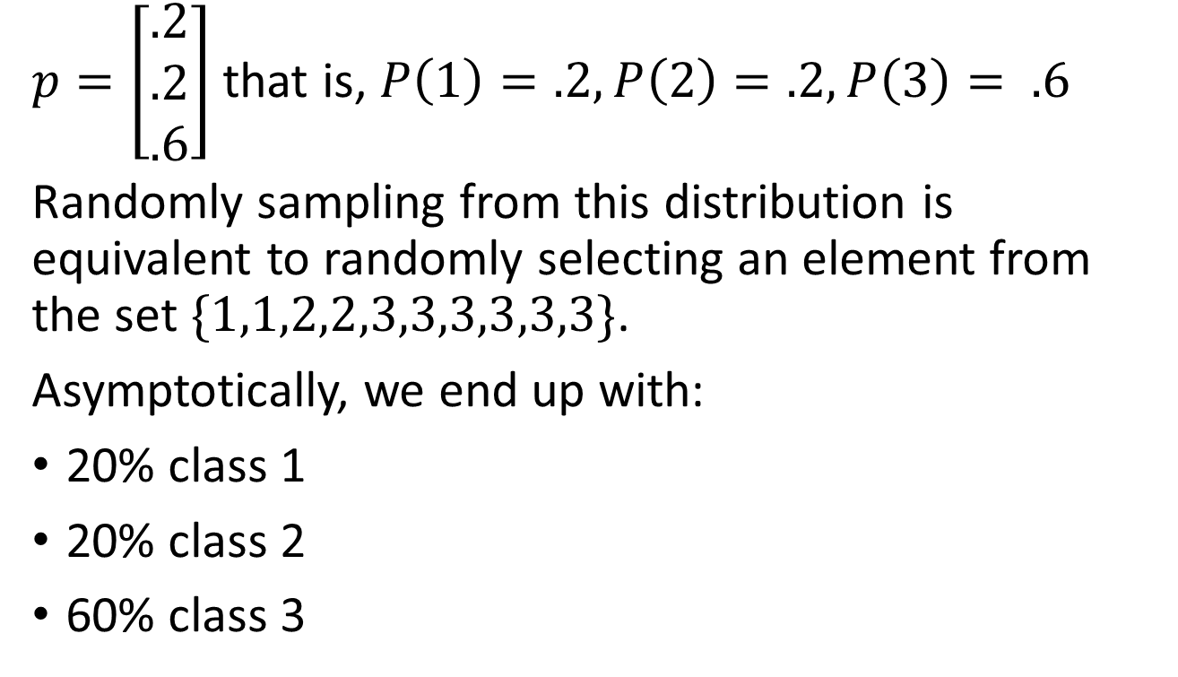
Random sampling – what does that mean?
$p=\left[\begin{matrix}.2 \\ .2 \\ .6\end{matrix}\right]$ that is, $P\left(1\right)=.2, P\left(2\right)=.2, P\left(3\right)= .6$
Randomly sampling from this distribution is equivalent to randomly selecting an element from the set $\{1,1,2,2,3,3,3,3,3,3\}$.
Asymptotically, we end up with:
20% class 1
20% class 2
60% class 3
Notes:
If we draw enough samples (with repetition) from this set, we end up with 60% class 3, 20% classes 1 and 2.

Slide 14

Random sampling decoding
<BOM>
This
was
a
word
<EOM>
Random sample!
$$\vec{h}$$
<EOM>
<BOM>
This
was
a
word

Slide 15
Random sampling decoding
Only considering one possible output
Randomness usually picks some of the most probable words
Why not consider multiple probably options?
Does choice at time t impact future?
Hint: remember HMMs & transition probabilities?

Slide 16
Beam search decoding
Instead of using one output per time-step, use the top K most probable.
Intuition:
Ruling out the 2nd most probable can have devastating consequences in the end.
Decisions at earlier time-steps can impact probability of entire sequence.
Similar intuition to Viterbi for HMMs.

Slide 17
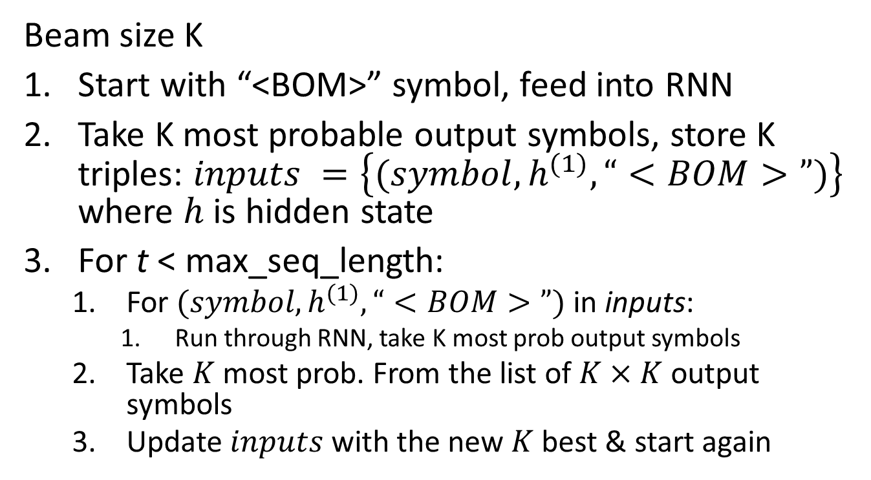
Beam search High level algorithm
Beam size K
Start with “<BOM>” symbol, feed into RNN
Take K most probable output symbols, store K triples: $inputs =\left\{(symbol,h^{(1)}, “<BOM>”)\right\}$ where $h$ is hidden state
For t < max_seq_length:
For $(symbol,h^{(1)}, “<BOM>”)$in inputs:
Run through RNN, take K most prob output symbols
Take $K$ most prob. From the list of $K×K$ output symbols
Update $inputs$ with the new $K$ best & start again
Notes:
I’ll add some stuff!

Slide 18












Beam search – a walk through
Beam size: 3
$h_{1}^{(2)}$,world: $.12$, $h_{1}^{(1)}$,Hello
STOP: all three words are <EOM>
$h_{2}^{(2)}$,world: $.11$, $h_{2}^{(1)}$,Hi
$h_{3}^{(2)}$,<EOM>: $.09$, $h_{1}^{(1)}$,Hello
$h_{1}^{(3)}$,<EOM>: $1.0$, $h_{3}^{(2)}$,<EOM>
$h_{1}^{(1)}$,Hello: $.15$, $h^{(0)}$,<BOM>
$h_{4}^{(2)}$,there: $.10$, $h_{1}^{(1)}$,Hello
$h_{2}^{(3)}$,<EOM>: $.5$, $h_{1}^{(2)}$,world
$h_{2}^{(1)}$,Hi: $.10$, $h^{(0)}$,<BOM>
$h_{5}^{(2)}$,there: $.10$, $h_{3}^{(1)}$,Hey
$h_{3}^{(3)}$,<EOM>: $.5$, $h_{2}^{(2)}$,world
$h_{3}^{(1)}$,Hey: $.10$, $h^{(0)}$,<BOM>
...
...
$h^{(0)}$,<BOM>:$1.0$,-,-
state, word: prob, prev_state, prev_word

Slide 19




Beam search – a walk through
Beam size: 3
Backtracking
$h_{1}^{(2)}$,world: $.12$, $h_{1}^{(1)}$,Hello
$h_{2}^{(2)}$,world: $.11$, $h_{2}^{(1)}$,Hi
$h_{3}^{(2)}$,<EOM>: $.09$, $h_{1}^{(1)}$,Hello
$h_{1}^{(3)}$,<EOM>: $1.0$, $h_{3}^{(2)}$,<EOM>
$h_{1}^{(1)}$,Hello: $.15$, $h^{(0)}$,<BOM>
$h_{4}^{(2)}$,there: $.10$, $h_{4}^{(2)}$,Hello
$h_{2}^{(3)}$,<EOM>: $.5$, $h_{1}^{(2)}$,world
$h_{2}^{(1)}$,Hi: $.10$, $h^{(0)}$,<BOM>
$h_{5}^{(2)}$,there: $.10$, $h_{4}^{(2)}$,Hey
$h_{3}^{(3)}$,<EOM>: $.5$, $h_{2}^{(2)}$,world
$h_{3}^{(1)}$,Hey: $.10$, $h^{(0)}$,<BOM>
...
...
$h^{(0)}$,<BOM>:$1.0$,- ,-
state, word: prob, prev_state, prev_word
$p($<BOM> Hello <EOM> <EOM> $)=1∙.09∙.15=.0135$

Slide 20

Beam search – a walk through
Beam size: 3
Backtracking
$h_{1}^{(2)}$,world: $.12$, $h_{1}^{(1)}$,Hello
$h_{2}^{(2)}$,world: $.11$, $h_{2}^{(1)}$,Hi
$h_{3}^{(2)}$,<EOM>: $.09$, $h_{1}^{(1)}$,Hello
$h_{1}^{(3)}$,<EOM>: $1.0$, $h_{3}^{(2)}$,<EOM>
$h_{1}^{(1)}$,Hello: $.15$, $h^{(0)}$,<BOM>
$h_{4}^{(2)}$,there: $.10$, $h_{4}^{(2)}$,Hello
$h_{2}^{(3)}$,<EOM>: $.5$, $h_{1}^{(2)}$,world
$h_{2}^{(1)}$,Hi: $.10$, $h^{(0)}$,<BOM>
$h_{5}^{(2)}$,there: $.10$, $h_{4}^{(2)}$,Hey
$h_{3}^{(3)}$,<EOM>: $.5$, $h_{2}^{(2)}$,world
$h_{3}^{(1)}$,Hey: $.10$, $h^{(0)}$,<BOM>
...
...
$h^{(0)}$,<BOM>:$1.0$,- ,-
state, word: prob, prev_state, prev_word
$p($<BOM> Hello world <EOM> $)=.5∙.12∙.15=.009$

Slide 21

Beam search – a walk through
Beam size: 3
Backtracking
$h_{1}^{(2)}$,world: $.12$, $h_{1}^{(1)}$,Hello
$h_{2}^{(2)}$,world: $.11$, $h_{2}^{(1)}$,Hi
$h_{3}^{(2)}$,<EOM>: $.09$, $h_{1}^{(1)}$,Hello
$h_{1}^{(3)}$,<EOM>: $1.0$, $h_{3}^{(2)}$,<EOM>
$h_{1}^{(1)}$,Hello: $.15$, $h^{(0)}$,<BOM>
$h_{4}^{(2)}$,there: $.10$, $h_{4}^{(2)}$,Hello
$h_{2}^{(3)}$,<EOM>: $.5$, $h_{1}^{(2)}$,world
$h_{2}^{(1)}$,Hi: $.10$, $h^{(0)}$,<BOM>
$h_{5}^{(2)}$,there: $.10$, $h_{4}^{(2)}$,Hey
$h_{3}^{(3)}$,<EOM>: $.5$, $h_{2}^{(2)}$,world
$h_{3}^{(1)}$,Hey: $.10$, $h^{(0)}$,<BOM>
...
...
$h^{(0)}$,<BOM>:$1.0$,- ,-
state, word: prob, prev_state, prev_word
$p($<BOM> Hi world <EOM> $)=.5∙.12∙.15=.009$

Slide 22
Beam search
Store O(K*max_seq_length) elements
Fast if you can parallelize the computation
Usually gives a boost in accuracy!
Any questions on beam search or decoding?

Slide 23
Natural Language Generation
Stylistic Paraphrasing
Xu et al. COLING 2012 – Paraphrasing for Style
Conversation modelling
Ritter et al. EMNLP 2011 – Data-driven Response Generation in Social Media
Li et al. NAACL 2016 – A Diversity Promoting Objective Function for Neural Conversation
Sordoni et al. NAACL 2015 – A Neural Network Approach to Context-Sensitive Generation of Conversational Responses
Serban et al. arXiv 2016 – A Hierarchical Latent Variable Encoder-Decoder Model for Generating Dialogues

Slide 24
Stylistic Paraphrasing
Source | Speaker | Input | Output
Romeo & Juliet | Benvolio | He killed your relative, brave Mercutio, and then young Romeo killed him. | he slew thy kinsman , brave mercutio , and then young romeo kill him .
Romeo & Juliet | Romeo | I can read my own fortune in my misery. | i can read mine own fortune in my woes .
Star Wars | Palpatine | If you will not be turned, you will be destroyed! | if you will not be turn ’d , you will be undone !
Star Wars | Luke | Father, please! Help me! | father , i pray you , help me !
The Matrix | Agent Smith | Good bye, Mr. Anderson. | fare you well , good master anderson .
The Matrix | Morpheus | I’m trying to free your mind, Neo. But I can only show you the door. You’re the one that has to walk through it. | i ’ll to free your mind , neo. but i can but show you the door. you ’re the one that hath to tread it .
Raiders of the Lost Ark | Bellow | Good afternoon, Dr. Jones. | well met , dr. jones .
Raiders of the Lost Ark | Jones | I ought to kill you right now. | i should kill thee straight .

Slide 25
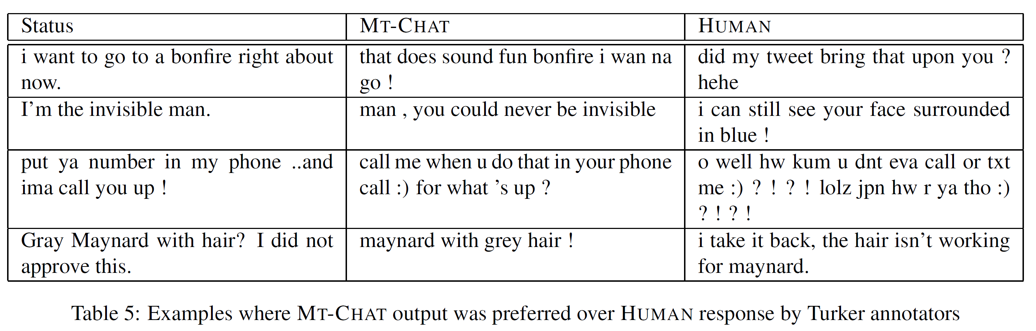
Conversation modelling Ritter et al. 2011

Slide 26
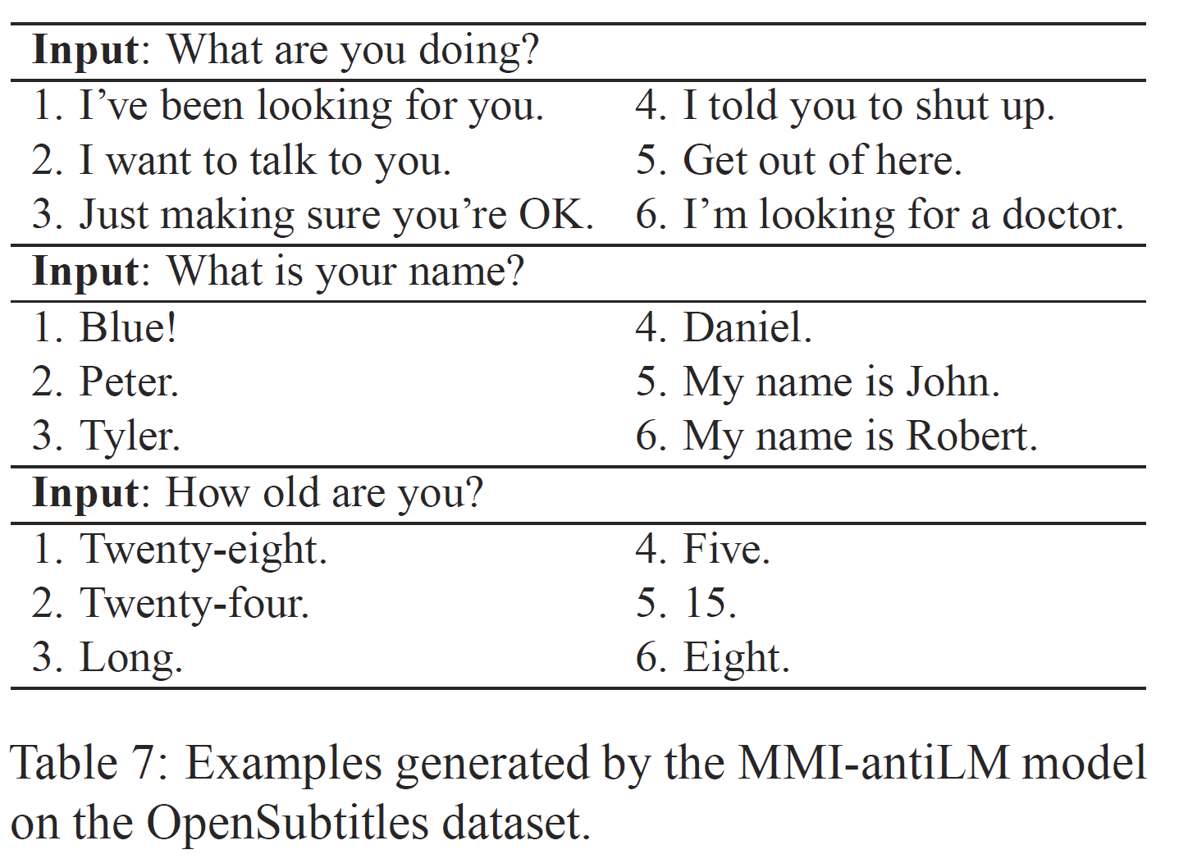
Conversation modelling Li et al. NAACL 2016

Slide 27
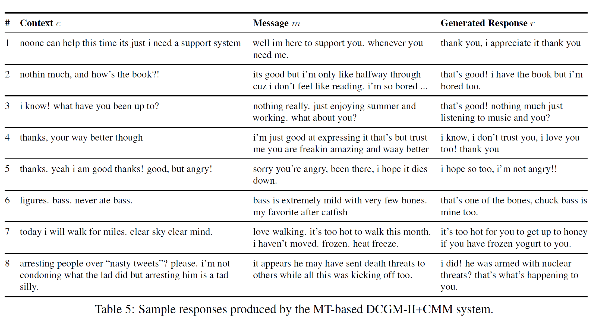
Conversation modelling Sordoni et al. NAACL 2015

Slide 28
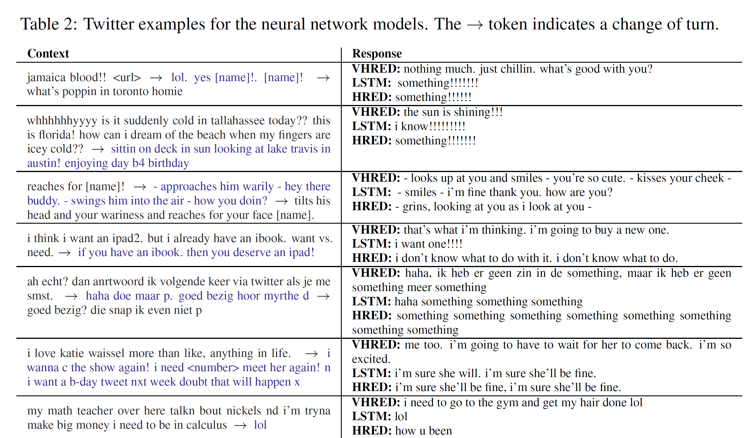
Conversation modelling Serban et al. arXiv 2016

