Slide 1
Zencoderss.
SMART INDIA
HACKATHON 2026
AVSAR (अवसर)
Centralized Academia–Industry Collaboration Portal
Assess skills. Close gaps. Prove talent. Get hired.
Problem Statement
Centralized Academia–Industry Collaboration Portal (Skill development, internships & placements)
Theme / Category
Smart Education · PS Category: Software
Team
ZENCODERSS · Team ID: __________ · SIH 2026
One platform for Students · Industries · Academicians · Institutions

Slide 2
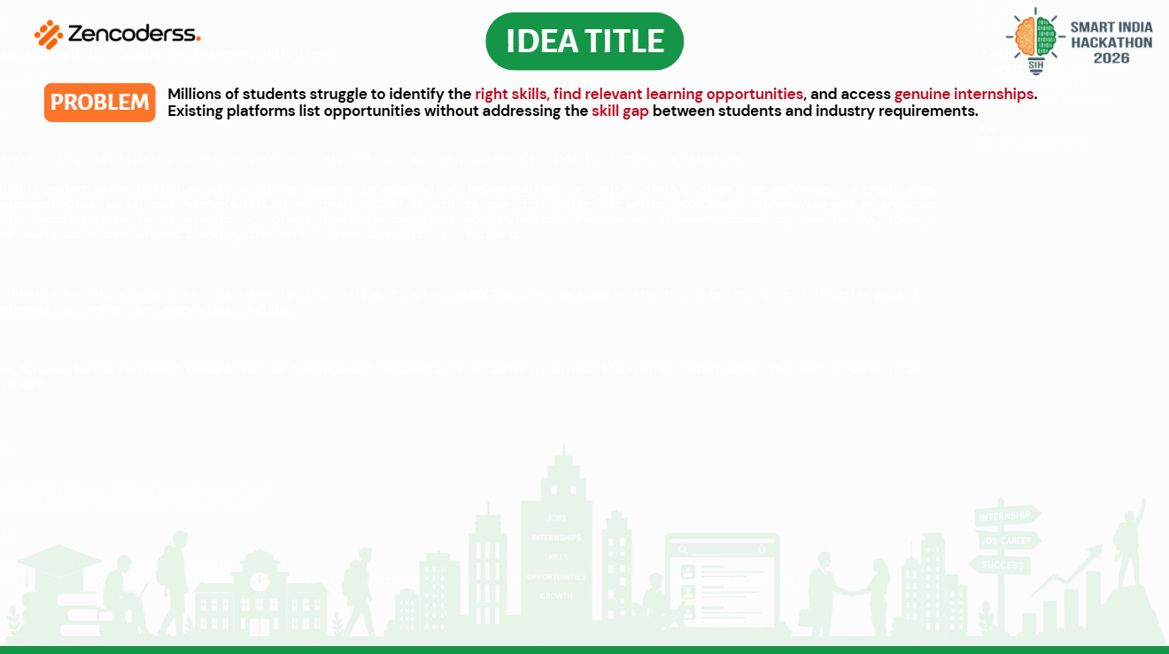
STUDENTS
Cannot identify the right skills for their dream role or find relevant learning paths.
INDUSTRIES
Struggle to find candidates with verified, job-ready skill sets. Listing portals don't prove ability.
ACADEMICIANS
No visibility into industry internships, FDPs and practices to align teaching with industry.
OUR IDEA — AVSAR bridges the gap: a single portal that assesses a student's skills, closes gaps with gamified upskilling, and matches verified talent to genuine internships, jobs and faculty programs.
4 roles · 1 platform
Score-gated genuine opportunities
Verified digital skill portfolio

Slide 3
Zencoderss.
PROPOSED SOLUTION
SMART INDIA
HACKATHON 2026
► Skill Assessment: transparent ATS engine (0–95) + daily aptitude quizzes turn a resume into a verified skill profile with strengths & gaps.
► Skill Mapping: gaps are ordered by live job demand and converted into a weekly roadmap — free course + build-task per skill.
► Internship & Job Matching: industries post skill-tagged openings; listings unlock by MAIN score, students apply & track in one pipeline.
► Industry Learning Programs: quests pair every skill with a course + mini-project with evidence URL — proof, not just certificates.
► Academician Portal: faculty explore FDPs, industrial training, consultancy and collaborative research boards.
► Institution Analytics: placement cells monitor cohort readiness, common skill gaps and export reports (CSV).
► Digital Portfolio: shareable public profile with verified-skill ticks, proof-backed projects and achievements.
#THE GAP WE CLOSE
Opportunities are listed everywhere, but nobody measures or builds the skill to grab them.
#HOW AVSAR ADDRESSES IT
Assess → Upskill → Prove → Match → Showcase. Every listing is gated by a verified score, so genuine talent surfaces.
#INNOVATION & UNIQUENESS
Proof-backed scoring (evidence URLs, seeded quizzes), gamified quests, offline-first privacy — resume never leaves the browser.

Slide 4
Zencoderss.
HOW AVSAR WORKS
SMART INDIA
HACKATHON 2026
1. ANALYZE
Upload resume → instant ATS score (0–95), 5-part breakdown + missing skills
2. UPSKILL
Daily quiz, quest tree & free courses; weekly roadmap ordered by job demand
3. PROVE
Mock interviews (voice/typed) + evidence URLs, GitHub & certificates
4. MATCH
Jobs & internships unlock by MAIN score; apply + track in one pipeline
5. SHOWCASE
Public verified portfolio, kudos & private college leaderboard battle
the loop repeats — re-upload an improved resume, the score rises, more jobs unlock (retention by design)
ONE PLATFORM — FOUR ROLE-BASED PORTALS
STUDENT
full loop above: assess, learn, prove, apply, showcase
INDUSTRY
post skill-tagged internships & jobs, view applicant counts
ACADEMICIAN
FDPs, industrial training, consultancy & research boards
INSTITUTION
cohort readiness dashboards, gap analytics, CSV export

Slide 5

FRONTEND — React 19 + Vite + Tailwind v4 + React Router — 12 routes, one per role workflow
SYSTEM ARCHITECTURE
REACT UI (12 routes)
Student · Industry · Faculty · Institute portals
CORE LOGIC (pure, tested) — ATS scoring, MAIN score, roadmap generator, job matching — 48 unit tests, all green
PURE LOGIC LAYER
scoring · matching · roadmap · coach — runs 100% offline
DATA — Curated + scraper-generated seeds (Naukri, Greenhouse, Lever, Ashby) · localStorage offline-first
CLOUD (optional) — Supabase Postgres — profiles, assessments, jobs, pipeline events (schema ready)
SEED DATA + localStorage
jobs · quizzes · quests · courses — zero server needed
AI (optional) — Gemini 1.5 Flash + Groq — AI coach, question sets, resume rewrite
OPTIONAL ADAPTERS (best-effort)
Supabase sync · Gemini / Groq AI · Remotive live feed
no key / no network → local fallback answers, nothing breaks
INTEGRATIONS — pdfjs (in-browser resume parsing) · Web Speech API (voice interviews) · Remotive live jobs
Design rule: deterministic core, optional AI — the cloud upgrades the app, it never gates it.

Slide 6
Zencoderss.
THE SCORING ENGINE
SMART INDIA
HACKATHON 2026
Every opportunity on Avsar is unlocked by a transparent, anti-cheat score — not by who applies first.
RESUME → ATS (0–95)
Skills 30 · Keywords 20 · Projects 25 · Format 15 · Impact 10
Cap 95 = headroom to improve
RANKS
Diamond 90+ · Platinum 80+
Gold 65+ · Silver 50+ · Bronze
ranks gate what a student can apply to
MAIN SCORE (0–100)
Tech: 0.5·ATS + 0.3·Quiz + 0.2·Proof
Non-tech: 0.6·ATS + 0.3·Quiz + 0.1·Proof
tech hiring weights proof-of-work higher
QUIZ (0–100)
10 questions daily, seeded per student-ID + day — fresh but fair, anti-copying
JOBS & INTERNSHIPS UNLOCK
locked listings show the exact score needed
PROOF (0–100)
quest pairs × 20 — each = course + mini-project + evidence URL
Worked example: ATS 80, Quiz 100, 5 quest pairs → Proof 100 → MAIN = 40+30+20 = 90 → Diamond → top-tier verified roles unlock.

Slide 7
Zencoderss.
PS REQUIREMENTS → AVSAR
SMART INDIA
HACKATHON 2026
PS requirement | Avsar module | How it works
Skill assessment via questionnaire / aptitude tests | ATS engine + daily seeded quizzes | 5-part rubric per track; per-ID-per-day question sets
Skill profiling & gap identification | Missing-skills + demand-ordered roadmap | gaps ranked by frequency across live job postings
Internship / job posting & matching | Jobs portal with minScore gating | eligible-first sort by skill overlap; locked jobs show target score
Application & placement tracking | Pipeline tracker | applied → interview → offer events, synced to cloud
Industry learning programs | Quests + free course links | every skill = course + build project + evidence URL
Faculty internships, FDPs, consultancy, research | Academician board | FDP listings with interest shelf; industry exposure programs
Institution dashboards & analytics | Institute portal | cohort KPIs, average score by track, top gaps, CSV export
Verified digital portfolio | Portfolio + shareable link | verified-skill ticks, proof-backed projects, achievements
Role-based access (4 roles) | Password-free C2C-ID | student / industry / academician / institution in one app

Slide 8
Zencoderss.
FEASIBILITY AND VIABILITY
SMART INDIA
HACKATHON 2026
FEASIBILITY
• Technical: mature open-source stack; ships as a static site — scales horizontally for free
• Financial: zero server cost (local-first); AI/cloud on free tiers, strictly optional
• Operational: password-free C2C-ID — zero signup friction for mass student adoption
CHALLENGES & RISKS
• Fake or inflated skill scores killing trust
• Student data privacy (resumes, scores)
• Flaky campus networks; cold-start job listings
MITIGATION STRATEGIES
• Proof needs evidence URLs; quizzes seeded per ID+day; quest variants hashed per student
• Resume parsed in-browser (pdfjs) — never leaves the device; leaderboards show aggregates only
• Offline-first with best-effort sync; scrapers seed live boards (Naukri, Greenhouse, Lever, Ashby)
Already built & verified: working prototype · 48/48 unit tests green · production build passes · offline demo-safe

Slide 9
Zencoderss.
IMPACT AND BENEFITS
SMART INDIA
HACKATHON 2026
FOR STUDENTS
FOR INDUSTRY
FOR ACADEMICIANS
FOR INSTITUTIONS
• Clarity on exactly which skills to learn
• Verified portfolio that speaks louder than a resume
• Access to genuine, score-gated internships
• Pre-assessed, skill-tagged candidate pool
• Lower screening & fresher-training cost
• Direct channel for training programs & mentorship
• Faculty internships, FDPs & consultancy in one board
• Industrial exposure to align teaching with practice
• Collaborative research & live-project bridges
• Placement-readiness dashboards per cohort
• Skill-gap trends to fix curriculum early
• Exportable reports for NAAC/NIRF-style reviews
SOCIAL IMPACT
Bridges the academia–industry gap at national scale; democratizes opportunity for tier-2/3 colleges; students train for roles that actually exist.
ECONOMIC IMPACT
Cuts industry screening & fresher-training spend; raises placement conversion per campus; data for policymakers on national skill-demand trends.

Slide 10
Zencoderss.
WHY AVSAR WINS
SMART INDIA
HACKATHON 2026
Existing platforms list opportunities. Avsar builds the candidate.
Feature | Internshala | LinkedIn | Unstop | AVSAR
Skill assessment & gap analysis | ✗ | partial | ✗ | ✓
Verified skill proof (evidence-backed) | ✗ | ✗ | ✗ | ✓
Gamified upskilling (quests, streaks, ranks) | ✗ | ✗ | partial | ✓
Score-gated genuine listings | ✗ | ✗ | ✗ | ✓
Academician portal (FDP / consultancy) | ✗ | ✗ | ✗ | ✓
Institution analytics dashboard | ✗ | partial | ✗ | ✓
Offline-first & privacy-first | ✗ | ✗ | ✗ | ✓

Slide 11
Zencoderss.
FUTURE SCOPE
SMART INDIA
HACKATHON 2026
NEXT (0–6 MONTHS)
PLATFORM PILLARS (6–24 MONTHS)
► Live cloud leaderboard — wire Supabase battle leaderboard — biggest demo payoff, schema already written
► AI-graded voice interviews — Gemini grades mock-interview transcripts for communication scoring
► 100% offline guarantee — vendor the pdfjs worker locally — removes the last network dependency
► Institutional integrations — LMS / ERP / institutional database connectors for auto roster sync
► XP for verified actions only — points for evidence URLs & test passes — never for clicks
► Certification tests with scarce badges — auto-graded skill tests; scarcity makes badges worth grinding
► Clans + mentorship — skill groups with moderated chat; industry mentors join quests
► Company squad-hire — hire verified skill-composed teams, not just individuals
► Policy analytics — anonymized skill-demand trends for institutions & policymakers

Slide 12
Zencoderss.
SMART INDIA
HACKATHON 2026
THANK YOU
AVSAR — har student ko sahi avsar.
Team ZENCODERSS · SIH 2026
Working prototype · 48/48 tests green · offline-demo ready

