Slide 1




SMART INDIA HACKATHON 2026
SMART INDIA HACKATHON
2026
Problem Statement ID:- 26044
Problem Statement Title:- Portal for Academia - Industry collaboration for Skill Mapping, Internships and Placement
Theme:- Smart Automation
PS Category:- Software
Team ID:- to be filled from the portal
Team Name:- Zencoderss
Organisation:- Ministry of Ayush — All India Institute of Ayurveda

Slide 2

IDEA TITLE
SMART INDIA HACKATHON
2026
PROPOSED SOLUTION
SYSTEM ARCHITECTURE
Avsar is one portal where an Ayush student finds the exact skills they lack for the role they want, closes each gap with free material and a proof-linked project, and applies to Ayush-sector roles through one tracked pipeline.
USERS
Student
Industry
Academician
Institution
Ayush / BAMS
hospitals, pharma
faculty
placement cell
CLIENT
Web PWA
Offline service worker
installable, mobile + desktop
cached, works with no network
HOW IT ADDRESSES THE PROBLEM
Skill assessment. A resume scan plus a 10-question role questionnaire produce a readiness score across five weighted dimensions, each showing the points earned and why.
Skill profile and gaps. Found versus missing skills for a target role, with the gap list ordered by how often that skill appears in live postings.
Explainable skill mapping. Roles are matched on a published formula, not a black box. The weights are shown at the foot of this slide.
Internships, jobs and learning programs. Industry posts against a minimum readiness bar and lands in the same feed students browse. Every gap ships a free course plus a proof-linked mini-project.
Four portals, one engine. Student, academician, industry and institution each get their own surface: FDPs, faculty internships, consultancy and research for academicians; cohort bands and demand-versus-supply analytics for institutions.
SKILL ENGINE
Skill taxonomy
Assessment
Gap analysis
Explainable matching
Evidence verification
Cohort analytics
DATA
LocalStorage — source of truth
Supabase Postgres — mirror
every screen renders from here
6 tables, anon REST, best-effort
AI + DEPLOY
Groq / Gemini — optional
Static deploy, free tier
deterministic fallback if no key
no server to operate
INNOVATION AND UNIQUENESS
VERIFICATION LOOP course + project + evidence URL → verified · self-typed tick → claimed · QR passport at /verify/:code
Explainable by construction. Every recommendation publishes its weights and its reasons. No unexplained ranking.
Verified is not claimed. A self-typed tick counts for nothing. Only a course, a project and an evidence link lift the score, and revocation stays visible.
Offline-first. The device is the source of truth. Cut the network and every screen still renders, so a demo can never blank out.
PUBLISHED MATCH WEIGHTS — NO BLACK BOX
45%
25%
15%
10%
5%
Skill coverage
Proficiency fit
Verified ratio
Recency of evidence
Interest alignment

Slide 3
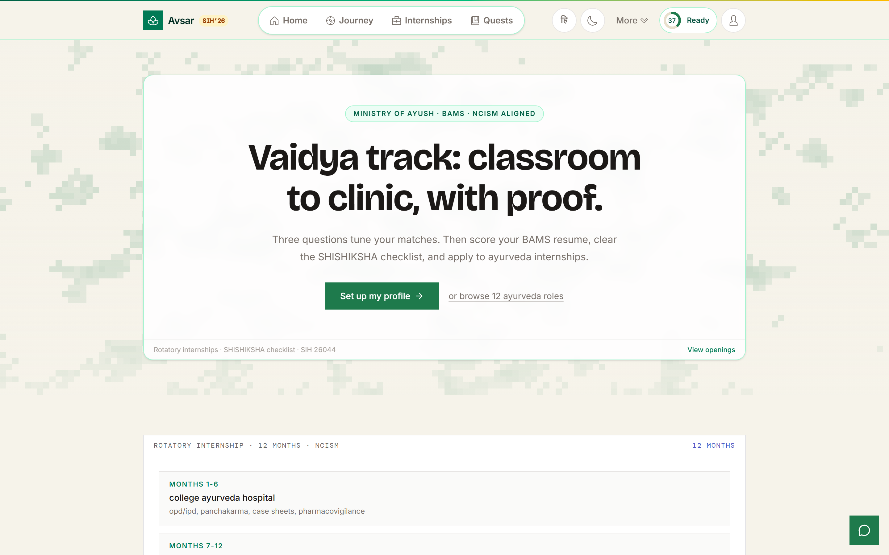
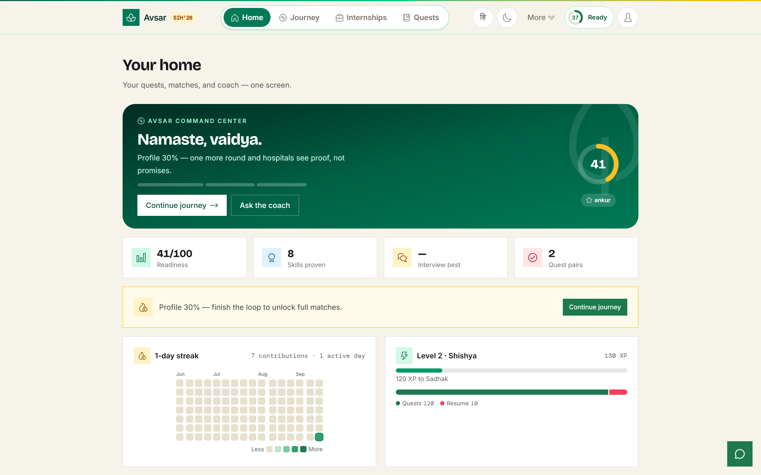
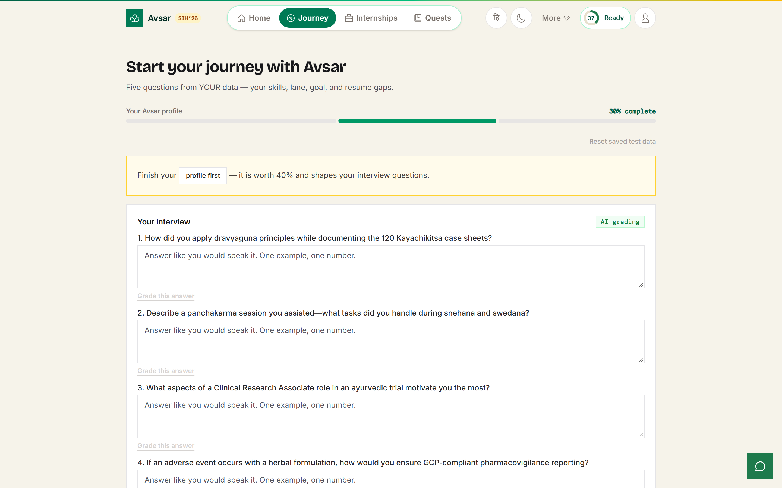
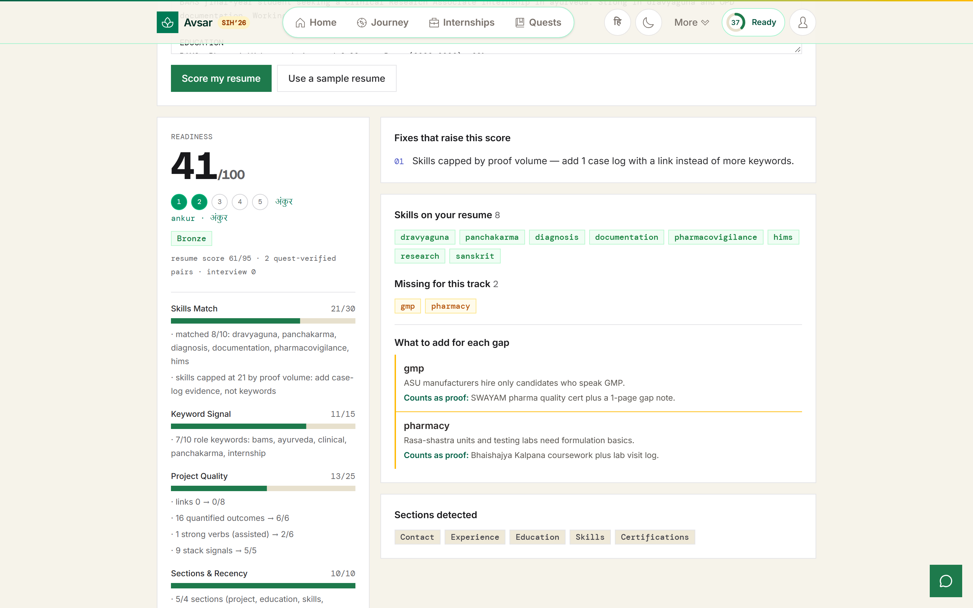
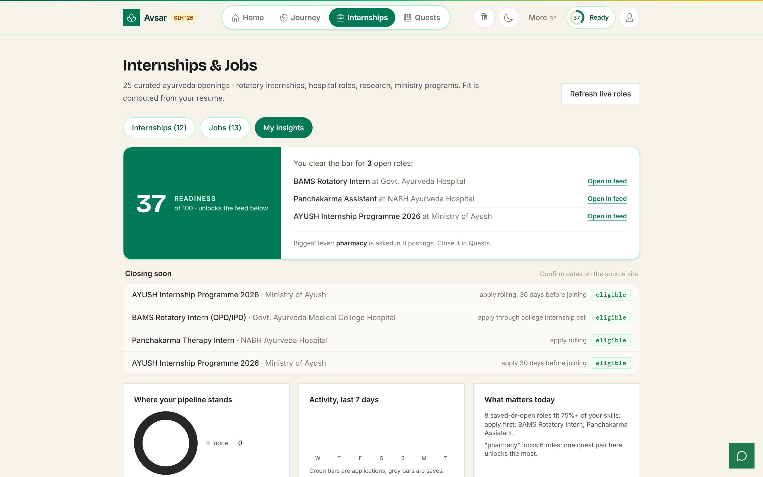
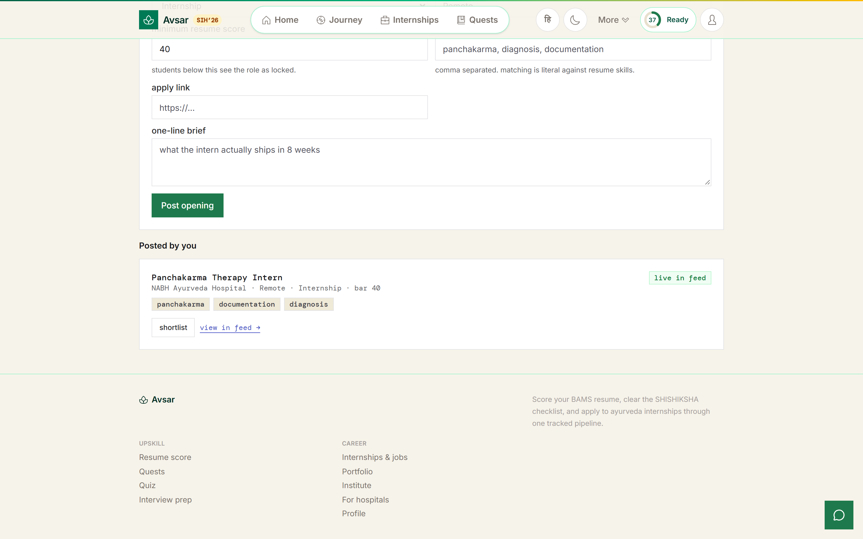
TECHNICAL APPROACH
SMART INDIA HACKATHON
2026
TECHNOLOGIES TO BE USED
React 19
Vite 8
Tailwind 4
Router 8
Supabase
Postgres
Groq
Gemini
PWA / SW
QR + PDF
Every dependency is free-tier. The LLM is an upgrade, never a gate: with no key the deterministic path produces the same output.
METHODOLOGY AND PROCESS
01
02
03
04
05
06
07
08
Resume in
Readiness score
Role quiz
Gap quests
Evidence
MAIN score
Eligibility gate
Track + verify
paste text or PDF
5 weighted dimensions
10 questions, 0-100
course + project
proof URL required
rank band assigned
industry sets the bar
pipeline, QR passport
177 passing unit tests across 34 suites guard the scoring, matching and verification math.
Pure-function logic layer (src/lib) so the engine is testable without a browser.
WORKING PROTOTYPE — REAL SCREENSHOTS FROM THE LIVE APP
Front door: Ayush student home
Student dashboard
Skill journey timeline
Readiness score, 5 dimensions
Role feed: fit and eligibility
Industry post, live in feed

Slide 4
FEASIBILITY AND VIABILITY
SMART INDIA HACKATHON
2026
BUSINESS MODEL — WHO PAYS, AND WHY IT SURVIVES
Students + Institutions
Industry + Hospitals
Certification providers
Free
Premium
Revenue share
Ministry / institution deployment. No student ever pays, and no account is needed to start.
Shortlisting analytics and program promotion. They fund the platform; students never do.
Course and certification referrals attached to a diagnosed gap, not to a banner ad.
TECHNICAL · ECONOMIC · OPERATIONAL FEASIBILITY
Technical
Economic
Operational
Static SPA plus managed Postgres. No server to operate, no ops burden at a nodal centre.
Scoring, matching and credential signing are pure functions under test.
Six tables and anon REST policies cover the whole lifecycle.
Zero infrastructure cost to reach the first cohort: free static host plus free database tier.
The pilot unit is one Ayush college and one placement officer, not a state rollout.
Industry shortlisting funds the platform, so students and institutes stay free.
Maps onto structures that already exist: the NCISM Shishiksha orientation and the rotatory internship.
Every faculty and industry card links out to the official page. Nothing asks anyone to migrate.
The institute dashboard is the placement cell's daily surface, not a report.
RISKY ASSUMPTIONS, AND WHAT WE DO ABOUT EACH
Model key missing or rate-limited mid-demo
Deterministic path renders identical output. AI is an upgrade, never a dependency.
Database unreachable on venue Wi-Fi
Seeds render, writes queue locally, a banner reports local mode. Nothing blanks.
Taxonomy drifts from industry reality
The taxonomy is data, not code. New sectors and skills are rows, not a release.
Adoption by people who did not ask for this
Faculty and industry boards route intent out to official pages instead of demanding migration.
Honest scope: real authentication and row-level security, an in-app resume builder, chat, payments and job scraping are post-SIH. A device ID is the login stand-in today, and this deck says so rather than implying otherwise.

Slide 5
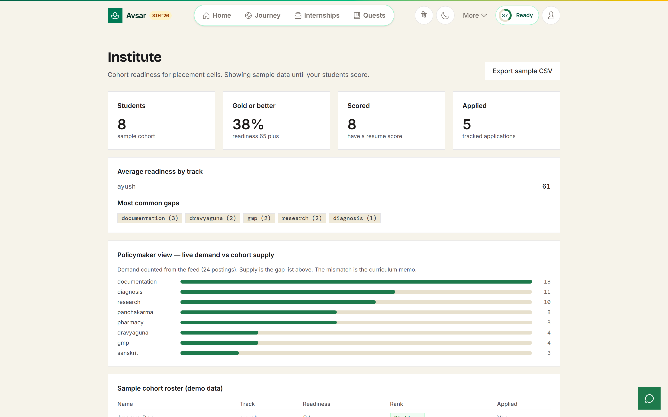
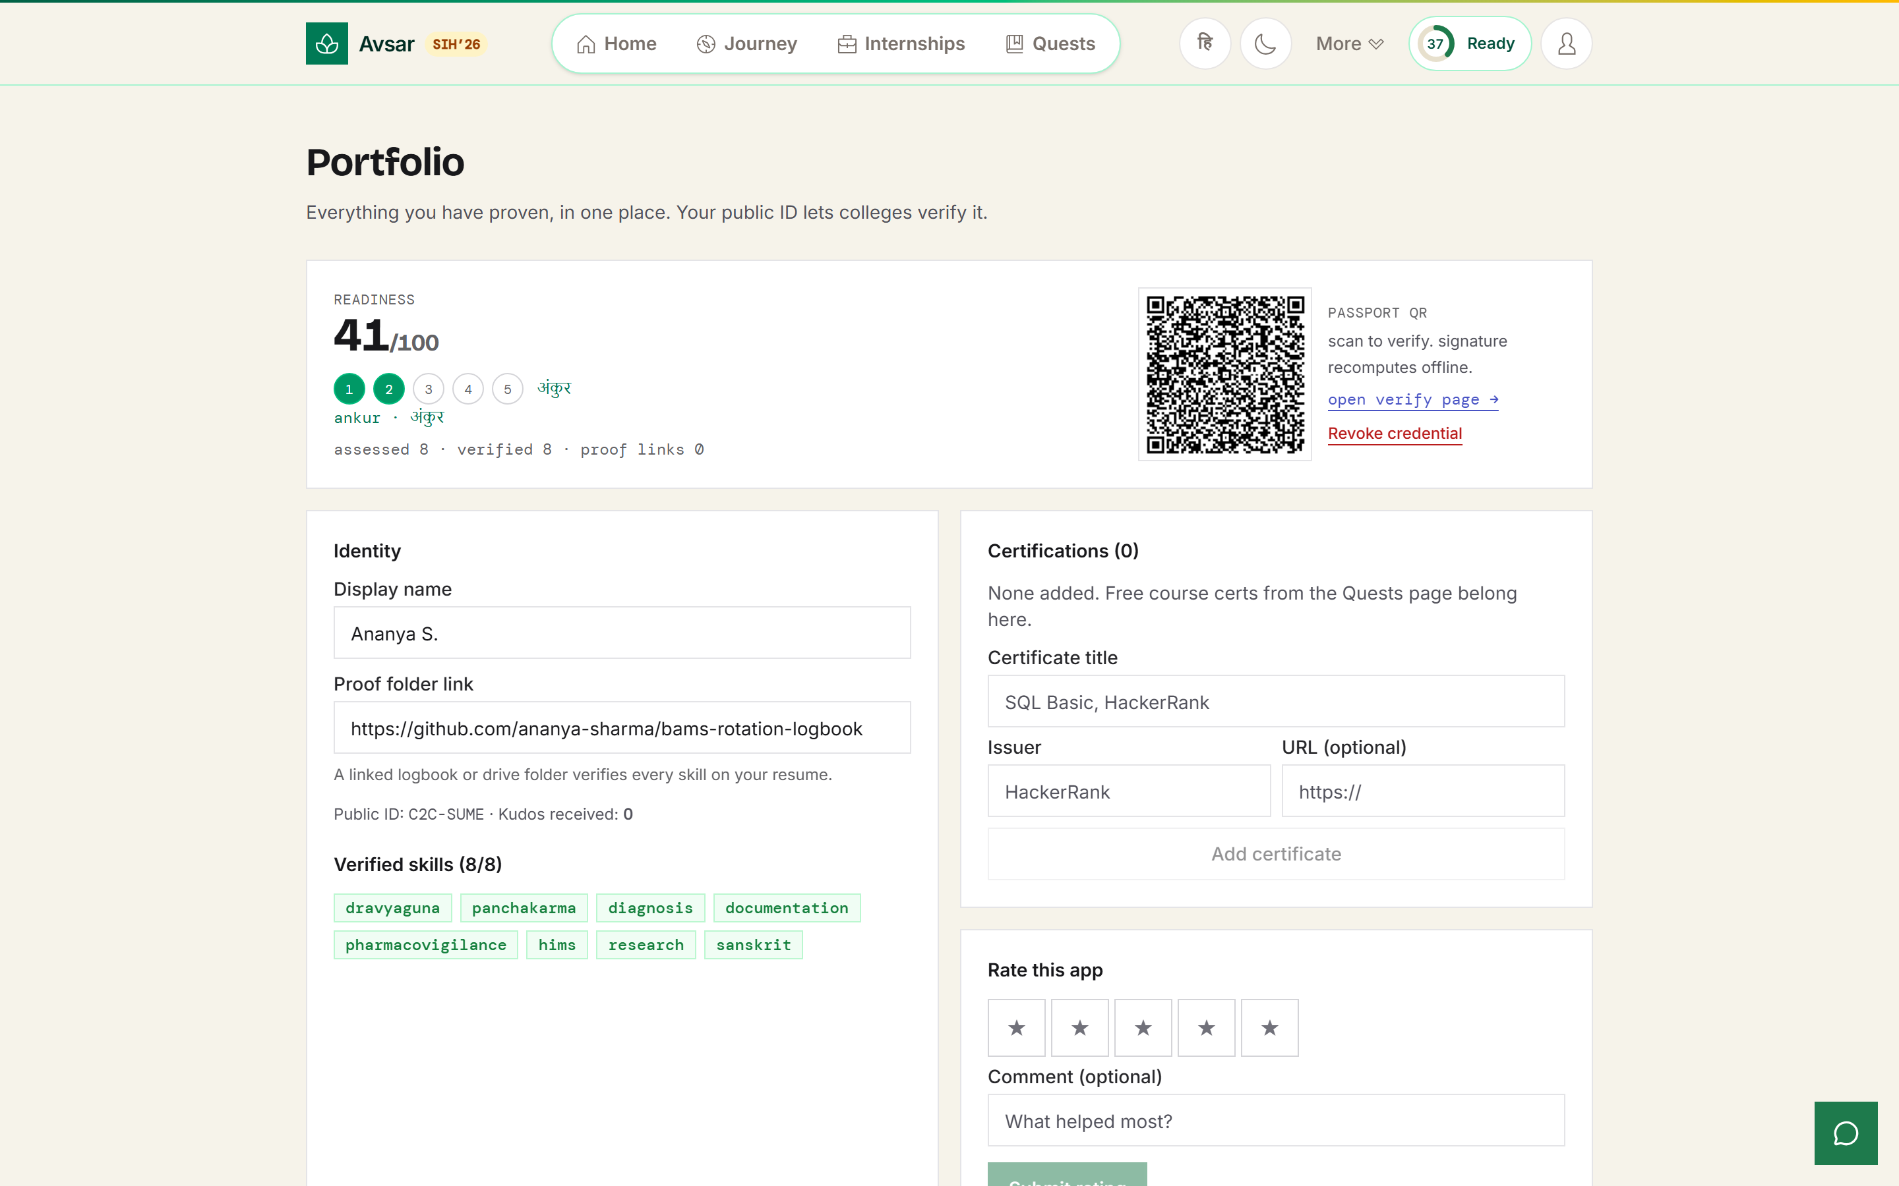
IMPACT AND BENEFITS
SMART INDIA HACKATHON
2026
62
5
4
24
skills across 8 domains, Ayush included
weighted dimensions behind every score
portals running on one skill engine
Ayush roles live in the feed
WHO BENEFITS, AND WHAT ACTUALLY CHANGES
Students
A readiness number that traces to actual resume lines. Each dimension shows points earned out of points available, so the next action is never a guess.
Industry and hospitals
Publish a role with a minimum readiness bar and receive a ranked, explainable shortlist instead of an inbox of PDFs.
Academicians
Faculty internships, FDPs, consultancy and research on one board, each linking to the official application page.
Institutions and policymakers
Cohort bands, share scoring Gold or better, the most common gaps, and a live demand-versus-supply view for the placement cell.
Institute view: cohort bands and live demand versus supply
ALIGNMENT AND EVIDENCE BASE
Alignment: NEP 2020 industry-linked learning, and skill levels mappable to NCrF so a completed internship can translate into academic credit. Sector framing follows the Ministry of Ayush statement this idea answers.
85% of employers now use skills-based hiring and 76% use skills tests (TestGorilla, 2025).
Entry-level hiring growth has flattened to +7% against +19% for senior roles (HackerRank, 2025).
India graduates roughly 1.5 crore students a year into a market that cannot yet read their skills.
Portfolio: verified skills sign a QR-verifiable public credential

Slide 6
RESEARCH AND REFERENCES
SMART INDIA HACKATHON
2026
HOW WE COMPARE WITH EXISTING SYSTEMS
RESEARCH AND REFERENCES
Capability | Avsar | LinkedIn | NCS | Internshala | HackerRank
Diagnoses the skill gap for a target role | YES | — | — | — | —
Closes the gap free, with a proof-linked project | YES | — | — | — | —
Separates verified skill from self-claimed | YES | — | — | — | PART
Gates a role on a published readiness bar | YES | — | — | — | PART
Faculty portal: FDP, consultancy, research | YES | — | PART | — | —
Institute cohort analytics and gap heatmap | YES | PART | — | — | PART
Built for Ayush / Indian System of Medicine | YES | — | — | — | —
01
SIH 2026 Problem Statement 26044 — Ministry of Ayush, All India Institute of Ayurveda
sih.gov.in
02
NCISM — Shishiksha programme, permitted BAMS colleges, rotatory internship
ncismindia.org
03
CCRAS — research programmes and fellowships seeded into the portal
ccras.nic.in
04
Ministry of Ayush Annual Report — sector benchmarks
They match on resumes and keywords. We match on a verified proficiency graph and then close the loop: assess, learn, prove, get placed. NCS has no gap engine; Internshala has no verification or faculty portal.
ayush.gov.in
05
data.gov.in — public datasets for skill and placement baselines
WHERE WE ARE
data.gov.in
OK Problem statement
understood
OK Requirement
analysis done
OK Existing vs proposed
studied
OK Idea deck
prepared
>> Prototype
built and live
06
NEP 2020 / NCrF — the credit framework skill levels map to
education.gov.in
07
LIVE PROTOTYPE
TestGorilla 2025 and HackerRank 2025 — the hiring statistics cited on slide 5
to be added before submission
cited inline
Prototype is deployed and reachable. Open the link rather than reading a screenshot.
08
Framework documentation (React, Vite, Supabase) — tooling docs, not research
listed separately

