Slide 1
Fábrica de Software
Prof. Thiago Almeida

Slide 2
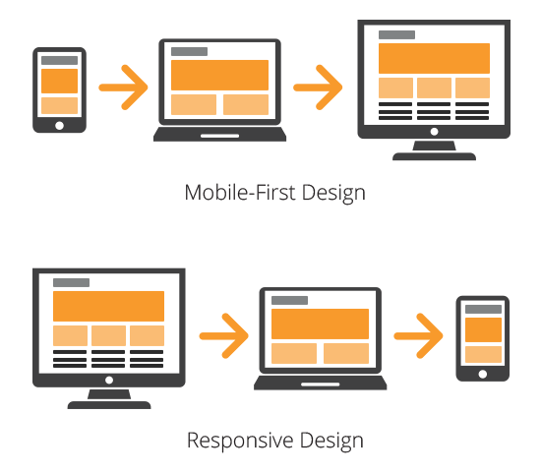

Slide 3
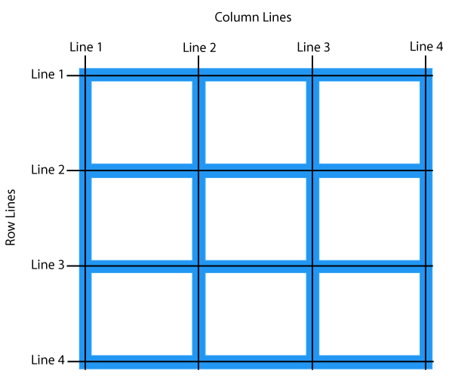
Grid

Slide 4
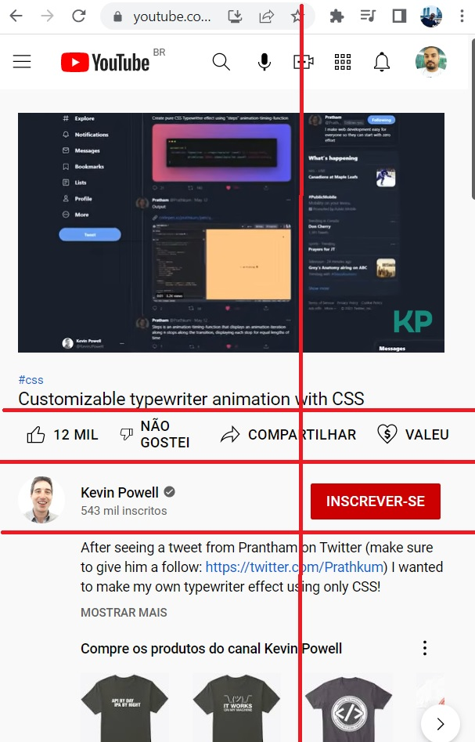
Layout Mobile

Slide 5
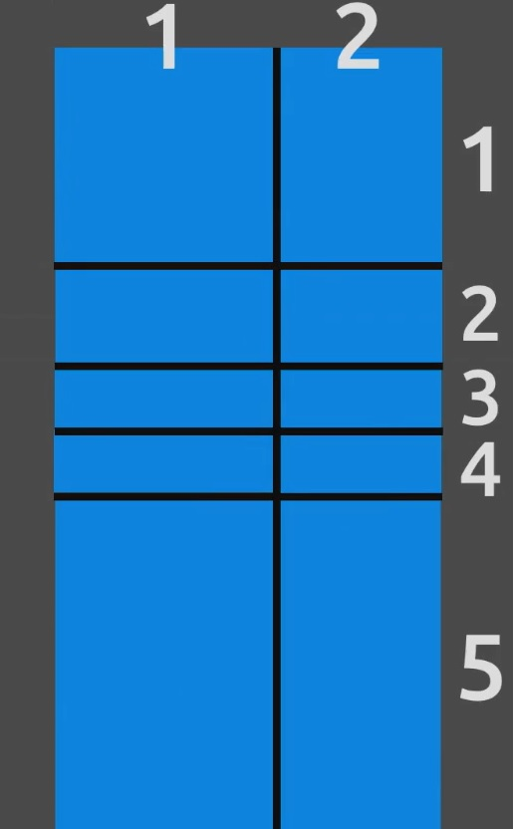
Layout Mobile

Slide 6
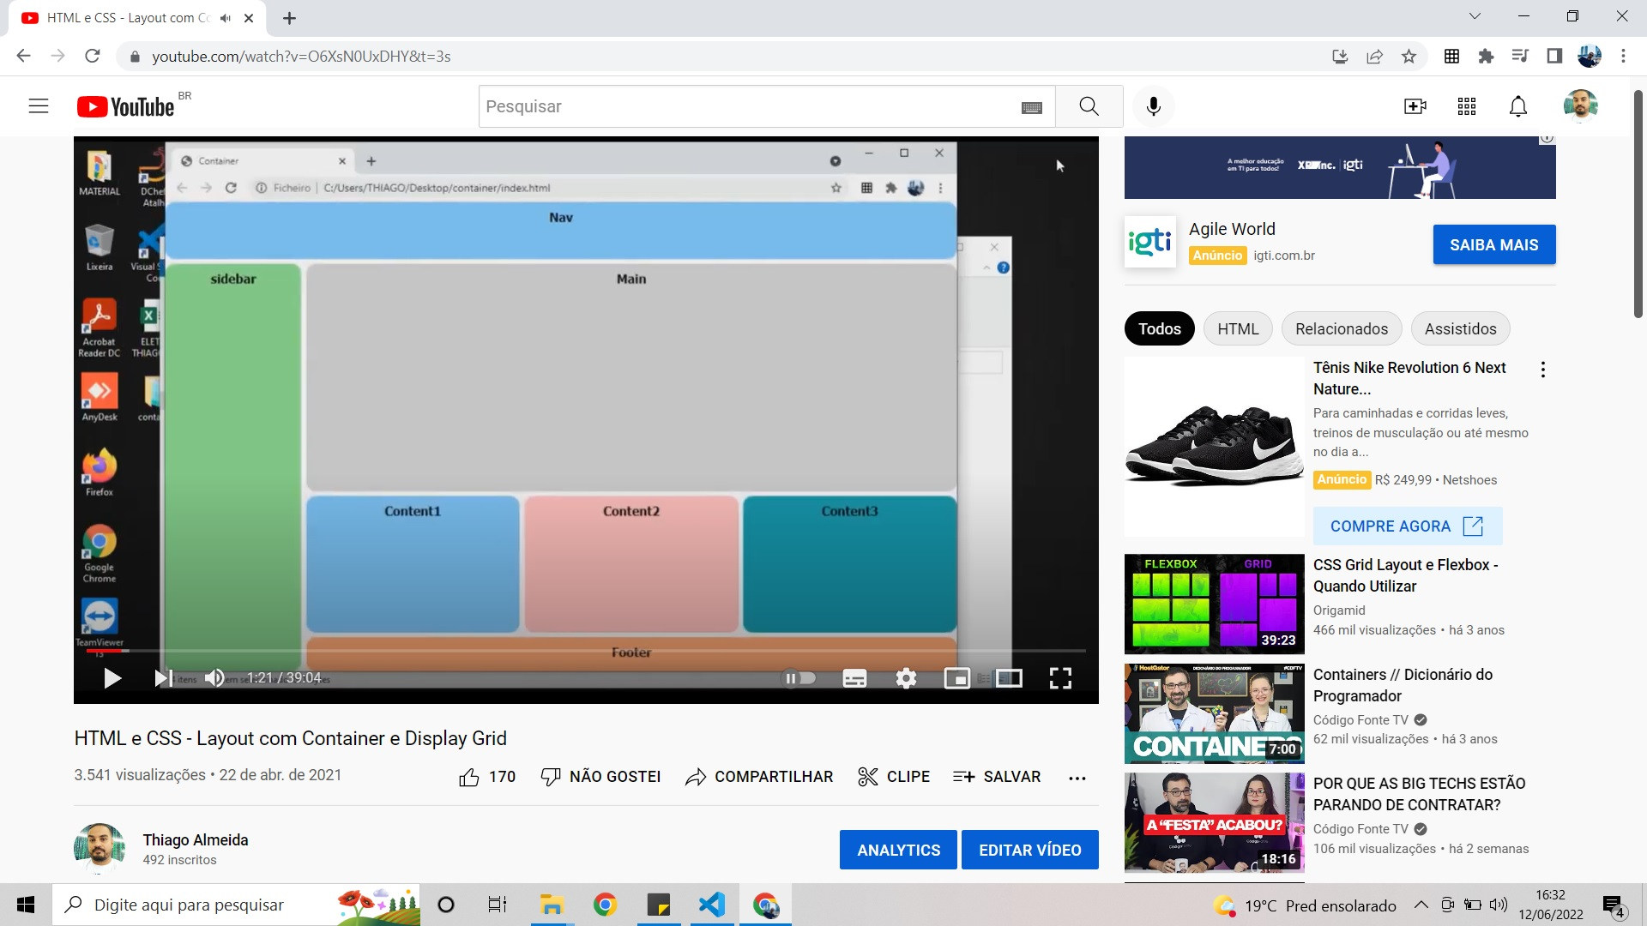
Grid

Slide 7
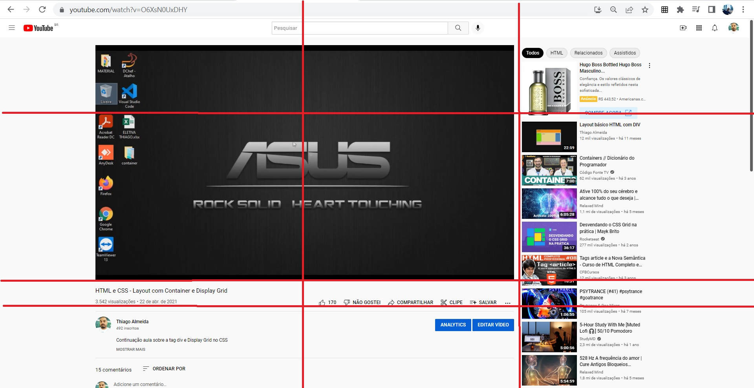
Grid

Slide 8
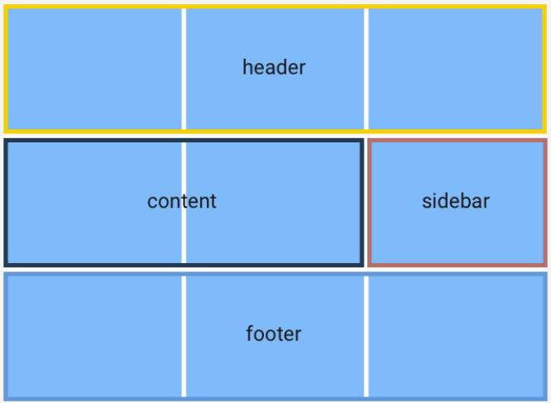
Grid template areas

Slide 9
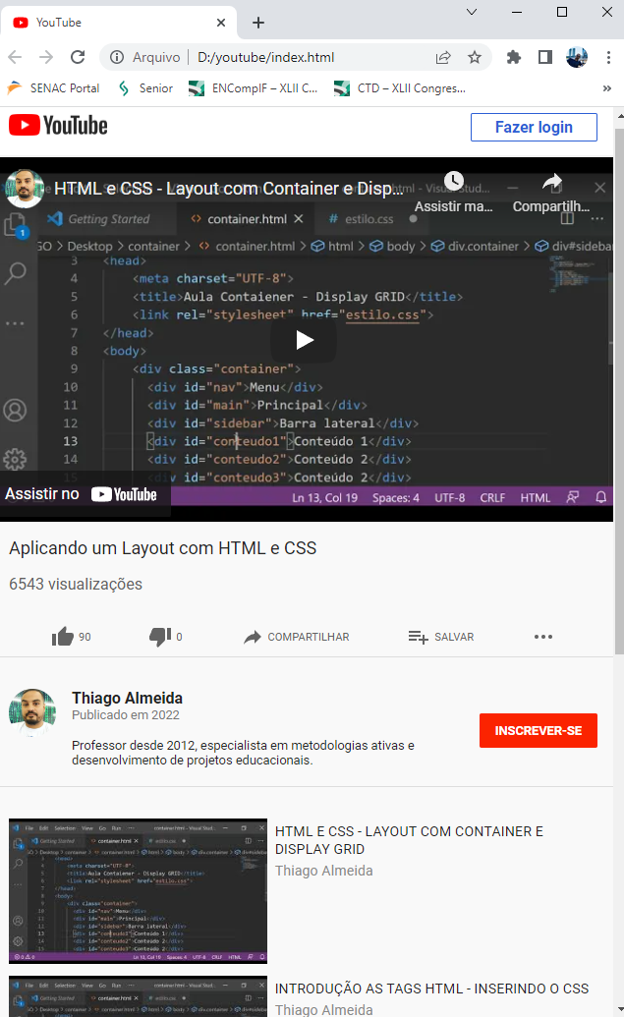
Projeto Mobile First

Slide 10
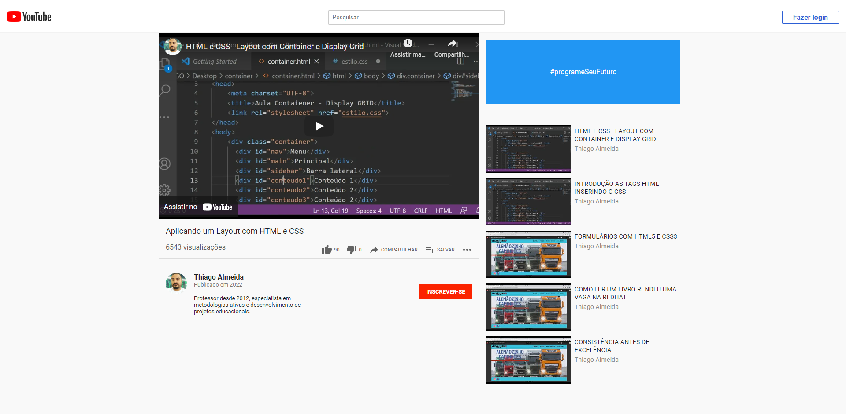
Projeto Mobile First

