Slide 1
INTERNSHIP PROJECT REPORT
Structured Chatbot
An AI-Powered Web Chat Interface Built with the Gemini API
Debopriyo Khan
Dilkush Napit
Mukesh Gangey
Priyanshi Thakur
Savara Sankara Rao

Slide 2
Project Overview
This project is a lightweight, browser-based AI chat assistant built entirely with vanilla HTML, CSS, and JavaScript. It connects directly to Google's Gemini API to hold multi-turn conversations, understand attached images, and render richly formatted replies — all without a backend server or any front-end framework.
1
Multimodal Input
Accepts both typed text and attached images in the same conversation.
2
Real-Time Responses
Calls the Gemini API directly and streams the reply into the chat window.
3
Zero Dependencies
No framework or backend — just plain HTML, CSS, and JavaScript.

Slide 3
Tech Stack
HTML5
CSS3
JavaScript
Gemini API
Live Server
Page structure & markup
Styling, layout & responsiveness
Vanilla — application logic
gemini-3.5-flash — AI responses
Local development environment

Slide 4
Key Features
1
2
3
Multi-Turn Conversations
Image Understanding
Markdown Rendering
Maintains full context using Gemini's structured message array.
Users can attach an image; Gemini analyzes it alongside the text.
A lightweight custom parser safely renders bold text, lists, code, and links.
4
5
6
Persistent History
Graceful Error Handling
Responsive Layout
Conversations are saved to localStorage and restored on reload.
Failed requests roll back cleanly instead of corrupting the chat state.
Adapts smoothly from desktop down to mobile screens.

Slide 5
How It Works
User Input
→
JS Event Handler
→
Gemini API Call
→
Parse Response
→
Render in Chat UI
Every message and reply is stored in a structured array (role + parts) so the model always has full conversation context.

Slide 6
Challenges & Solutions
1
CHALLENGE
SOLUTION
The AI stopped responding entirely.
The hardcoded model (gemini-1.5-flash) had been fully retired by Google. Repointed the API call to the current gemini-3.5-flash model.
2
CHALLENGE
SOLUTION
An empty image-preview box stayed visible at all times.
A CSS display rule was silently overriding the native hidden attribute. Added a specific [hidden] override to fix it.
3
CHALLENGE
SOLUTION
API failures only showed one generic, unhelpful message.
Used browser DevTools (Console & Network tabs) to inspect the real HTTP status codes and error bodies for precise debugging.

Slide 7
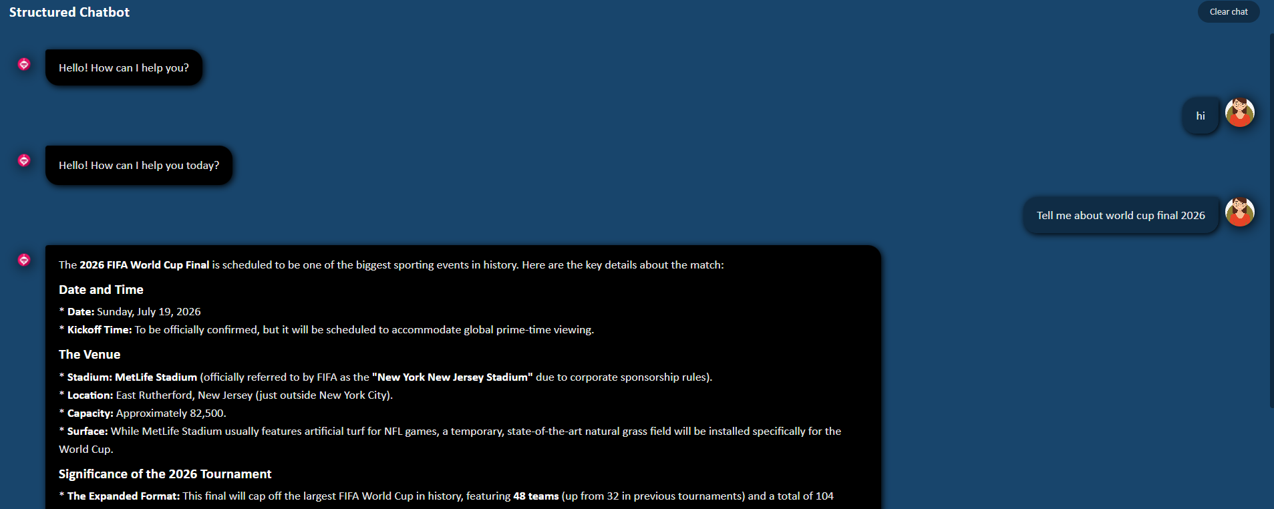
Live Demo
The assistant renders structured Markdown — headings, bold text, and lists — directly inside the chat bubble, and keeps full conversation context across turns.

Slide 8
Future Enhancements
1
Streaming Responses
Stream the reply word-by-word instead of all at once.
2
Custom System Prompt
Let users define a persona or instruction sent with every request.
3
Retry on Failure
One-click resend for messages that fail to reach the API.
4
Theme Toggle
Switch between the current dark theme and a light mode.
5
Chat Export
Download the full conversation as a plain text file.

Slide 9
Key Learnings
1
REST API Integration
Structuring requests and handling responses from a real-world LLM API.
2
DOM Manipulation
Building and updating an interactive UI dynamically with vanilla JavaScript.
3
Browser Storage
Persisting application state across sessions using localStorage.
4
Practical Debugging
Diagnosing CSS specificity issues, deprecated APIs, and silent JS errors using DevTools.
5
Responsive UI Design
Designing a layout that adapts cleanly across screen sizes.

Slide 10
Thank You
Questions & Discussion

