Slide 1
Chapter 8
Traffic Channel Allocation

Slide 2
Outline
Introduction
Static versus Dynamic allocation
Fixed Channel Allocation Schemes
Dynamic Channel Allocation Schemes
Other Channel Allocation Schemes
Allocation in Specialized System Structures
Channel Modeling
Modeling for Handoff Calls

Slide 3
Introduction
What is channel allocation?
A given radio spectrum is to be divided into a set of disjointed channels that can be used simultaneously while minimizing interference in adjacent channel by allocating channels appropriately (especially for traffic channels).
Channel allocation schemes can be divided in general into
  Fixed Channel Allocation schemes (FCA schemes);
  Dynamic Channel Allocation schemes (DCA schemes);
  Hybrid Channel Allocation schemes (HCA schemes: combining both FCA and DCA techniques);

Slide 4
Fixed Channel Allocation (FCA)
In FCA schemes, a set of channels is permanently allocated to each cell in the network.
If the total number of available channels in the system S is divided into sets, the minimum number of channel sets N required to serve the entire coverage area is related to the frequency reuse distance D as follows:
N = D² / 3R²
Due to short term fluctuations in the traffic, FCA schemes are often not able to maintain high quality of service and capacity attainable with static traffic demands. One approach to address this problem is to borrow free channels from neighboring cells.

Slide 5
Simple Borrowing (CB) Schemes
In CB schemes, cell (acceptor cell) that has used all its nominal channels can borrow free channels from its neighboring cell (donor cell) to accommodate new calls.
Borrowing can be done from an adjacent cell which has largest number of free channels (borrowing from the richest)
Select the first free channel found for borrowing using a search algorithm (borrow first available scheme)
Return the borrowed channel when channel becomes free in the cell (basic algorithm with reassignment)
To be available for borrowing, the channel must not interfere with existing calls, as shown in the next figure.

Slide 6
Simple Channel Borrowing (CB) Schemes
Donor Cell for Sector X
Cell 3
1
2
X
Y
Z
A call initiated in the sector X of cell 3 can borrow a channel from adjacent cells 1 or 2.

Slide 7
Impact of Channel Borrowing in Sectored Cell-based Wireless System
A₇
c
a
A₂
b
c
a
b
A₆
c
a
A₁
b
c
a
A₃
b
x
c
a
b
A₅
c
a
A₄
b
c
a
b
X borrows some channels from a

Slide 8
Simple Channel Borrowing (CB) Schemes
Scheme | Description
Simple Borrowing (SB) | A nominal channel set is assigned to a cell, as in the FCA case. After all nominal channels are used, an available channel from a neighboring cell is borrowed.
Borrow from the Richest (SBR) | Channels that are candidates for borrowing are available channels nominally assigned to one of the adjacent cells of the acceptor cell. If more than one adjacent cell has channels available for borrowing, a channel is borrowed from the cell with the greatest number of channels available for borrowing.
Basic Algorithm (BA) | This is an improved version of the SBR strategy which takes channel locking into account when selecting a candidate channel for borrowing. This scheme tried to minimize the future call blocking probability in the cell that is most affected by the channel borrowing.
Basic Algorithm with Reassignment (BAR) | This scheme provides for the transfer of a call from a borrowed channel to a nominal channel whenever a nominal channel becomes available.
Borrow First Available (BFA) | Instead of trying to optimize when borrowing, this algorithm selects the first candidate channel it finds.

Slide 9
Dynamic Channel Allocation (DCA)
In DCA schemes, all channels are kept in a central pool and are assigned dynamically to new calls as they arrive in the system.
After each call is completed, the channel is returned to the central pool. It is fairly straightforward to select the most appropriate channel for any call based simply on current allocation and current traffic, with the aim of minimizing the interference.
DCA scheme can overcome the problem of FCA scheme. However, variations in DCA schemes center around the different cost functions used for selecting one of the candidate channels for assignment.

Slide 10
Dynamic Channel Allocation (DCA)
DCA schemes can be centralized or distributed.
The centralized DCA scheme involves a single controller selecting a channel for each cell;
The distributed DCA scheme involves a number of controllers scattered across the network (MSCs).
Centralized DCA schemes can theoretically provide the best performance. However, the enormous amount of computation and communication among BSs leads to excessive system latencies and renders centralized DCA schemes impractical. Nevertheless, centralized DCA schemes often provide a useful benchmark to compare practical decentralized DCA schemes.

Slide 11
Centralized DCA
For a new call, a free channel from the central pool is selected that would maximize the number of members in its co-channel set.
Minimize the mean square of distance between cells using the same channel.

Slide 12
Centralized DCA Schemes
Scheme | Description
First Available (FA) | Among the DCA schemes the simplest one is the FA strategy. In F A, the first available channel within the reuse distance encountered during a channel search is assigned to the call. The FA strategy minimizes the system computational time.
Locally Optimized Dynamic Assignment (LODA) | The channel selection is based on the future blocking probability in the vicinity of the cell where a call is initiated.
Selection with Maximum Usage on the Reuse Ring (RING) | A candidate channel is selected which is in use in the most cells in the co-channel set. If more than one channel has this maximum usage, an arbitrary selection among such channel is made to serve the call. If none is available, then the selection is made based on the FA scheme.

Slide 13
Centralized DCA Schemes
Scheme | Description
Mean Square (MSQ), | The MSQ scheme selects the available channel that minimizes the mean square of the distance among the cells using the same channel.
1-clique | This scheme uses a set of graphs, one for each channel, expressing the non co-channel interference structure over the whole service area for that channel.

Slide 14
Distributed DCA Schemes
Based on one of the three parameters:
  Co-channel distance
  - co-channel cells in the neighborhood not using the channel
  - sometimes adjacent channel interference taken in to account
  Signal strength measurement
  - anticipated CIR above threshold
  Signal to noise interference ratio
  - satisfy desired CIR ratio

Slide 15
Comparison between FCA and DCA
FCA | DCA
Performs better under heavy traffic Low flexibility in channel assignment Maximum channel reusability Sensitive to time and spatial changes Not stable grade of service per cell in an interference cell group High forced call termination probability Suitable for large cell environment Low flexibility | Performs better under light/moderate traffic Flexible channel allocation Not always maximum channel reusability Insensitive to time and time spatial changes Stable grade of service per cell in an interference cell group Low to moderate forced call termination probability Suitable in microcellular environment High flexibility

Slide 16
Comparison between FCA and DCA
FCA | DCA
Radio equipment covers all channels assigned to the cell Independent channel control Low computational effort Low call set up delay Low implementation complexity Complex, labor intensive frequency planning Low signaling load Centralized control | Radio equipment covers the temporary channel assigned to the cell Fully centralized to fully distributed control dependent on the scheme High computational effort Moderate to high call set up delay Moderate to high implementation complexity No frequency planning Moderate to high signaling load Centralized, distributed control depending on the scheme

Slide 17
Other Channel Allocation Schemes
Based on different criterion being used as a potential way of optimizing the performance, many other channel allocation schemes have been suggested.
  Hybrid Channel Allocation (HCA)
  Flexible Channel Allocation (FCA)
  Handoff Channel Allocation (HCA)

Slide 18
Hybrid Channel Allocation (HCA)
HCA schemes are the combination of both FCA and DCA techniques.
In HCA schemes, the total number of channels available for service is divided into fixed and dynamic sets.
  The fixed set contains a number of nominal channels that are assigned to cells as in the FCA schemes and, in all cases, are to be preferred for use in their respective cells.
  The dynamic set is shared by all users in the system to increase flexibility.
  Example: When a call requires service from a cell and all of its nominal channels are busy, a channel from the dynamic set is assigned to the call.

Slide 19
Hybrid Channel Allocation (HCA)
Request for a channel from the dynamic set is initiated only when the cell has exhausted using all its channels from the fixed set.
Optimal ratio: ratio of number of fixed and dynamic channels.
3:1 (fixed to dynamic), provides better service than fixed scheme for 50% traffic.
Beyond 50% fixed scheme perform better.
For dynamic, with traffic load of 15% to 32%, better results are found with HCA.

Slide 20
Flexible Channel Allocation (FCA)
Similar to hybrid scheme with channels divided into fixed and flexible (emergency) sets.
Fixed sets used to handle lighter loads.
Variations in traffic (peaks in time and space) are needed to schedule emergency channels.
Two types: Scheduled and Predictive
Scheduled: Prior estimate is done about traffic change
Predictive: Traffic intensity and blocking probability is monitored in each cell all the time.

Slide 21
Channel Allocation in One-dimensional Systems
Call initiated
1 2 3 4 5 6 7 8
a
b
c
d
e
Reuse distance D
If a new call is initiated in cell 1, with the current location of channels a, b, c, d, e as shown. It is better to assign channel e to mobile in cell 1.
Assuming that as cell 1 moves to cell 2, MS in cell 7 moves to cell 8.

Slide 22
Reuse Partitioning based Channel Allocation
Each cell is divided into concentric zones.
Inner zone being closer to BS would require lesser power to attain a desired channel.
4
3
2
1

Slide 23
Overlapped Cells-based Allocation
Cell splitting into number of smaller cells (pico , micro cells) ,to handle increased traffic.
For fast moving MS, if channels are assigned from micro cell , no of handoffs will increase.
Therefore Highly mobile cells are assigned channels from the cell.
MS with low mobility are assigned to micro or pico cells.

Slide 24
Overlapped Cells-based Allocation
Cell
7
6
2
1
Microcell
5
3
4

Slide 25
Use of Overlapped Cell Areas
In the shared area Handoffs not necessary.
Worst Case Scenario: if MS in shared area does not find a free channel in cell A, it can take the free channel from cell B.
C
A
B

Slide 26
Channel Modeling
The follows assumptions are made to obtain an approximate model of system.
  All MSs are assumed to be uniformly distributed through the cell.
  Each MS moves at a random speed and to an arbitrary random direction.
  The arrival rate of originating call is given by λ_{O.}
  The arrival rate of handoff call is given by λ_{H.}
  The call service rate is given by μ.

Slide 27
System Model
S
.
.
2
1
λ_{H}
μ
λ_{O}
Channels
A generic system model for a cell

Slide 28
Analysis Model
The states of a cell can be represented by (S+1) states Markov model. And a transition diagram of M/M/S/S model as shown below.
λ_{O}+ λ_{H}
λ_{O}+ λ_{H}
λ_{O}+ λ_{H}
λ_{O}+ λ_{H}
0
· · ·
i
· · ·
S
μ
iμ
(i+1)μ
Sμ
State transition diagram

Slide 29
Analysis Model (cont’d)
The follows parameters are defined in the analysis model.
P(i): the probability of “i” channels to be busy,
λ_{O} : the arrival rate of an originating call in the cell,
λ_{H} : the arrival rate of a handoff call from neighboring cells
B_{O} : the blocking probability of originating calls,
S : the total number of channels allocated to a cell,
μ: the call service rate,
μ_{c} : the average call duration,
μ_{c-dwell}: the outgoing rate of MSs.

Slide 30
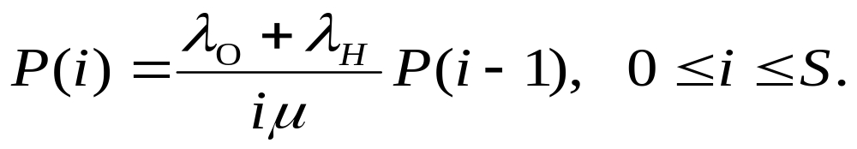
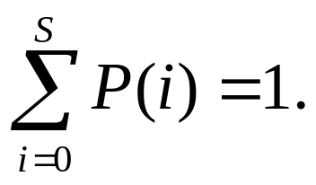
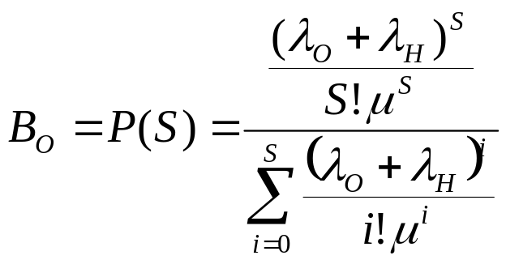
Analysis Model (cont’d)
The state equilibrium equation for state i can be given as
And the sum of all states must to be equal to one:
The blocking probability when all S channels are busy, can be expressed by:

Slide 31
Modeling for Handoff Calls
Why should we provide a higher priority to handoff calls?
From users’ view, the dropping of handoff calls is more serious and irritating than the blocking of originating calls.
How to provide a higher priority to handoff calls?
One approach is reserve S_{R} channels exclusively for handoff calls among the S channels in a cell.

Slide 32
System Model
S
.
S_{C}
.
.
2
1
λ_{H}
S_{R}
μ
λ_{O}
Channels
System model with reserved channels for handoff
(No blocking till less than S_{C} channels are busy)

Slide 33
Analysis Model
λ_{O}+ λ_{H}
λ_{O}+ λ_{H}
λ_{H}
λ_{H}
0
· · ·
S_{C}
· · ·
S
μ
S_{C}μ
(S_{C}+1)μ
Sμ
State transition diagram

Slide 34
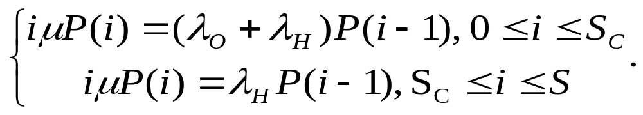
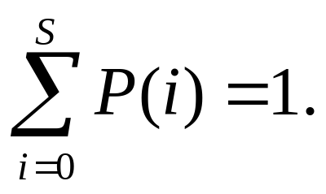
Analysis Model (Cont’d)
The state balance equations can be obtained as
and

Slide 35
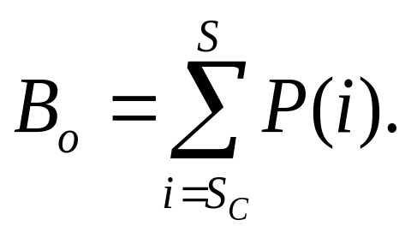
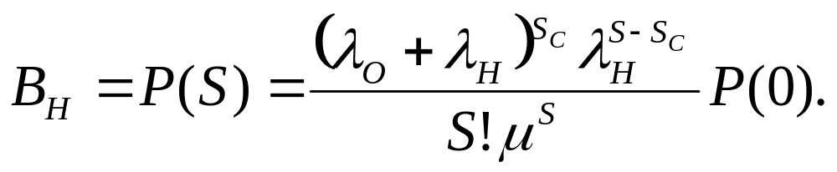
Analysis Model (Cont’d)
The blocking probability B_{O} for an originating call is given by (at least S_{C} channels busy):
The blocking probability B_{H} for a handoff call is (all S channels busy):

