Slide 1
Sistema
MusicScholl

Slide 2
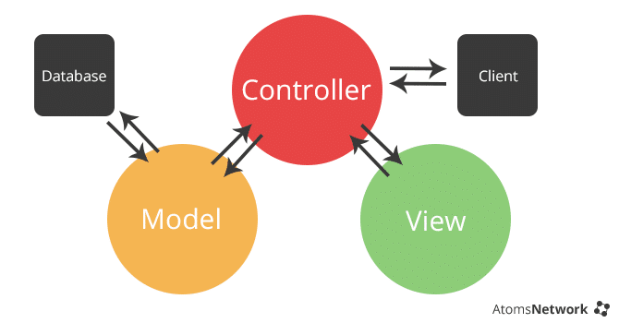
MVC

Slide 3
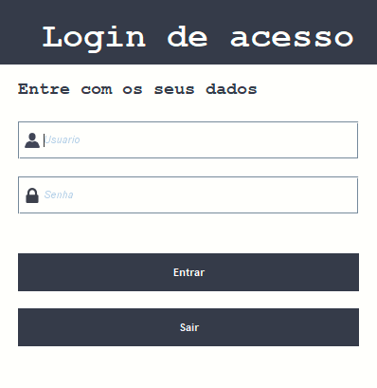
View

Slide 4



Controller
Model
Controller.class

Slide 5
Controllers – Helpers
setarUsuario()
obterUsuario ()
limparTela()
Login Helper
Controller.class

