Slide 1

Demographic Changes & Republican Voting A Replication
Debora Gonzalez
Gov1006: Models | Dr. David Kane
Spring 2020

Slide 2
Overview of the Paper
Local Demographic Changes and US Presidential Voting, 2012-2016
Argue that demographic changes are not associated with increased Republican vote share at the precinct level between 2012 and 2016.
ACS & Census data of 32,000 precincts across 7 states to explore how demographic changes influenced republican vote share in affected precincts across the United States.
8 Main OLS regression models (+several others included in the appendix) exploring the relationship between change in Hispanic proportions and change in Republican vote share over two separate time intervals.

Slide 3
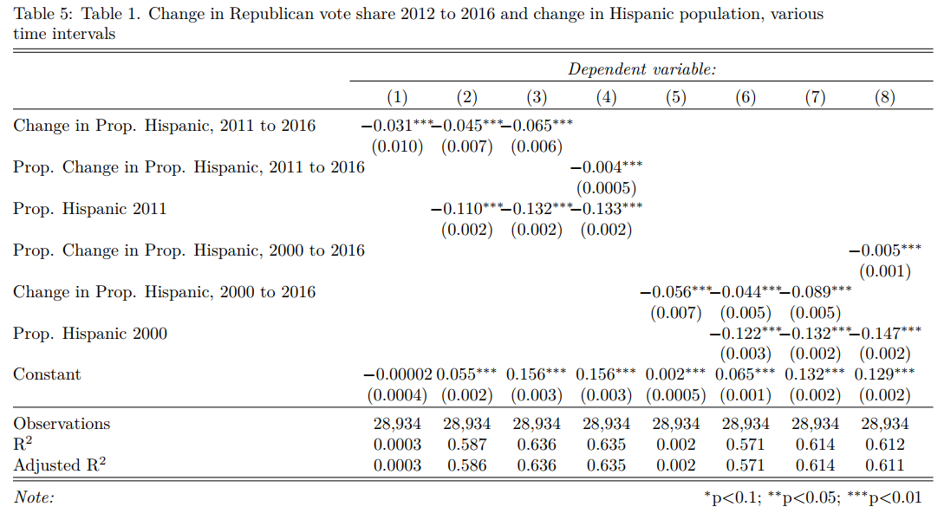
Replication Results
Translation from Stata to R
Main 8 OLS models
Dep. Variable: Change in GOP vote Share (2016-2012)
Explanatory Vars & census controls
Consistent with original findings

Slide 4
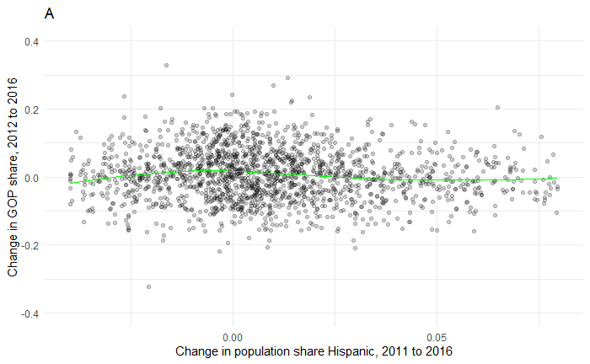
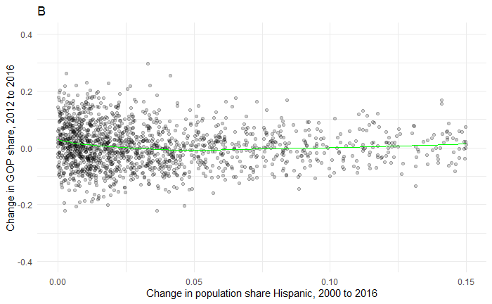
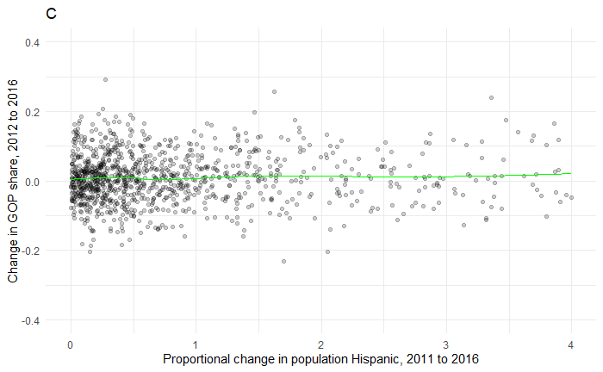
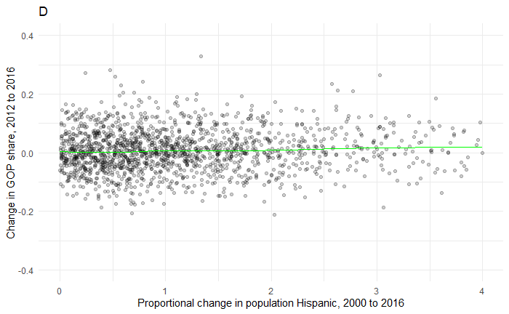
The Graphics & Loess Lines

Slide 5
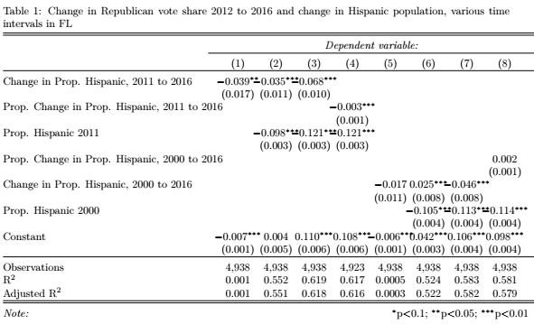
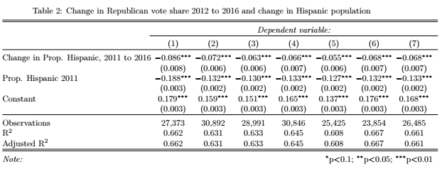
Robustness: Subset Analysis

Slide 6
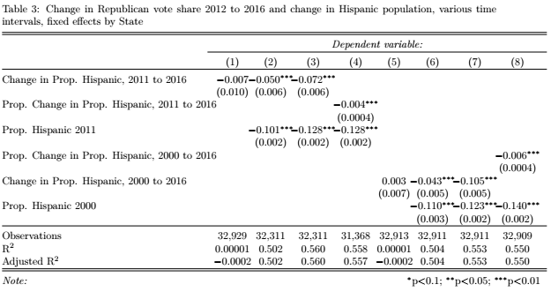
Robustness: Fixed Effects

Slide 7
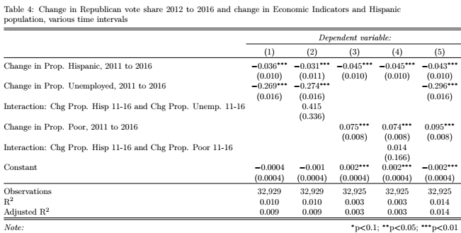
Economic Indicators Models

