Slide 1
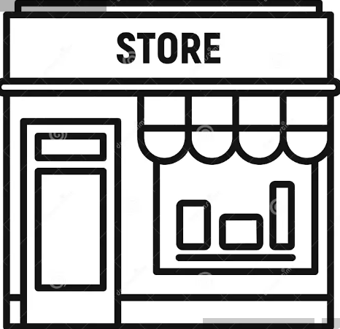


Vector Store
Query
Split the data into chunks
Embed the data chunks into a high-dimensional space
Embed the query into a high-dimensional space
Vector database
Semantic similarity search
Knowledge files
Retrieved information
LLM
Answer

