Slide 1


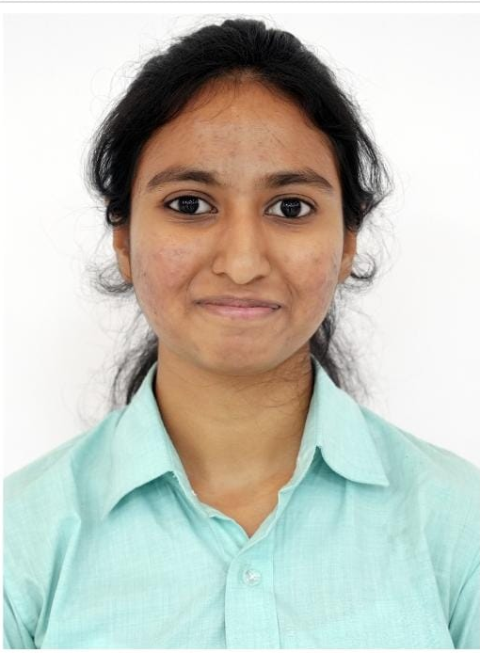
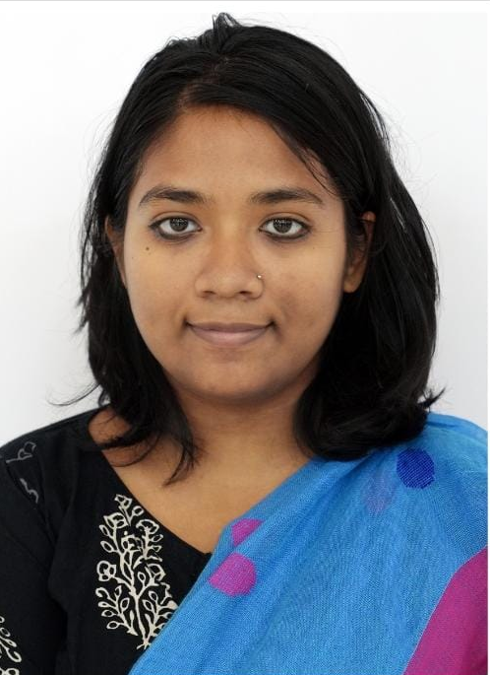
XLRI Jamshedpur
DEBOSREE ROY
DRISHA PAUL
Himalaya Wellness
Nestle

Slide 2



There remains a huge potential to be unlocked in the form of female participation, but the environment doesn’t seem conducive
Current state of female employability
Major Hindrances
Indian fem. enrolled in higher edu (mn.)
Share of women employees in 2021
A sales job means I would have to keep travelling.it is very hectic and I need to stay close to my family
Employability of Indian women is higher than men, at 52.8 %.
only 33.8% women participate in the labour force
It is male dominated. The distributors are not willing to listen to us. The ASM gives us less important distributors…… Raina, Sales officer is a leading FMCG
Women professionals in sales workforce
Women professionals in supply chain workforce
Rate of employability of Indian females
Educational Qualification of Indian females
Limited recruitment
Family responsibilities
Not treated well by male counterparts
Existing initiatives at PepsiCo.
Pep(SHE)Co: Inclusion of women in sales through female hiring from MBA colleges
Supply Chain Mavericks: Targeted female hiring from engineering colleges for plant roles
High physical labour
Long commute
Tough working conditions
What can attract women graduates
Rural
Extra income
Skill dev.
A better life
Semi Urban
Extra income
Mentorship
proximity to family
Our target segments
Use cases of other org.
Persona
Rural/urban
Employability
Financial dependence
College
Potential for impact
Project Vividtha: special women-only shifts at warehouses
Urban
Career growth
Work life balance
Leadership
Mahira, 19
Rural
Tier 3
Scope for women in supply chain
Bidipta, 22
Urban
Tier 1
Operational Function | Scope
Warehousing and Distribution
Supplier Relationship Management
Quality Control and Assurance
Order Management
Resource Planning
Women of Mettle: scholarship program to induct women into manufacturing
Ria, 21
Semi urban
Tier 2
Fatima, 22
Urban
Tier 1
Ashima,20
Urban
Tier 2
Global Woman’s Safety Framework in Rural Spaces: women safety in tea supply chain
Proposed interventions would be highest in those target group where our scope for impact would be the highest
Women have very high scopes for employability in supply chain function, maintaining relationships being on the top

Slide 3








College going graduate female
Requisite skills and employability
Identification of right talent through partnerships
Skill development of talent
Provide other support whatever required
Increased employability
Project UDITA
Greater focus on urban colleges
Greater focus on semi urban and rural colleges
Project USHA
Tie up with corporates to reach women, provide them required information
Identify right talent and groom them
Onboard them
Overall increase in women in sales and supply chain
Project UDITA
Project USHA
Salient features of UDITA & USHA
1
Identifying the right partner colleges
1
Identify the right colleges
A day as a sales officer
Identifying the right partner colleges. Major targets are tier 2 and tier 3 colleges and semi urban area colleges. Make them key partners of project UDITA. partner with women NGO s to reach rural colleges
USHA focuses more on urban tier 2 colleges where graduated are more employment ready. Here conversion and bringing them on board is more important
Shadow an Area Sales manager for a day to see how things happen in the real world. Interact with
2
Hold career counselling camps and seminars
2
Hold career fairs, bring in ambassadors
A visit to an R&D/manufacturing plant
Have interactive seminars held by PepsiCo. Educate and create awareness. Provide with all relevant information and schemes. Involve their families
Have career counselling fairs. Interact with the graduates. Know their preferences
An opportunity to visit the manufacturing plant for a week and learn how processes work
3
Identifying the right talent
3
Have partnerships with corporates
Partnering with the Govt of IND
A basic screening test based on language proficiencies. Identify the potential talent. Use unbiased objective screening processes.
Invite other corporates, especially FMCGs to come and groom them, have unbiased screening processes and interviews
PRAGATI scholarship
4
Provide mentorships and scholarships
4
Onboard them
Hire them on a probationary basis. Assess their skills. Allow them to choose what they feel is the best suited to them
To bring women from technical education into supply chain
Partner with the govt, sponsor those who financially require it. ‘Mukti’ shall be the flagship scholarship
PMKVY scheme
Key partners
Tier 2 colleges
Semi urban colleges
Women colleges
NGOs
Key partners
Tier 2 colleges
Semi urban colleges
Women colleges
NGOs
Skill development to make them employment ready
Scope
Scope
Proposed Scholarships
Online presence
Making the benefits visible on the PepsiCo website
Partner with academic institutions to reach out to eligible students
SkillsForSuccess: informative webinars on skill building for supply chain
MentorshipMondays: weekly talks by mid & sr. level women leaders in sales
‘Mukti’ an annual scholarship given to the financially weak
Other benefits: commute, menstrual leaves, family assistance & preferred location

