Slide 1
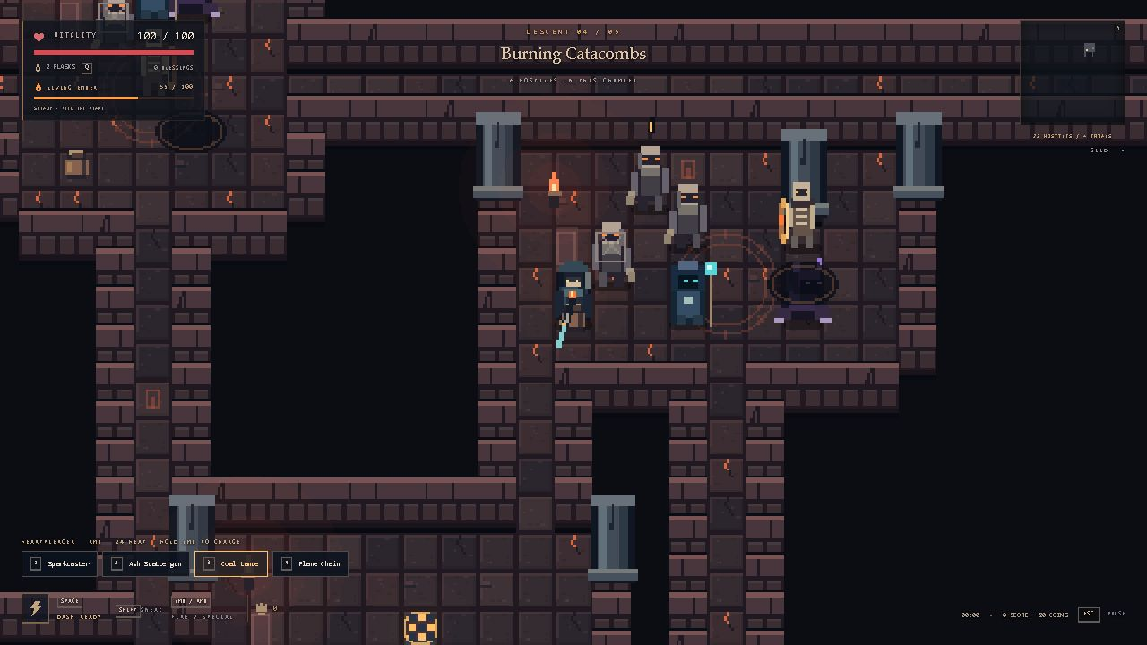
BELOW
THE EMBER
A 2D action game for the browser
Explore five floors and protect the last ember.
Fight enemies and face the Ember Warden.
Game view: the Burning Catacombs
Choose from four weapons and 18 upgrades.
The dash helps you avoid attacks.
Interactive AI Laboratory
See how the algorithms work, step by step.
Bekzat Zhailkhan / Individual project
Technical design
TypeScript + Phaser 3 + Vite
Enemy behaviour and music
CSP places rooms using rules and a seed.
A* finds paths around walls.
FSM controls patrol, chase and attack.
Web Audio changes music during combat.
Notes:
Presentation script (B2 English):
Below the Ember is a 2D action game that runs in a web browser. The player explores five dungeon floors and protects the last ember. There are four weapons and 18 upgrades, so players can try different combat styles. The dash helps the player avoid dangerous attacks. The final enemy is the Ember Warden.
The project uses TypeScript, Phaser 3 and Vite. TypeScript supports clear code. Phaser handles the game graphics and input. Vite runs the project during development and creates the final build. Separate modules handle game rules and graphics.
CSP means constraint satisfaction problem. It follows rules to place rooms. A seed is a starting value that can create the same dungeon again. A star finds paths around walls. FSM means finite state machine. It changes enemy actions between patrol, chase and attack. AI Laboratory shows the algorithms step by step. Web Audio creates sound and changes the music during combat.
Project sources: README.md; DESIGN.md; src/dungeon.ts; src/ai.ts; src/simulation.ts; src/audio/score.ts; src/audio/musicState.ts.
Image source: artifacts/expansion/living-ember-game.png. This image shows a selected development scene on floor 4. It illustrates the game and does not document a full campaign playthrough.

Slide 2
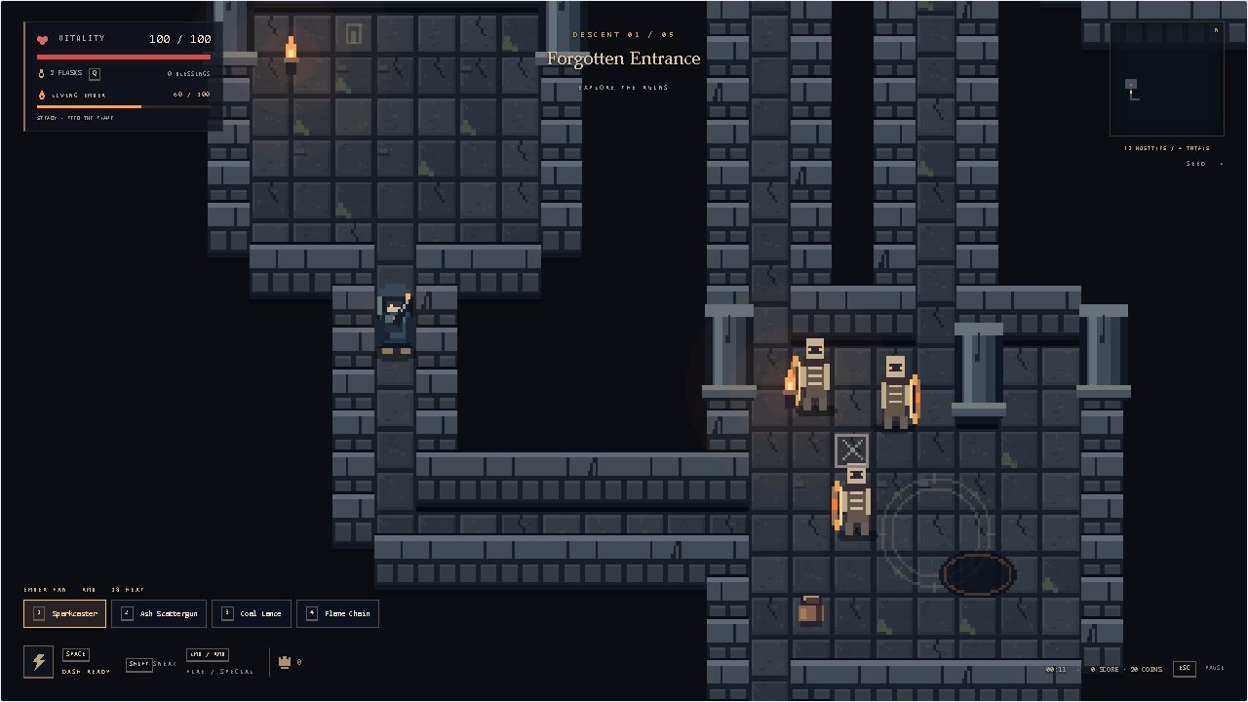
Gameplay and architecture
The last keeper carries an ember
through five floors of forgotten ruins.
Four combat styles
Sparkcaster: accurate bolts
Ash Scattergun: close-range pellets
Coal Lance: a charged piercing shot
Flame Chain: an arc against a group
High heat increases damage and visibility.
Special attacks spend heat.
Separate game rules and graphics
TypeScript modules run combat and AI.
Phaser 3 draws the world and reads input.
Vite runs and builds the browser app.
Web Audio changes music with the action.
02
Notes:
The story follows the last keeper, who carries an ember into ruins where an ancient Heart once gave people warmth. The player clears room objectives, chooses upgrades and visits a shelter between floors. The final floor contains the Ember Warden. Four weapons support different ways to fight. The heat system creates a choice: high heat improves damage, but enemies can see the player more easily. Special attacks use this resource.
The project separates rules from graphics. The Run class contains combat and campaign rules, so tests can execute them without a browser. Phaser handles graphics and input. DOM elements provide menus and the HUD. Vite produces a static browser build, and Web Audio synthesizes the music and effects. No AI service or API key is required.
Project sources: README.md; EXPANSION.md; src/simulation.ts; src/main.ts; src/visuals/WorldRenderer.ts; src/audio/musicState.ts. Image: artifacts/qairu-audit/gameplay.png, ordinary run with seed qairu-audit-2026 on 25 October 2026. It documents the first floor, not a full campaign completion.

Slide 3
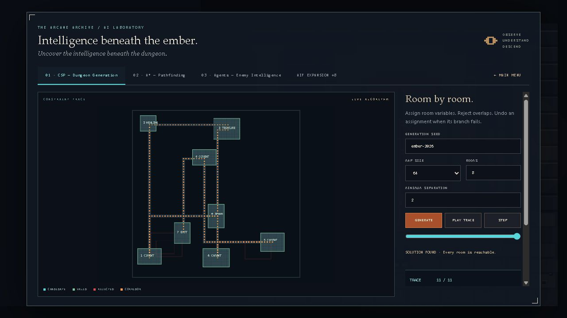
CSP dungeon generation
Week 3 Constraint satisfaction
Inputs
Seed, map size, room count
and minimum separation.
Method
Assign a room and check the rules.
Undo a choice when its branch fails.
Output
Rooms, connecting corridors and a trace.
This example has eight reachable rooms.
A search limit can trigger a fallback layout.
03
Notes:
CSP means constraint satisfaction problem. Each room is a variable. Candidate positions and sizes form its possible assignments. Rooms must stay inside the map and keep a minimum distance from other rooms. A seeded random generator supplies candidates. Recursive backtracking accepts a valid candidate, continues to the next room, and undoes the choice when a branch fails. After room placement, a chain of corridors connects the rooms. A reachability check confirms the result.
The same seed and parameters reproduce the map. The standard example shown here has eight rooms and a connected result. Tests check room separation, map bounds, repeatability and real rollback events. The solver has a budget of 6000 candidate attempts, and its recorded trace holds at most 1500 entries. If search fails, a regular fallback layout keeps the game playable. The laboratory explicitly labels fallback generation, trace truncation and the total number of attempts. Fractional inputs show an error and keep the previous map.
Project sources: src/dungeon.ts; src/lab.ts; tests/core.test.ts; tests/trace.test.ts; tests/adventure.test.ts; QAIRU_AUDIT.md. Image: artifacts/qairu-audit/csp-default.png, cropped to the map. Standard laboratory example, seed ember-2026, size 64, count 8, separation 2.
Concept reference: UC Berkeley CS 188, Constraint Satisfaction Problems and Solving CSPs. https://inst.eecs.berkeley.edu/~cs188/textbook/csp/csps.html and https://inst.eecs.berkeley.edu/~cs188/textbook/csp/solving.html

Slide 4
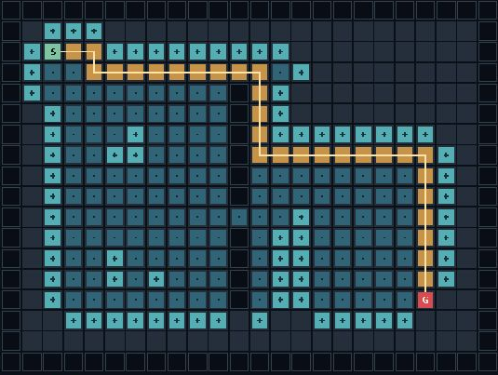
A* pathfinding
Week 2 Search and heuristics
Inputs
A grid with walls, a start and a goal.
Players can edit the map in the lab.
Search rule
f = g + h
g is the cost so far.
h estimates the distance left.
Example: 30 moves
165 closed nodes
Weighted A* also considers dangerous tiles.
04
Notes:
A star finds a route across a grid. It keeps candidate nodes in a min-heap and expands the node with the smallest f score. The g score is the cost already paid. The h score estimates the remaining distance. This project uses Manhattan distance because movement follows four directions. The algorithm stores parent nodes to rebuild the final route. The laboratory lets users move the start and goal, add walls, inspect costs and step through the search.
The displayed example needs 30 moves and closes 165 nodes. Tests verify a shortest detour, valid neighboring steps and an unreachable goal. Campaign enemies can use weighted A star to avoid dangerous cells. In a separate weighted example, BFS took 11 moves with cost 65. Dijkstra and A star each found a 13-move route with cost 13. A star visited 28 nodes in that example, compared with 105 for Dijkstra. These results describe one test map.
Project sources: src/ai.ts; src/intelligence/search.ts; src/lab.ts; tests/core.test.ts; tests/intelligence.test.ts; artifacts/qairu-audit/metrics.json. Image: artifacts/qairu-audit/astar.png, cropped to the search grid.
Concept reference: UC Berkeley CS 188, Informed Search. https://inst.eecs.berkeley.edu/~cs188/textbook/search/informed.html

Slide 5
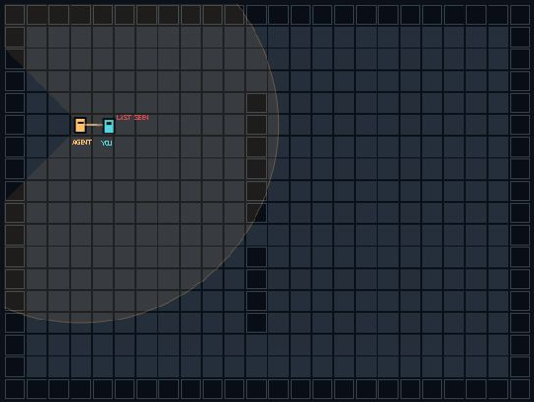
Intelligent enemy agents
Week 1 Agents and environments
Perception
Distance and view direction affect sight.
Walls block the line of sight.
Noises can start an investigation.
Finite state machine
Detection starts an alert.
The enemy can chase and attack.
After losing sight, it searches
its last known target position.
Observed state: ATTACK
Lab attacks are harmless. Campaign attacks cause damage.
05
Notes:
An intelligent agent senses its environment and chooses an action. Our enemy observes player distance, direction and visible walls. A finite state machine, or FSM, controls patrol, alert, chase, attack and search. The alert state gives a short reaction time. When the player disappears, the enemy remembers the last position and searches before returning to patrol. A star supplies routes around walls.
The screenshot shows the actual laboratory after a click moves the player into view. The agent reaches ATTACK and reports true detection. Lab attacks are harmless so the user can study behavior. The campaign adds damage, cooldowns and more tactical decisions. Tests check wall occlusion and the full sequence of state changes. These agents use explicit rules rather than a neural network. Utility scores, a small action planner and a probability map add tactical choices in the campaign.
Project sources: src/ai.ts; src/simulation.ts; src/intelligence/EnemyMind.ts; tests/core.test.ts; tests/adventure.test.ts. Image: artifacts/qairu-audit/agent-detected.png, cropped to the perception grid.
Concept reference: UC Berkeley CS 188, Agents. https://inst.eecs.berkeley.edu/~cs188/textbook/search/agents.html

Slide 6
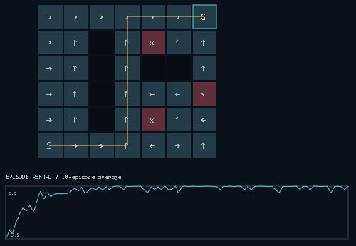
More AI experiments
Week 4 Minimax
A rune guardian looks ahead in a duel.
Alpha-beta pruning reduces its search.
Week 5 Q-learning
An agent learns from rewards.
Users change the training settings
and inspect its learned policy.
Week 6 Probability
A Bayesian filter updates beliefs
about the hidden player position.
1000 episodes: goal reached
98% recent training success
Q-learning runs in the laboratory only.
06
Notes:
The project also includes algorithms from other course weeks. Minimax evaluates possible moves in a rune duel. Alpha-beta pruning removes branches that cannot change the answer. On an empty board, pruning used 34,202 nodes instead of 549,945 while preserving the best move and value. Q-learning starts with a zero Q-table. The learner explores actions and updates values from rewards. After 1000 episodes in this fixed educational arena, its greedy policy reached the goal. The last 50 training episodes had a 98 percent success rate. This is a training result on one map, not a separate generalization test. Campaign enemies do not use this learner.
The probability module is a discrete Bayesian filter. It predicts movement, weights observations and normalizes the probabilities. It is not a full Bayesian network with conditional probability tables. Other laboratory views show utility choices, action planning, a boss behavior tree, genetic encounters and search comparisons. The main defense can still focus on weeks one, two and three.
Project sources: src/intelligence/minimax.ts; src/intelligence/learning.ts; src/intelligence/belief.ts; src/intelligence/AdvancedLab.ts; tests/intelligence.test.ts; artifacts/qairu-audit/metrics.json. Image: artifacts/qairu-audit/q-learning.png, cropped to the learned policy and reward plot.

Slide 7
Validation and development
50 / 50
150
Build passes
Automated tests passed
Seeded map configurations
TypeScript and Vite
Resolved audit issues
Next features
Prologue buttons accept mouse input.
Room counts use whole-number validation.
CSP reports fallback and trace limits.
Memory choices and different endings.
Mini-bosses and team tactics.
More complete saves and controls.
Campaign verification
Automated driver: five floors, 98 enemies.
Human completion still needs verification.
07
Notes:
The full test suite now passes all 50 tests, including 100 basic and 50 expanded seeded map configurations. TypeScript checking and the production build pass. Three audit issues are fixed: mouse input in the prologue, whole-number validation for room parameters, and explicit labels for fallback generation and truncated search traces. Browser checks confirm these behaviors.
A separate automated simulation driver completed all five floors with seed qairu-final-2026. It defeated 98 enemies and completed 20 mandatory objectives in 391.8 simulated seconds. It uses normal movement, attacks, healing, upgrades and shelter actions. It does not remove enemies, complete objectives artificially, teleport or boost statistics. The driver can inspect the full state and does not run the browser renderer. This is a reproducible integration experiment, not a human playthrough.
The submission includes a technical report, an approximately two-and-a-half-minute video, the AI usage declaration and the individual contribution statement for Bekzat Zhailkhan. The student should review the declarations and rehearse the algorithms independently. GitHub publication must be confirmed separately by an actual repository URL. Future features remain proposals.
Project sources: VERIFICATION.md; docs/Technical_Report.md; docs/results/tests.txt; docs/results/campaign.json; src/story/prologue.css; src/dungeon.ts; src/lab.ts; ROADMAP.md.

