Slide 1
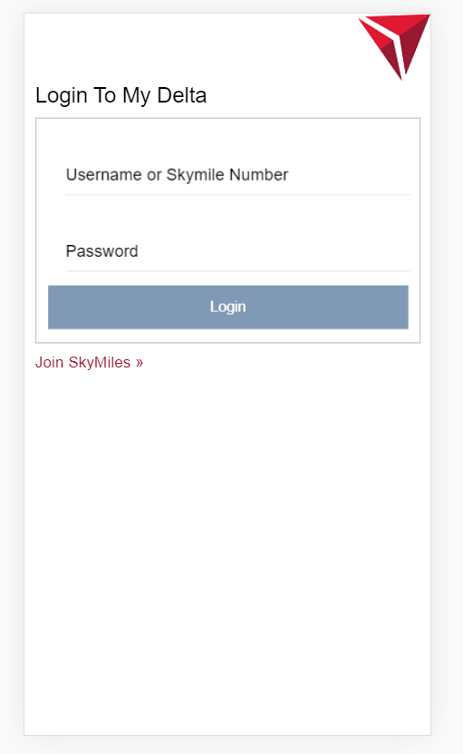

Slide 2
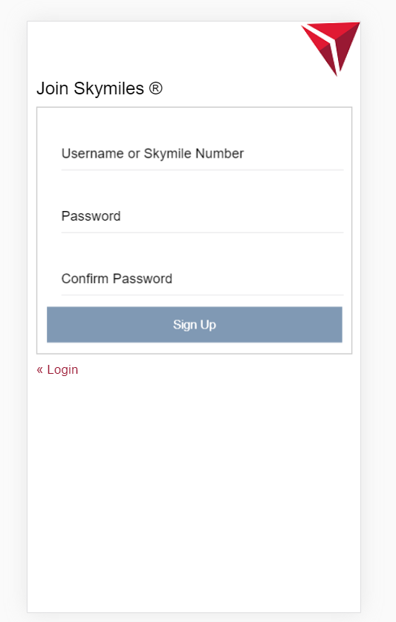
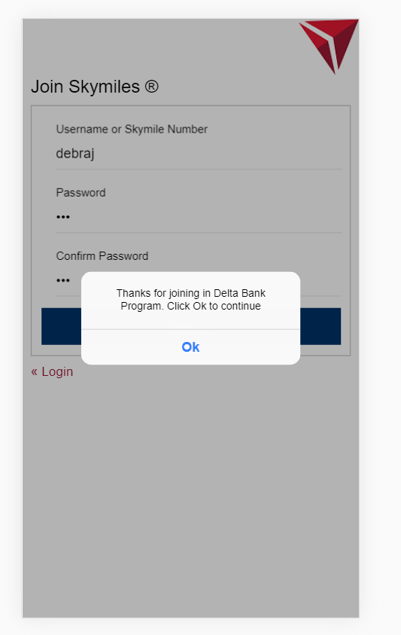

Slide 3
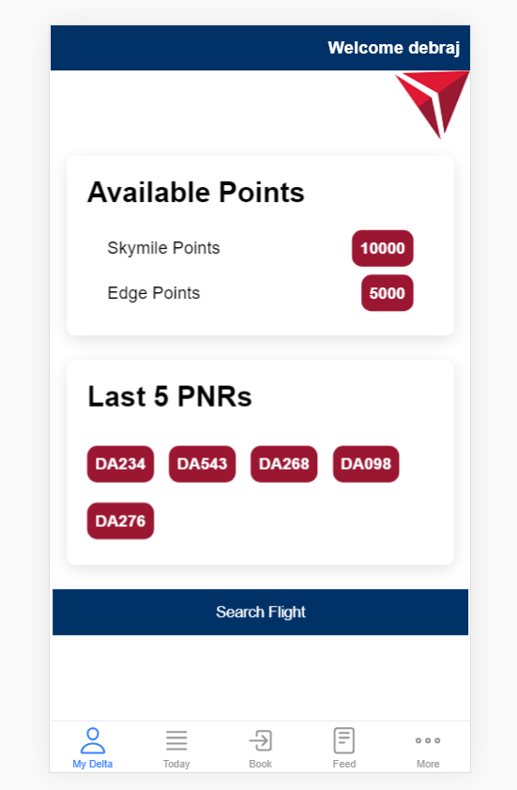
User home page
Member Name Skymiles Number
Debraj XXXXXXXXXXXX
Title – My Wallet - Instead of Available Points
Skybonus Points instead of Skymile Points
Edge Points – no Change
Regional Upgrade Certificate – 5
Button “Book a flight”. Clicking here should take to Flight Search page
Past PNRs – instead of last 5 PNRs
Past PNRs should be displayed in a Tabular form with the following details
PNR Number | Origin | Destination | Date of Travel

Slide 4
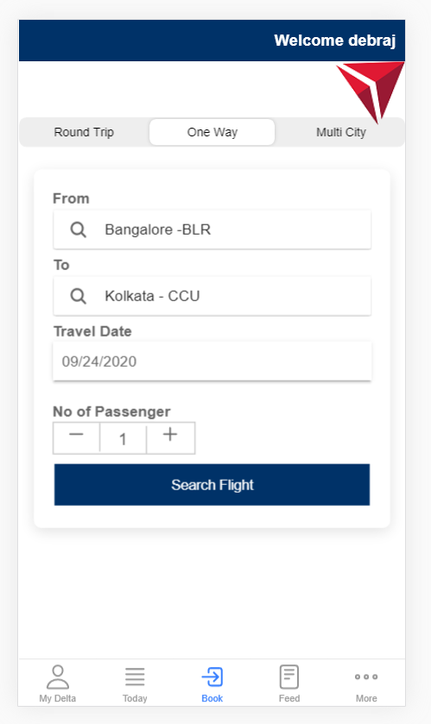
Search Flight Page

Slide 5
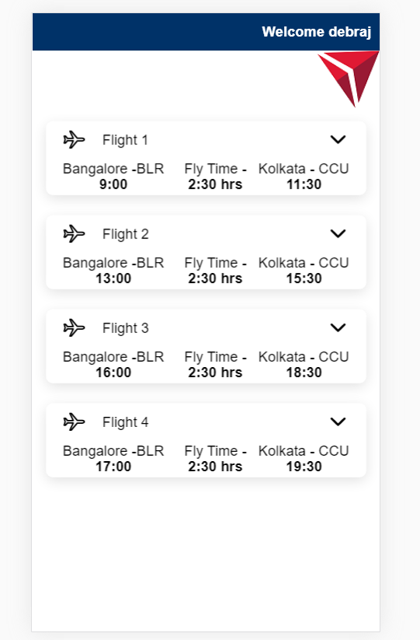
Search result
Add heading
Search Results
Bengaluru to Kolkata – 24-Sep-2020
Flight DL001
Flight DL030

Slide 6
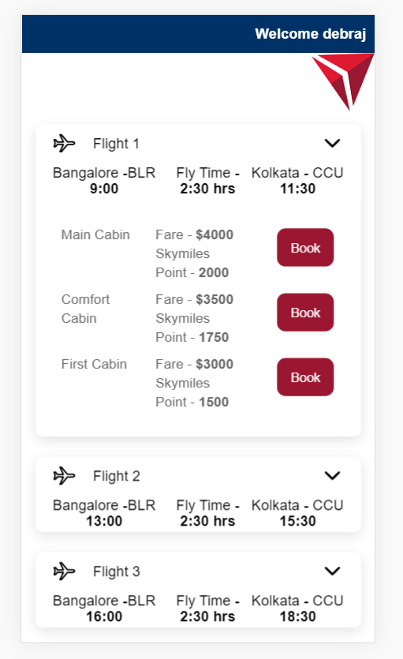
Expanded result
Add heading
Search Results
Bengaluru to Kolkata – 24-Sep-2020

Slide 7
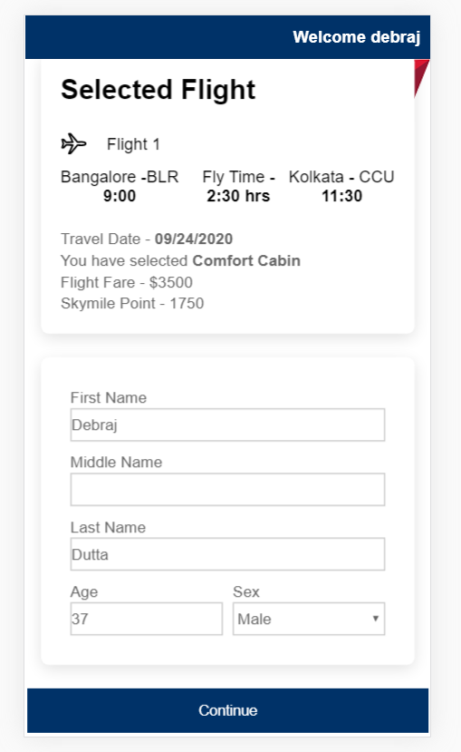
Enter passenger info
First Name
Last Name
DoB
Nationality
Gender

Slide 8
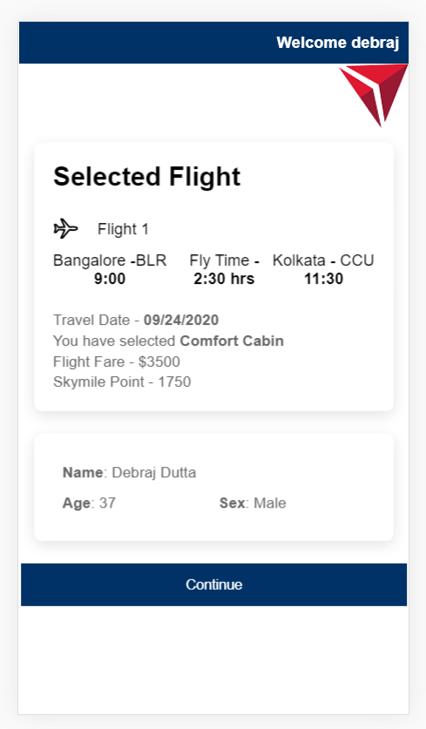
Flight and Passenger preview page
Heading “Review Booking Information”
“Pay” instead of Continue

Slide 9
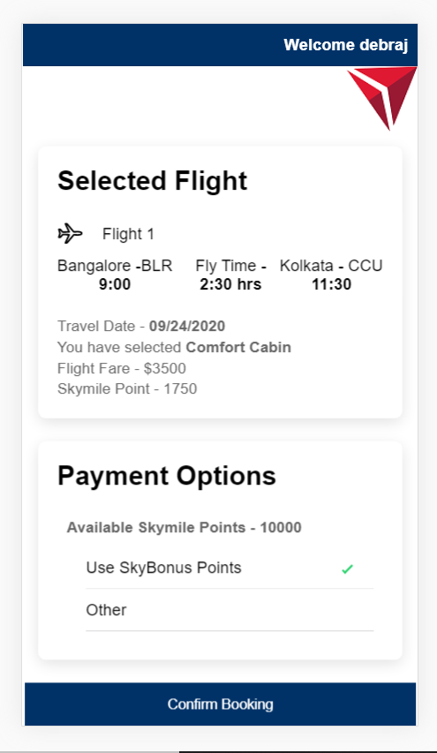
Payment page
Payment Options
Wallet
- Provide Radio button to select
Credit Card USD$250
SkyBonus Points 2000
Edge Points 1500
Button “Pay”

Slide 10
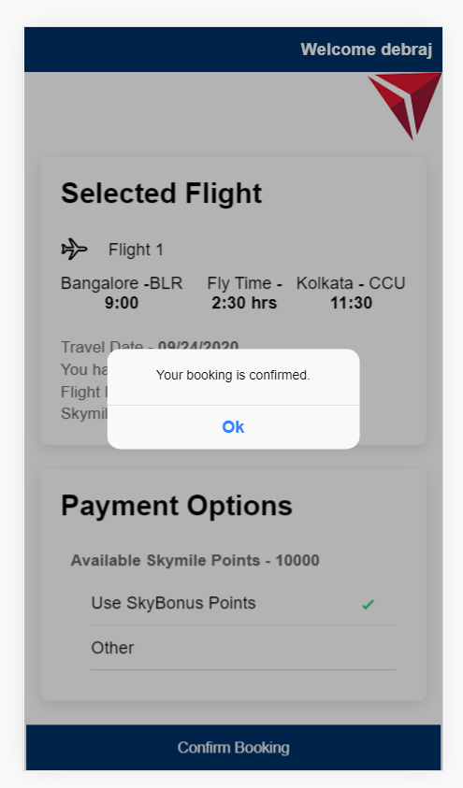
Booking confirmation
Possible Show the Heading as
Booking Confimed. Booking Reference Number <XXXXX>
Show the Booking Summary

Slide 11
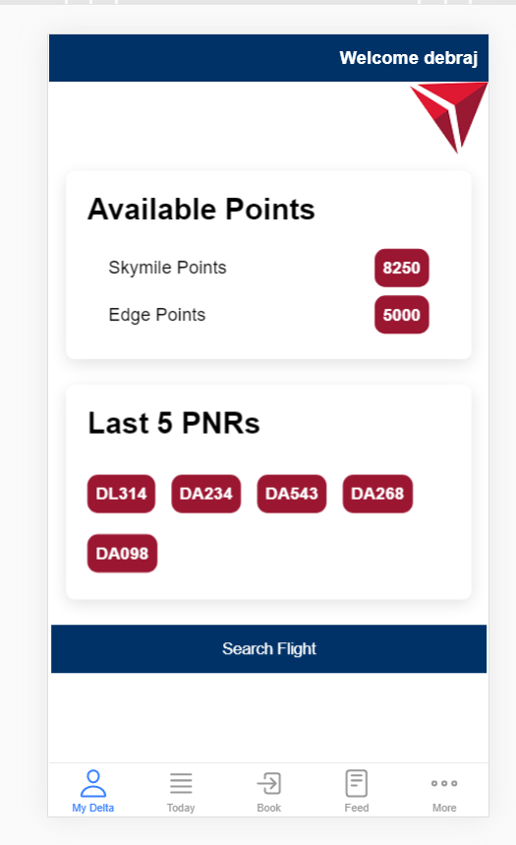
Home page with updated point and pnr

