Slide 1
Fallback Reverse Proxy for Unknown Routes in Next.js
Architecture Approaches & Implementation
Er. Debraj Ray

Slide 2
Problem Statement
Unknown routes in Next.js often need to be forwarded to AEM dispatcher services instead of returning 404.

Slide 3
Clean Architecture Diagram
Next.js App
Routes + Middleware
Client
Browser / Mobile
CDN / Edge Proxy
(Nginx / Cloudflare / Azure Front Door)
AEM Backend
Fallback Service

Slide 4
Approach 1: Middleware
Intercept requests using middleware.ts and rewrite unknown routes to a legacy backend.

Slide 5
Approach 2: Rewrites
Use next.config.js rewrites to forward path patterns to external services.

Slide 6
Approach 3: Custom Server
Implement a Node.js/Express server with http-proxy-middleware for full control.

Slide 7
Approach 4: Infrastructure Proxy
Use Nginx/CDN to route traffic to Next.js first and fallback to legacy backend on 404.

Slide 8
Best Practices
Log fallback requests, avoid proxy loops, monitor latency, and implement caching.

Slide 9
Implementation with Approach 2: Rewrites
Use next.config.js rewrites to forward path patterns to external services.
Here, 1stly we remove the custom handling logic for 404 pages in web app
Write rule for the paths that are to be proxied to external server URL.
Then, configure nextJS server such that these rewrites are checked after static files and dynamic routes and before the 404 page is rendered.
In an ideal fallback reverse proxy case, all paths that doesn’t matches in web app’s static files and dynamic routes should be forwarded to the proxy destination.

Slide 10
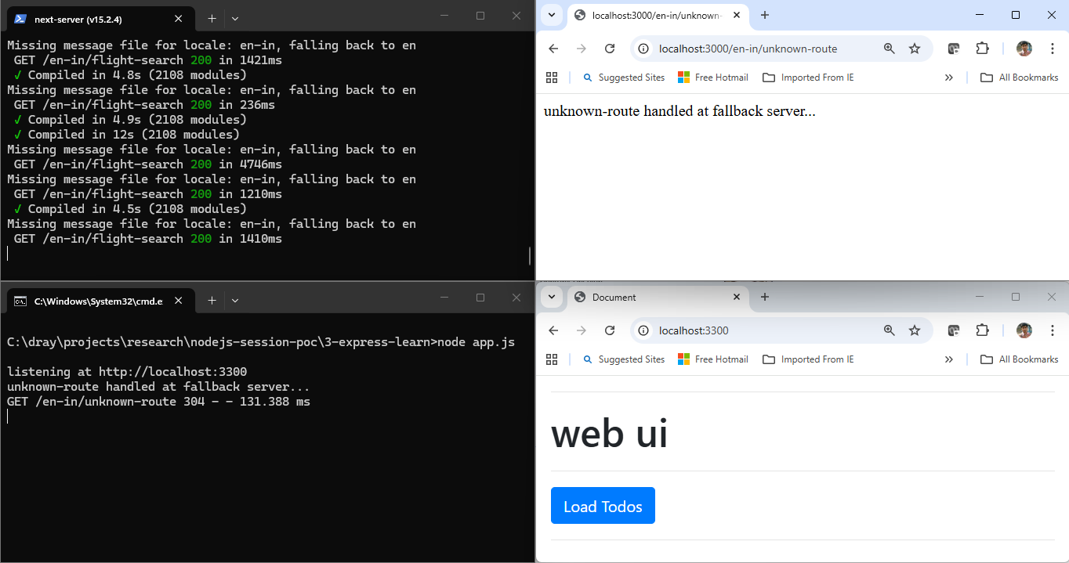
Sample O/P with Approach 2: Rewrites

